Slide 1
Unit 4-5 File Storage

Slide 2
Unit 4-5 File Explorer
4-5 Learning Objective Standards
9. Demonstrate knowledge of Windows File Explorer and identify drives on the computer, as well as cloud storage services (e.g., OneDrive).
10. Move documents and files, including to and from Recycle Bin.
4-5 Vocabulary
delete
desktop
Documents folder
file
File Explorer
Recycle Bin
restore
Root Folder
Sub-Folder

Slide 3
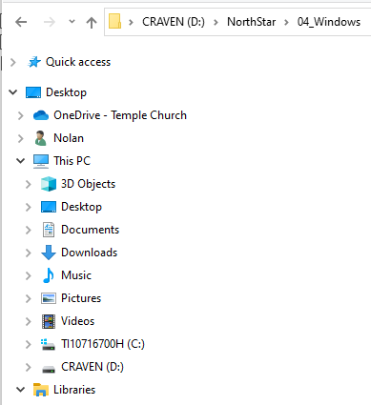
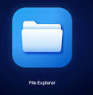
Unit 4-5 File Explorer

Slide 4
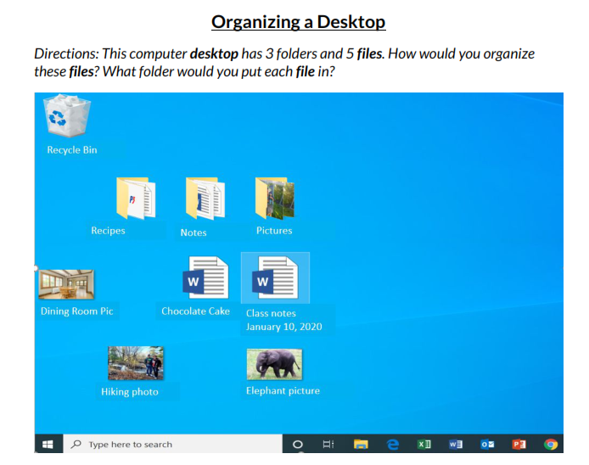
Unit 4-5 File Management (Desktop)

Slide 5
Unit 4-5 File Organization FOLDERS and Sub-Folders
DESKTOP
LIBRARIES
Documents
Downloads
Music
Video
Pictures
C: Drive
External Drives
Cloud Storage

Slide 6
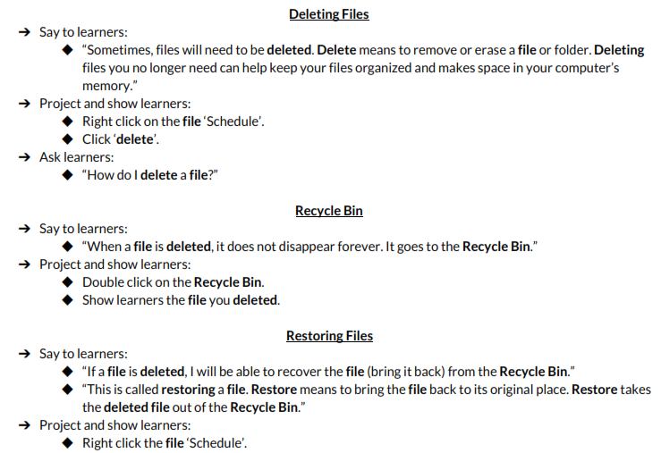
Unit 4-5 DELETE a File (or Folder)
1) Drag it to the Recycle Bin
2) Select and <Delete>
3) Select the File
<Right Click>

Slide 7
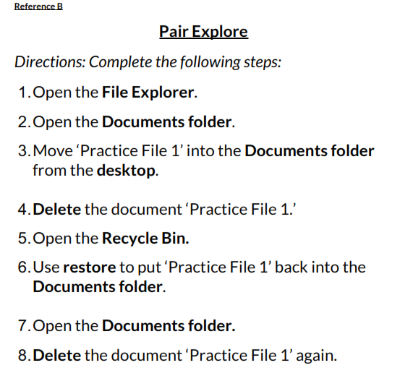
Unit 4-5 Reference B

Slide 8
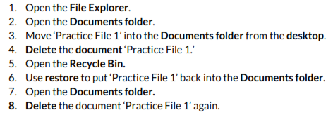
Unit 4-5 File Management (Project Reference B)

Slide 9
Unit 4-5 File Management

Slide 10
Unit 4-5 File Management (Reference C)

Slide 11
Unit 4-5 A Handout – File Storage QUIZ
1)
A) file
2)
B) desktop
3)
C) Documents Folder
4)
D) File Explorer
5)
E) Recycle Bin
6)
F) Restore

