Slide 1
Unit 3-1 Making an Email Address (Username)
Learning Goals:
3. Register for a new email account,
using a professional user name and a strong password.
4. Log into email.
13. Sign out of email, especially when using shared computers.
Unit 3-1 Vocabulary:
account
address
Captcha professional
log in unique
log out username
password
provider

Slide 2
Unit-3-1 Email Skills
Learners will be skilled at…
making a professional email account for work or school using professional email etiquette in order to send a message to meet a task, such as applying for a job.
understanding when to utilize common email functions (forwarding, copying, reply all, sending attachments, etc.).
managing an email account to delete unwanted messages,
retrieve deleted messages, and search for emails.
recognizing common characteristics of spam or phishing emails in order to protect personal information.
explaining the difference between casual and formal tone in
emails and when a more formal time is required.

Slide 3
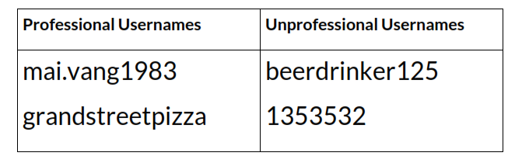
Professional Username Address and Passwords
3-1 Reference A

Slide 4
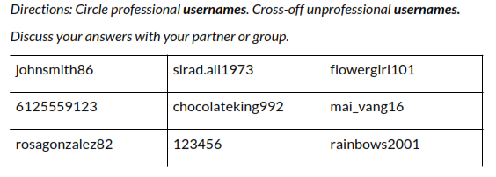
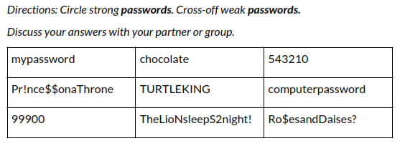
Professional Username Address and Passwords
3-1 Handout A
◆ A strong password includes :
numbers, upper-case, lower-case letters,
and symbols (%^#).
◆ A strong password is long –
around 12-16 characters.
(Many systems require at least 6)
◆ A strong password does not include
your name or family names, or common
public knowledge (Dates, address)
(they’re too easy to guess).

Slide 5
EMAIL ACCOUNT SERVICE PROVIDERS
https://www.softwaretestinghelp.com/email-service-providers/
FREE and PREMIUM (paid)
Google
Gmail
Microsoft
Outlook
AOL
Yahoo!
HOTMAIL (obsolete)

Slide 6
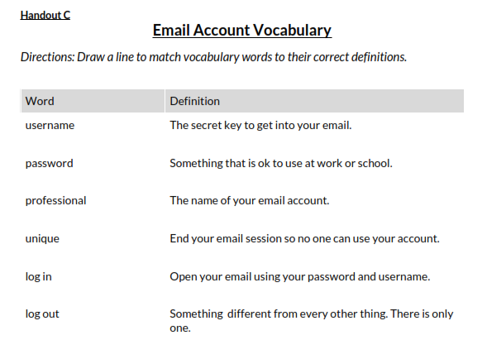
3-1 Handout C

