Slide 1
Internet Basics Unit: 2 – 3 TABS and FAVORITES (Bookmarks)

Slide 2
Warm-up: Thumbs Up / Thumbs Down
QUESTIONS I HAVE?.......

Slide 3
Unit 2-3 Internet Basic Skills Tabs, History, and Bookmarks
11. Identify common browser tools and icons
(e.g., favorites, downloads, refresh, and back).
15. Identify and work with tabs and windows.
On some computers, the bookmarks bar may not be visible. It can be opened in the browser settings menu.
On some browsers you can also open with Ctrl+Shift+B.

Slide 4
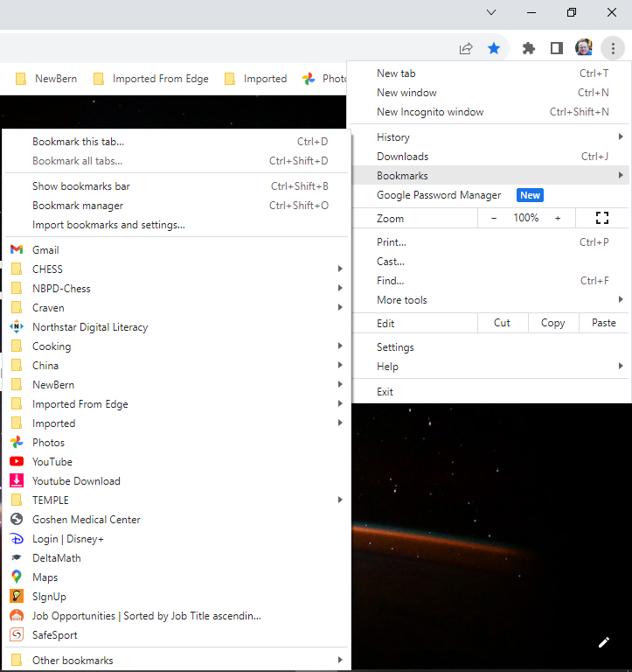
Activate the HISTORY Menu

Slide 5
Unit 2-3 Bookmarks Vocabulary
favorite (bookmark)
bookmark Bar
tab
browser
history
Incognito (Private)

Slide 6
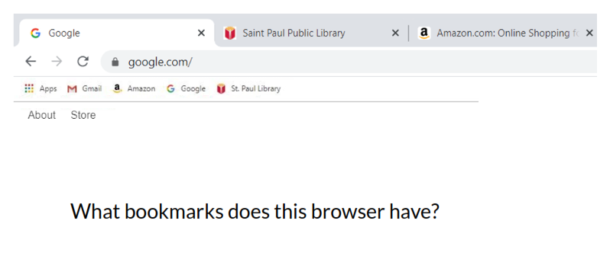
Reference 2-3-A Bookmarks (Favorites)
Sometimes the BOOKMARK Bar or Menu is hidden. (…) or Ctrl+Shift+B
The Computer Lab may not let us bookmark pages since it resets every night!

Slide 7
Reference 2-3-B Using Bookmarks and Tabs
1. Open a new tab and go to: monster.com
2. Open a new tab and go to: indeed.com
3. Open a new tab and go to: AOL.com
4. Open a new tab and go to: MeTV.com
5. Open a new tab and go to: TUBITV.com
6. Open a new tab and go to: NBC.com
7. Open a new tab and go to: Weather.com
8. Open a new tab and go to: I95Exits.com
9. Open a new tab and go to: Foodlion.com
10. Open a new tab and go to: NewBernNC.gov
11. Open a new tab and go to: Zillion.com
12. Open a new tab and go to: CravenCountyNC.gov (Services, GIS)

Slide 8
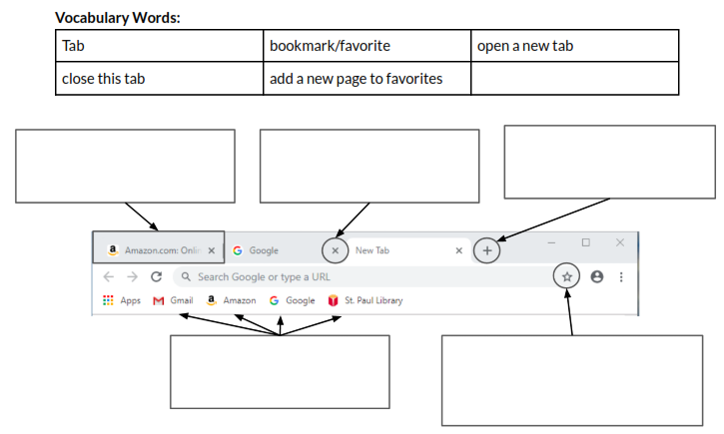
Unit 2-3-C Handout Vocabulary

