Slide 1
Internet Basics Unit: 2 – 2 Navigating Websites

Slide 2
Warm-up: Thumbs Up / Thumbs Down
QUESTIONS I HAVE?.......

Slide 3
Unit 2 – Internet and Email Basic Skills
In this lesson, learners will practice navigating websites to ﬁnd information.
They will scroll up and down to
ﬁnd and click links (Often BLUE or change to HAND pointer)
open menus (…. Or ‘hamburger’)
Recognize and close ads
They will also learn to use browser buttons to help support internet use, such as:
Back ←
Forward →
Refresh
Home

Slide 4
2-2 Internet Navigations Objectives
3. Demonstrate familiarity with website structure
(landing pages, internal pages).
11. Identify common browser tools and icons
(favorites, downloads, refresh, and back).
13. Demonstrate ability to scroll up and down a page and left and right on a page.
14. Identify and make use of common website interactions
(play buttons, hyperlinks).

Slide 5
2-2 Website Navigation Vocabulary
ad
back ←
close
forward →
homepage
Hyperlink / link
menu
refresh

Slide 6
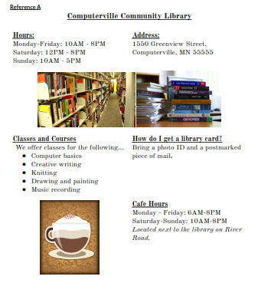

Slide 7
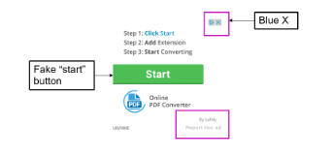
Example of Ads (Hover and check links)
Reference B: Check Ads and Links

Slide 8
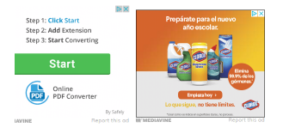
Reference-B (Page-2)

Slide 10
Using a Website: https://www.rclreads.org/
Reference-C
Directions: Complete the following steps:
1.Go to rclreads.org or your local library’s website.
2.Click a link.
3.Click the back button.
4.Click the forward button.
5.Click on the link that goes to the homepage.
6.Click refresh.
New Bern County Library:
https://mycprl.org/newbern

Slide 11
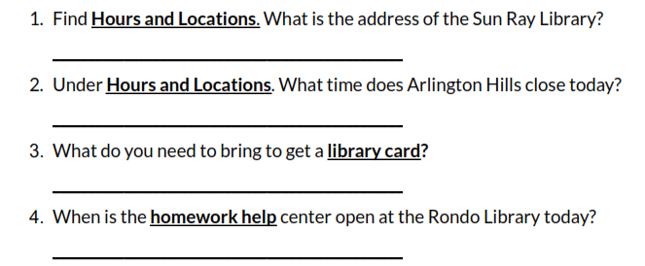
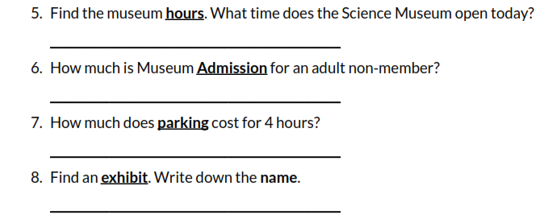
Handout B Scavenger Hunt
Go to SPPL.org
Go to the Websites to answer the equations!
Go to SMM.org
Notice that the SSM.org website was redirected to New.SSM.org
What if you typed SSM.org website?

Slide 12
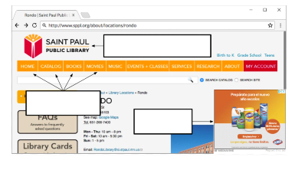
Handout C Website Vocabulary Quiz

