Slide 1
Internet Basics Unit: 2 – 1 Connecting to the Internet

Slide 2
Warm-up: Thumbs Up / Thumbs Down
QUESTIONS I HAVE?.......

Slide 3
Unit 2 Internet Basic Skills
1. Identify the different ways a person can connect to the internet.
2. Demonstrate knowledge of browsers and identify commonly used browsers.
4. Identify top-level domains (e.g., .edu, .com, .org, .gov, .mil, .net).
10. Identify address bar and demonstrate understanding of its functionality.

Slide 4
2-1 Connecting to the Internet Vocabulary
address bar
Browser
Safari / Apple
Chrome / Google
Edge & Explorer / Microsoft
Firefox / Mozilla
Cable / DSL (Direct Service Line)
Ethernet
Host
Hot Spot
Homepage
HTTP: (webpage) The Hypertext Transfer Protocol (HTTP) is the foundation of the World Wide Web, and is used to load webpages using hypertext links.
internet
Internet Provider
top-level domain
.com .org .gov .edu .net .mil
web address / URL
wireless (WiFi)
WWW (World Wide Web 1994)

Slide 5
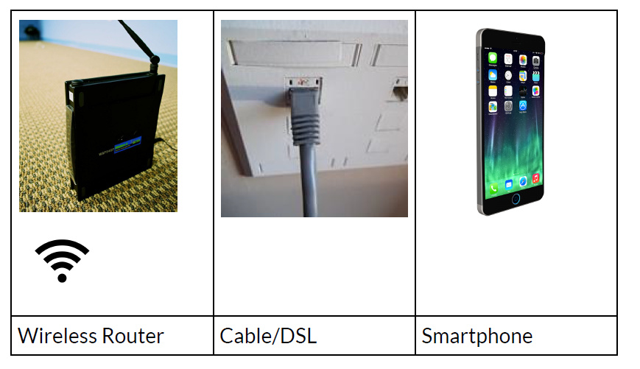
Unit 2 -1 Connecting to the Internet
Ethernet
HotSpot:
https://www.youtube.com/watch?v=MvXVa57l3co&t=12s

Slide 6
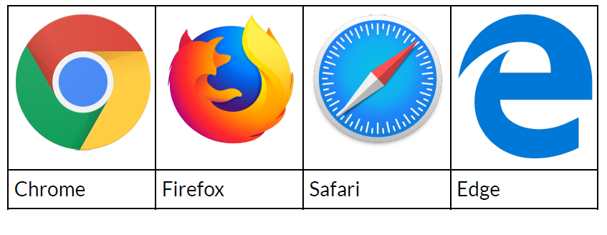
Top Internet Browsers

Slide 7
https://www.softwaretestinghelp.com/best-browser-ranking/

Slide 8
Address Bar & (Search Bar)
URL
https://en.wikipedia.org/wiki/URL
A Uniform Resource Locator (URL), colloquially known as an address on the Web,^{[1]} is a reference to a resource that specifies its location on a computer network and a mechanism for retrieving it. A URL is a specific type of Uniform Resource Identifier (URI),^{[2][3]} although many people use the two terms interchangeably.^{[4][a]} URLs occur most commonly to reference web pages (HTTP/HTTPS) but are also used for file transfer (FTP), email (mailto), database access (JDBC), and many other applications.
Most web browsers display the URL of a web page above the page in an address bar. A typical URL could have the form http://www.example.com/index.html, which indicates a protocol (http), a hostname (www.example.com), and a file name (index.html).
Uniform Resource Locators were defined in RFC 1738 in 1994 by Tim Berners-Lee, the inventor of the World Wide Web, and the URI working group of the Internet Engineering Task Force (IETF),^{[7]} as an outcome of collaboration started at the IETF Living Documents birds of a feather session in 1992.^{[7][8]}
The format combines the pre-existing system of domain names (created in 1985) with file path syntax, where slashes are used to separate directory and filenames. Conventions already existed where server names could be prefixed to complete file paths, preceded by a double slash (//).^{[9]}

