Slide 1
TABE Math-E PAXEN Unit-6 Geometry CHAPTER REVIEW
Revised: November 4, 2023
Nolan Tomboulian
Some graphics may not have copied well during the scan process.

Slide 2
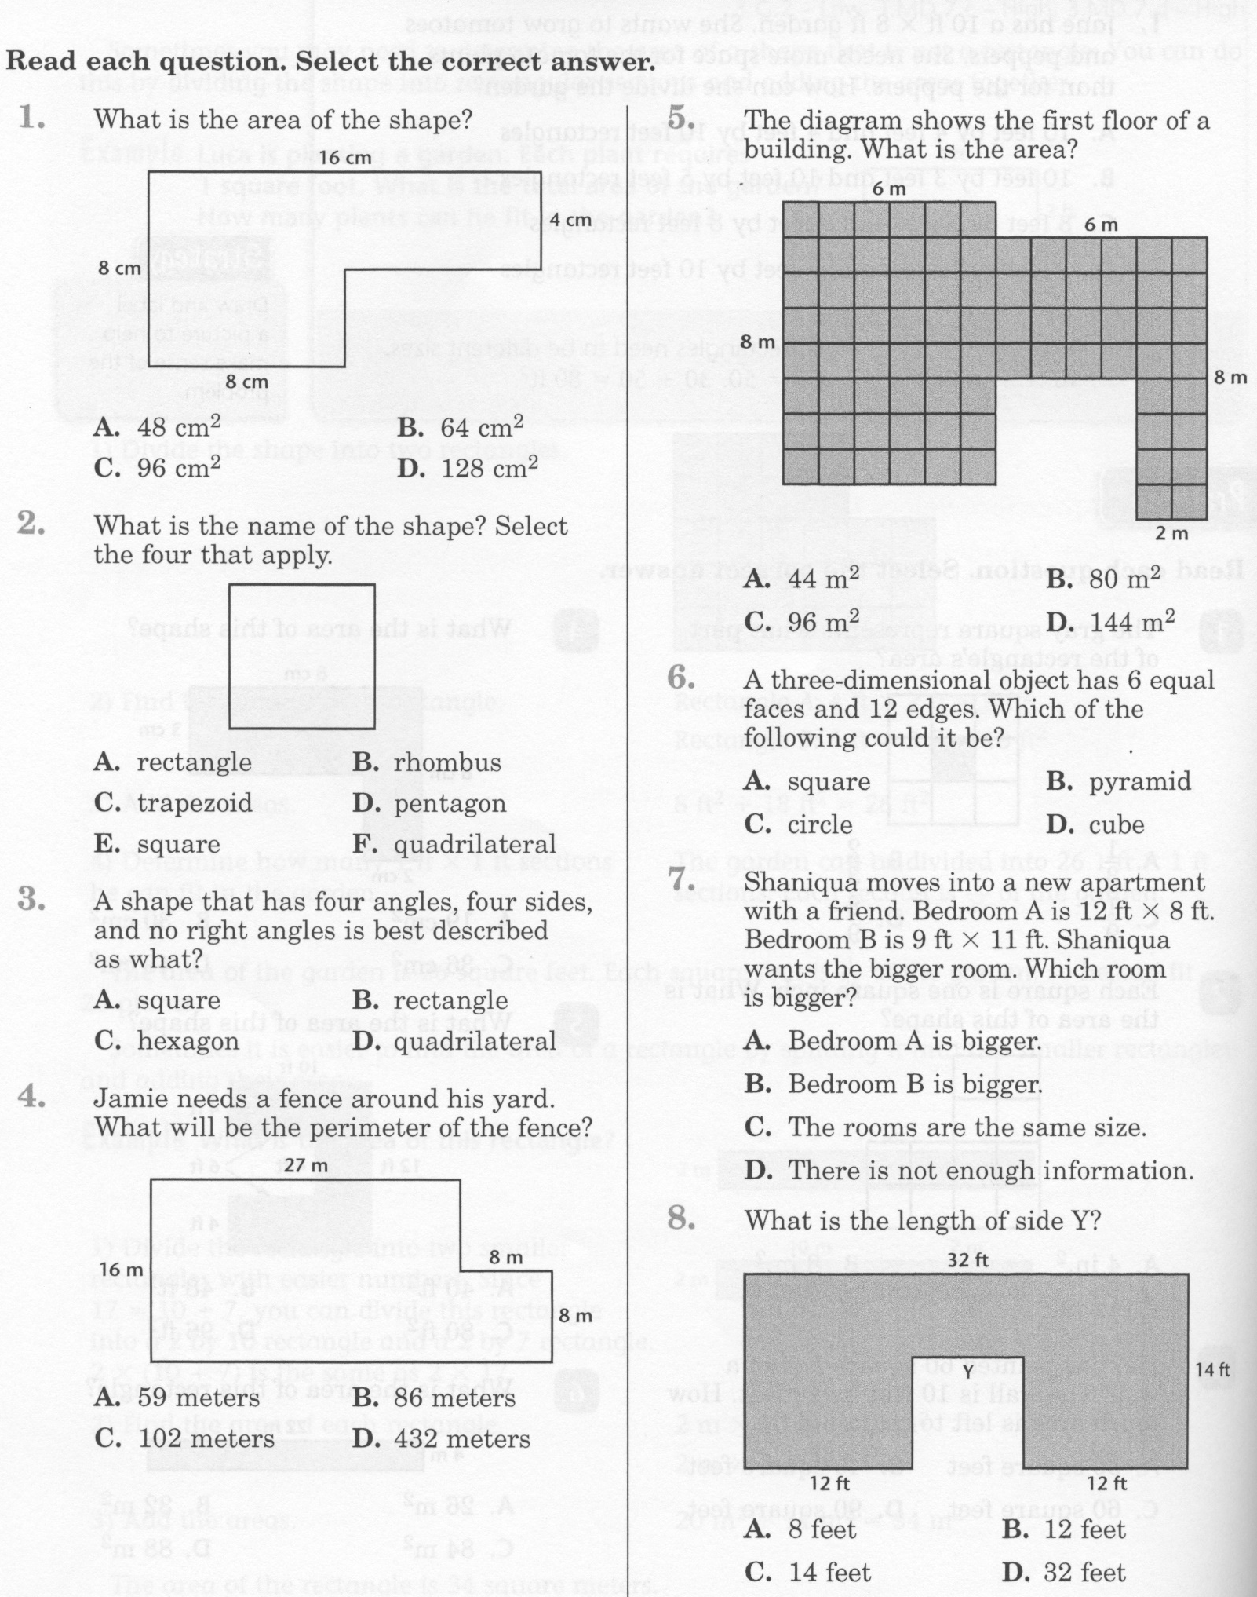
Math-E - Unit-6 – Lesson Review

Slide 3
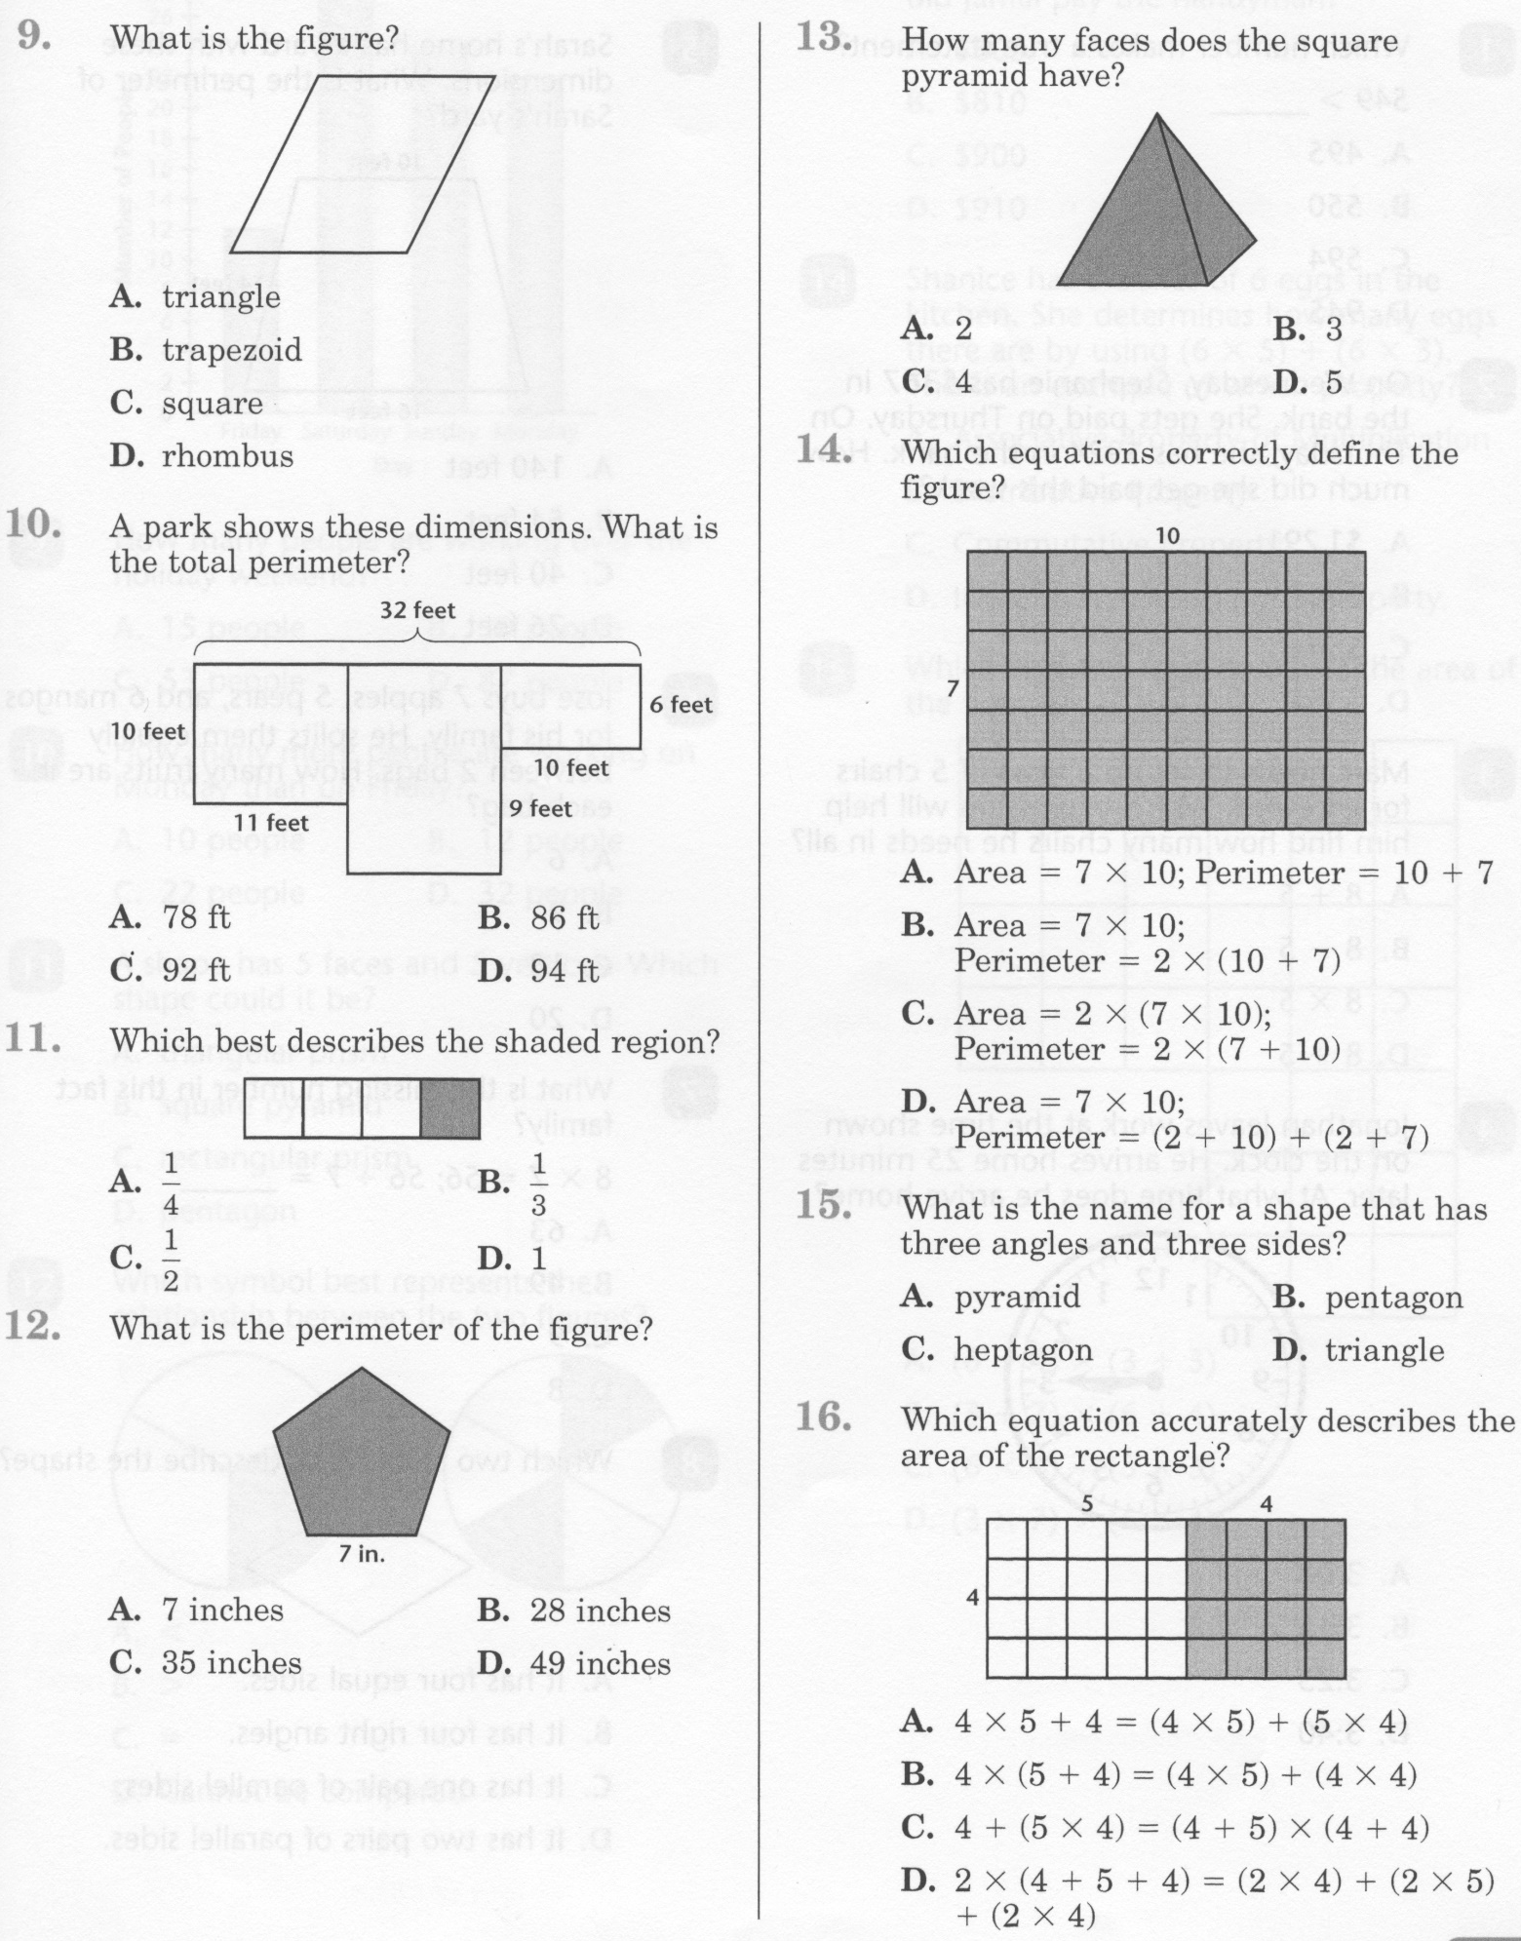
Math-E - Unit-6 – Lesson Review

Slide 4
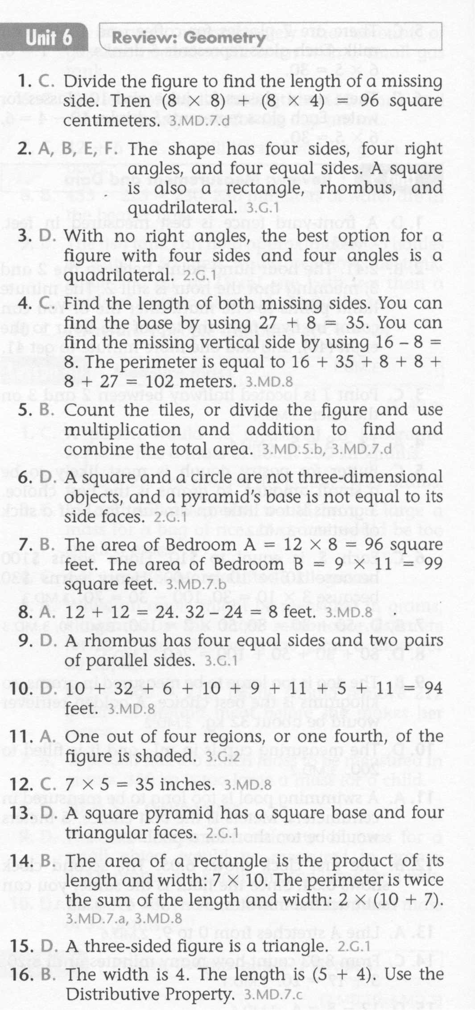
Math-E - Unit-6 – Lesson Review

Slide 5
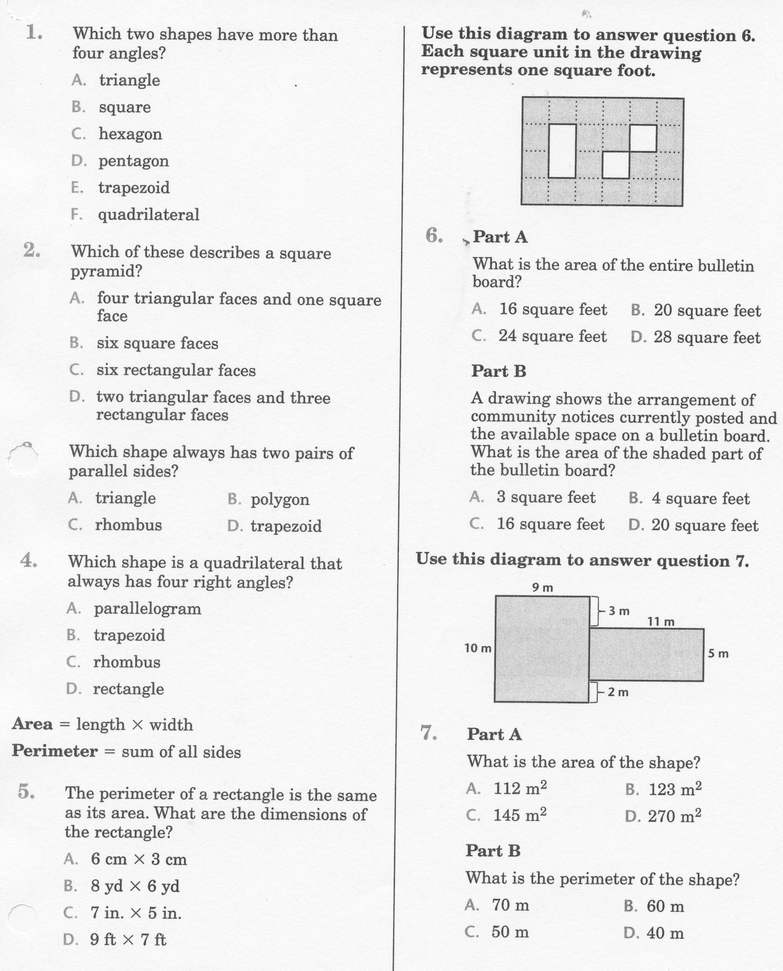
Math-E - Unit-6 – Practice Review

Slide 6
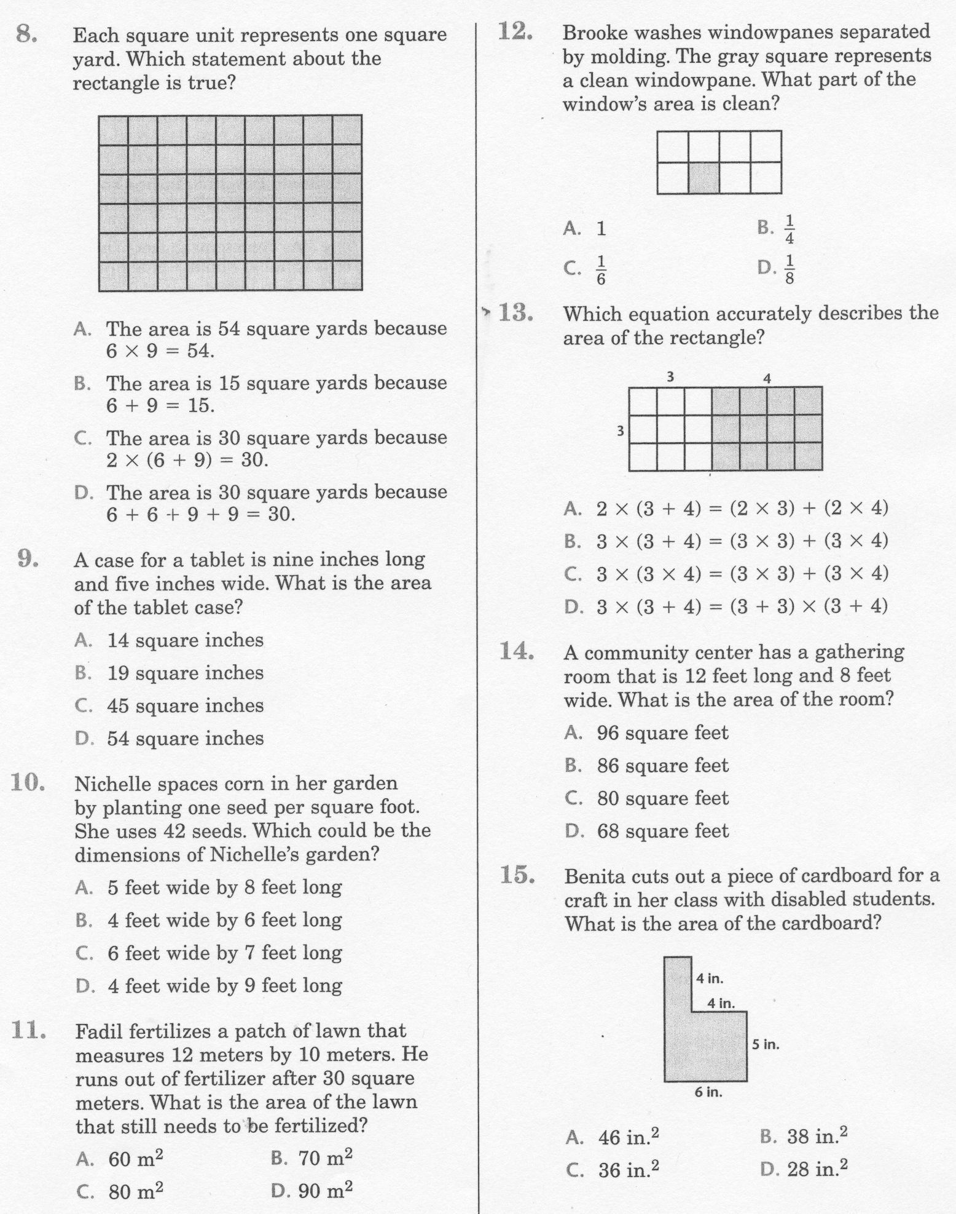
Math-E - Unit-6 – Practice Review

Slide 7
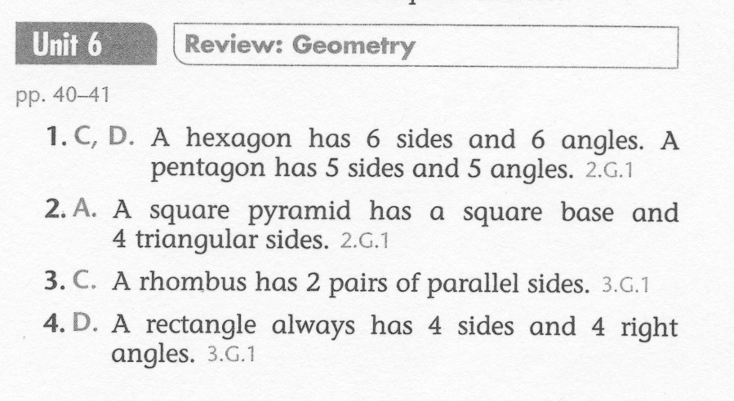
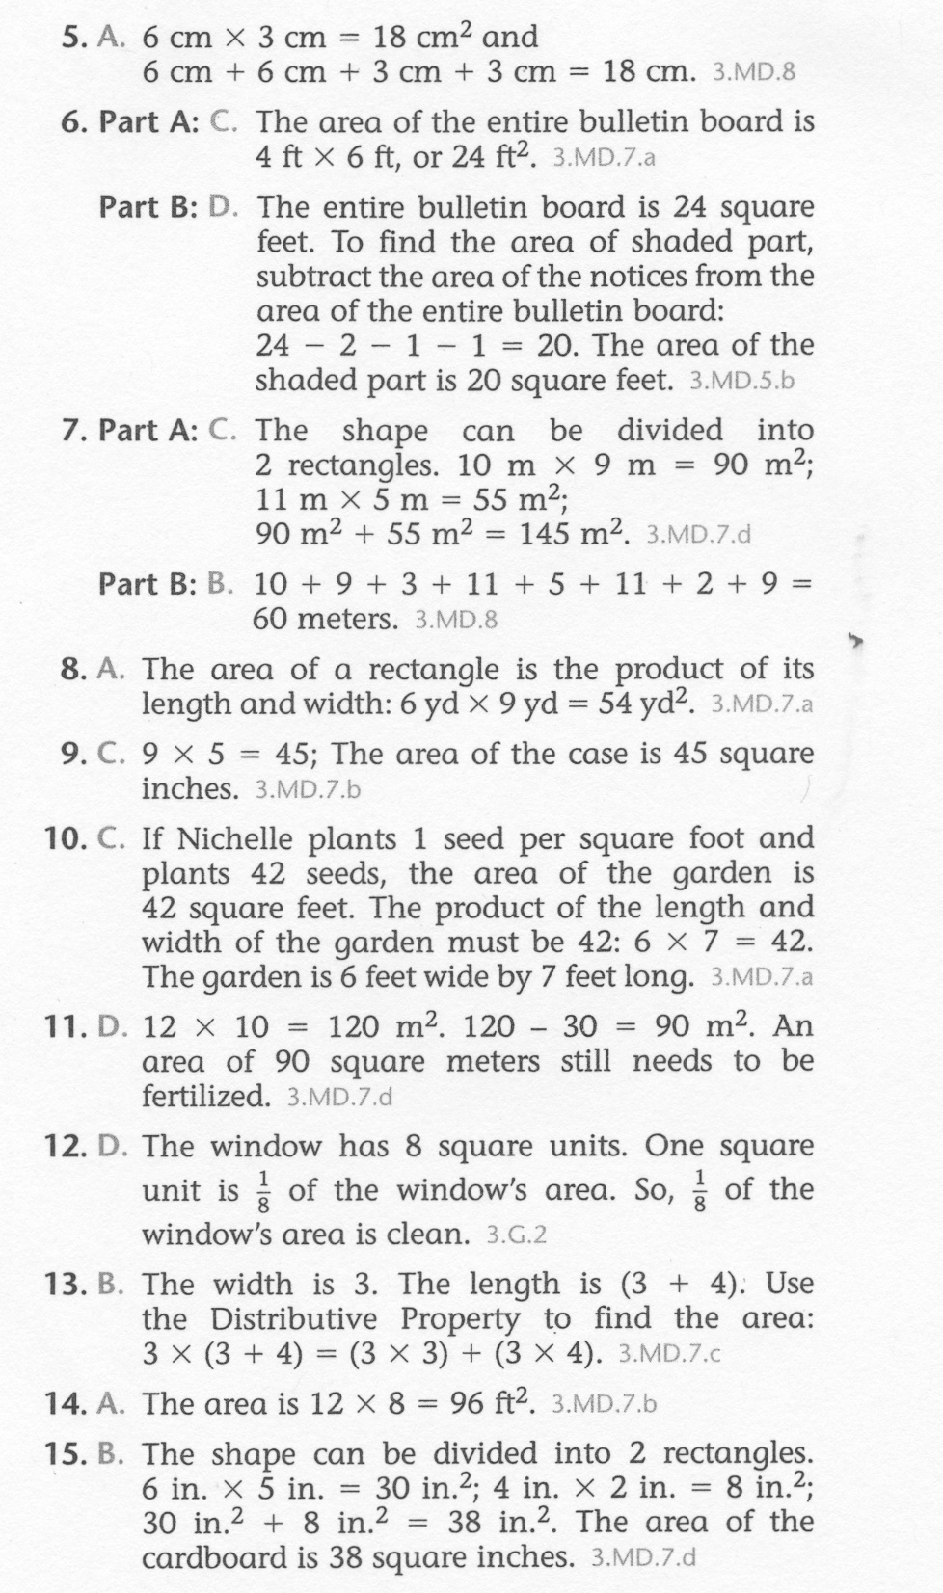
Math-E - Unit-6 – Practice Review

