Slide 1
TABE Math-E PAXEN Unit-6 Geometry Lesson 45 Area and Sq Units
Revised: November 4, 2023
Nolan Tomboulian
Some graphics may not have copied well during the scan process.

Slide 2
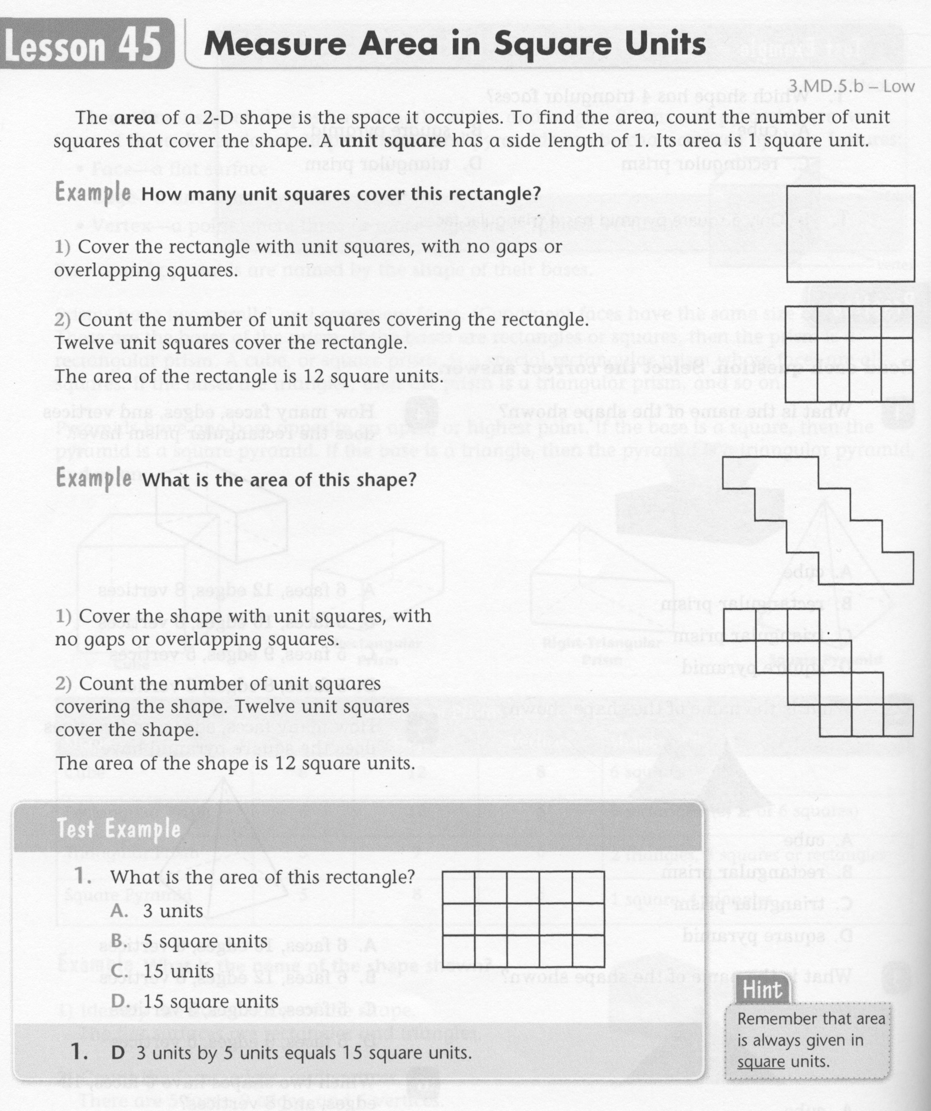
Math-E - Lesson 45 – Area and Sq. Units

Slide 3
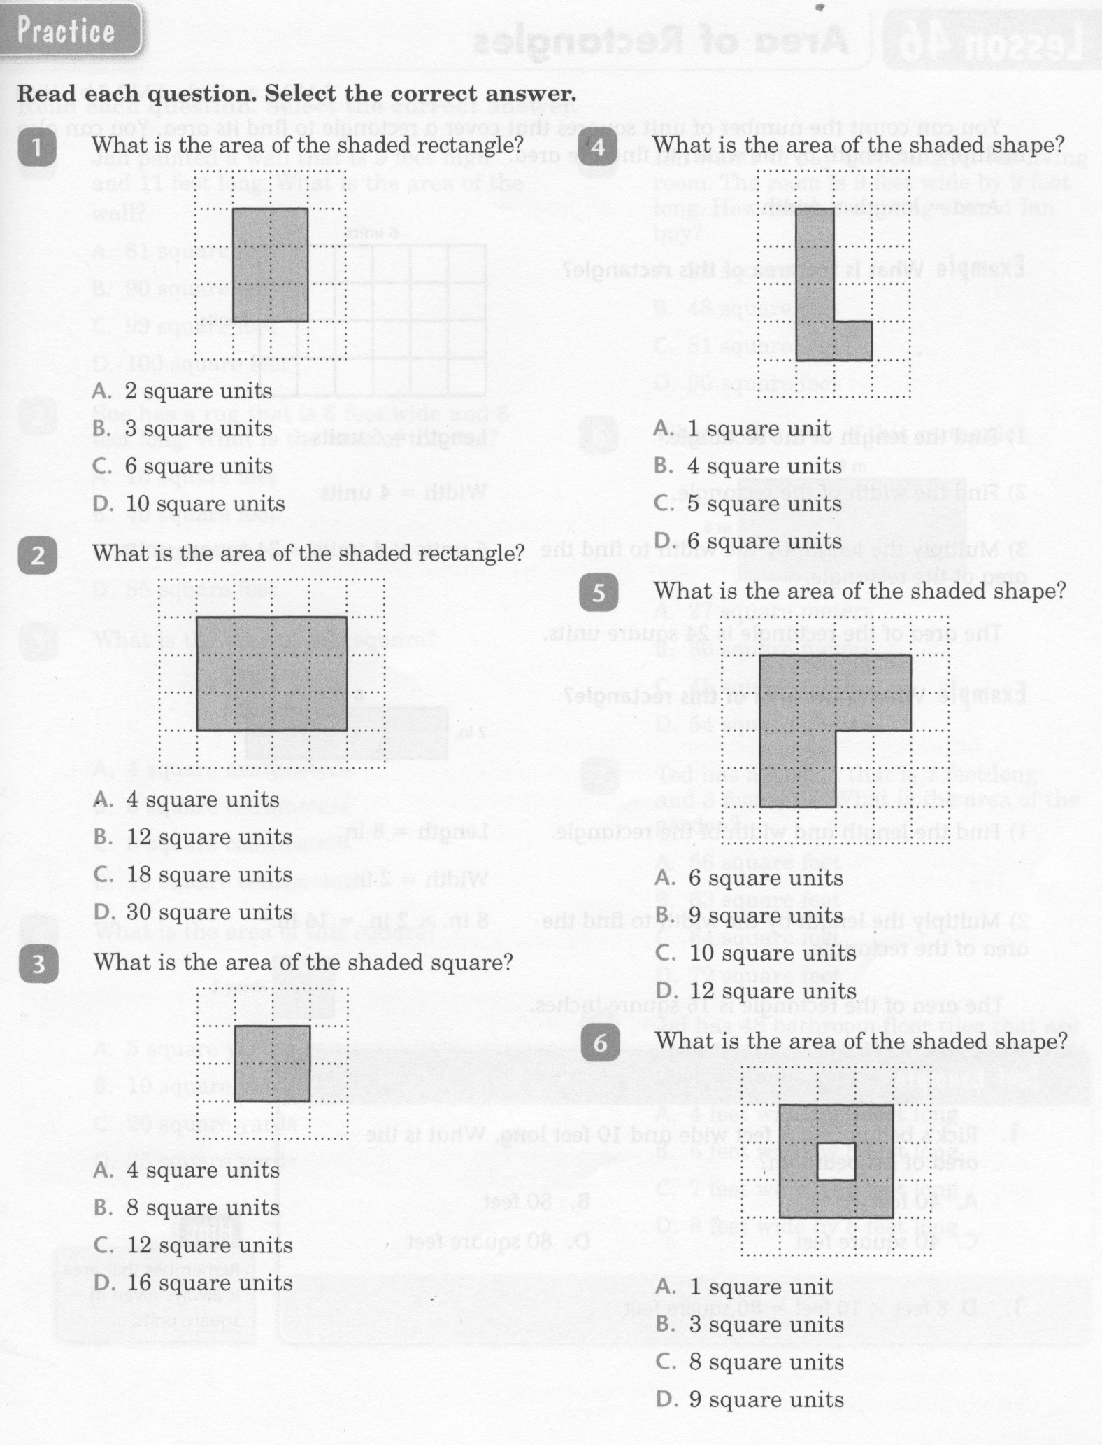
Math-E - Lesson 45 – Area and Sq. Units

Slide 4
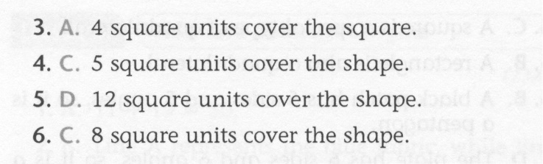
Math-E - Lesson 45 – Area and Sq. Units

Slide 5
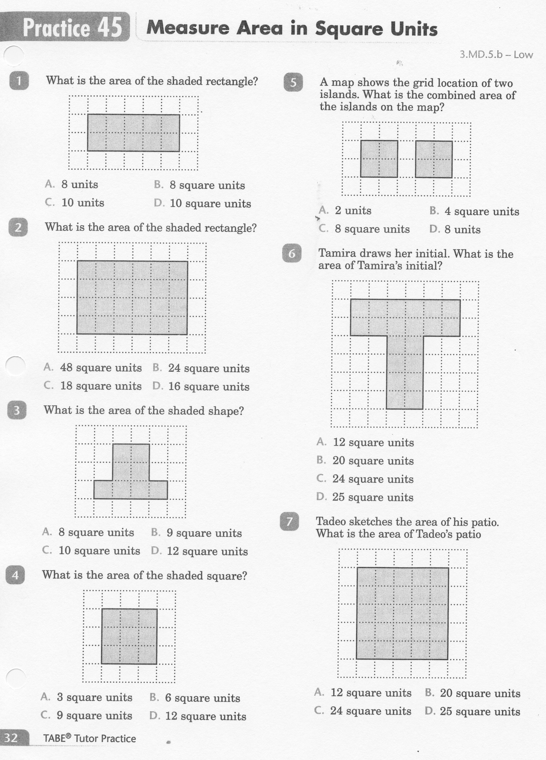
Math-E - Practice 45 – Area and Sq. Units

Slide 6
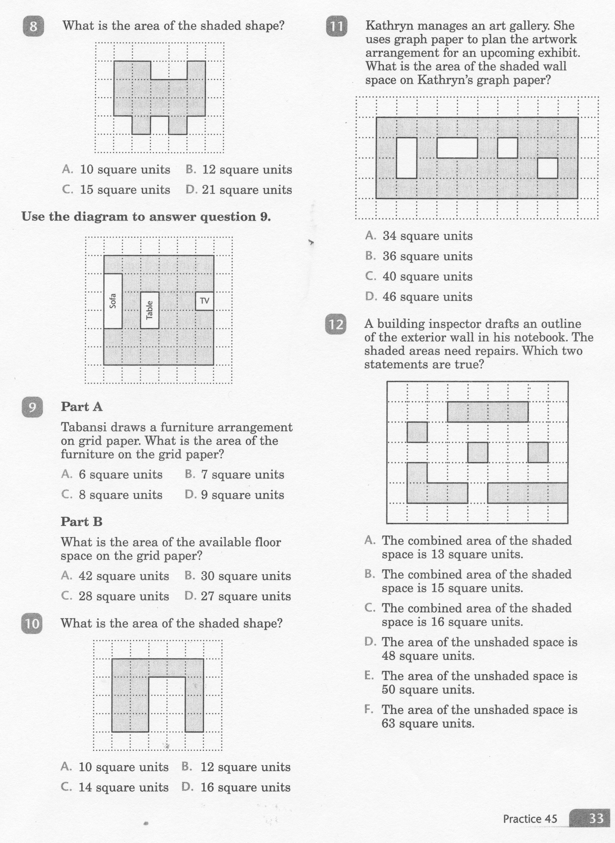
Math-E - Practice 45 – Area and Sq. Units

Slide 7
Math-E - Practice 45 – Area and Sq. Units

