Slide 1
TABE Math-E PAXEN Unit-5 Measurement and Data Lesson 40 Measure of Mass (Metric)
Revised: October 16, 2023
Nolan Tomboulian
Some graphics may not have copied well during the scan process.

Slide 2
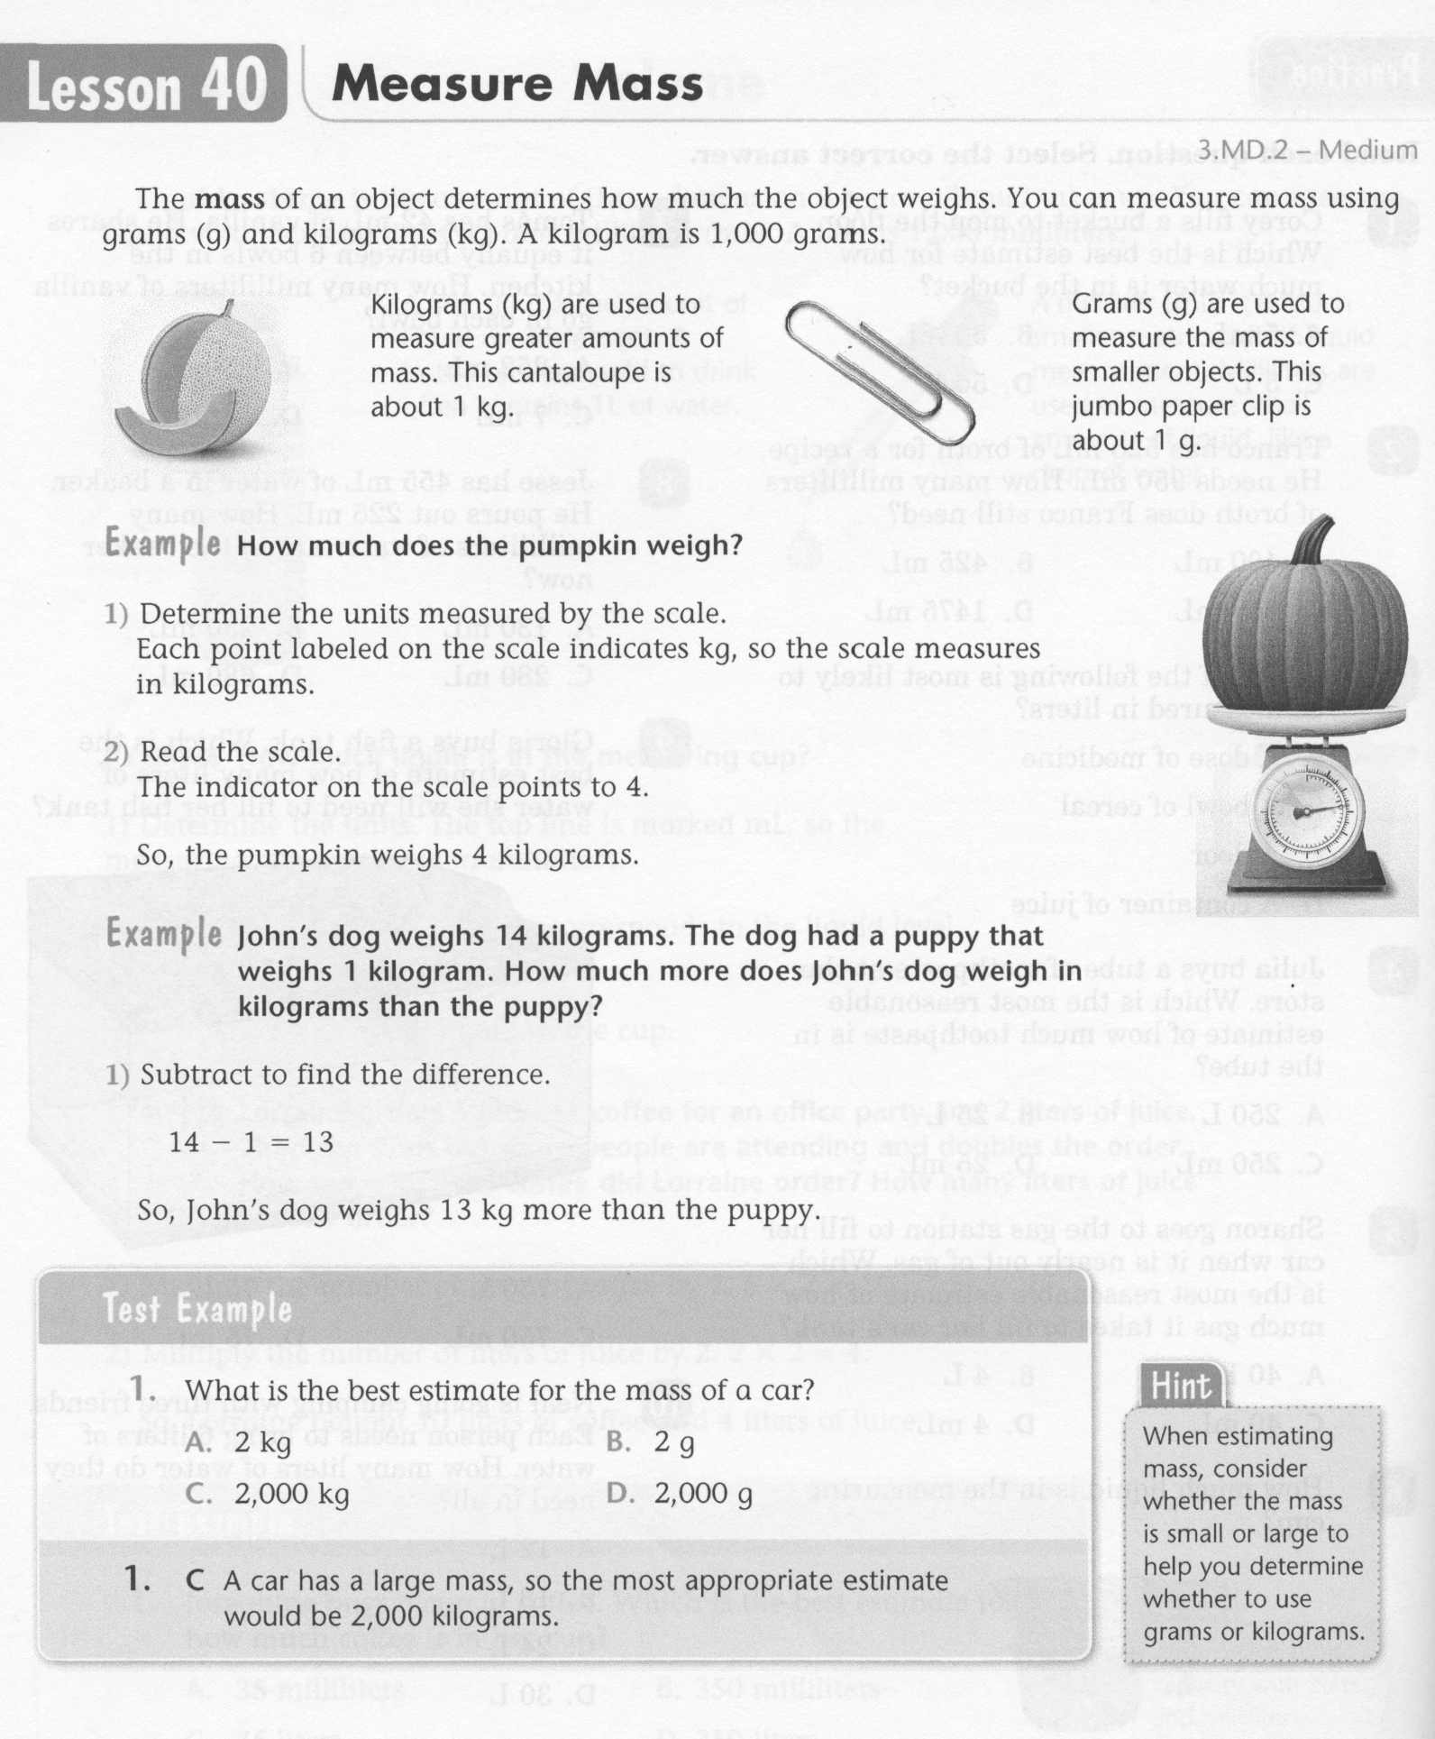
Math-E - Lesson 40 – Mass (Metric)

Slide 3
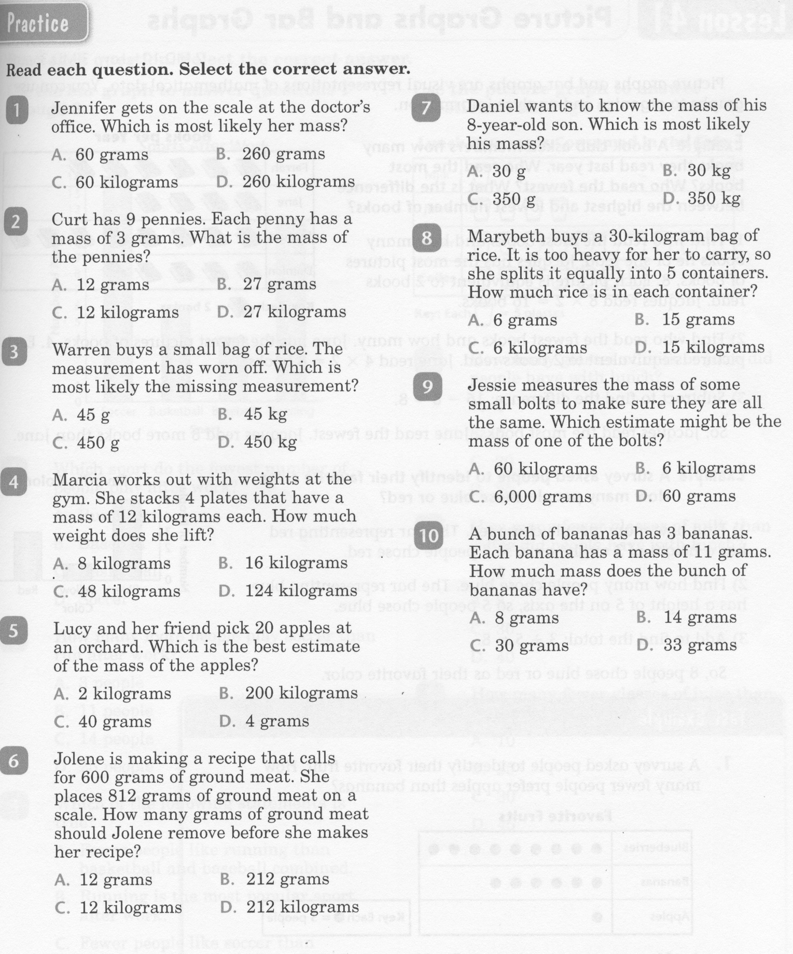
Math-E - Lesson 40 – Mass (Metric)

Slide 4
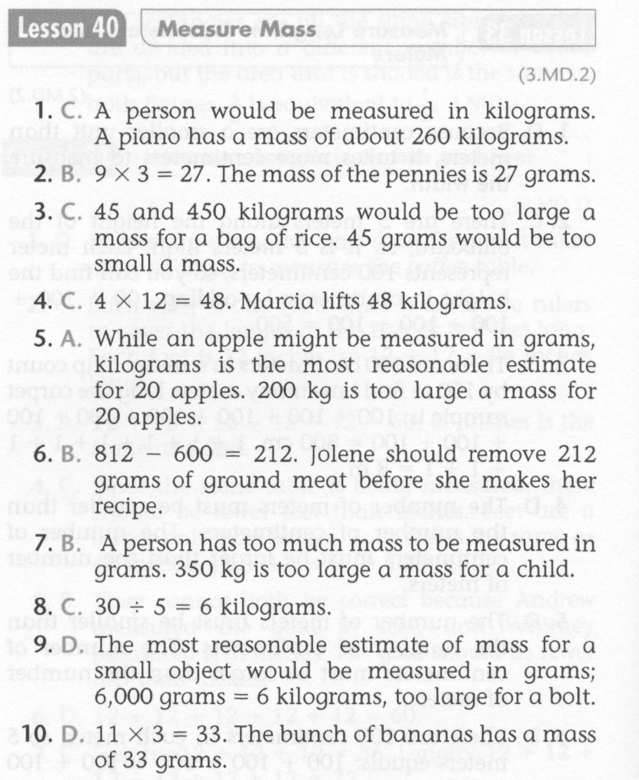
Math-E - Lesson 40 – Mass (Metric)

Slide 5
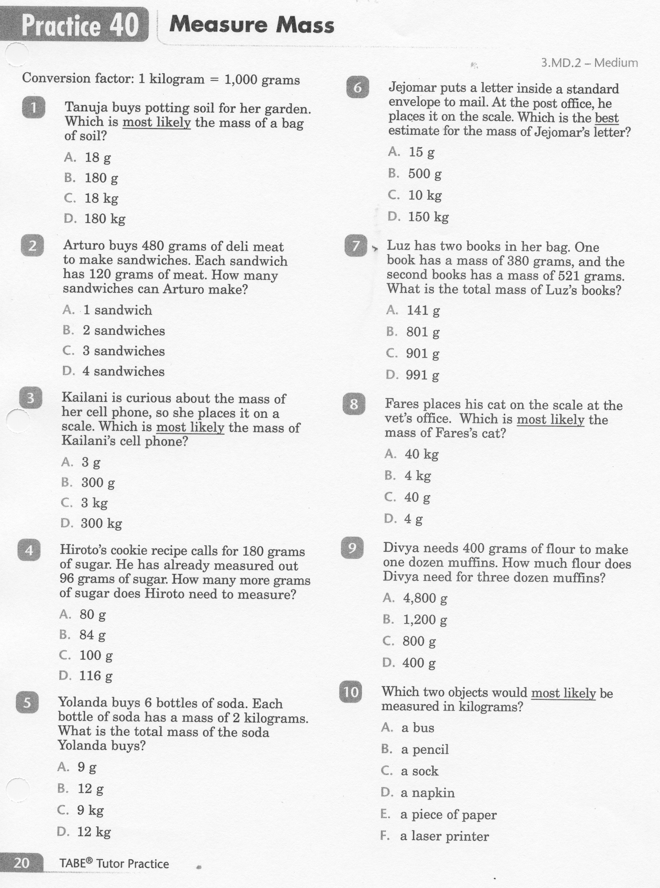
Math-E - Practice 40 – Mass (Metric)

Slide 6
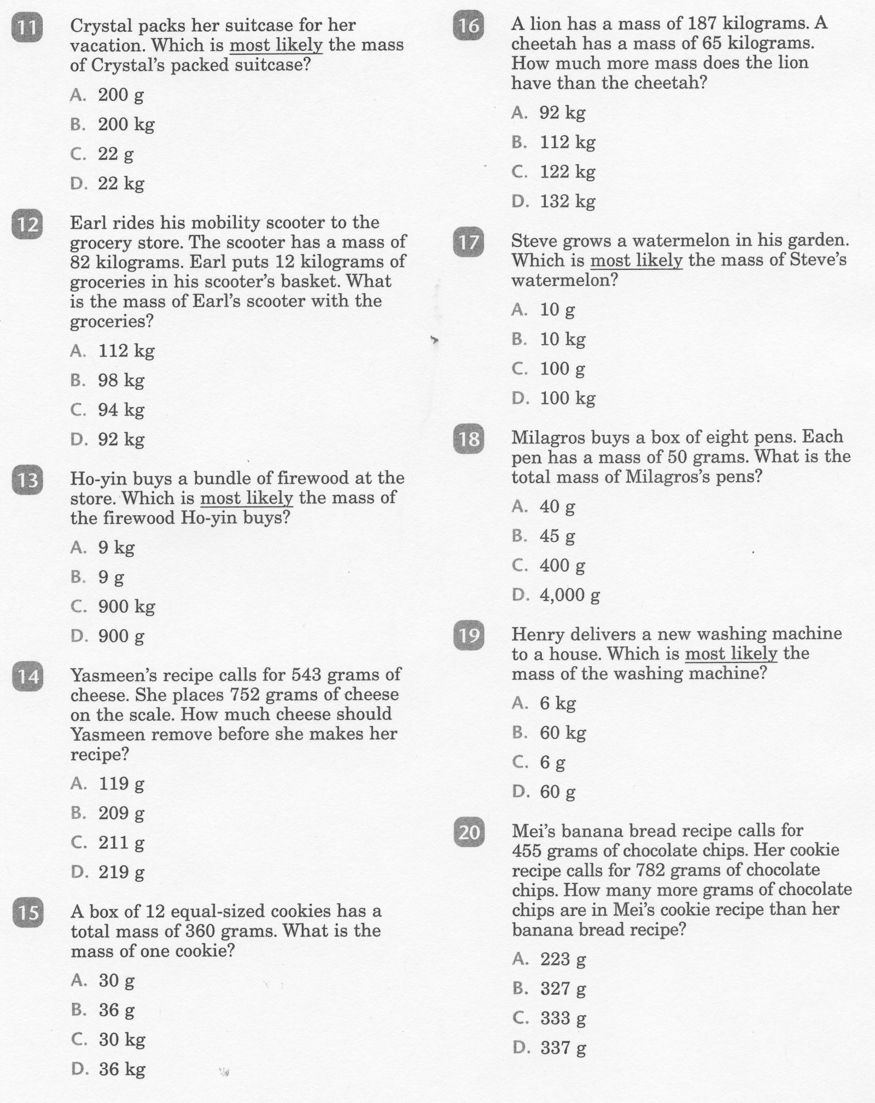
Math-E - Practice 40 – Mass (Metric)

Slide 7
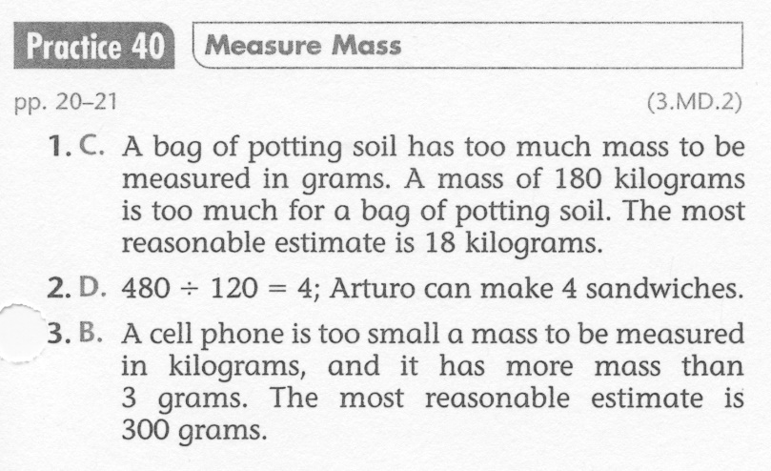
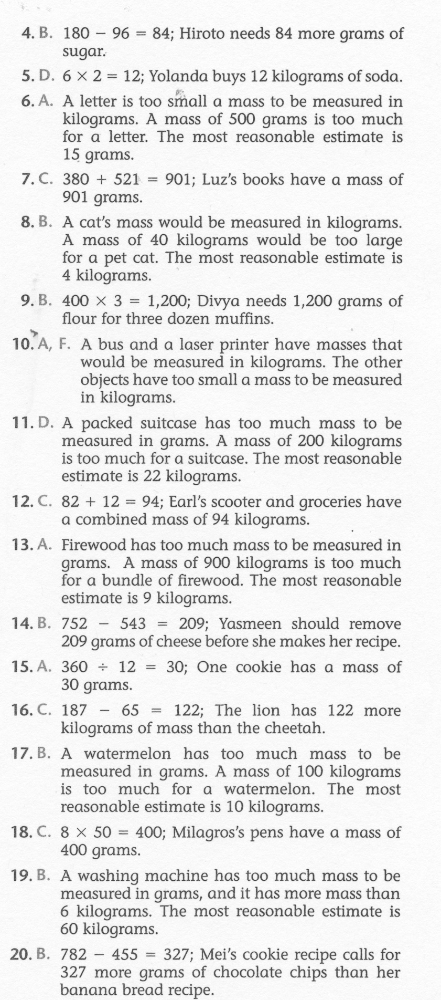
Math-E - Practice 40 – Mass (Metric)

