Slide 1
TABE Math-E PAXEN Unit-4 Fractions Lesson 26 Equivalent Fractions (Scale up and Scale Down)
Revised: October 16, 2023
Nolan Tomboulian
Some graphics may not have copied well during the scan process.

Slide 2
Math-E - Lesson 26 – Equivalent Fractions

Slide 3
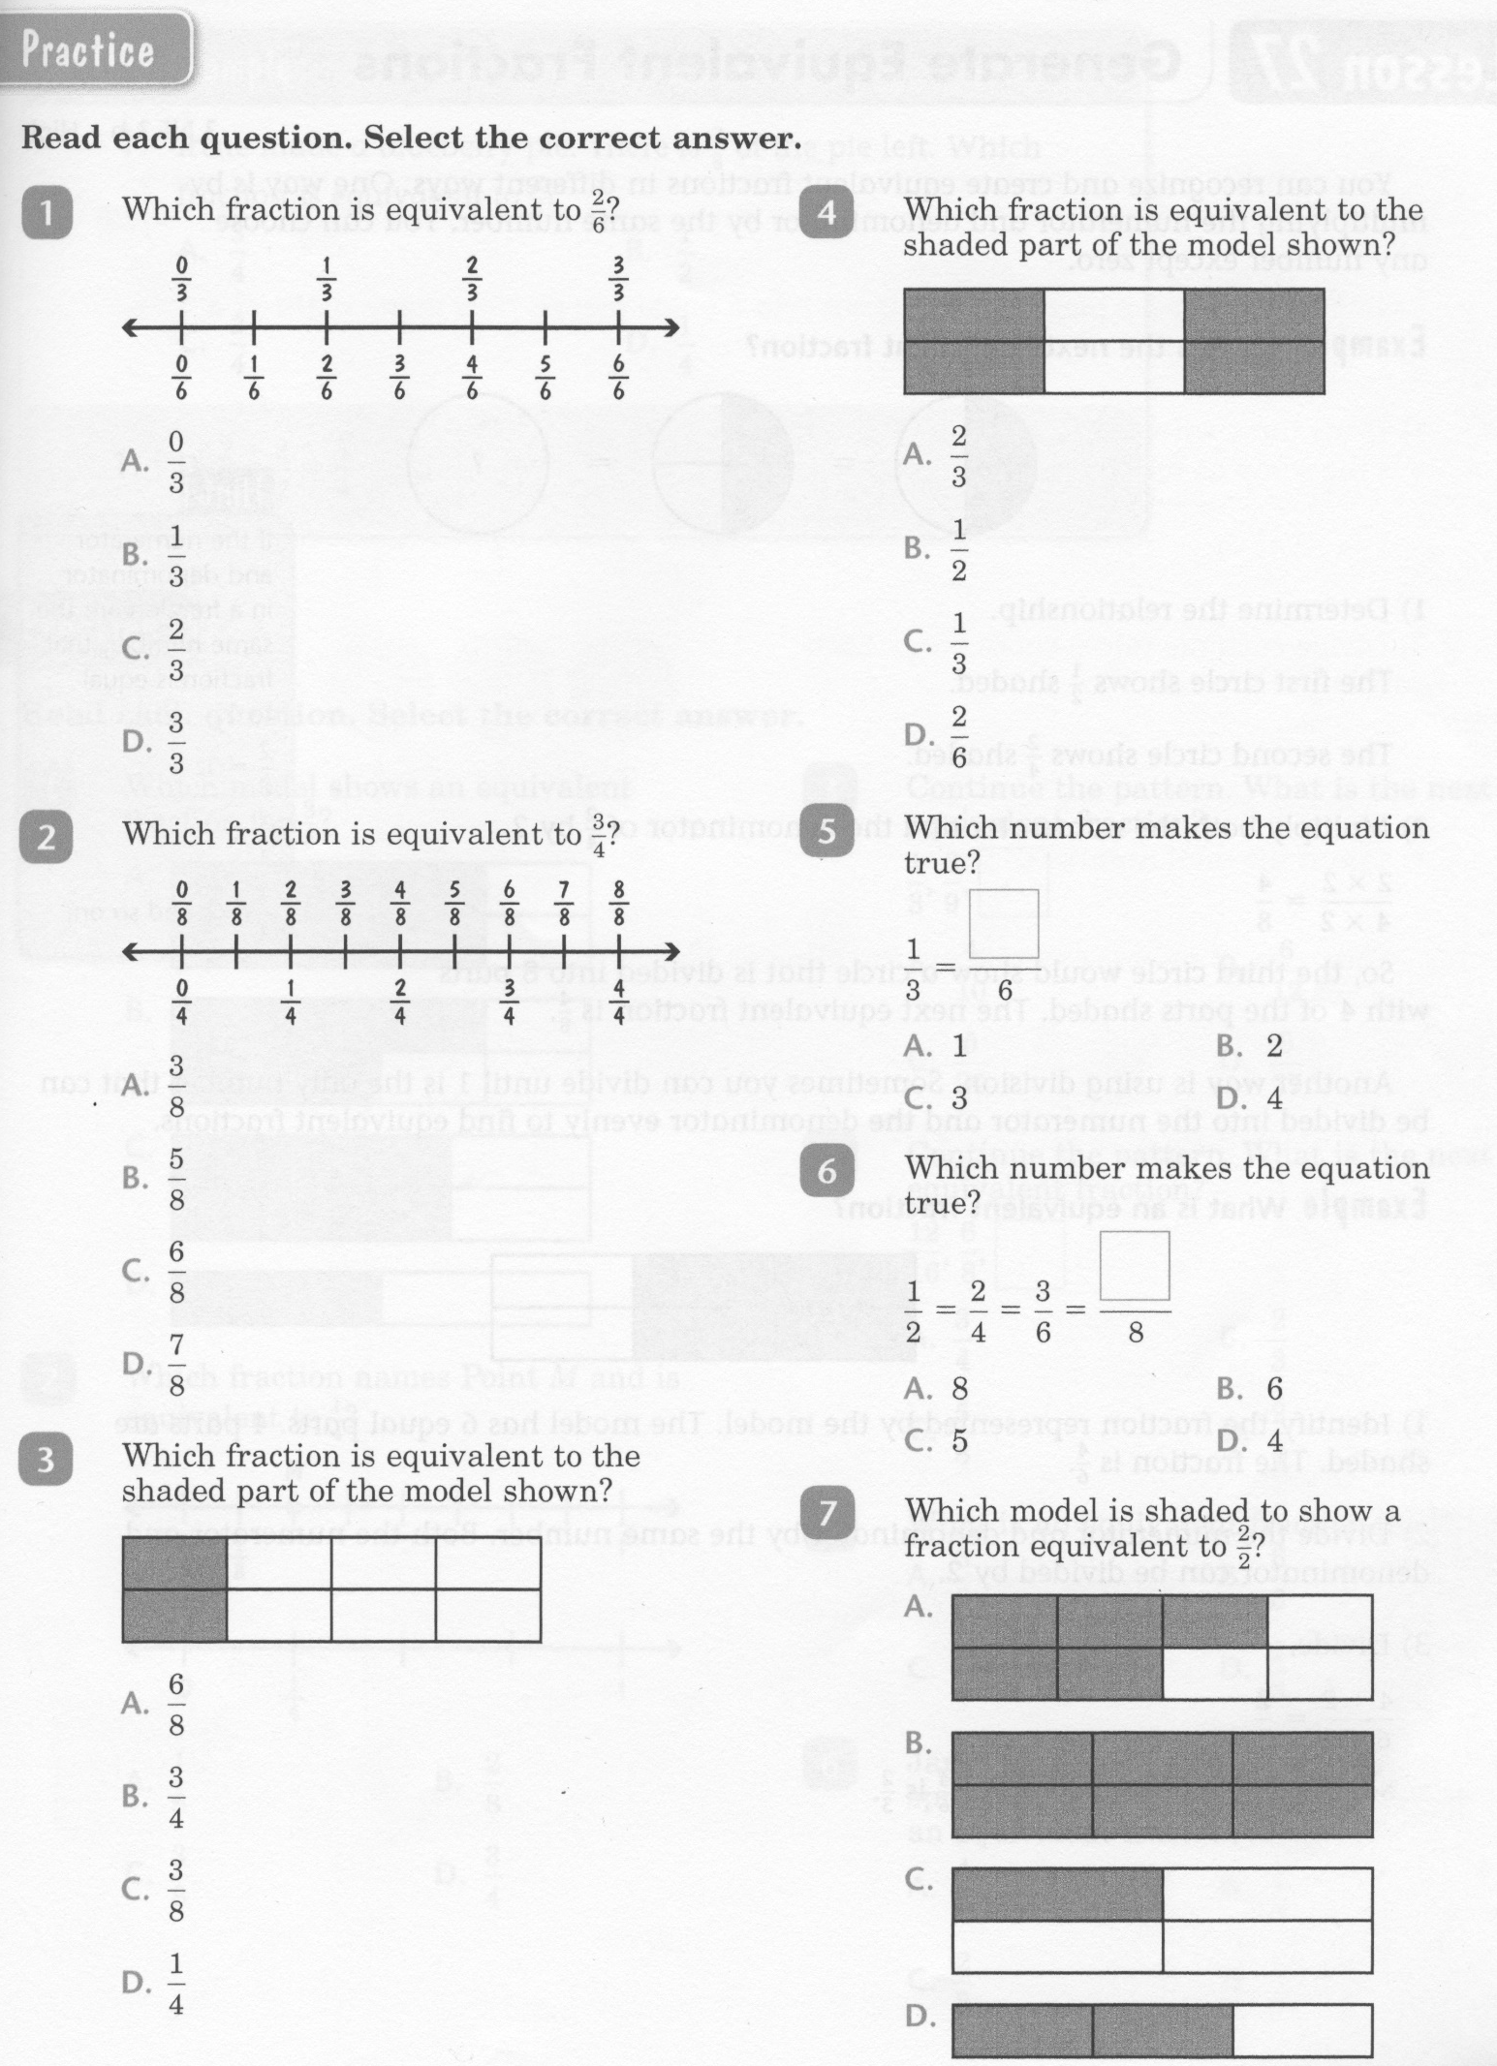
Math-E - Lesson 26 – Equivalent Fractions

Slide 4
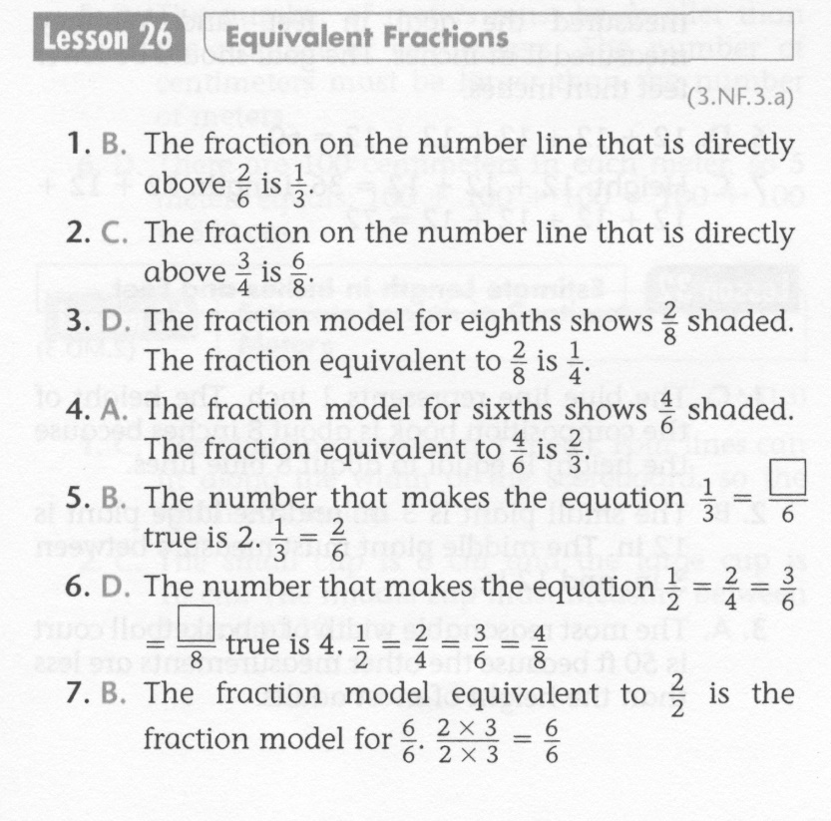
Math-E - Lesson 26 – Equivalent Fractions

Slide 5
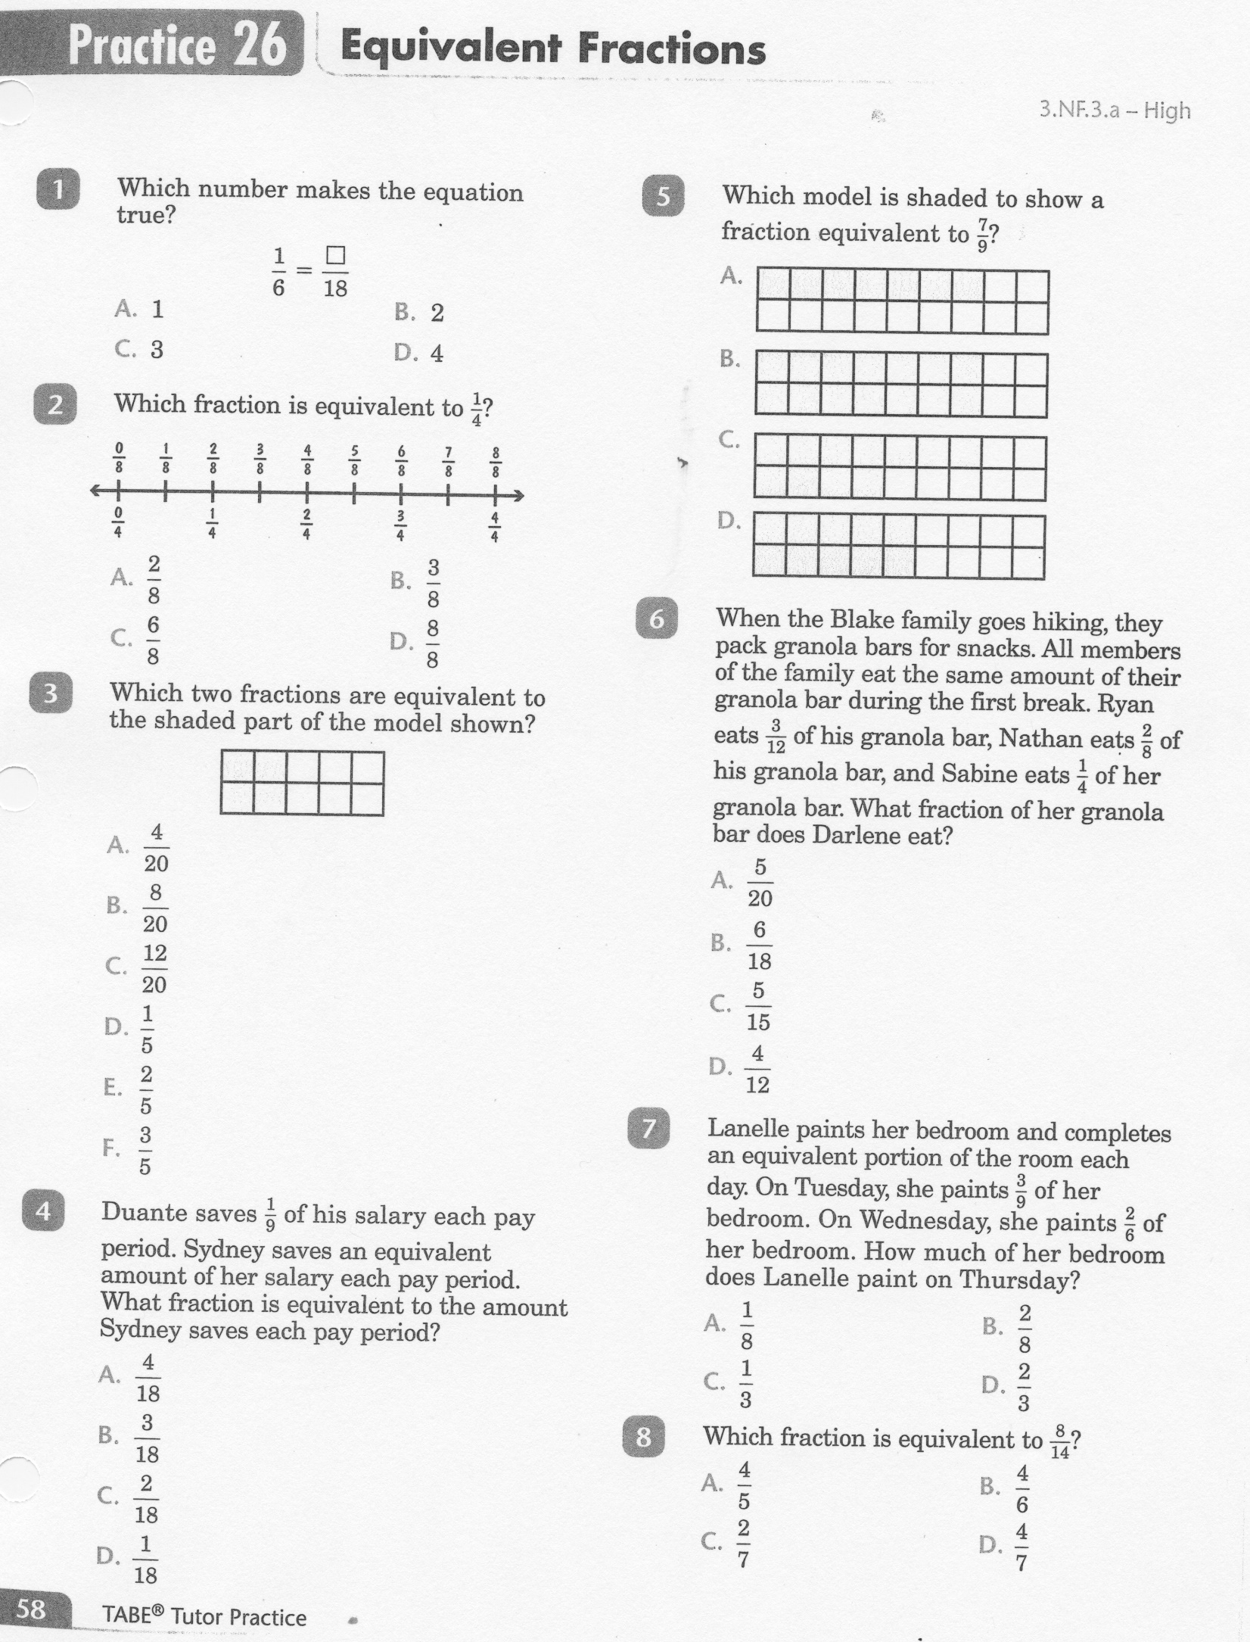
Math-E - Lesson 26 – Equivalent Fractions

Slide 6
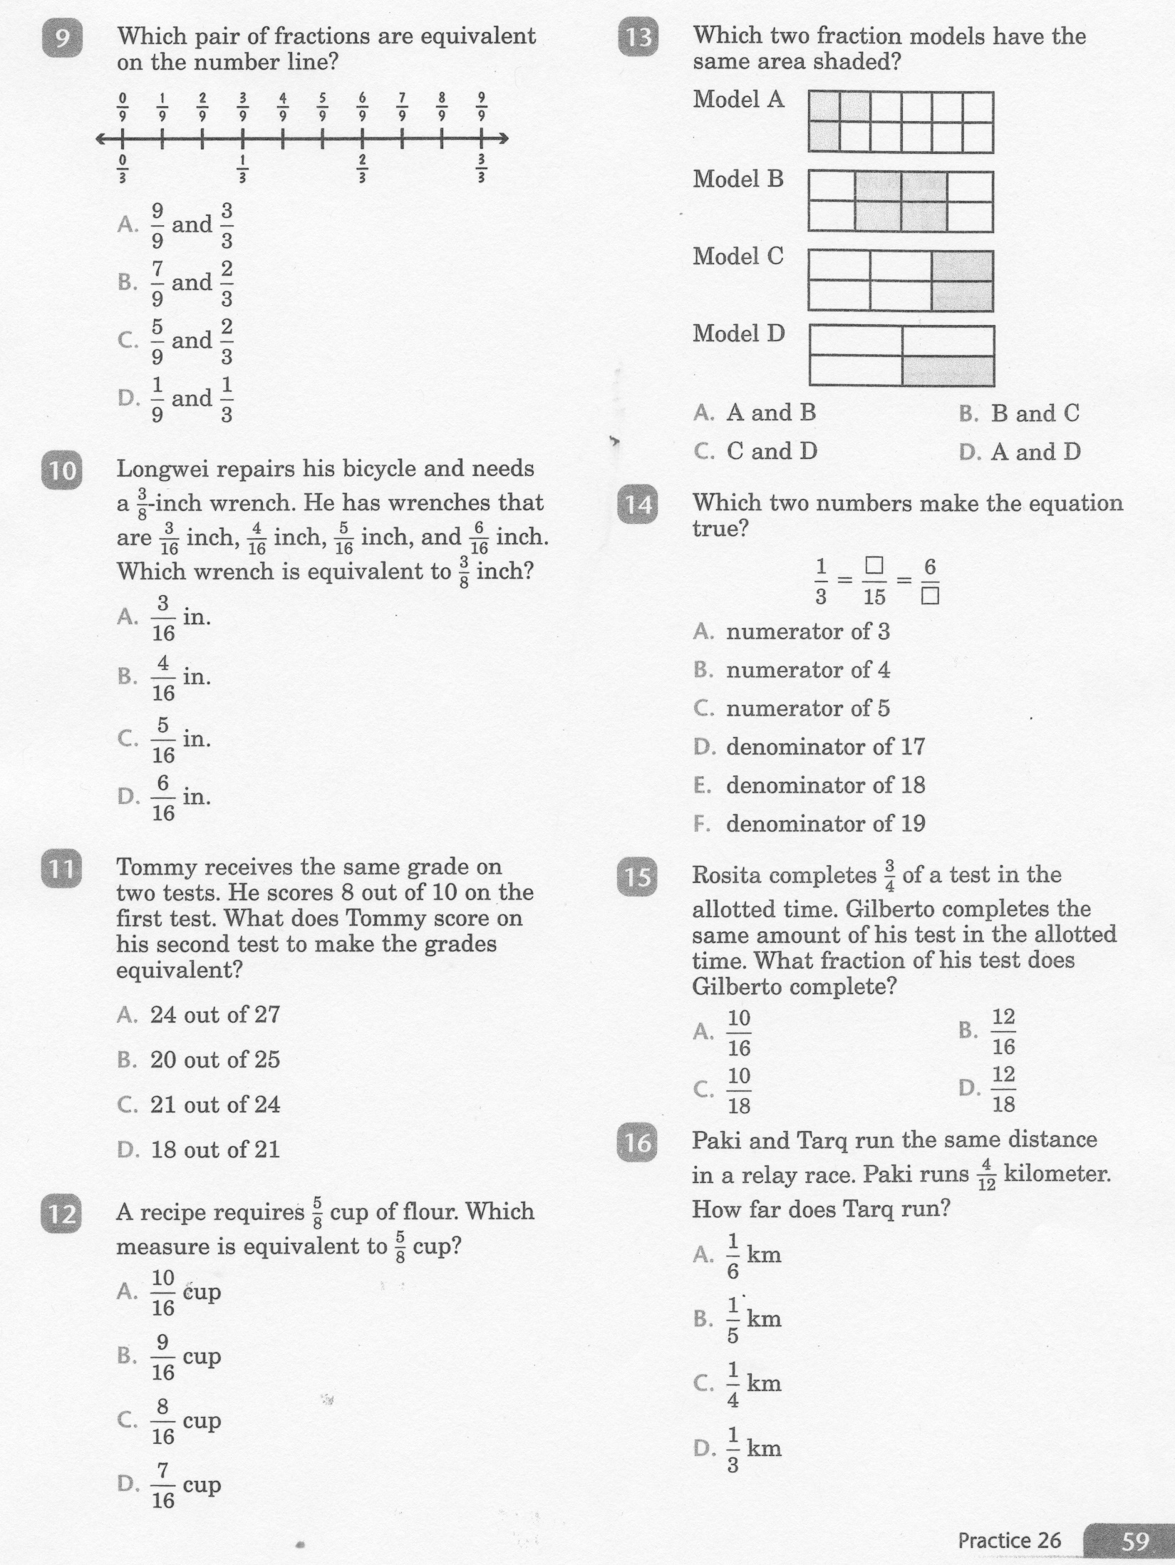
Math-E - Lesson 26 – Equivalent Fractions

Slide 7
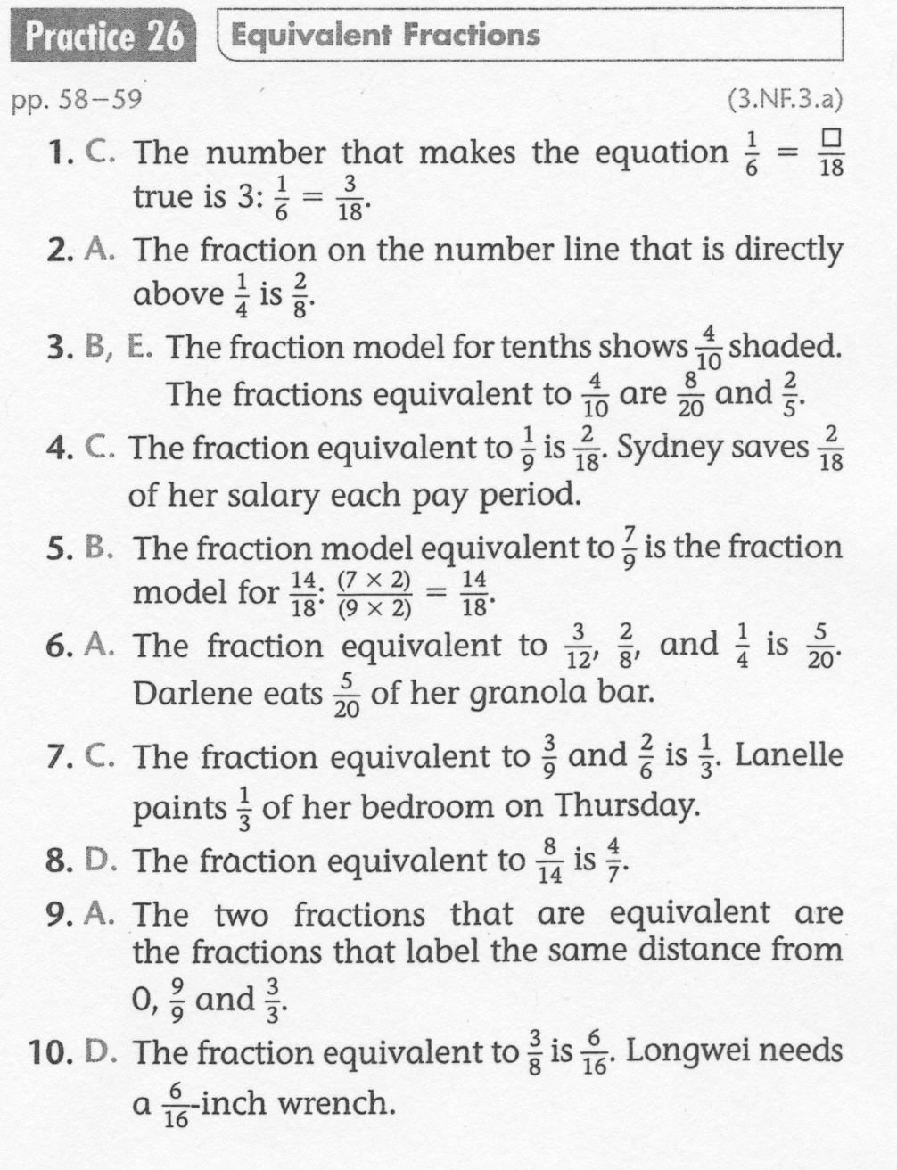
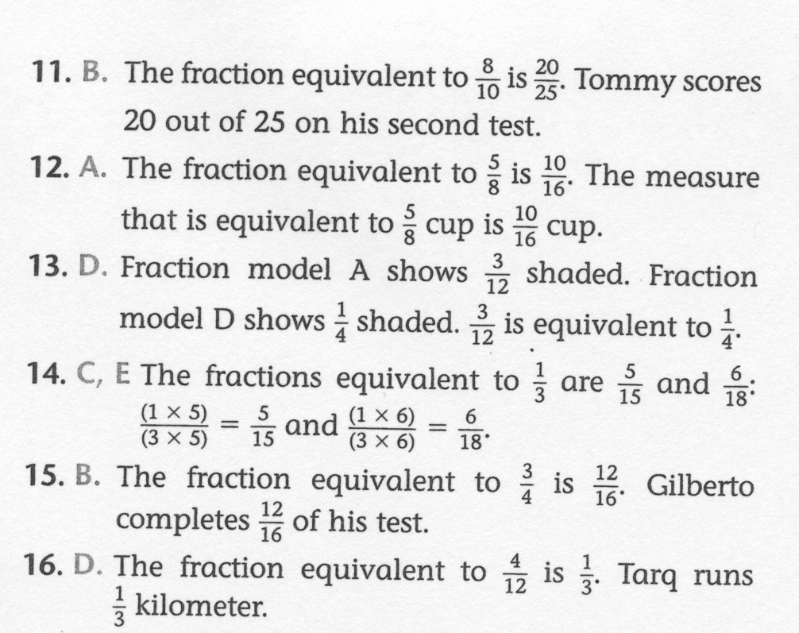
Math-E - Lesson 26 – Equivalent Fractions

