Slide 1
TABE Math-E PRAXEN Unit-1 Working With Whole Numbers Lesson-04 Compare Numbers
Revised: October 12, 2023
Nolan Tomboulian
Some graphics may not have copied well during the scan process.

Slide 2
Math-E - Lesson-04 Compare 3-Digit Numbers

Slide 3
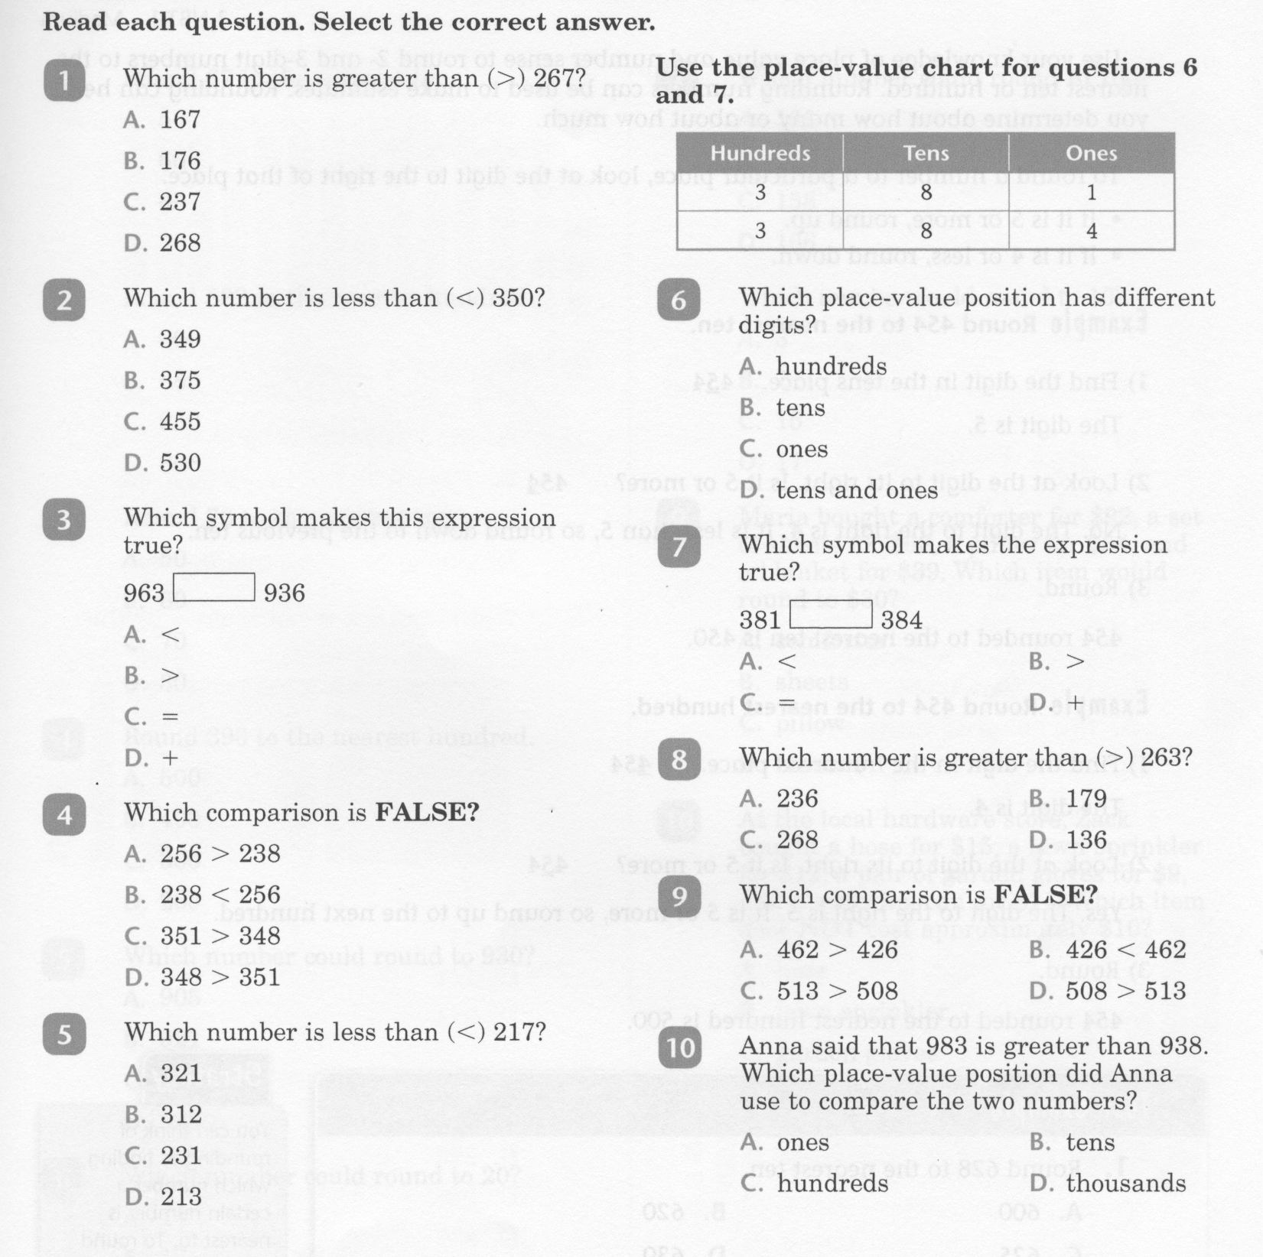
Math-E - Lesson-04 Compare 3-Digit Numbers

Slide 4
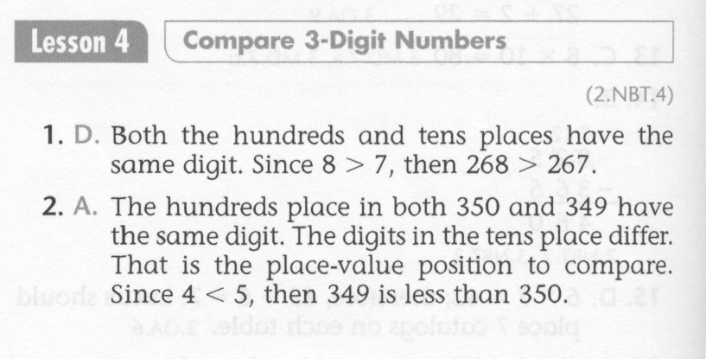
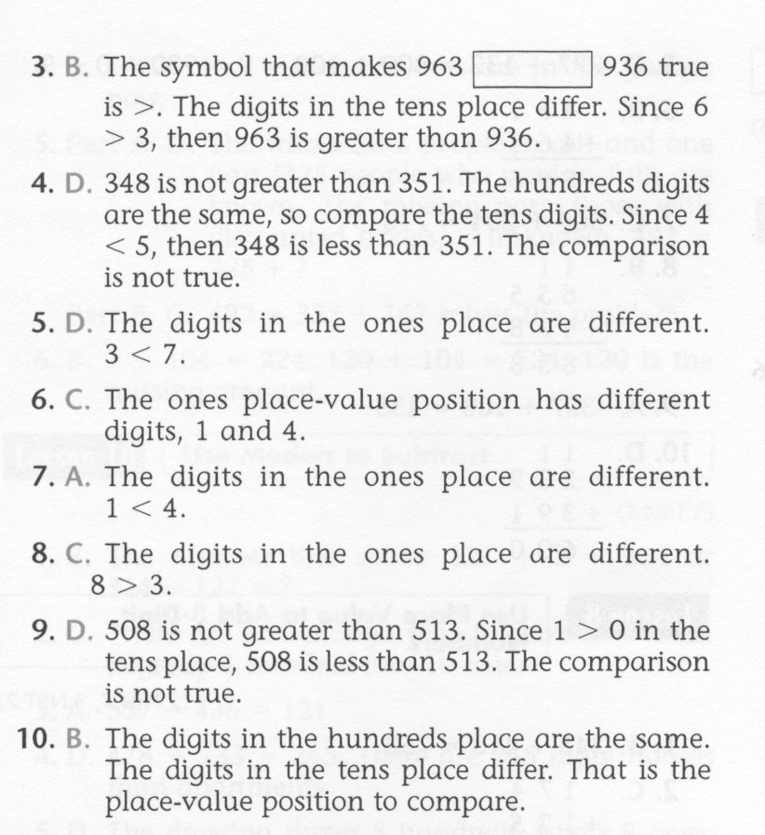

Slide 5
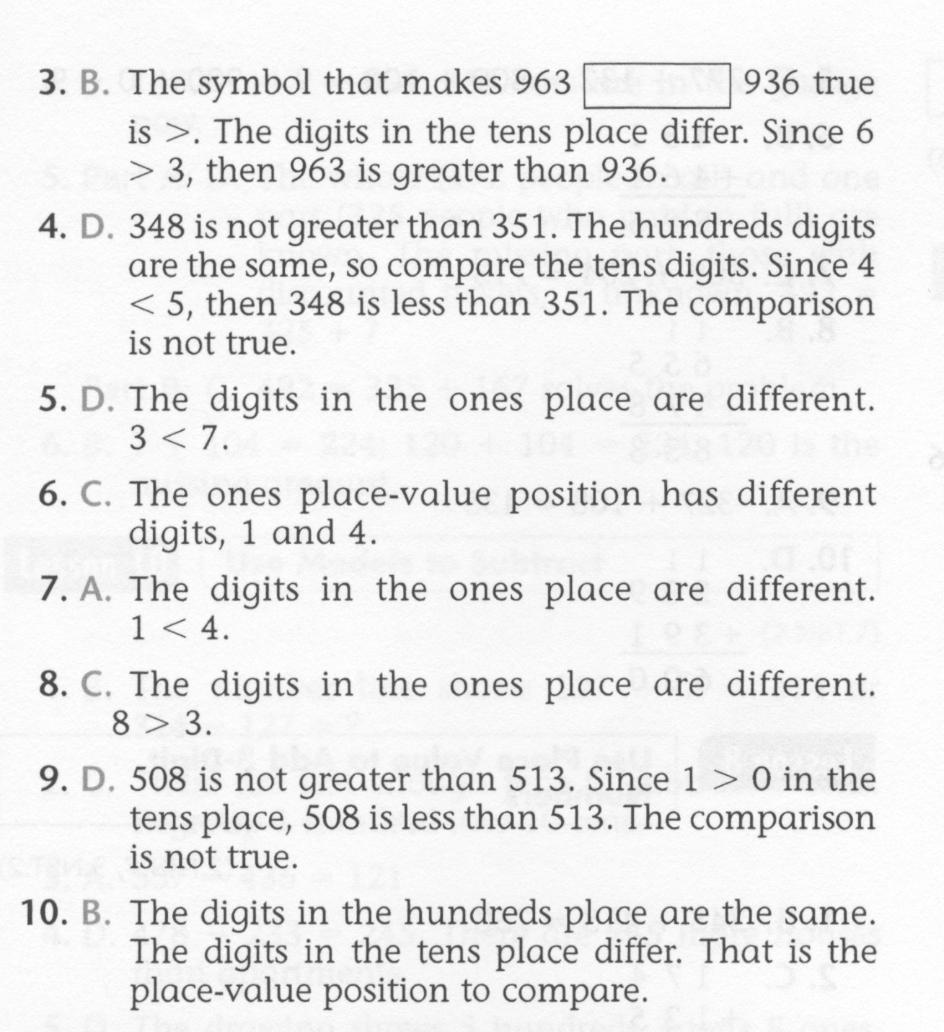

Slide 6
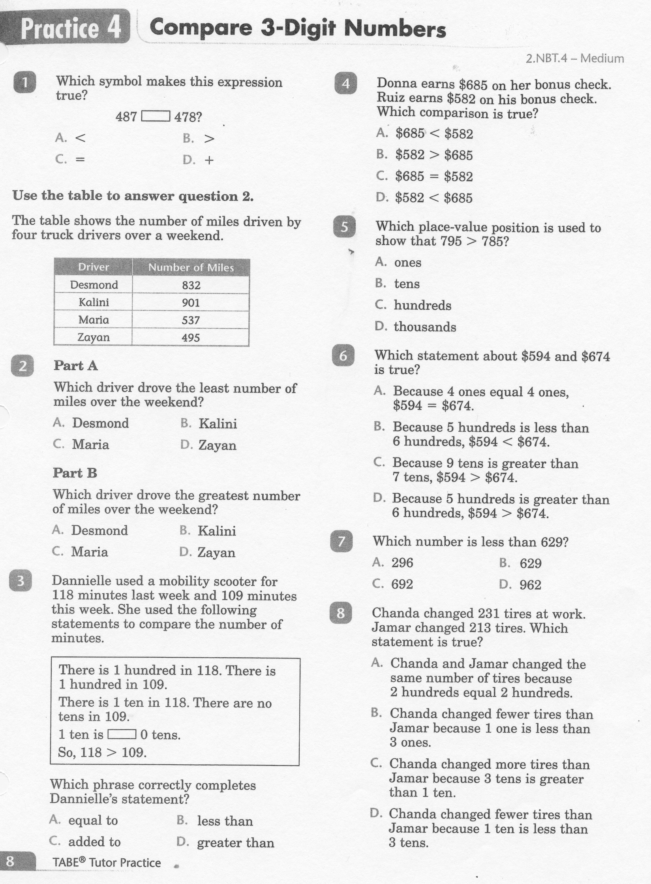

Slide 8
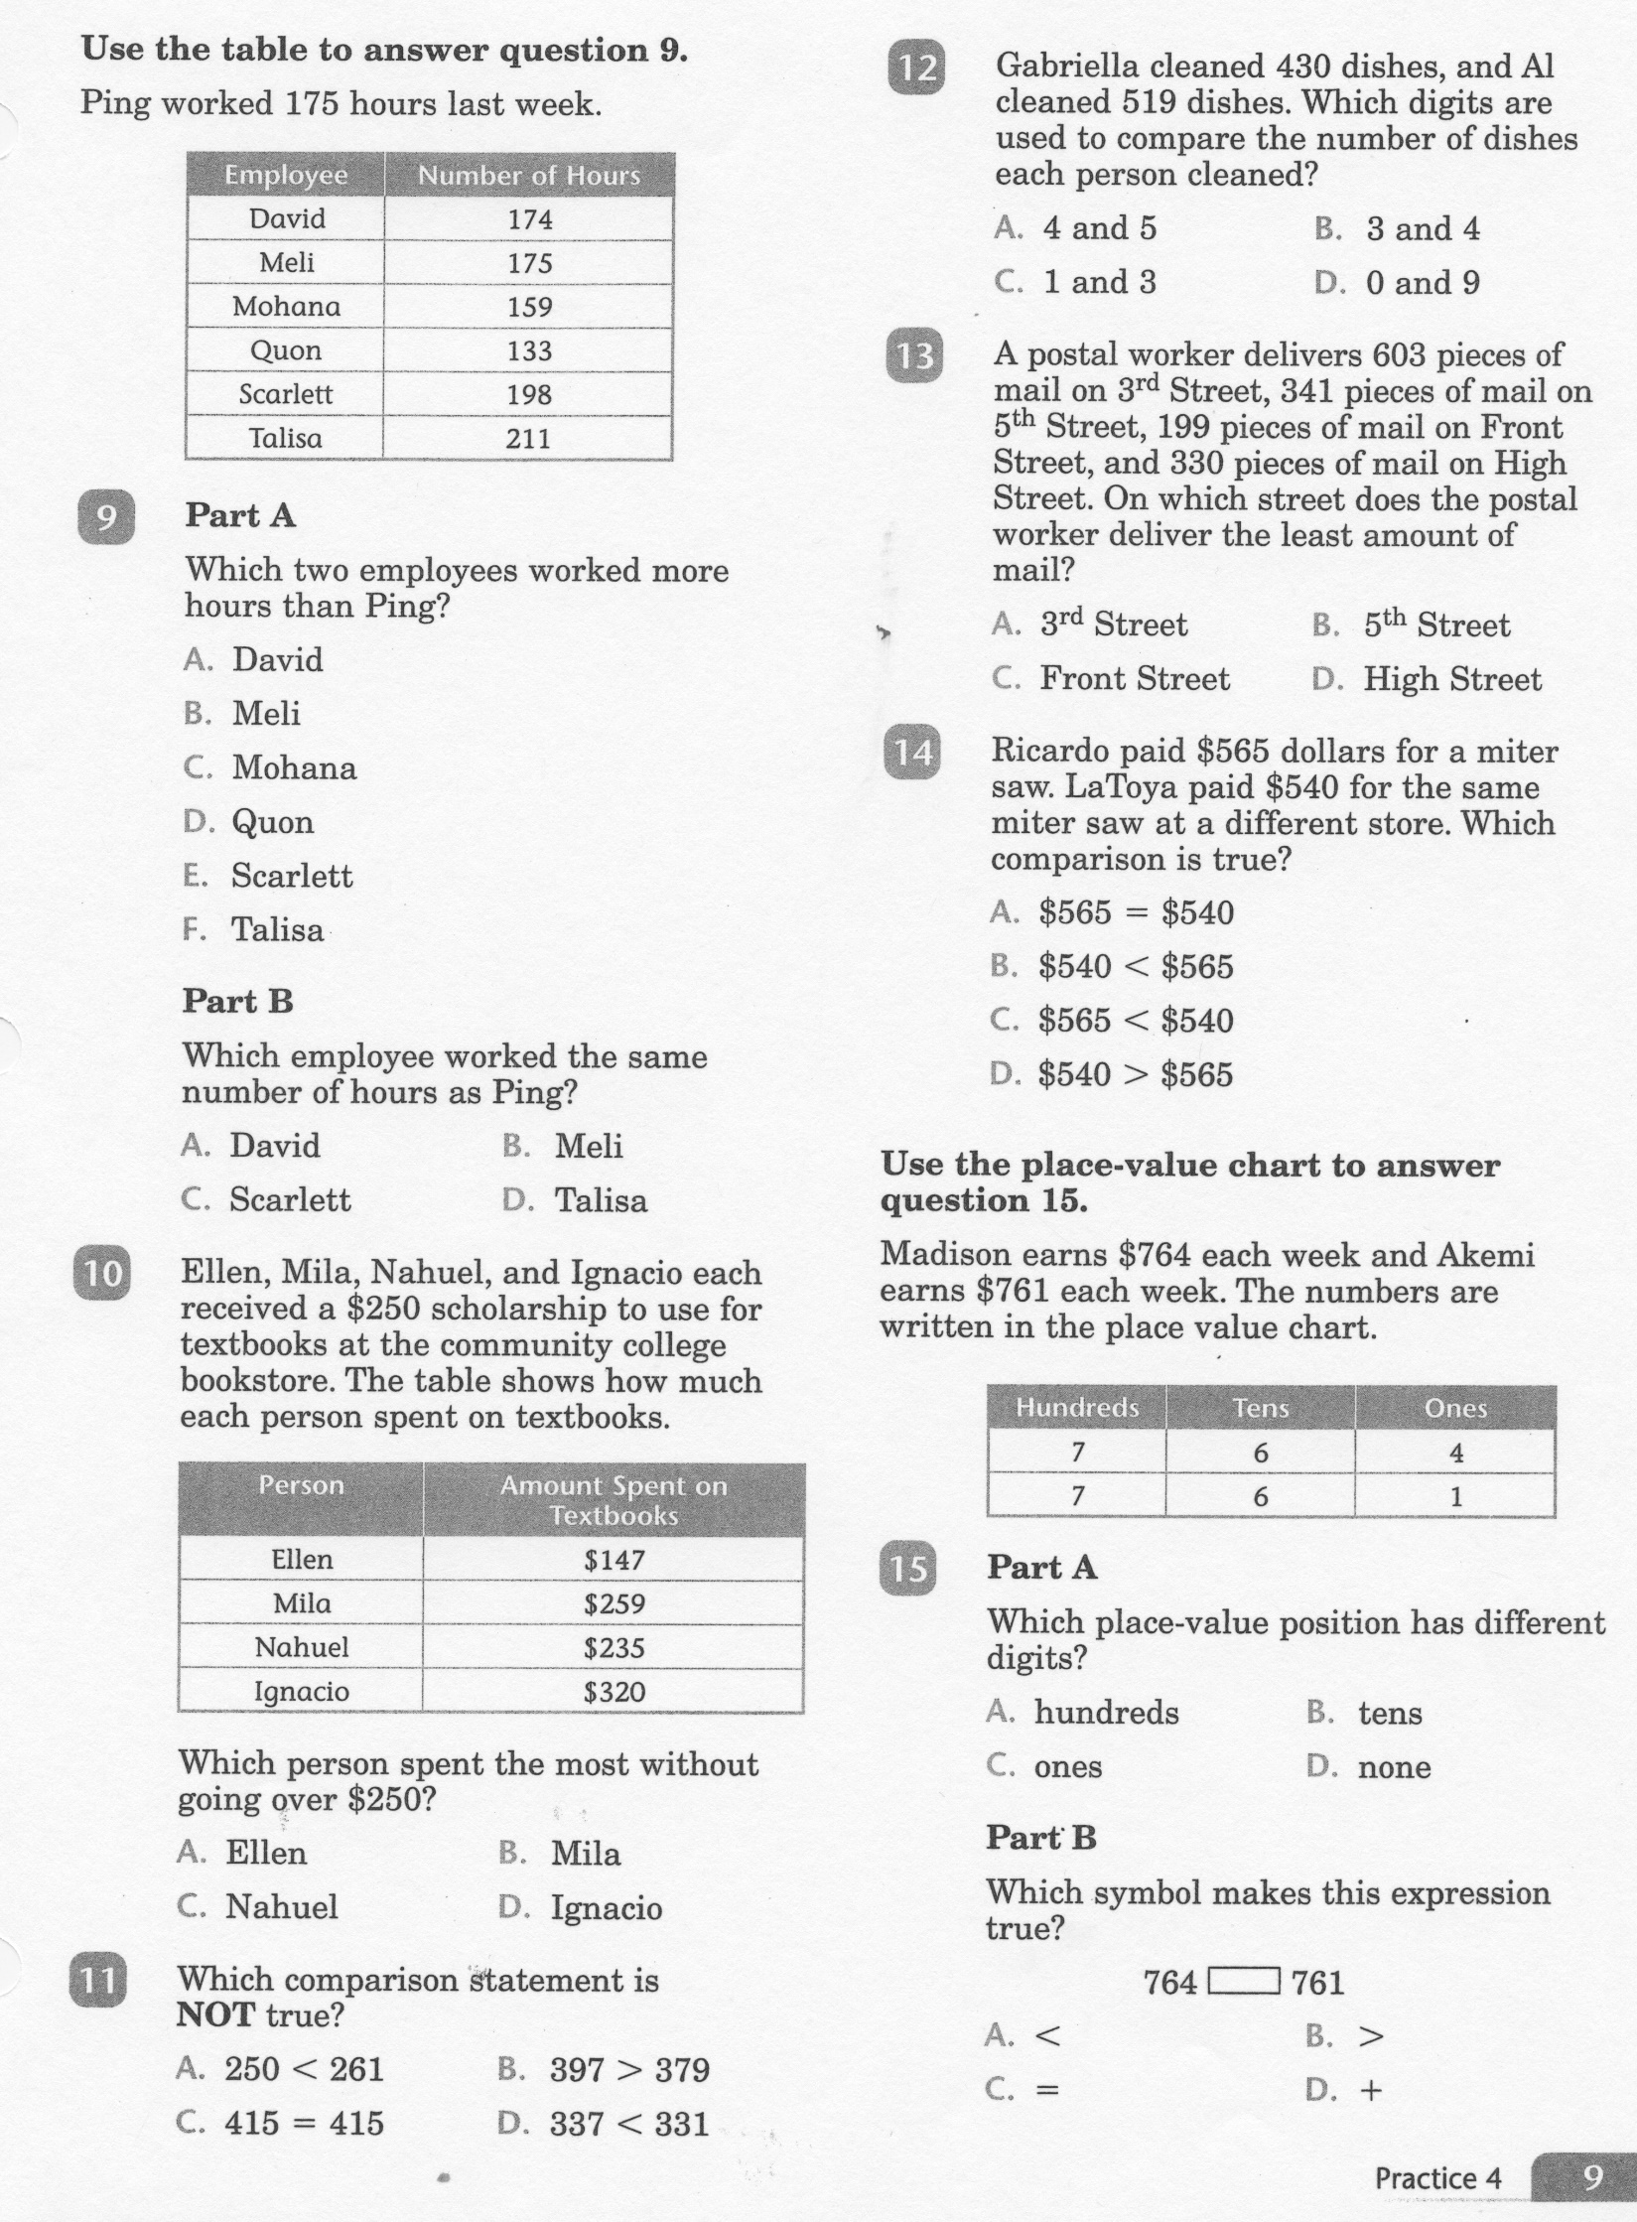

Slide 10
