Slide 1
TABE Math-E PAXEN Unit-1 Working With Whole Numbers Lesson-02 3-Digit Numbers
Revised: October 16, 2023
Nolan Tomboulian
Some graphics may not have reproduced well during the scan process

Slide 2
Math-E - Lesson-02 – 3-Digit Numbers

Slide 3
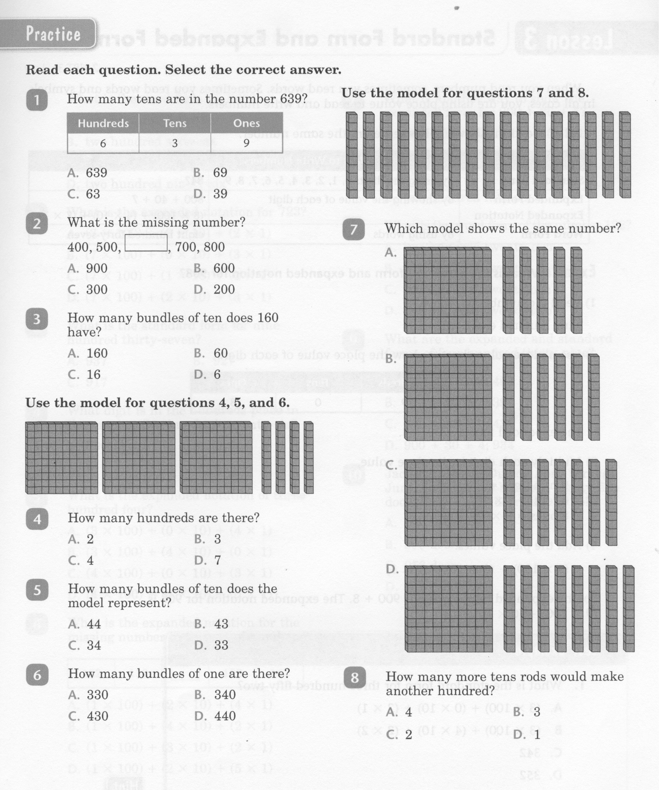
Math-E - Lesson-02 – 3-Digit Numbers

Slide 4
Math-E - Lesson-02 – 3-Digit Numbers

Slide 5
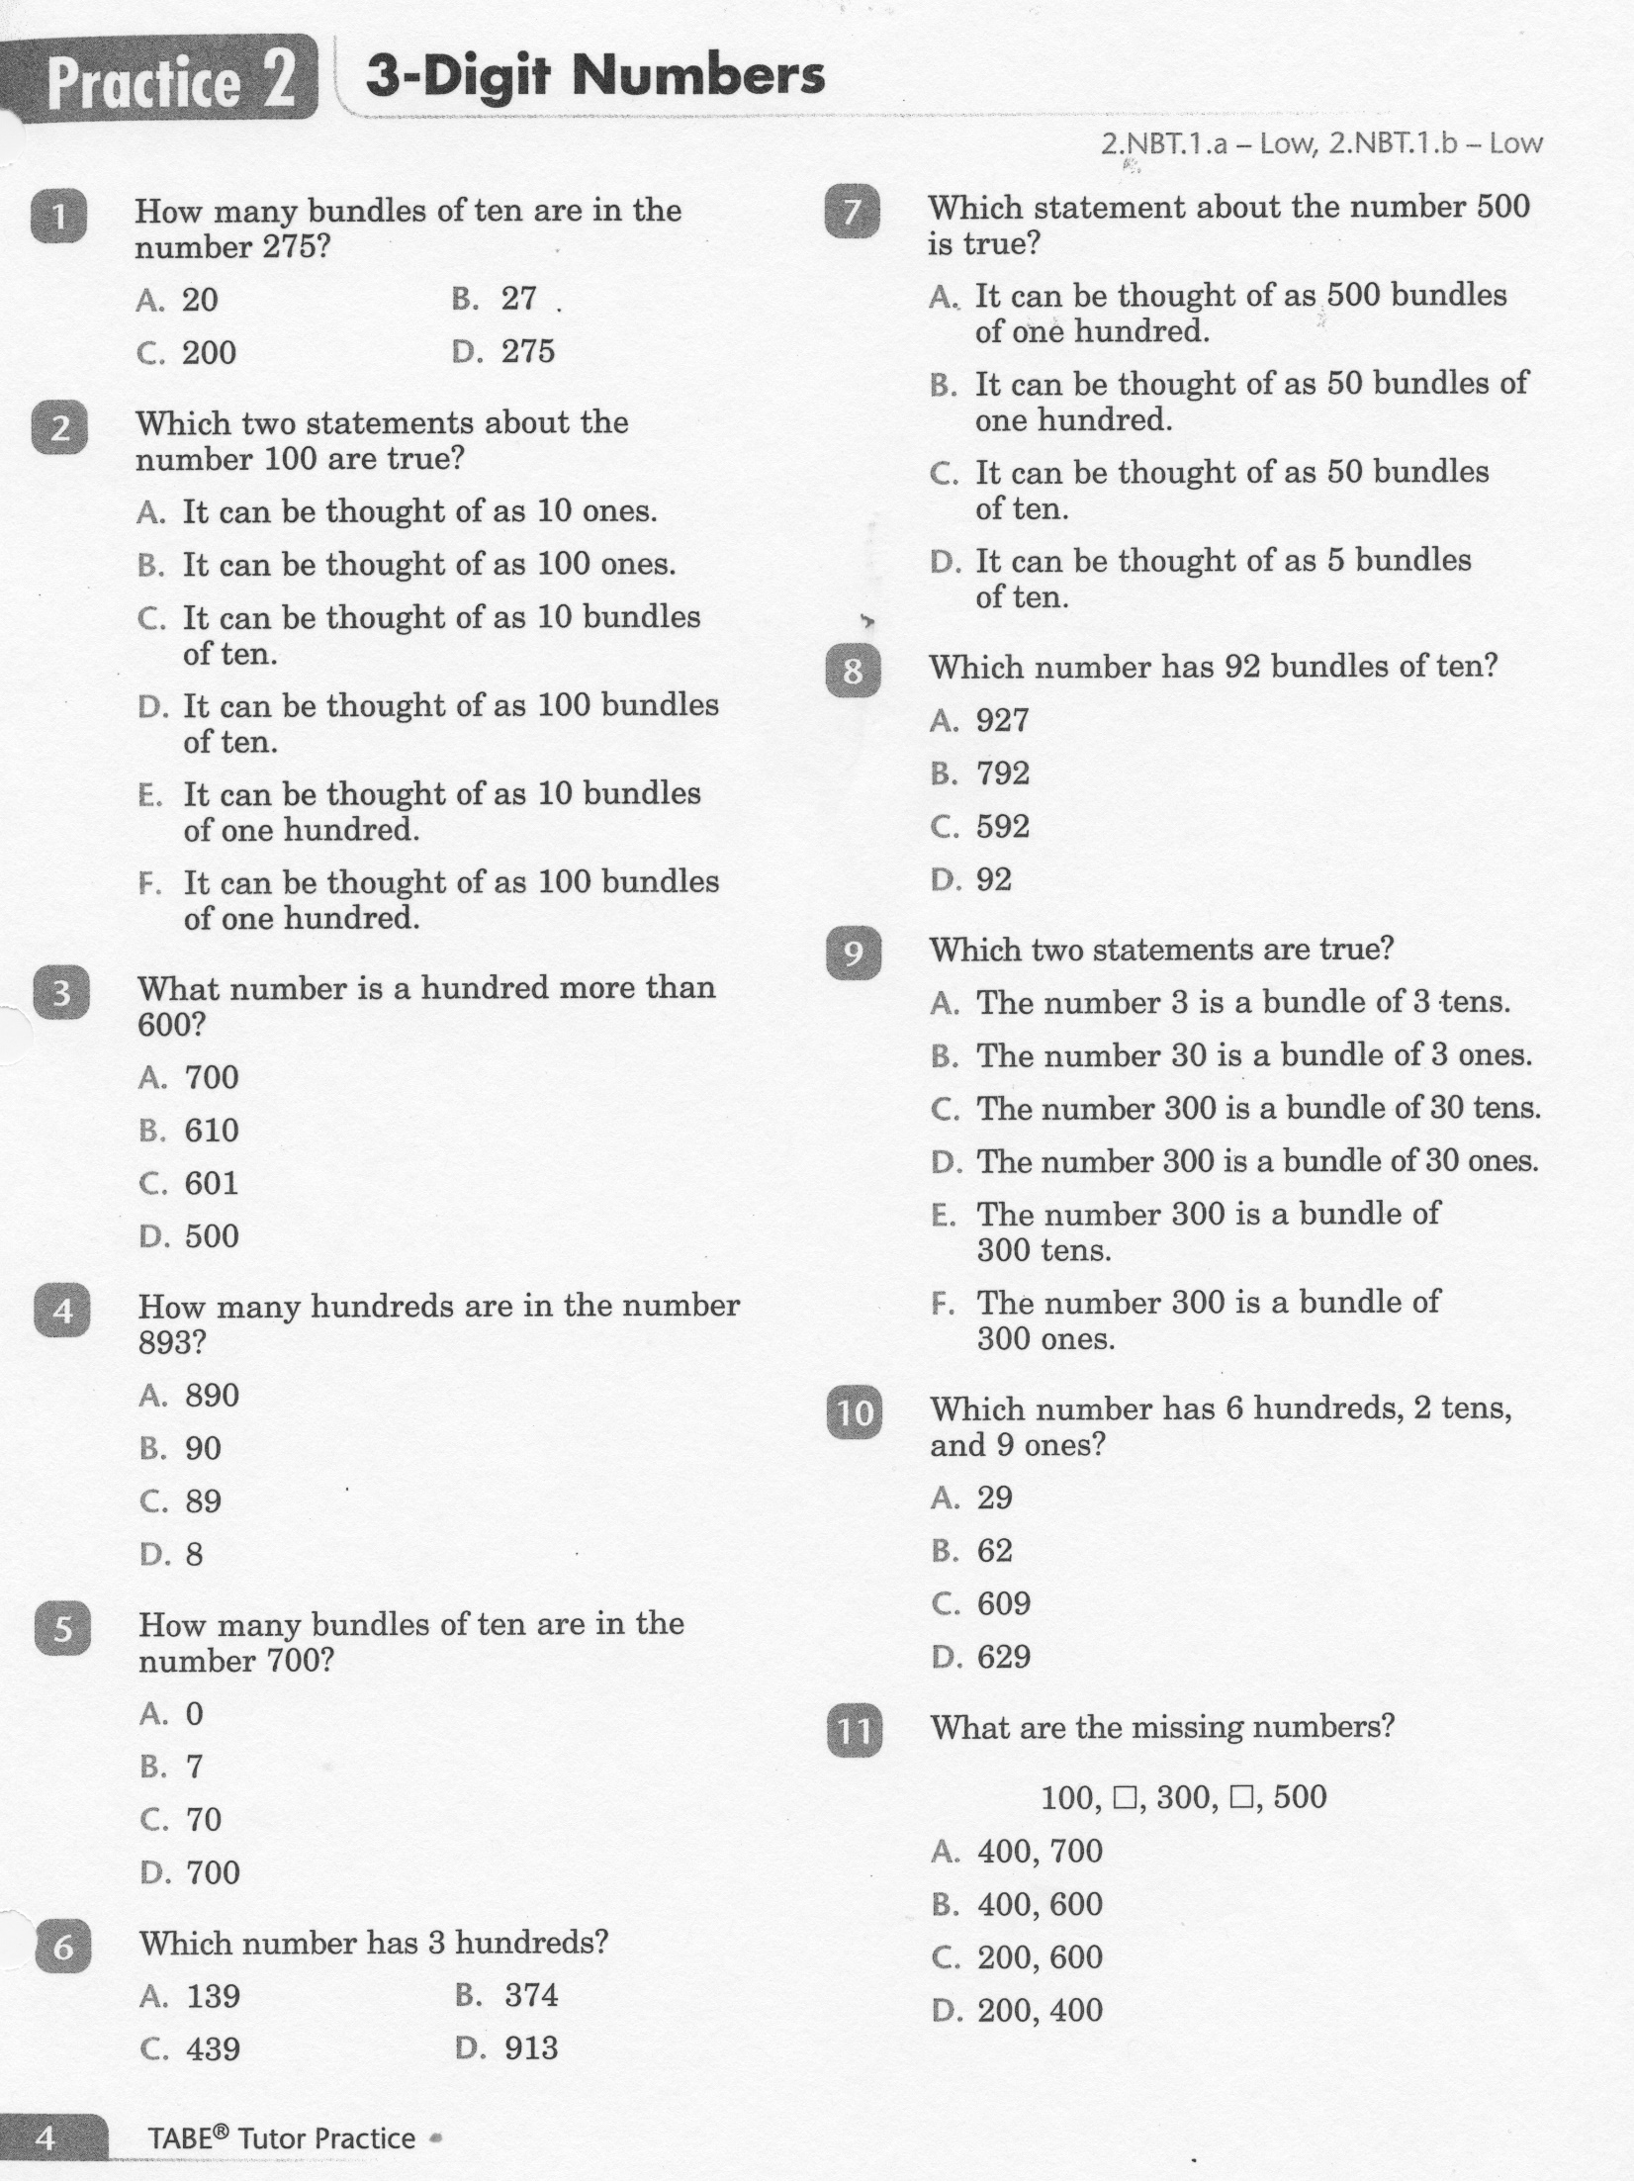
Math-E - Practice-02 – 3 Digit Numbers

Slide 6
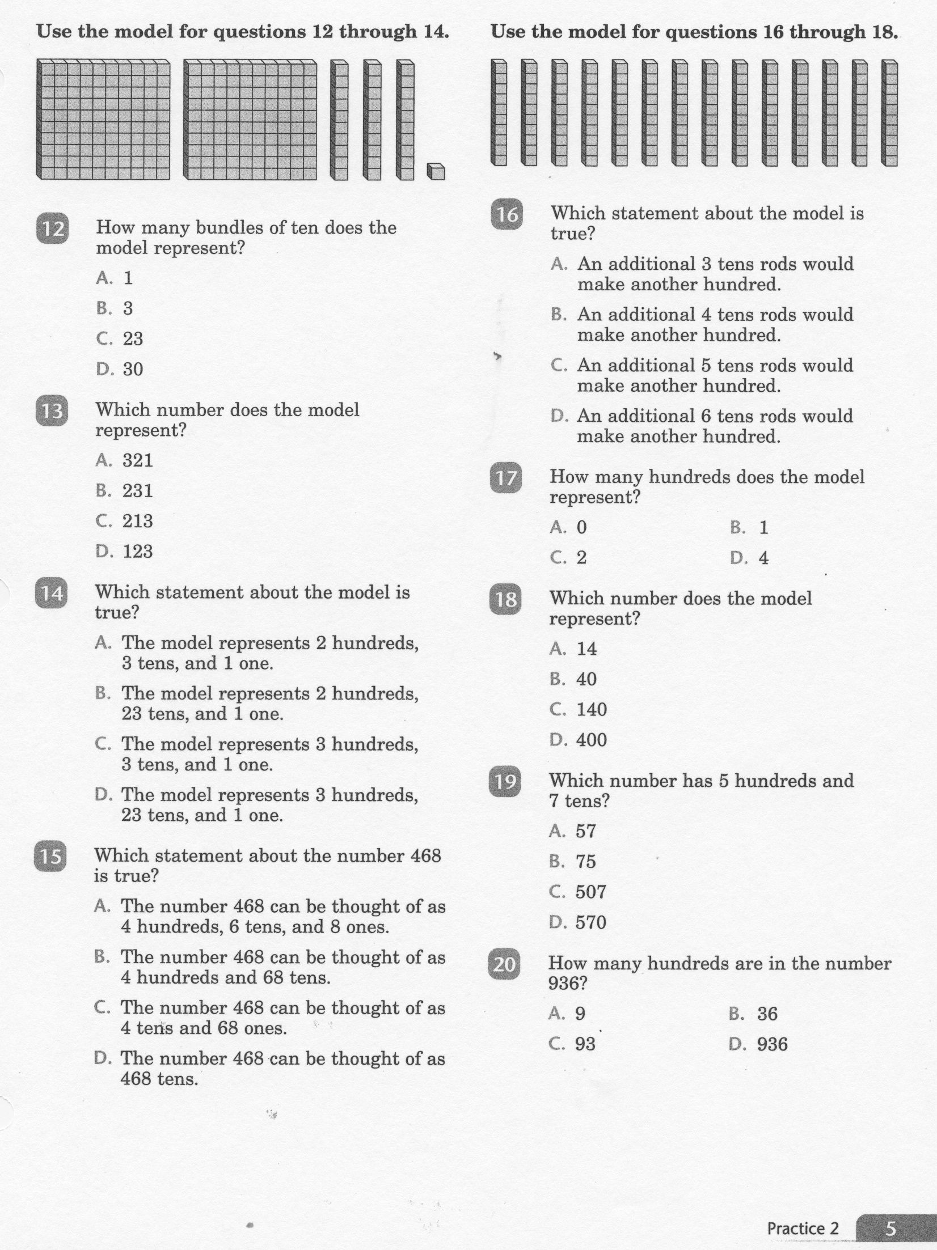
Math-E - Practice-02 – 3 Digit Numbers

Slide 7
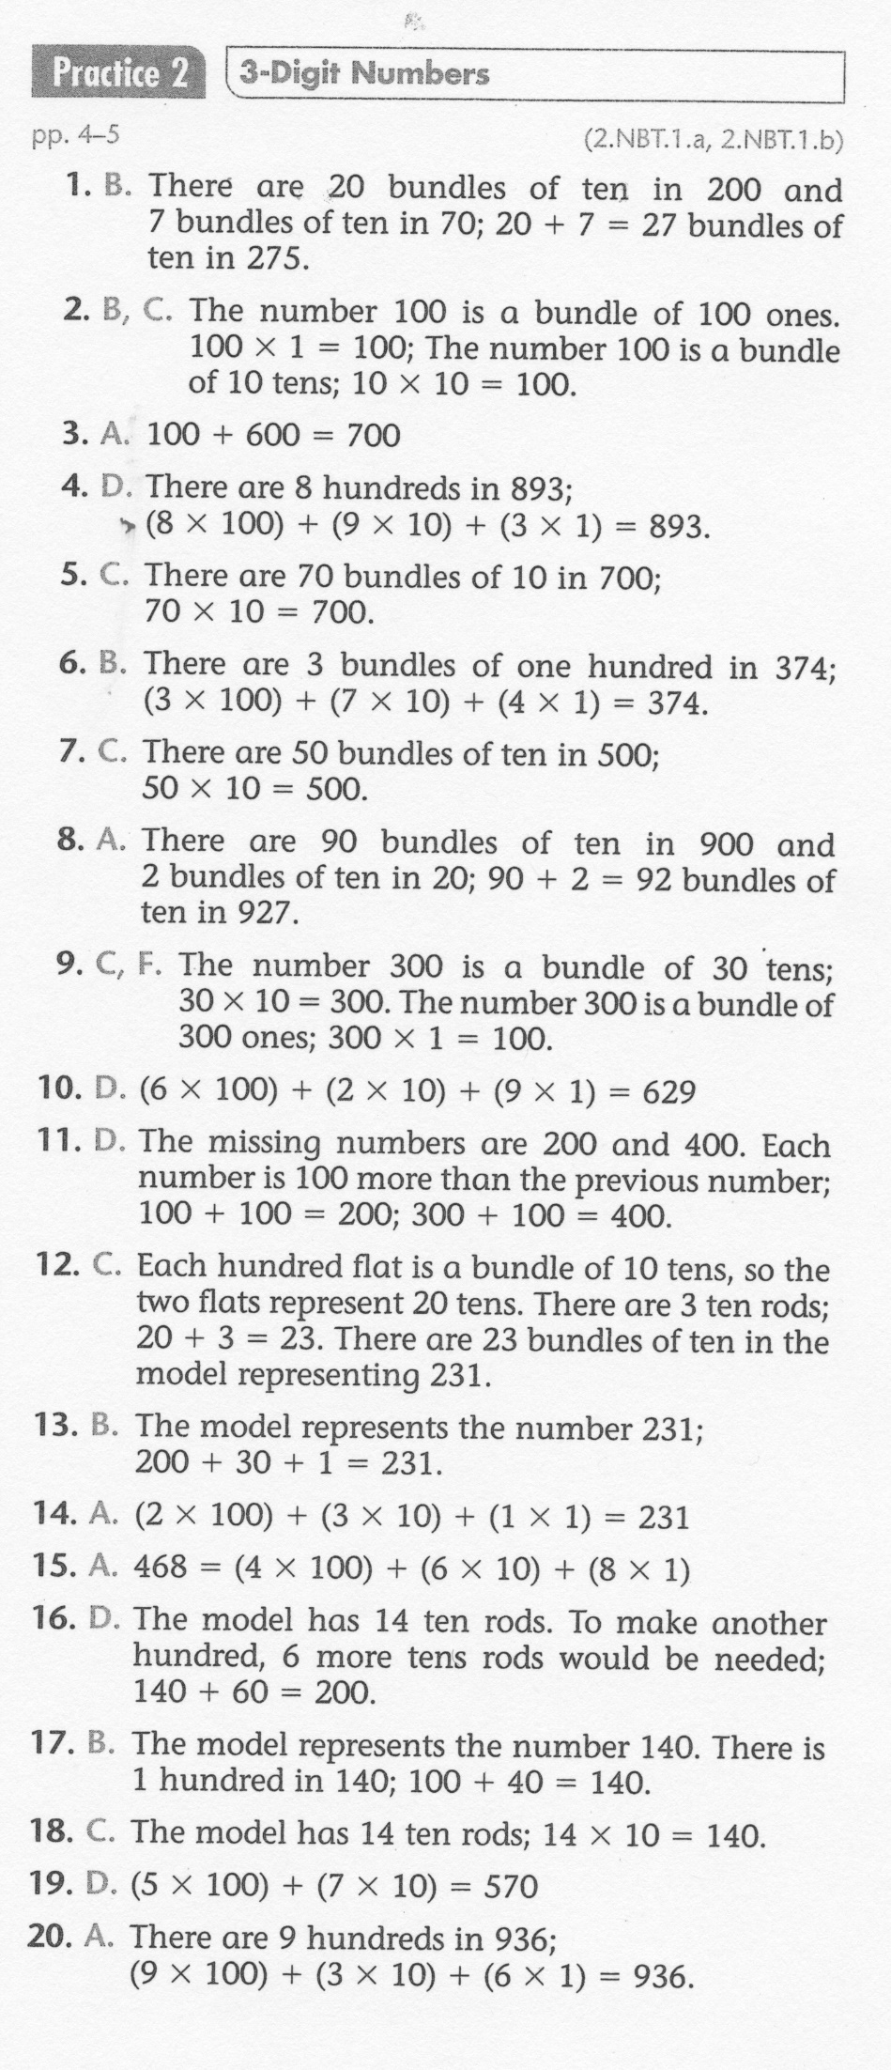
Math-E - Practice-02 – 3 Digit Numbers

