Slide 1
TABE MATH - D
Unit - 1
Lesson - 6
Coordinate Plane
X – Y Axis
Revised: March 10, 2024
Nolan Tomboulian

Slide 3
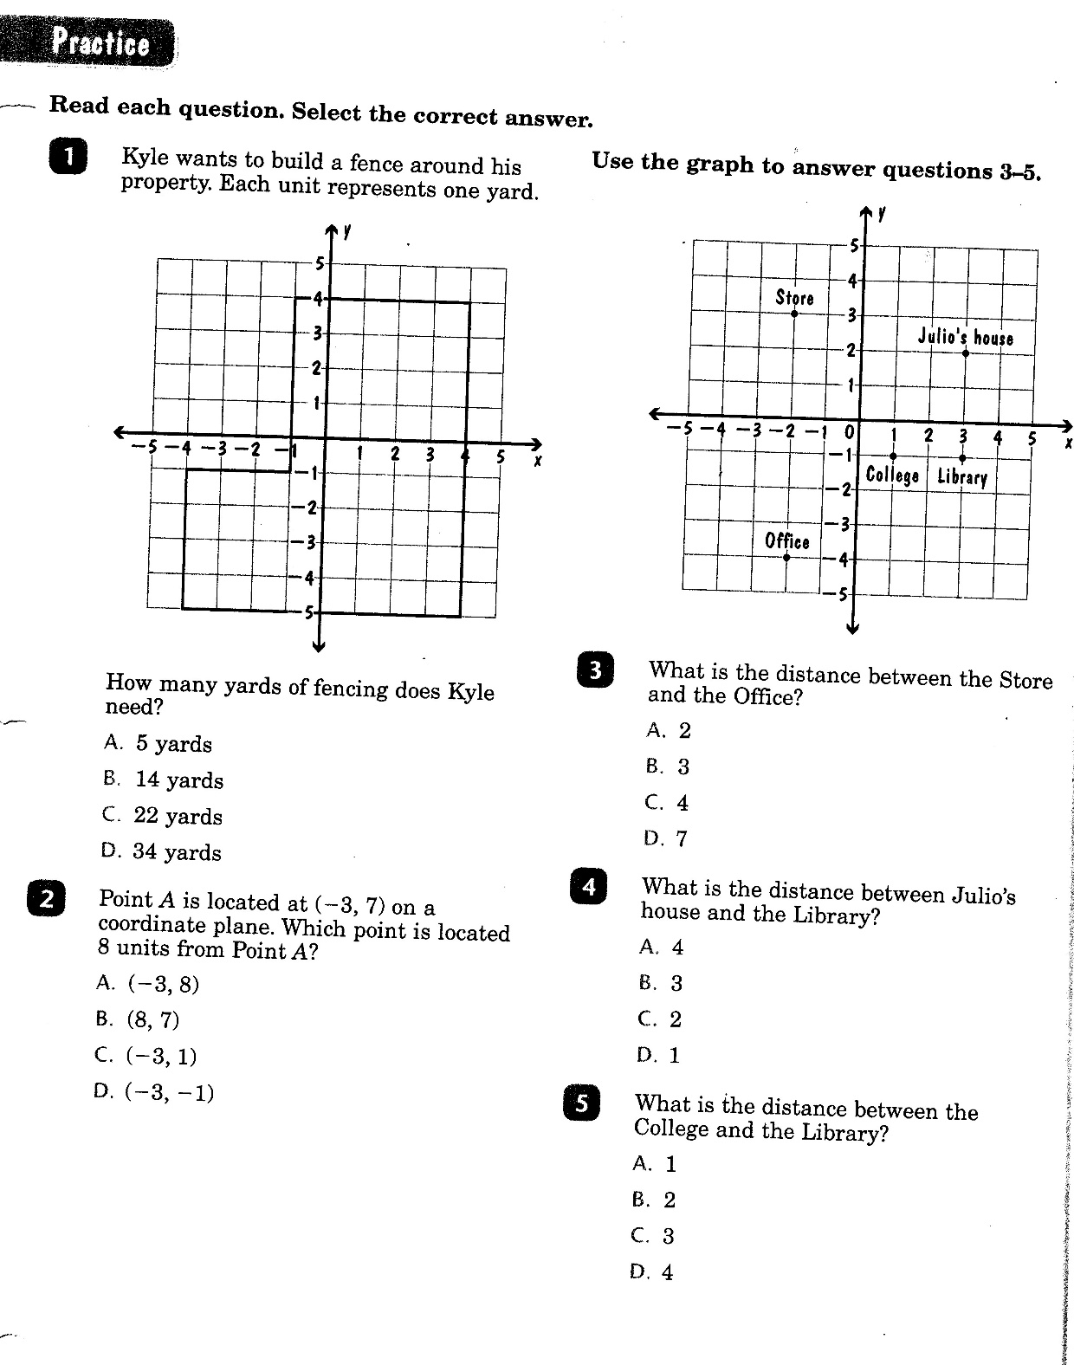

Slide 4
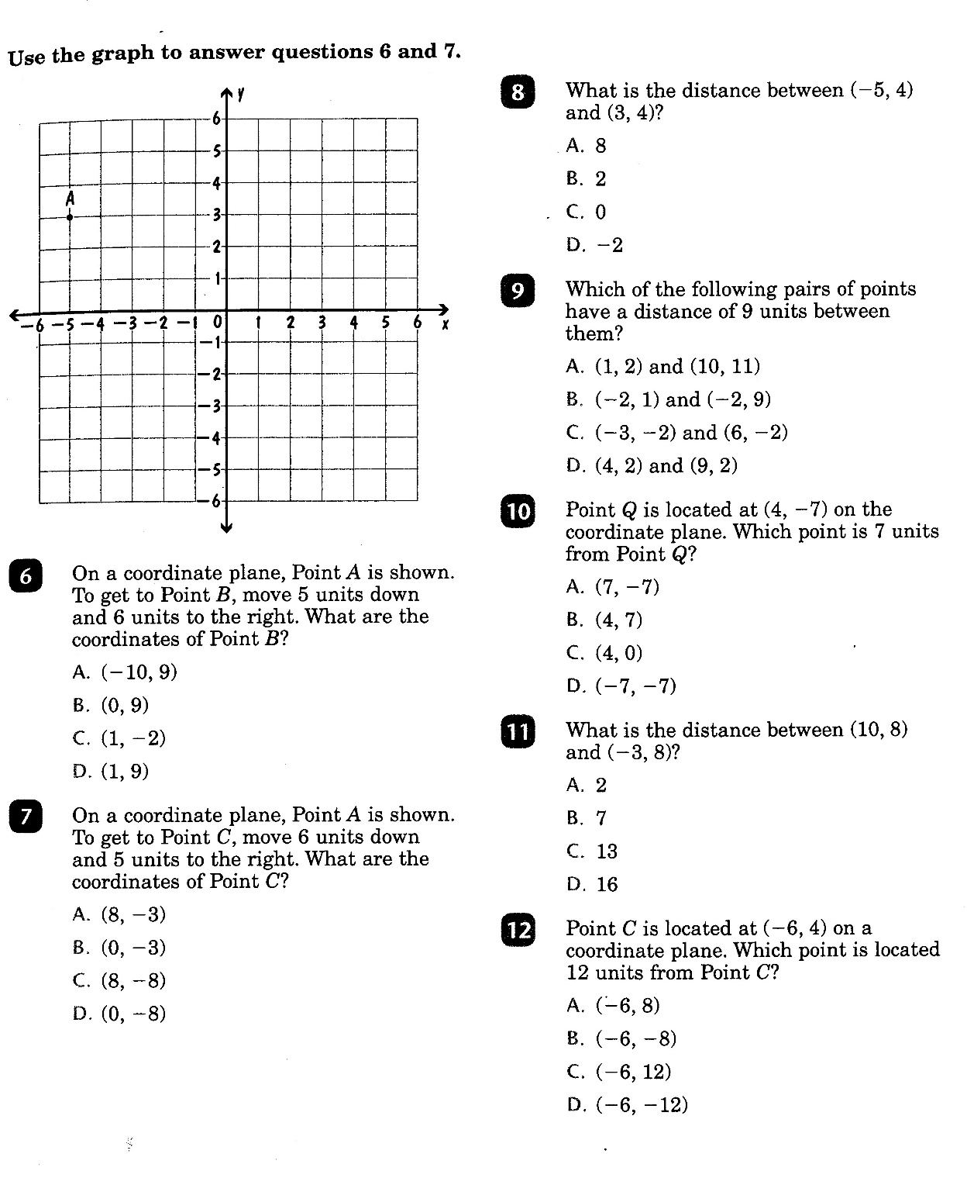

Slide 5
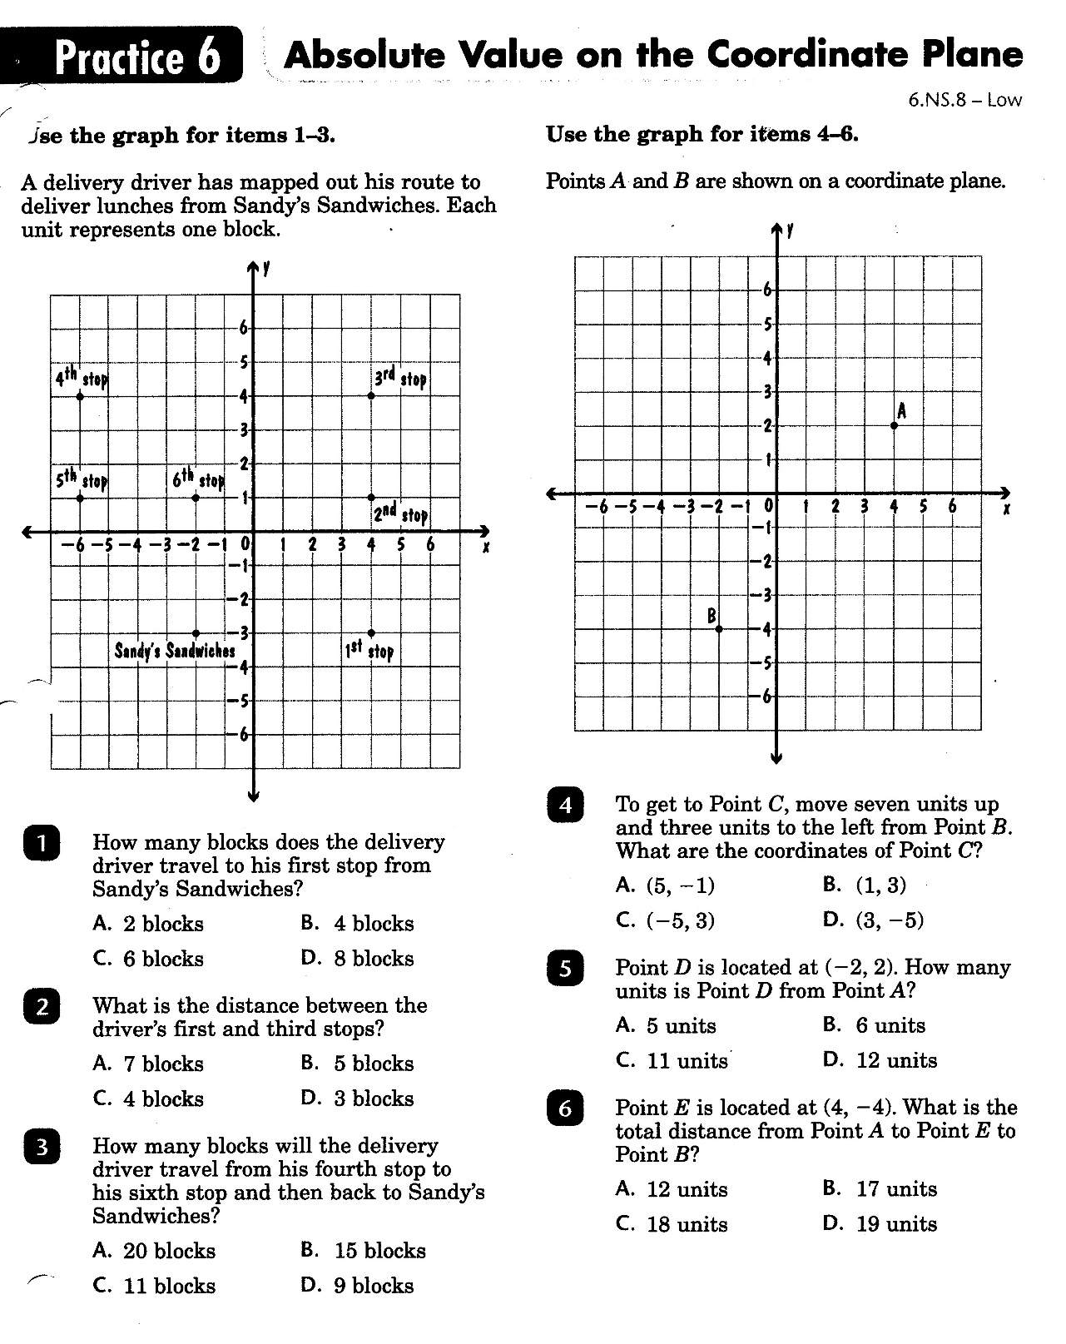

Slide 6
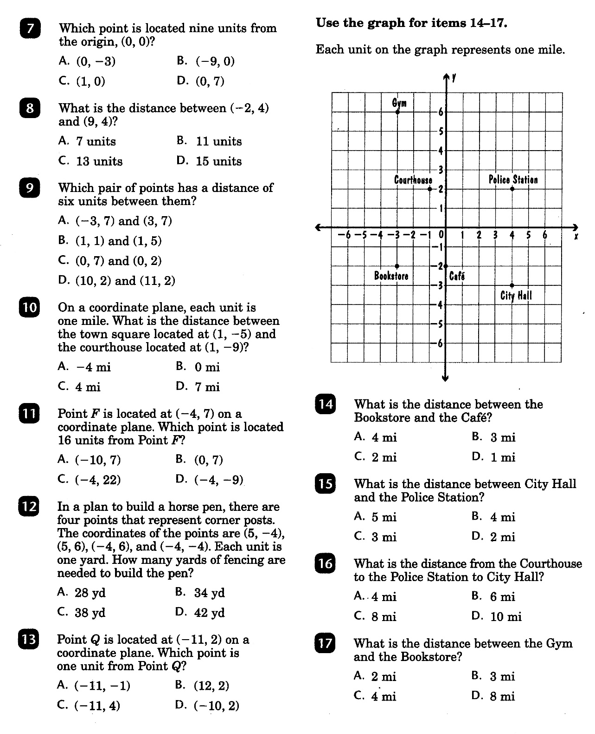

Slide 7
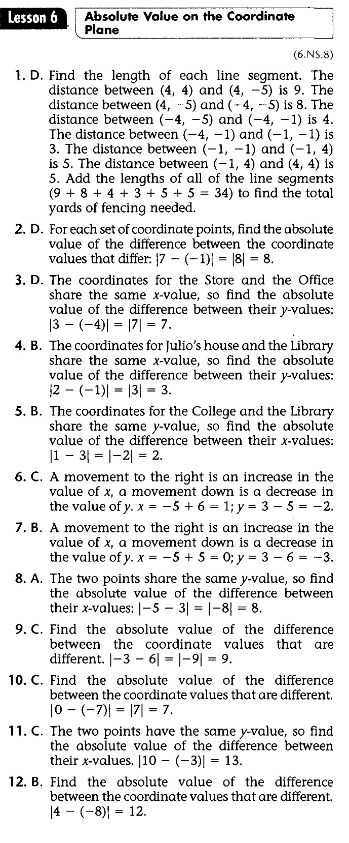
Math-D Lesson-6 Key

Slide 8
Math-D Practice-6 Key

