Slide 1
TABE ELA-E PAXEN Unit-3 SENTENCES REVIEW
Some graphics may not have copied well during the Scan Process

Slide 2
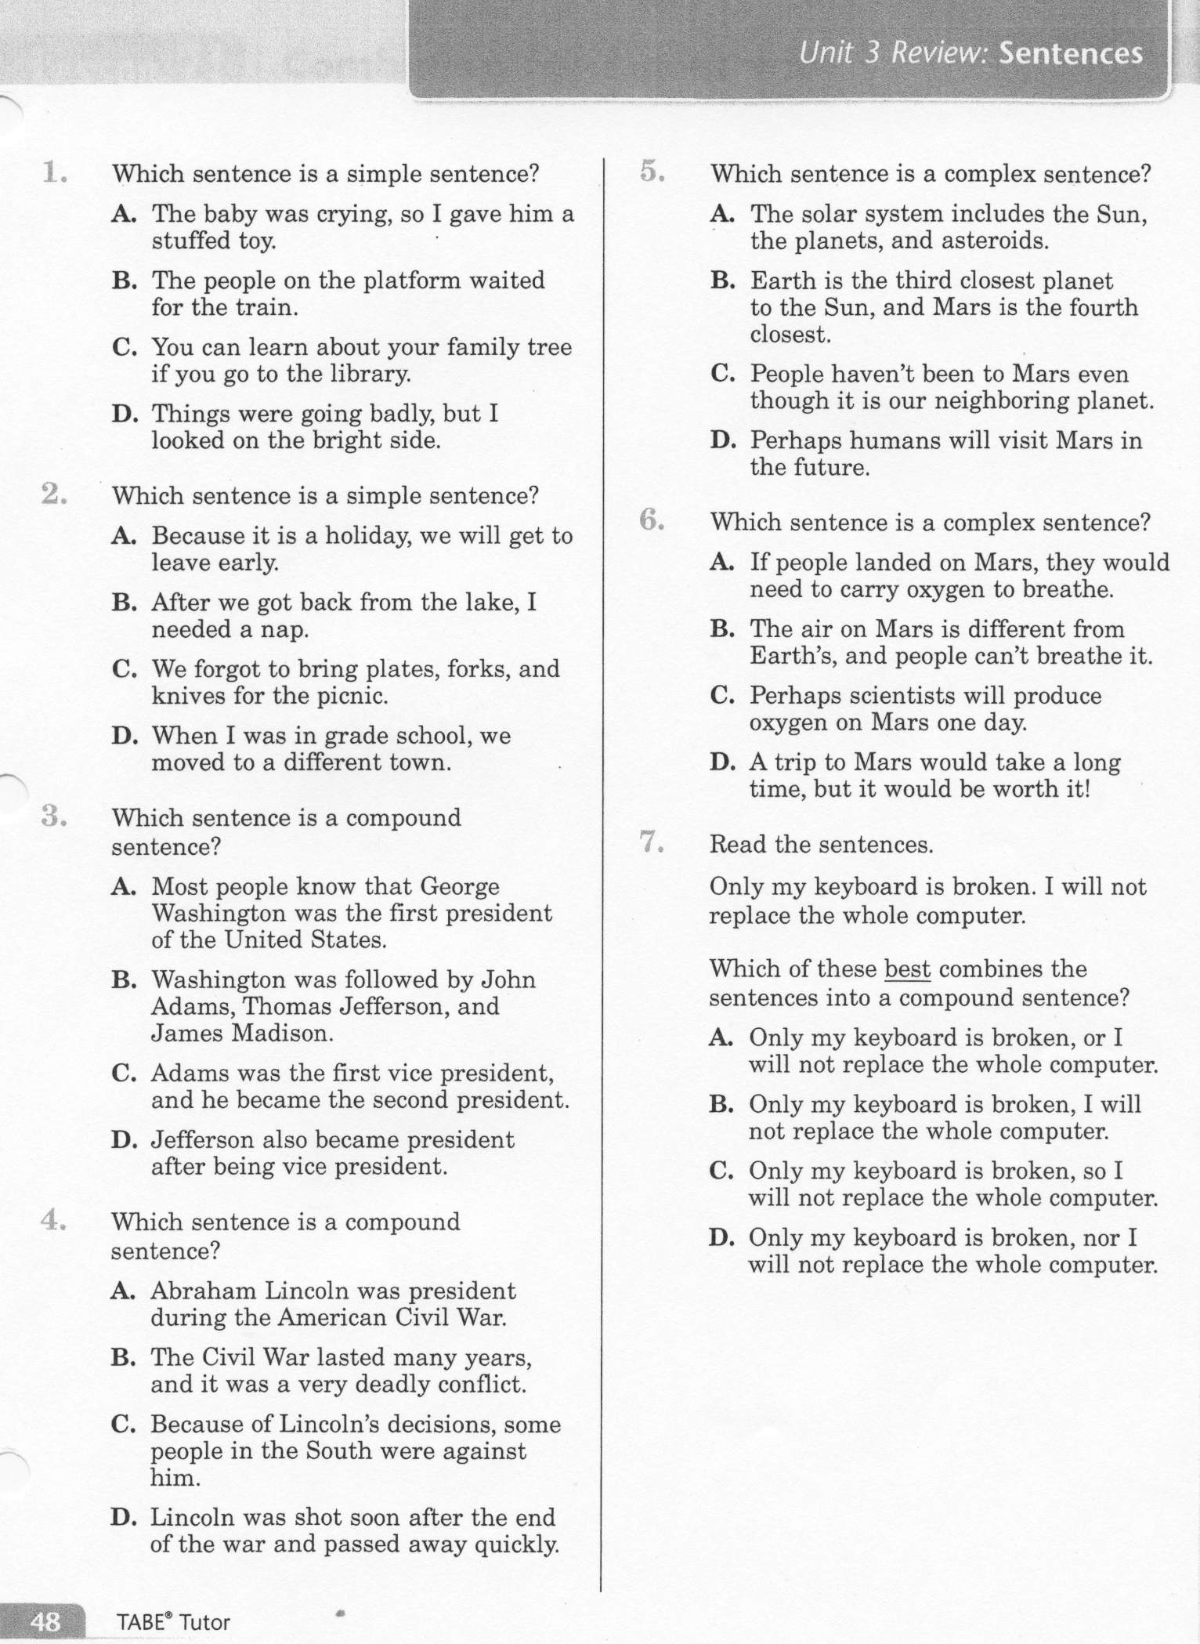
ELA-E Unit-3 Review Sentences

Slide 3
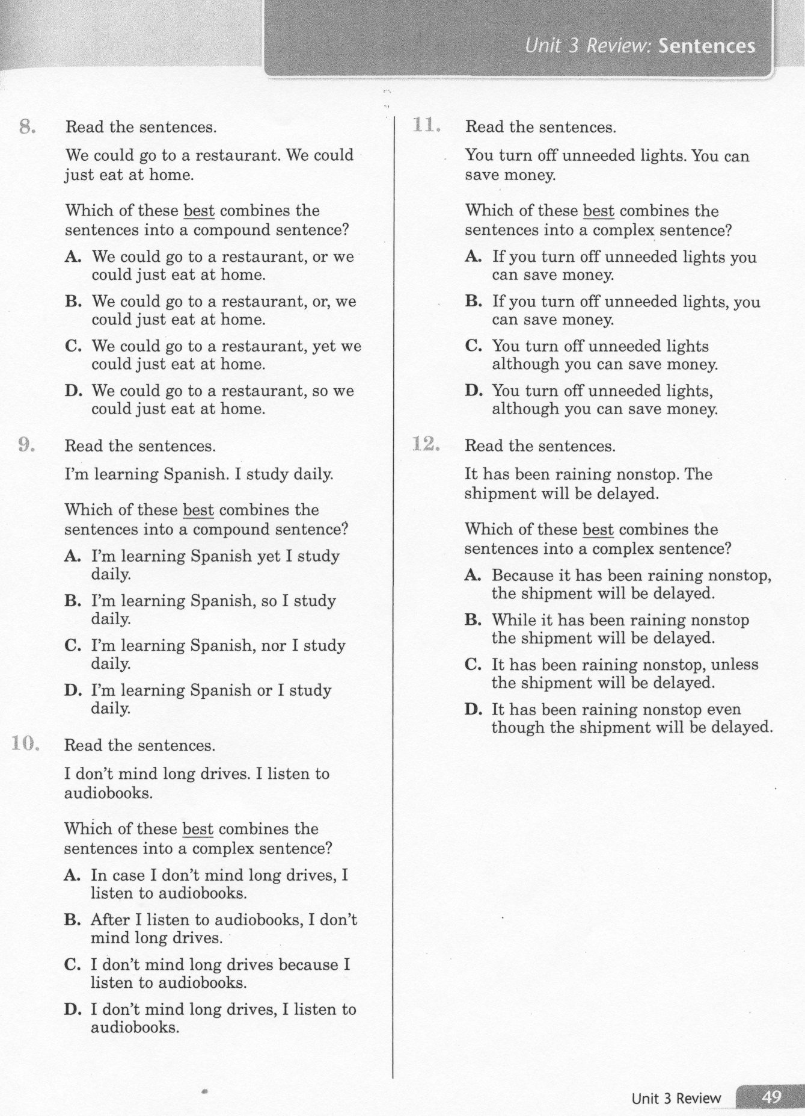
ELA-E Unit-3 Review Sentences

Slide 4
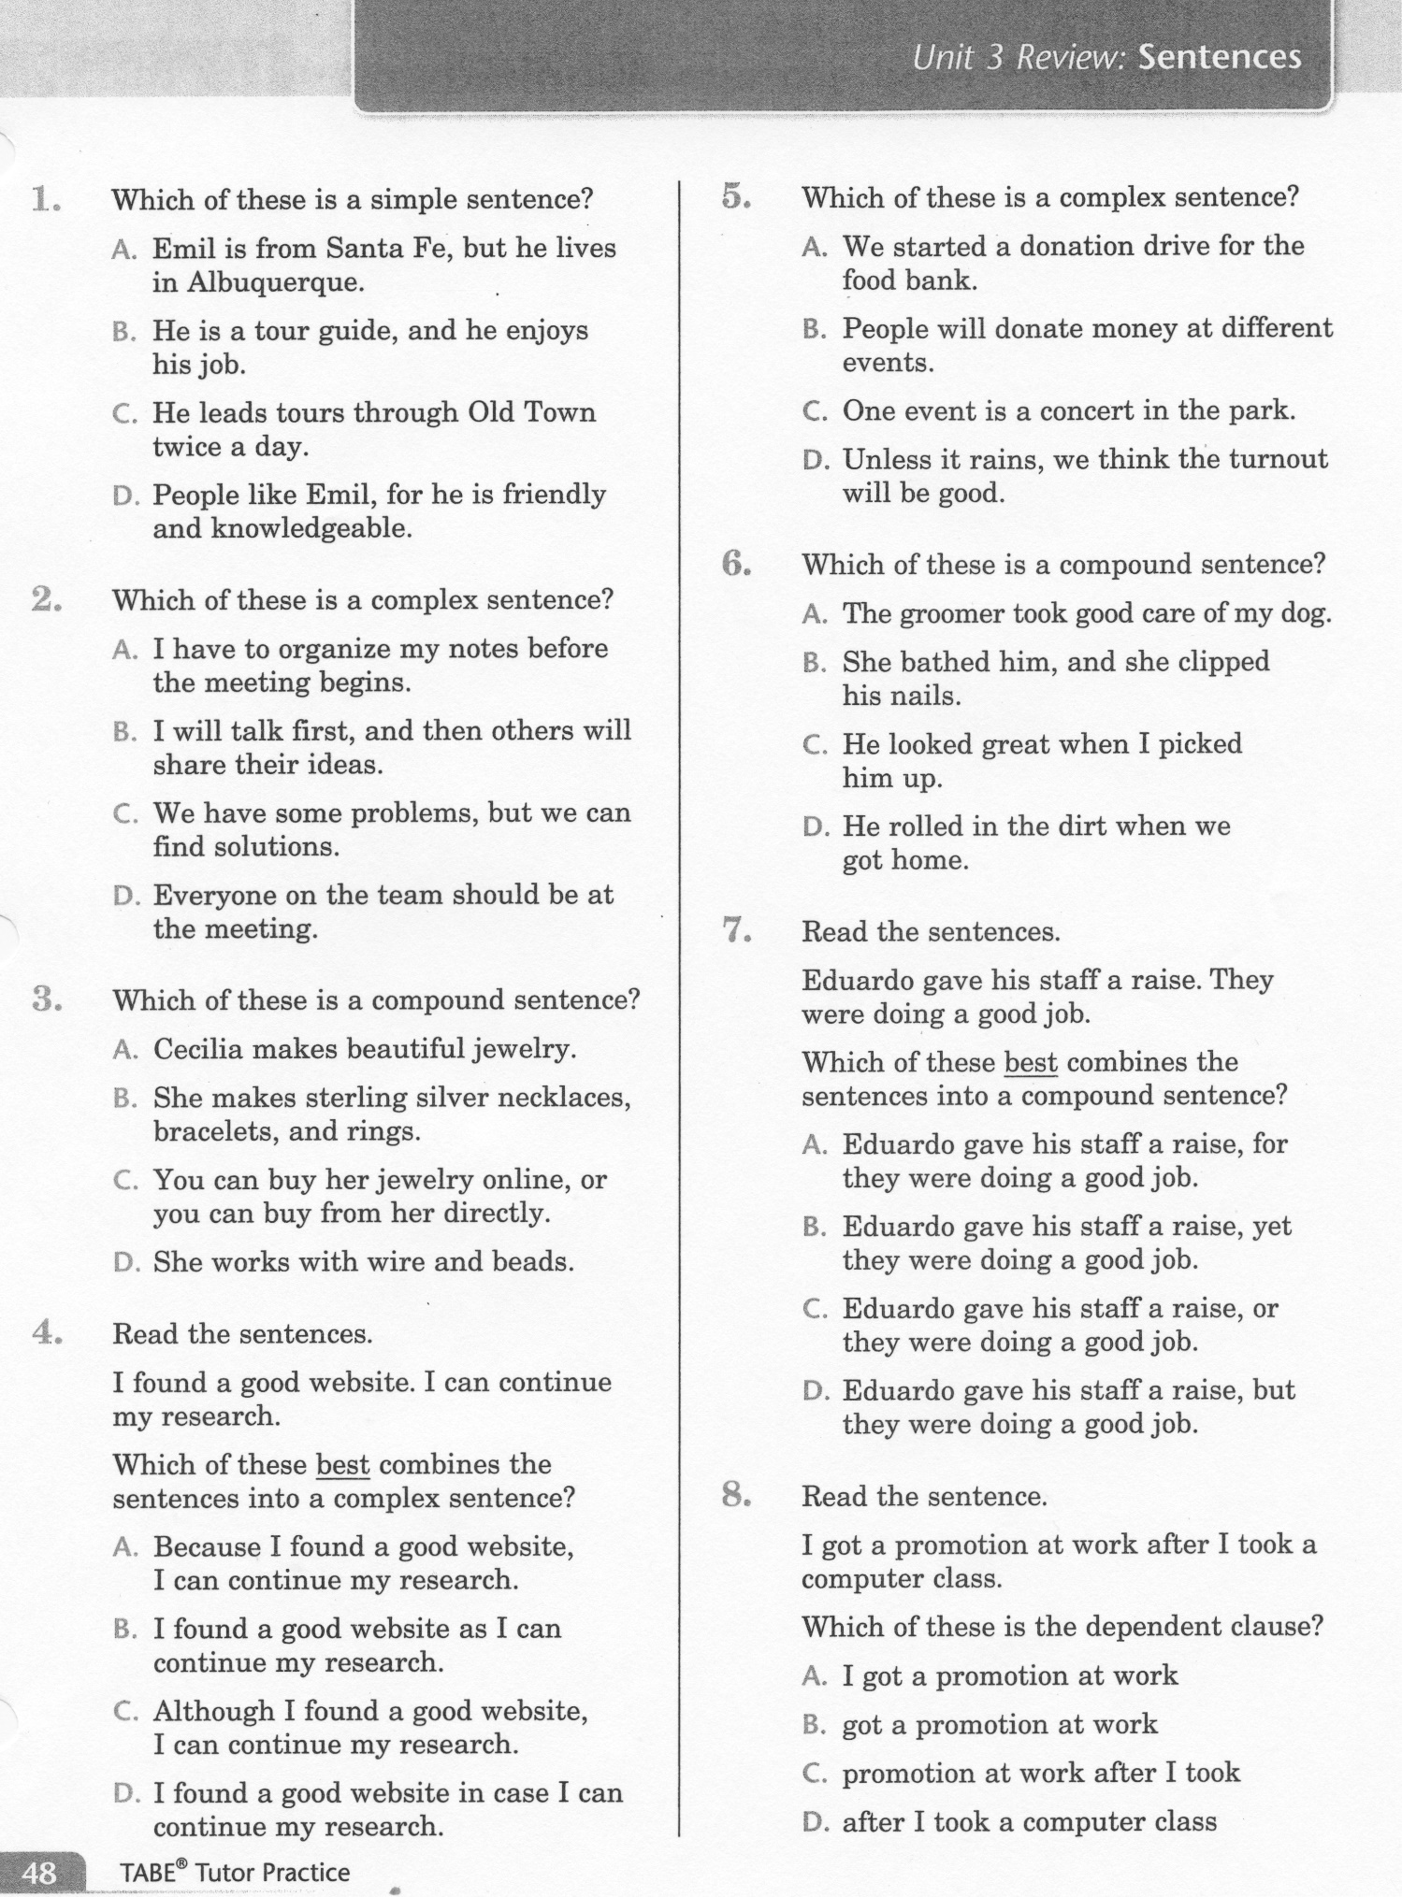
ELA-E Unit-3 Review Sentences

Slide 5
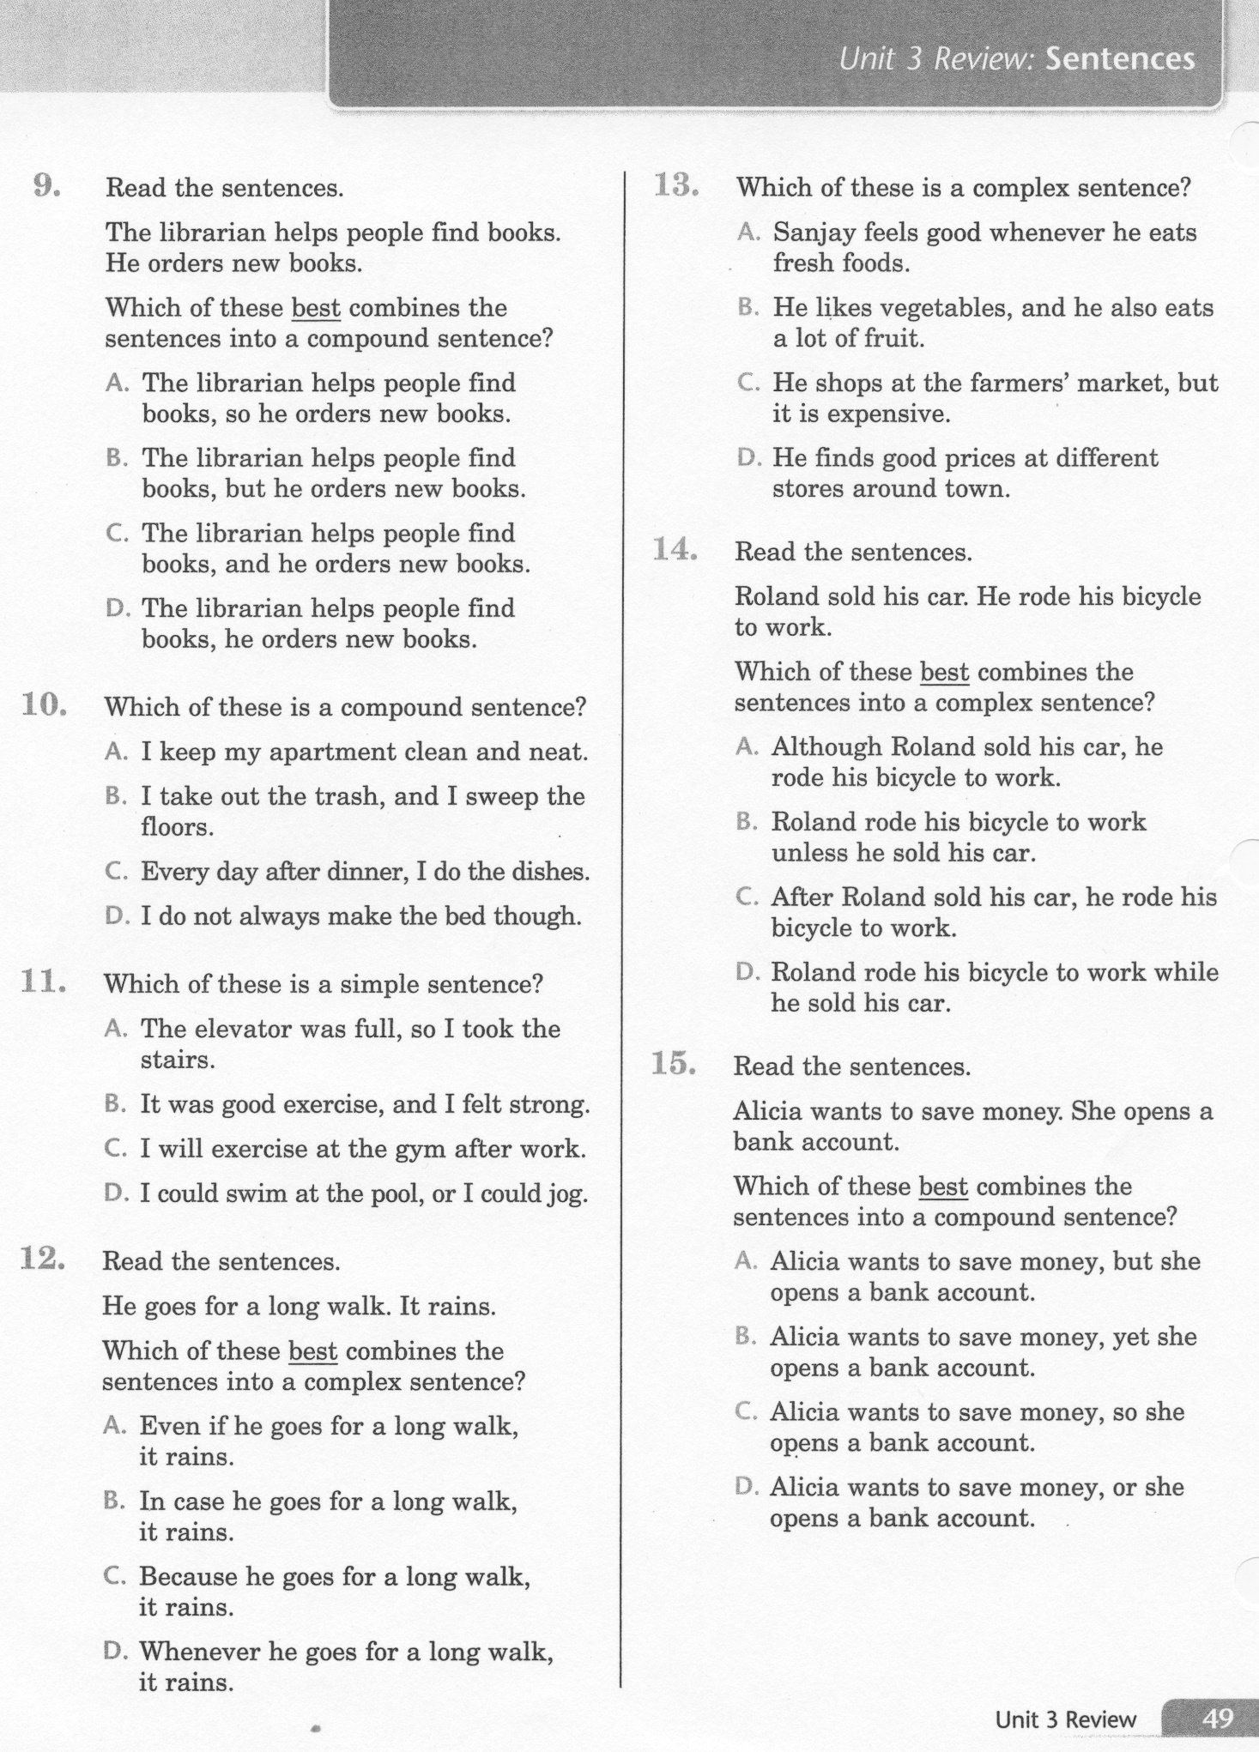
ELA-E Unit-3 Review Sentences

Slide 6
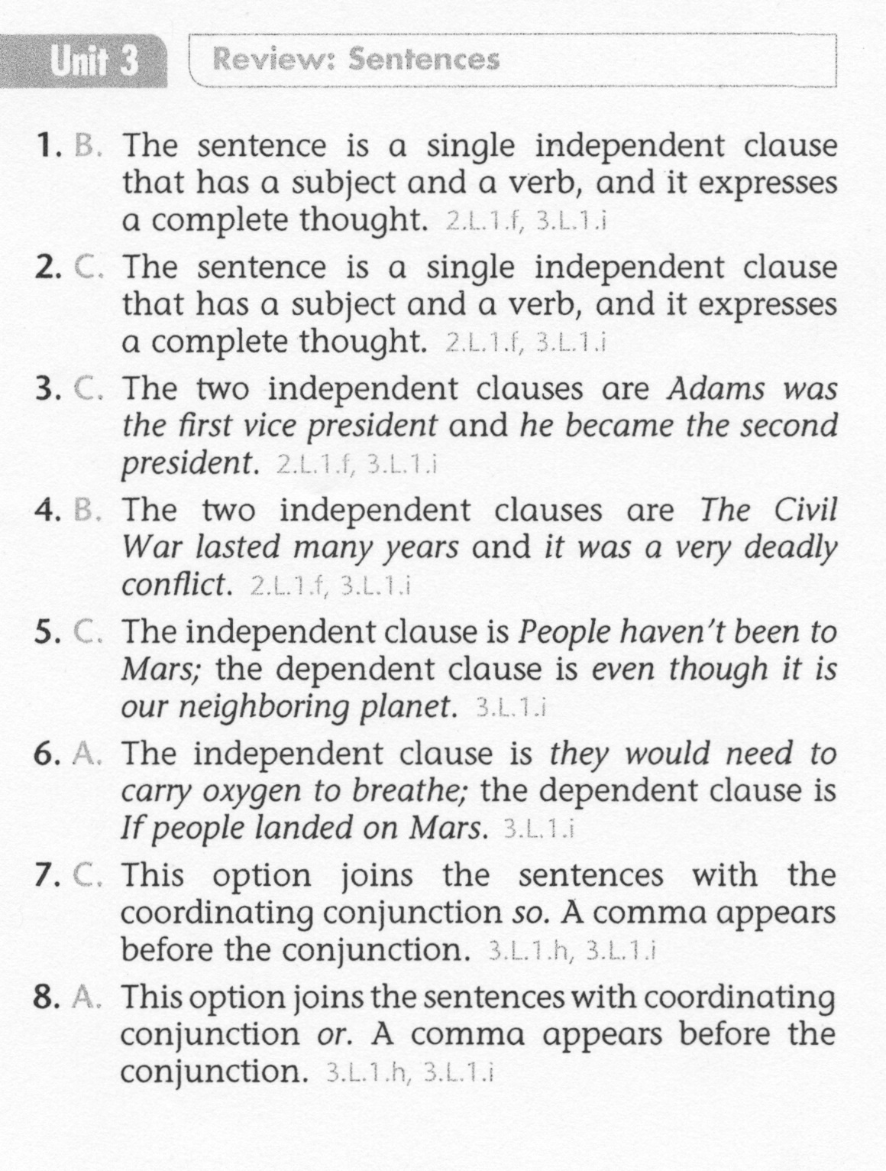
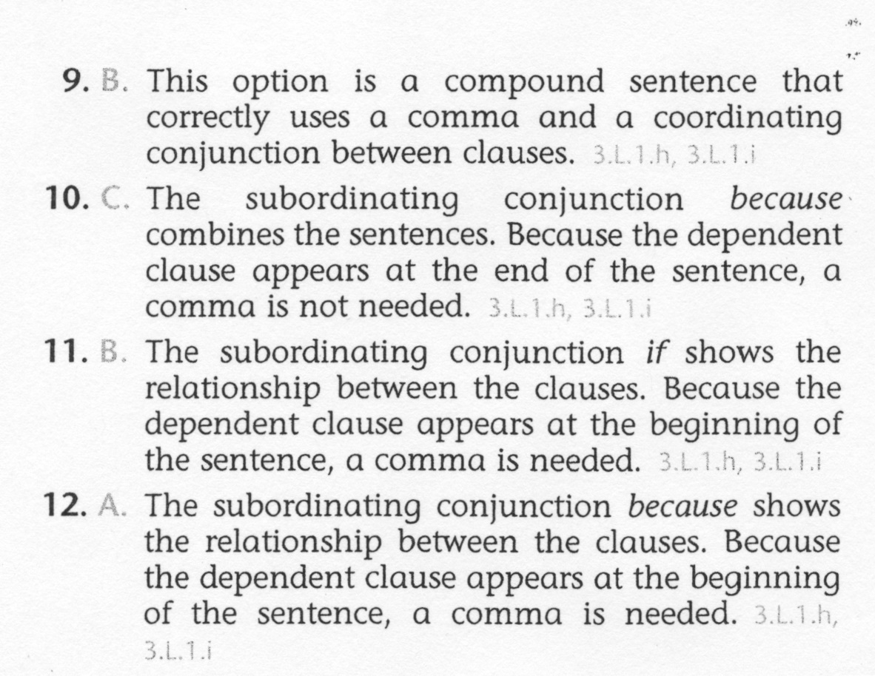
ELA-E Unit-3 Review Sentences

Slide 7
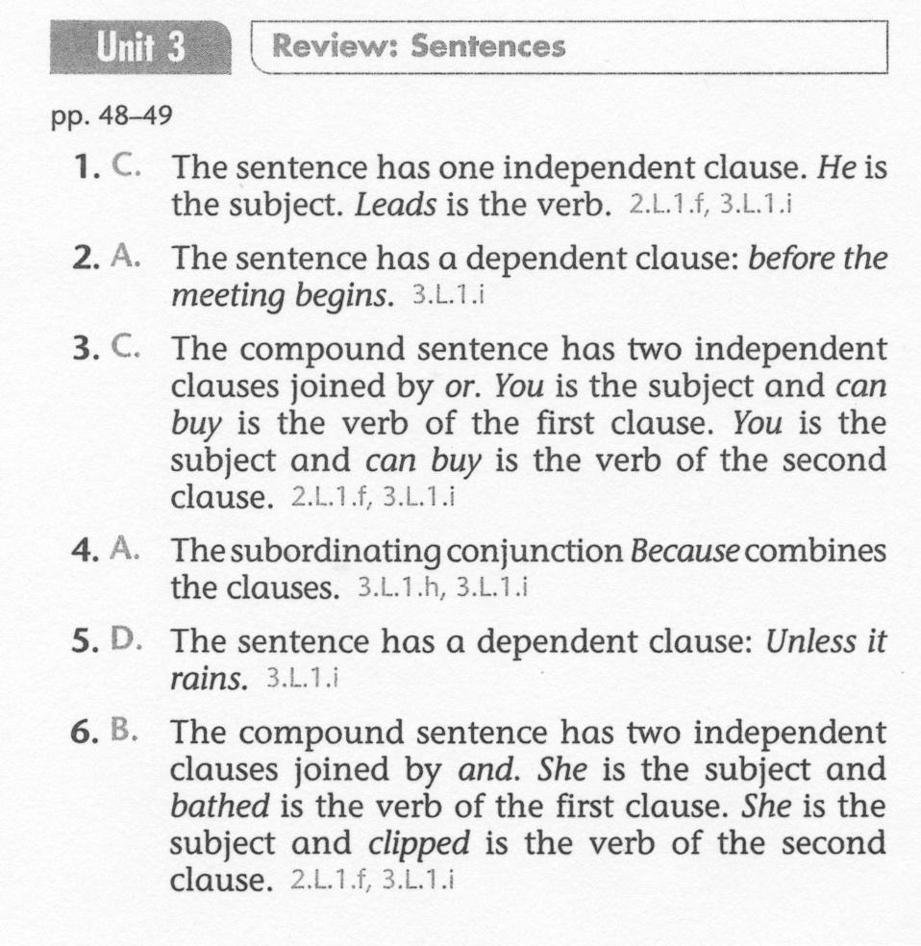
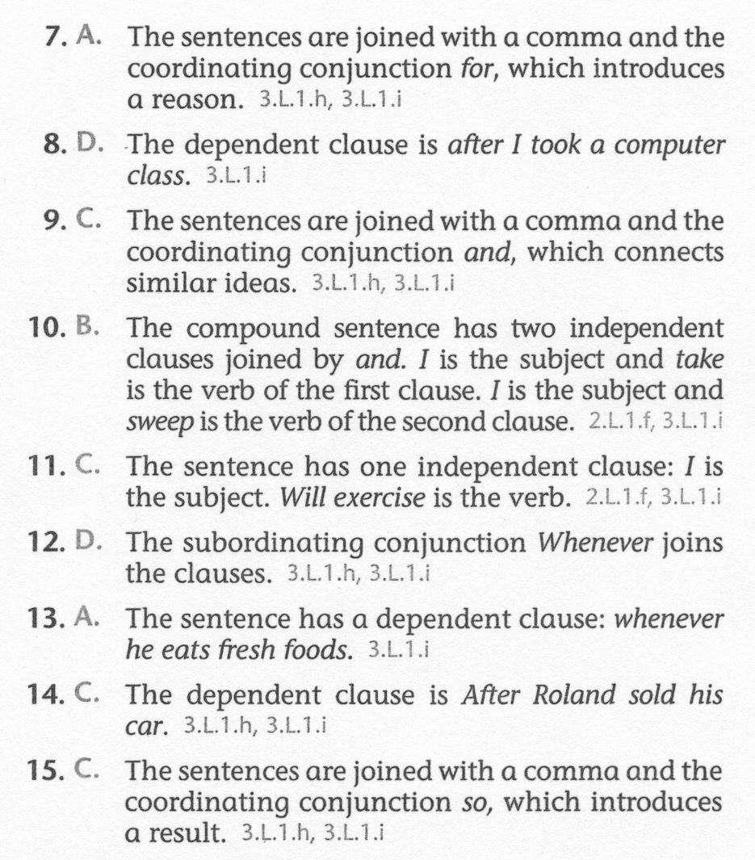
ELA-E Unit-3 Review Sentences

