Slide 1
TABE ELA-E PAXEN Unit-1 Usage REVIEW
Some graphics may not have copied well during the Scan Process

Slide 2
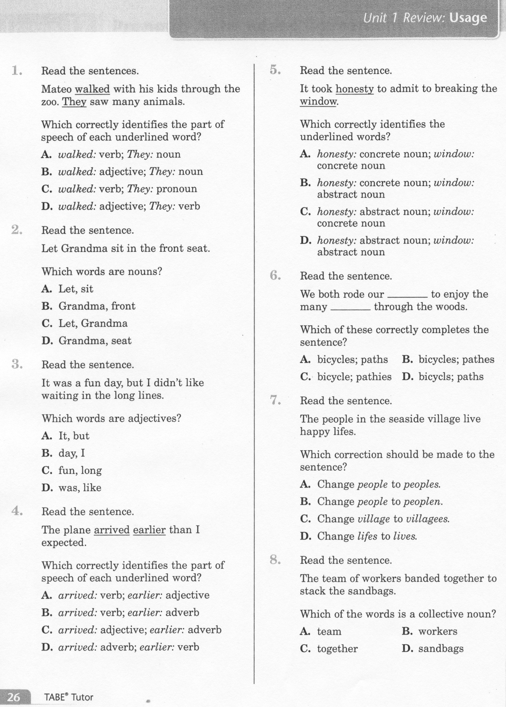
ELA-E-Unit-1 Usage Review

Slide 3
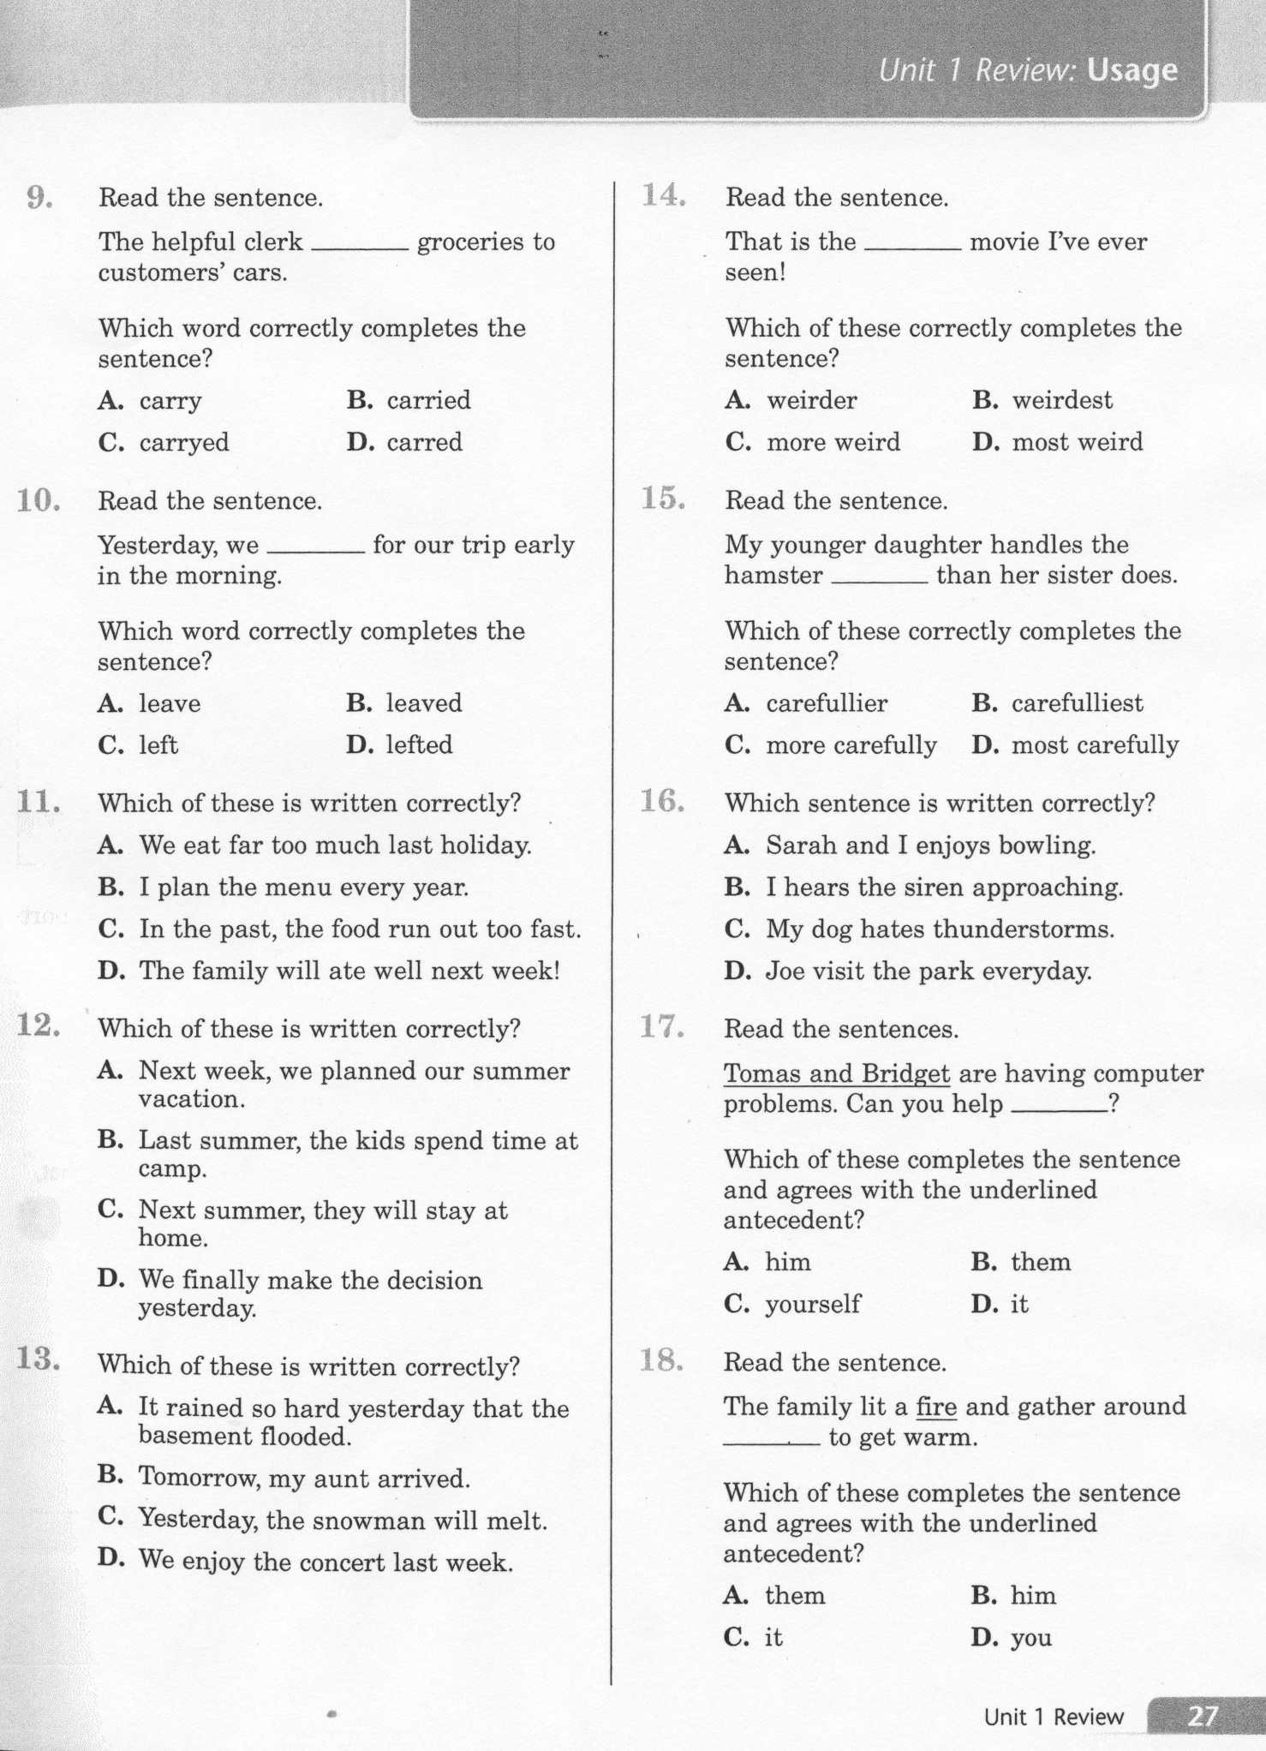
ELA-E-Unit-1 Usage Review

Slide 4
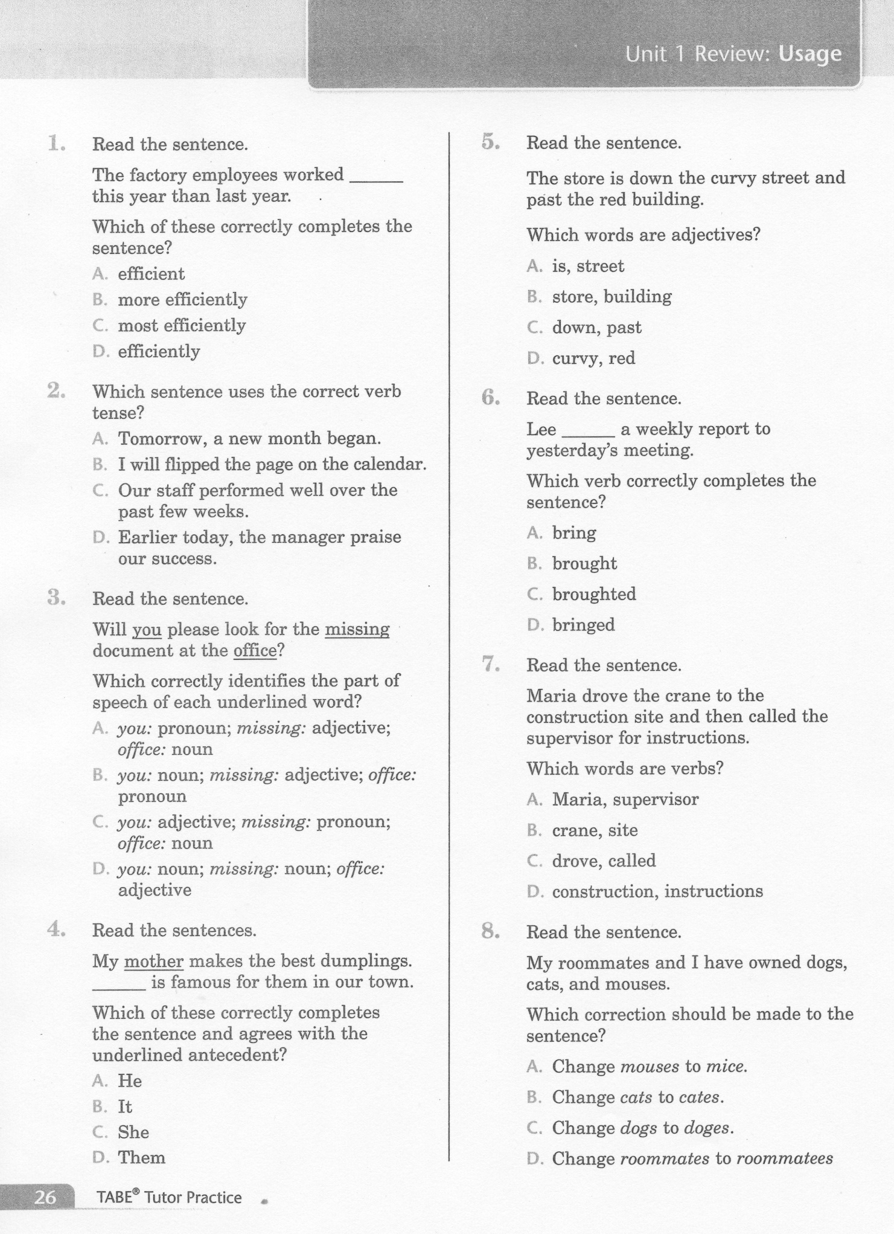
ELA-E-Unit-1 Usage Review - Practice

Slide 5
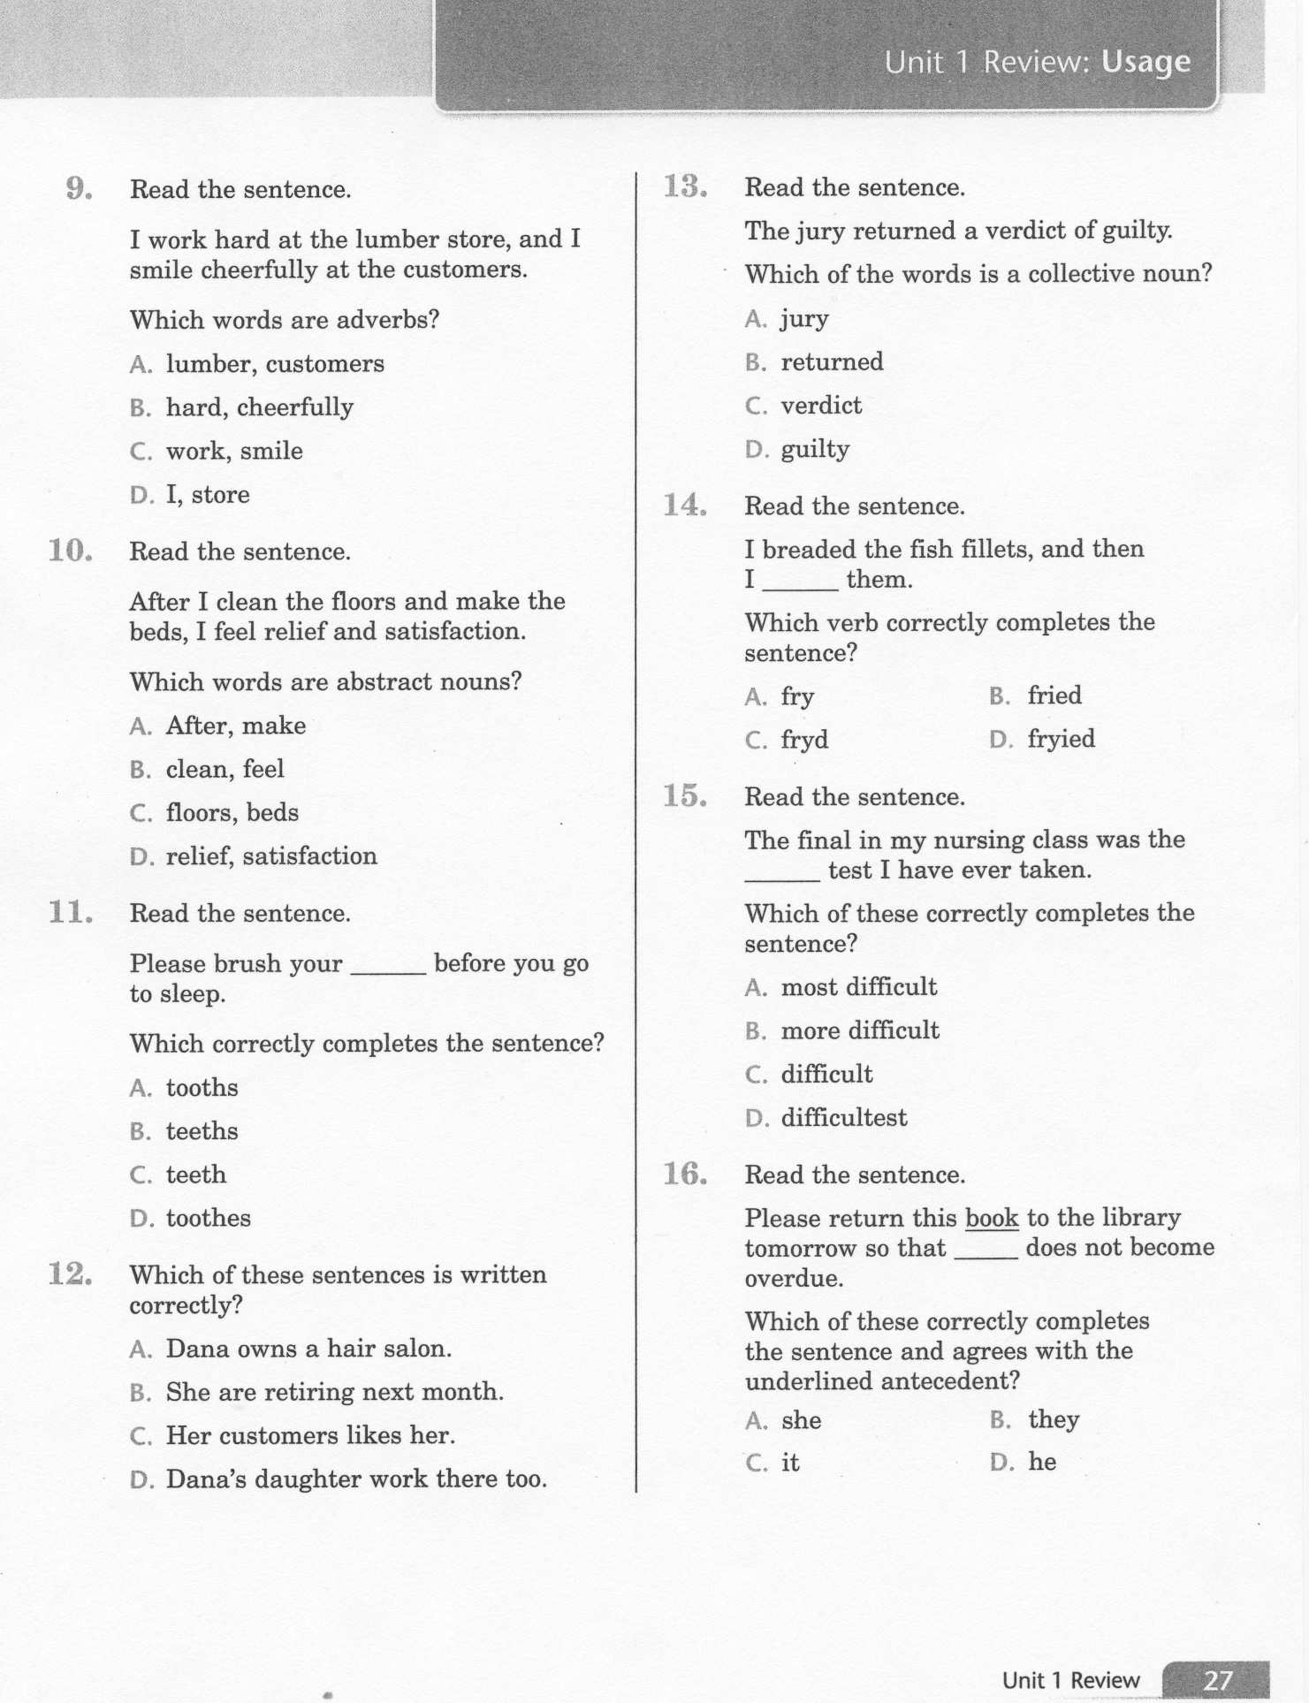
ELA-E-Unit-1 Usage Review Practice

Slide 6
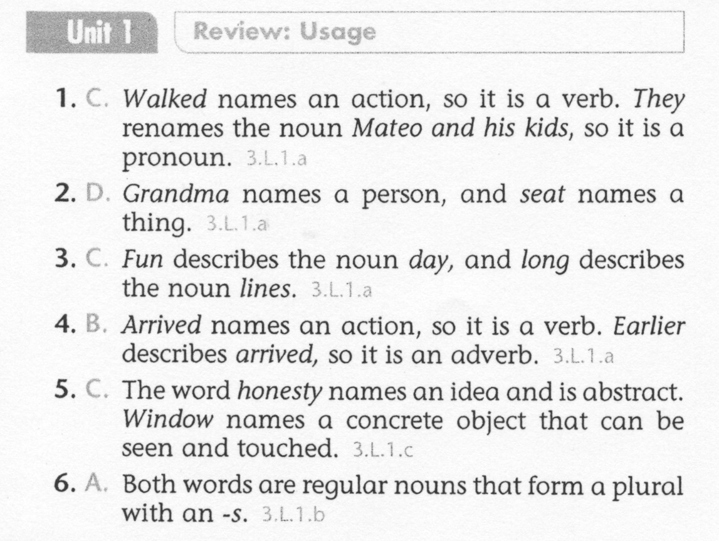
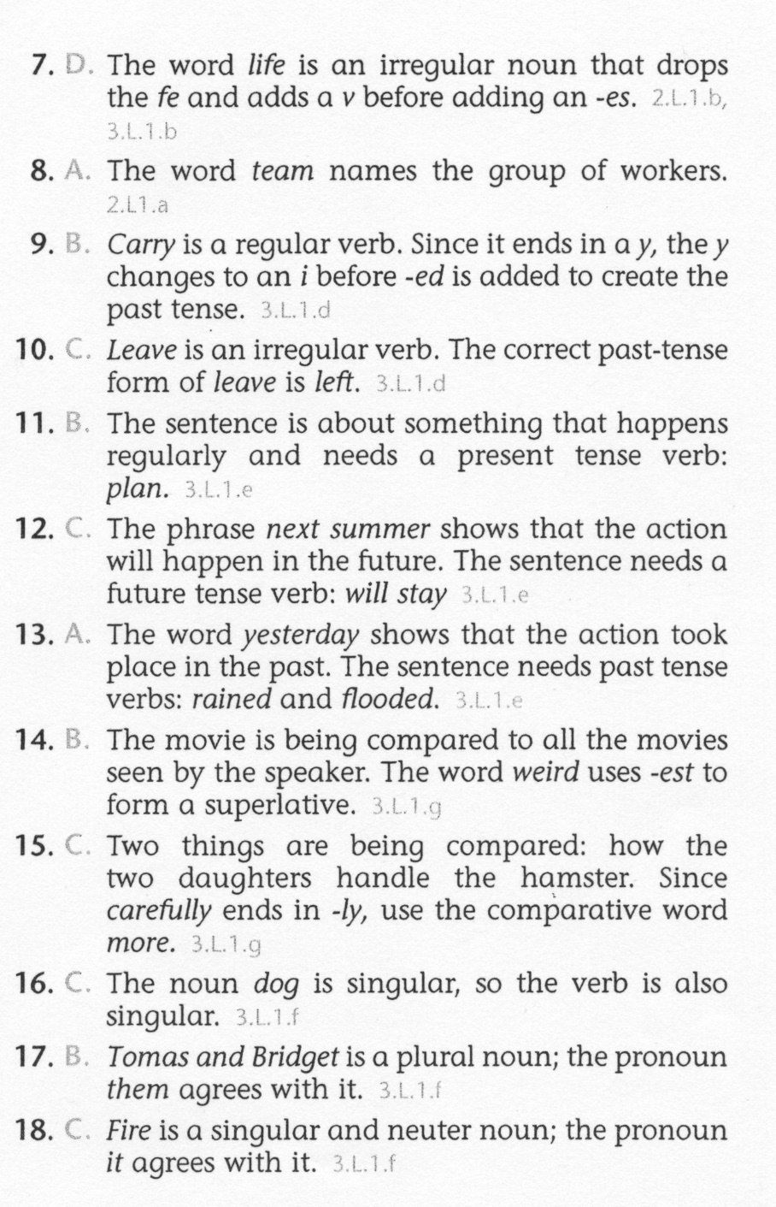
ELA-E-Unit-1 Usage Review Lesson

Slide 7
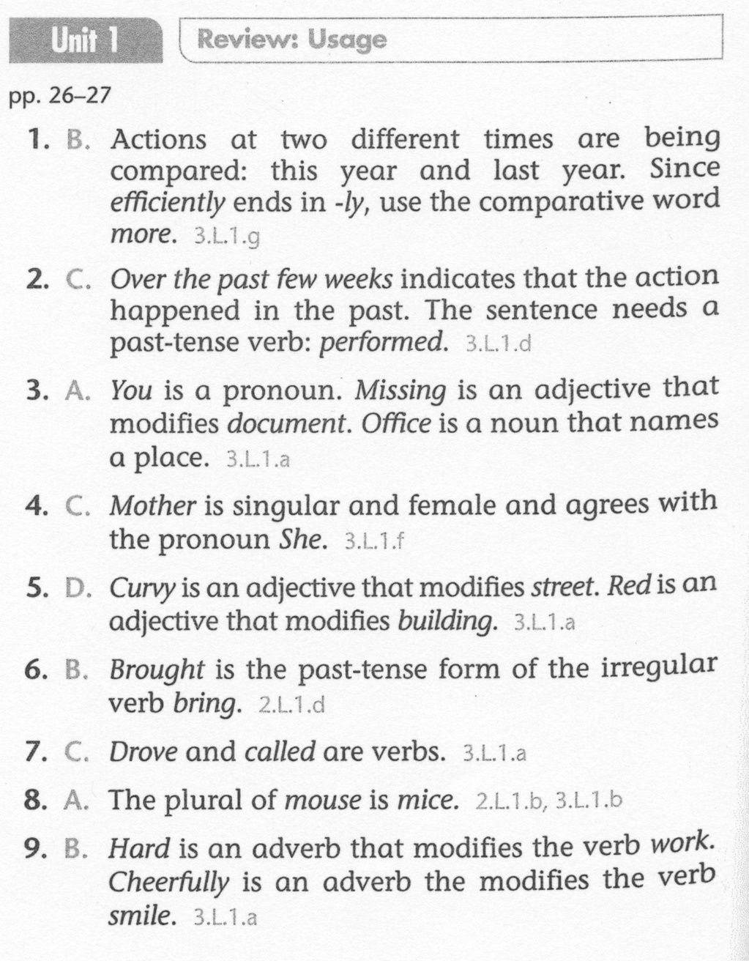
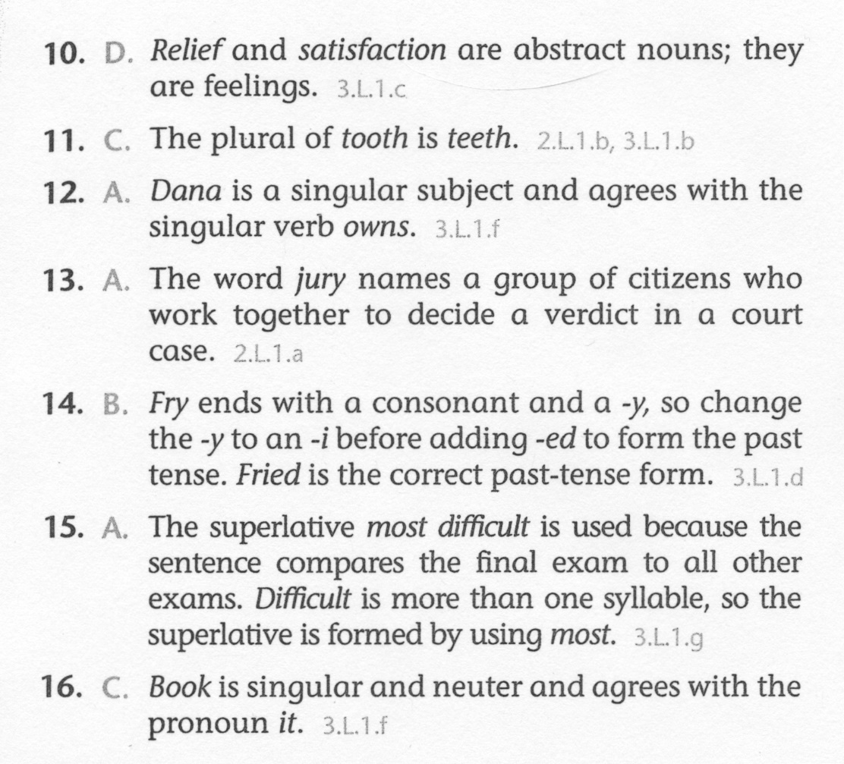
ELA-E-Unit-1 Usage Review Practice

