Slide 1
TABE ELA-E PAXEN Unit-5 Text Types and Purposes Lesson-34 Supporting Sentences
Some graphics may not have copied well during the Scan Process

Slide 2
ELA-E-34 Supporting Sentences

Slide 3
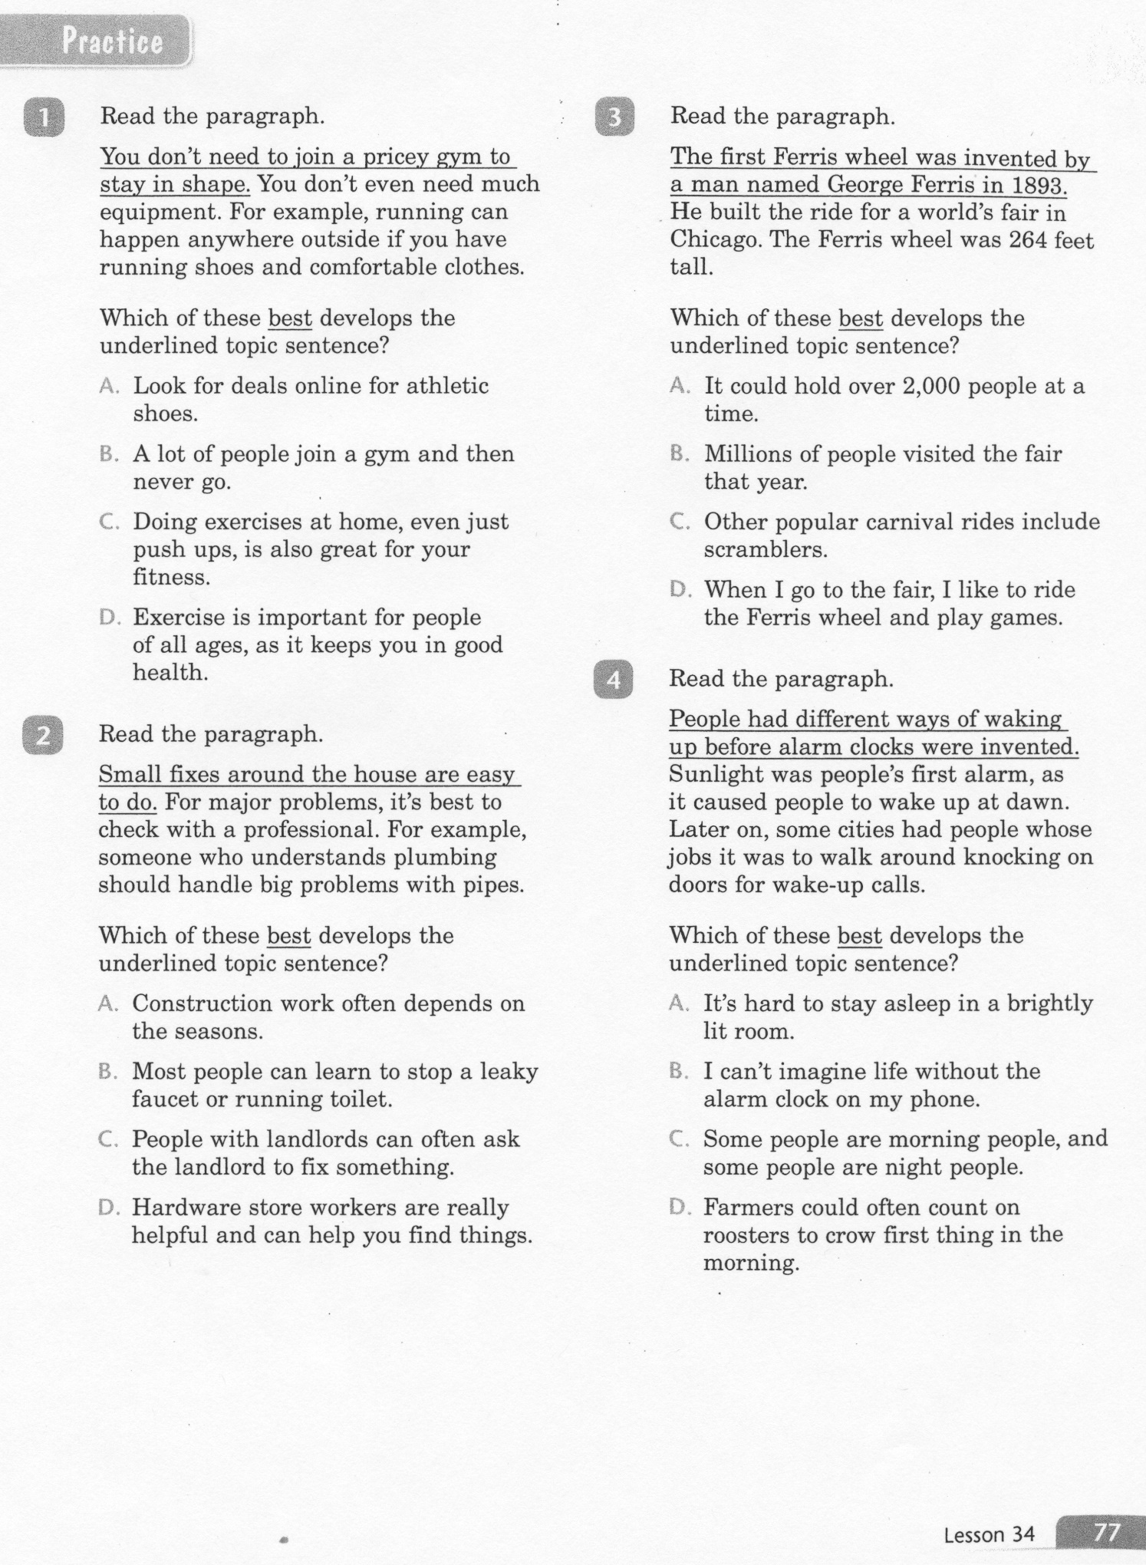
ELA-E-34 Supporting Sentences

Slide 4
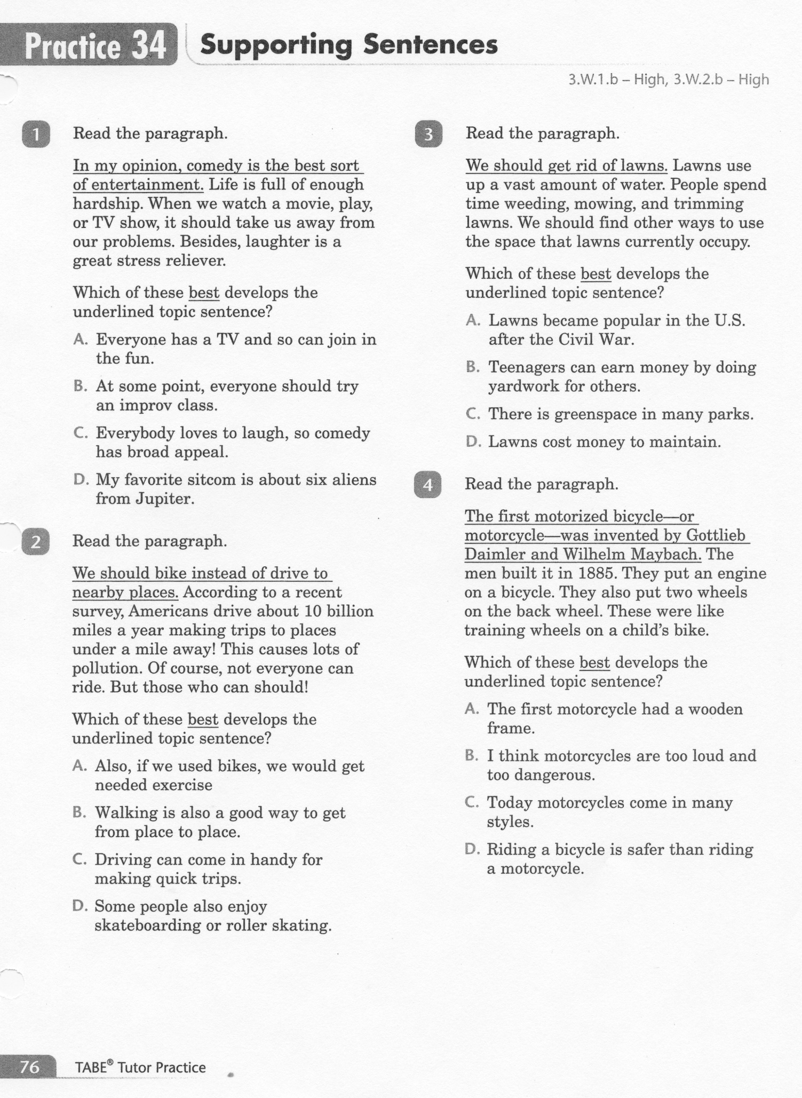
ELA-E-34 Supporting Sentences

Slide 5
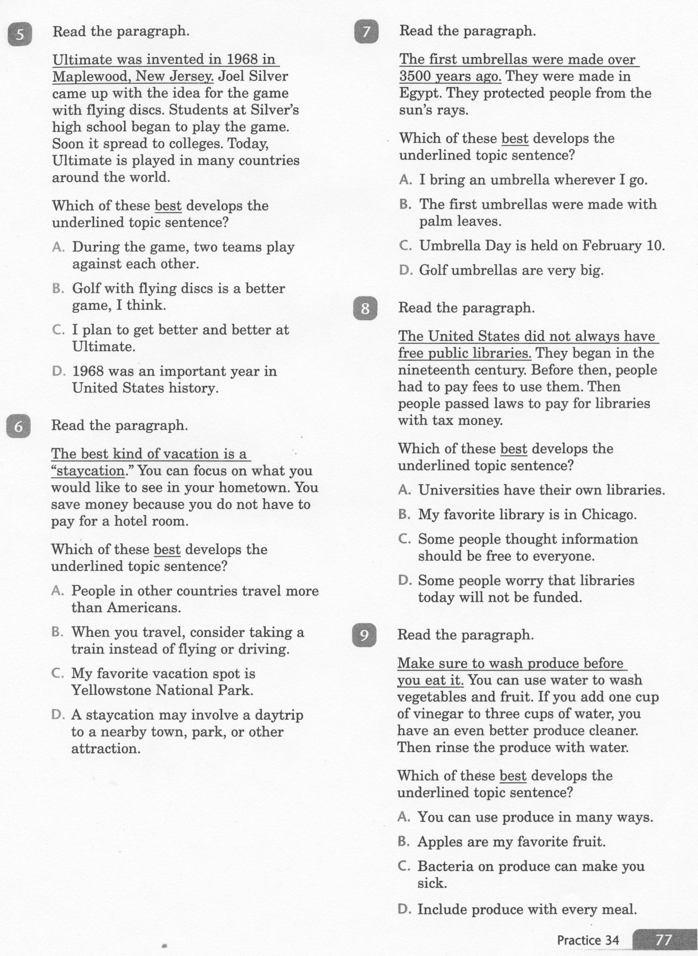
ELA-E-34 Supporting Sentences

Slide 6
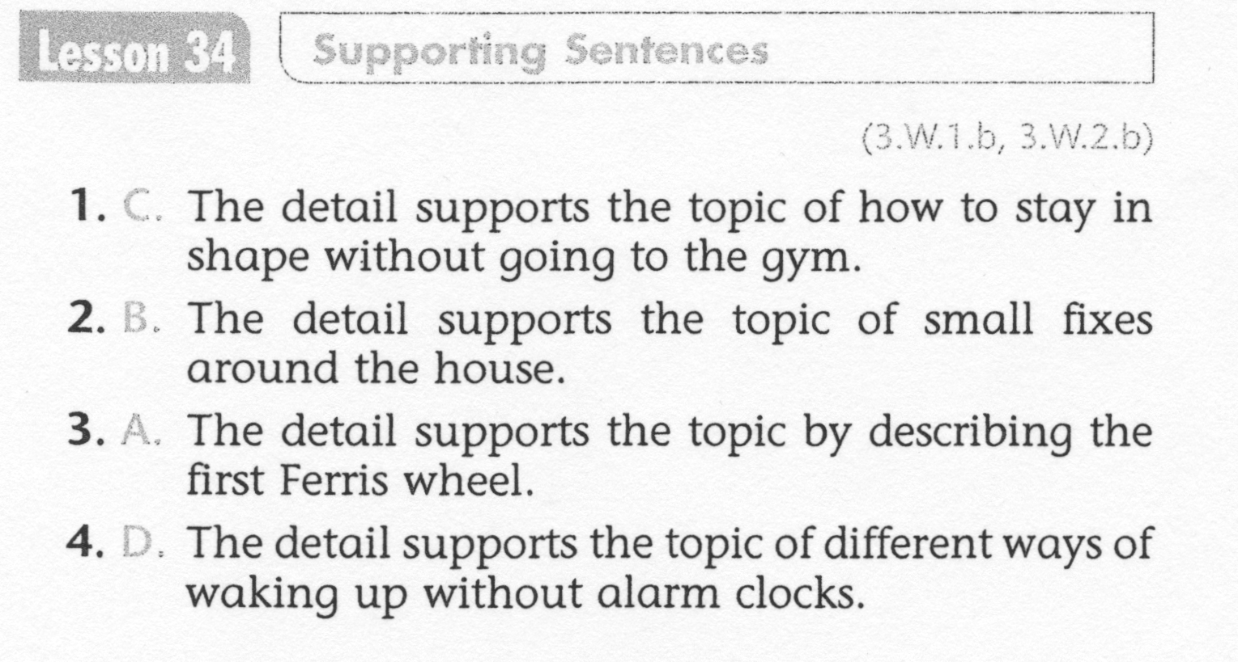
ELA-E-34 Supporting Sentences

Slide 7
ELA-E-34 Supporting Sentences

