Slide 1
AutoFill
Nolan Tomboulian
Tomboulian@yahoo.com
Tomboulian.Wikispaces.com

Slide 2
Working with AutoFill
AutoFill copies content and formats from a cell or range into an adjacent cell or range
Select the cell or range that contains the Data, Formula (s) you want to copy
Drag the fill handle in the direction you want to copy and then release the mouse button
To copy only the formats or only the formulas, click the AutoFill Options button (that appears after dragging the fill handle) and select the appropriate option

Slide 3
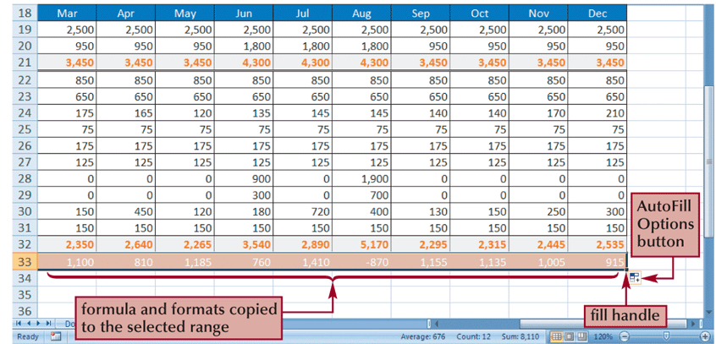
Working with AutoFill

Slide 4
Using the AutoFill Options Button
By default, AutoFill copies both the formulas and the formats of the original range to the selected range
You can specify what is copied by using the AutoFill Options button that appears after you release the mouse button

Slide 5
Working with AutoFill
or
Select the cell or range that contains the formula(s) you want to copy
Go to the [Home] tab - Editing group and click the Fill button
Select the appropriate fill direction and fill type (or click Series, enter the desired fill series options, and then click the OK button)

Slide 6
Filling a Series
AutoFill can also be used to create a series of numbers, dates, or text based on a pattern

Slide 7
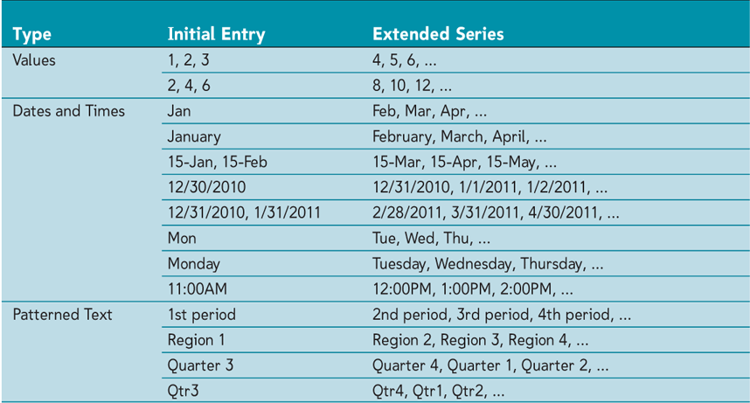
Filling a Series

Slide 8
Creating a Series with AutoFill
Enter the first few values of the series into a range
Select the range, and then drag the fill handle of the selected range over the cells you want to fill
or
Enter the first few values of the series into a range
Select the entire range into which you want to extend the series
Go to the [Home] tab - Editing group, click the Fill button, and then click Down, Right, Up, Left, Series, or Justify to set the direction you want to extend the series

