Slide 1
Unit 4-1 Finding and Opening Programs
Identify the parts of the Windows (10) interface
desktop, taskbar, Search bar (may not be active), etc.).
B. Demonstrate knowledge of the Windows Start Menu, including Get Help.
(Get Help may not be on some versions)
C. Use the search bar to locate a file, program, or document.
D. Start and exit (Close) programs.

Slide 2
Unit 4-1 Find and Open WINDOWS Programs
4-1 Learning Objective Standards
2. Identify the parts of the Windows 10 interface (desktop, taskbar, Start Menu, etc.).
3. Demonstrate knowledge of the Windows Start Menu, including Get Help.
4. Use the search bar to locate a file, program, or document. (may be hidden! Just Type)
6. Start and Exit (close) programs.
4-1 Vocabulary
Application / app / program
search bar
desktop
Start Menu
Taskbar / (Dock on Mac)
Windows

Slide 3
START (Hide or Show Apps)
ICONS
of
APPS
Alphabetical List
Of Applications
(Use Mouse Scroll Wheel)
Or type a Letter to JUMP to
the section in the list)
User Profile
and Logout
Document Folder
Pictures Folder
Settings
Power
WINDOWS
Task Bar

Slide 4
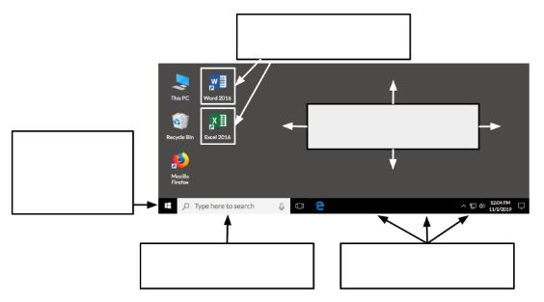
4-1-B Handout “Places on the Desktop”
Programs
Desktop
Start
Menu
Search bar
Taskbar

Slide 5
4-1-C Reference Organization
◆ “Where is Firefox (a program to search the internet)?” ( desktop and taskbar )
◆ “Where is Edge (a program to search the internet)?” ( taskbar )
◆ “Where is Word (a program to create documents)?” ( desktop and taskbar )
◆ “Where is Excel (a program to create spreadsheets of numbers)?” ( desktop and taskbar )

Slide 6
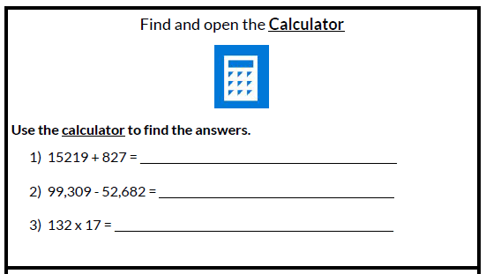
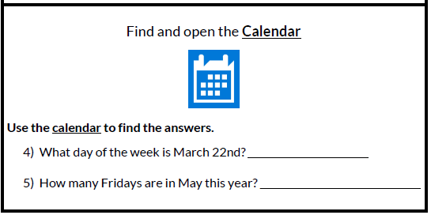
4-1-A Handout: Practice with APPS
Other Applications:
NOTE MEDIA PLAYER SNIP
PAINT Camera VOICE
ADOBE Clock

Slide 7
4-1-D Reference Pair Explore
Directions: Complete the following with a partner on one computer.
1. Use the Start Menu to open ‘Microsoft Edge’. (Not Chrome)
2. Search for “weather today”.
3. Close ‘Microsoft Edge’.
4. Use the search bar to open ‘Word’.
5. Type your name.
6. Close ‘Word’ (click ‘don’t save’).

