Slide 1
Unit-3-4 Email: Reply, Reply All, Forward
Learners will be skilled at…
In this lesson, learners will use REPLY to send responses to an email and
REPLY ALL to send responses to everyone in a group email.
Learners will identify common situations in which to use each of these email functions. In the task, they will use FORWARD to send a copy of an email to another recipient
​
Teaching Tips:
● The: Reply, Reply ALL and FORWARD buttons are often found in different places depending on what email provider you are using.
Show learners where these buttons are on different email providers if you have access to multiple accounts.

Slide 2
Unit 3-4 Email: Reply, Reply All, Forward
Learning Goals:
6. Open and reply to an email.
7. Understand why and how to: reply, reply all, and forward an email.
Unit 3-4 Vocabulary:
forward reply all
recipient sender
reply
distribution List
group

Slide 3
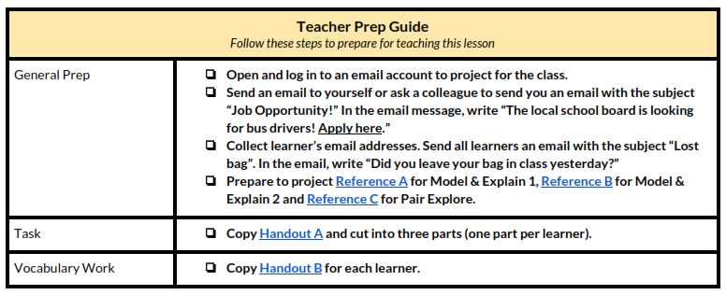
Unit 3-4 Email: Reply, Reply All, Forward

Slide 4
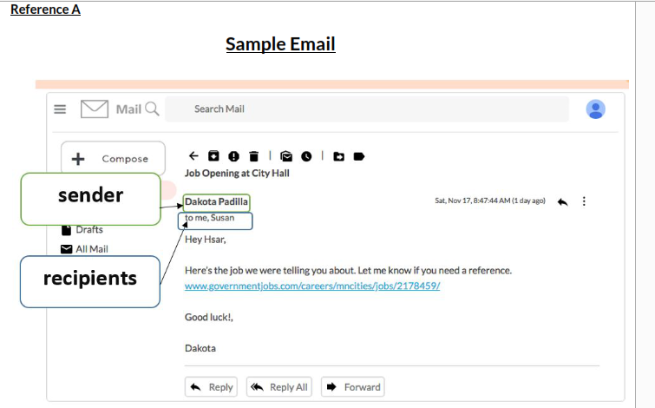
3-4 Reference A

Slide 5
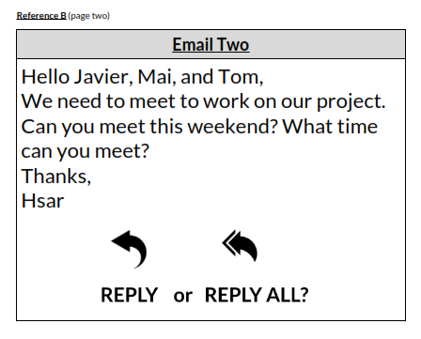
3-4 Reference B

Slide 6
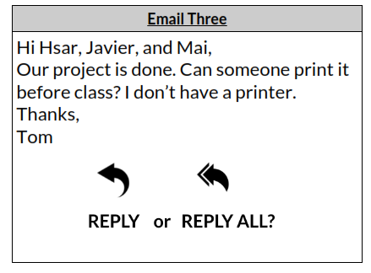
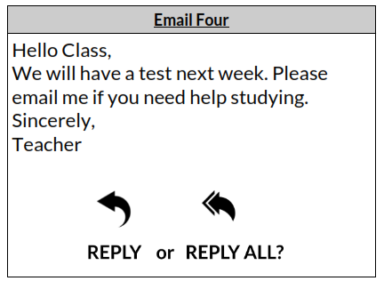
3-4 Reference B

Slide 7
ACTIVITY -1
3-4 Reference-C

Slide 8
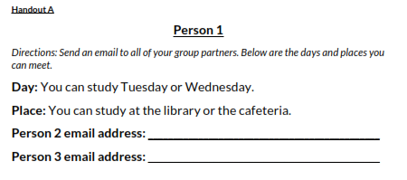
ACTIVITY - 2
3-4 Handout A

Slide 9
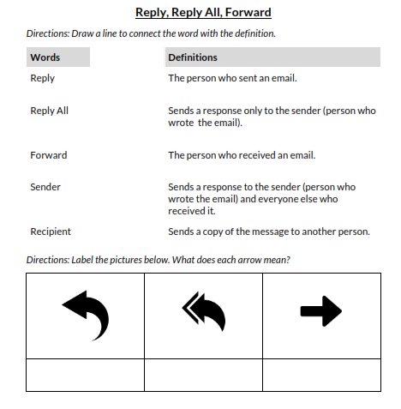
3-4 Handout-B
QUIZ

