Slide 1
Basic Computer Skills
Unit: 1 – 2
Mouse
(and
Skills
Operations
File Management)

Slide 2
Warm-up:
❑
Thumbs
Up
/
Thumbs
Down
I
I
I I
have used a
have used a
Mouse
Touchpad
❑
❑
❑
am excited to be here
am ready to learn
❑
QUESTIONS I HAVE…….

Slide 3
Unit 1-2 :
• DEFAULT HANDED
Mouse Use
MOUSE SETTINGS PEOPLE!
ARE
FOR
RIGHT
• IS ANYONE LEFT-HANDED?
• DOUBLE CLICKING (Left Button)
CAN
BE HARD!
• DRAG and DROP CAN BE DANGEROUS
• RESPONSE TIME (SLOW) CAN BE AGGRAVATING

Slide 4
Basic Hardware Skills and Objectives
Distinguish between different types of devices (tablets, desktop and laptop computers).
Identify specific computer hardware (system unit, monitor, printer, keyboard, mouse or touchpad, ports, touchscreen).
Log on to and shut down a computer.
Demonstrate knowledge of keys on keyboard (Enter, Shift, Control, Backspace, Delete, Arrow Keys, Tab, Caps Lock, Number Lock, ALT).
Identify types of mice: mouse and touchpad.
Identify mouse pointer shapes and the functions they represent
[spinning wheel (loading), I-Beam (text), arrow (basic clicking), hand pointer (clickable links)]
Demonstrate knowledge and appropriate use of mouse clicks (right-click, left-click, and double click).
Drag and drop.
Utilize common controls for screen interaction (selecting check boxes, using drop-down menus, scrolling). 1
Access and control audio output features (volume, mute, speakers and headphones).
Identify icons on desktop.
Demonstrate ability to trash and retrieve items using the trash or recycle bin.
Demonstrate understanding that it is possible to customize a computer for increased accessibility
(customizing a mouse for left-handed use and sensitivity, and changing screen resolution on a monitor).
Demonstrate understanding that software programs are upgraded periodically to fix bugs and increase utility,
and that different versions may be installed on different computers.
Identify mechanisms for storing files (flash drives, hard drives, cloud-based storage).
Identify if a device is connected to the internet.
Identify and locate camera and mic on laptops, tablets. Turn computer and monitor on and off.
1.
2.
3.
4.
5.
6.
7.
8.
9.
10.
11.
12.
13.
14.
15.
16.
17.
18.

Slide 5
Unit 1-2 :
Hardware Mouse Skills Standards
7.
Demonstrate knowledge
and
appropriate
use
of
mouse:
click
right-click
left-click
double (Left) click
8.
11.
13.
Drag and drop.
Identify icons on desktop.
Customize Mouse Settings.

Slide 6
Unit 1-2 : Mouse Operations Skills
click {press the button}
Icon derived from the Greek eikon or eikenai, which means “To Seem or Be Like”
A picture or image that represents something or an action.
click and hold {Useful for selecting text and highlighting}
menu {options that can be performed on an ‘Object’}
drag and drop {File and Desktop management}
right click {brings up “menu” options for the ‘Object’}
double (Left) click {Left Mouse. Opens a folder or File.

Slide 7
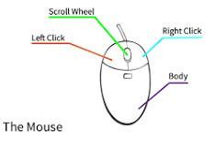
MOUSE (Apple ‘bought’/modified Invention)
Point and Click
Drag and Drop
Left Click (select / highlight)
Right Click (Menu options)
Double Left Click (select and Open)
Scroll Wheel
Wired or Wireless
https://edu.gcfglobal.org/en/mousetutorial/mouse-tutorial/1/
https://www.youtube.com/watch?v=KNKgBBn_Fsg

Slide 8
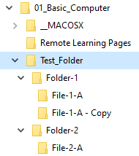
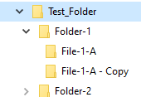
FILE FOLDER
Vocabulary: Desktop File
LAB ACTIVITY
Folder
Drop Down
Sub-Folder
Expand
Directory
Compress

Slide 9
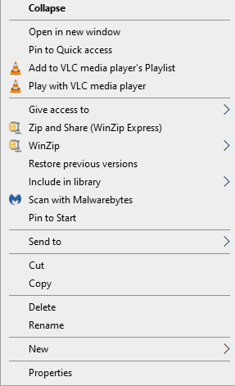
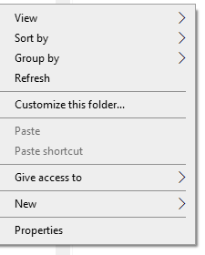
RIGHT CLICK {Menu Options}
Depends where the cursor Is! (The Object)
and what software is loaded on your computer.
In Explorer
On the Desktop

Slide 10
Handout-A
Unit 1-2
Using the Mouse
Directions: Answer the questions using the vocabulary words below
A) click
B) right click
C) double click
D) Menu options
E) icon
F) click and hold, then drag
and
drop
1)
2)
3)
4)
5)
6)
7)
How
How
How
do
do
do
you
you
you
open a file or folder?
move a file or folder icon?
open a menu?
What does right click open?
How do you push a button?
What is a picture of a file or folder called?
How many icons are in the picture in the right?
(This is a bad / tricky question!)

