Slide 1
TABE Math-E PAXEN Unit-6 Geometry Lesson 47 Perimeter
Revised: November 4, 2023
Nolan Tomboulian
Some graphics may not have copied well during the scan process.

Slide 2
Math-E - Lesson 47 – Perimeter

Slide 3
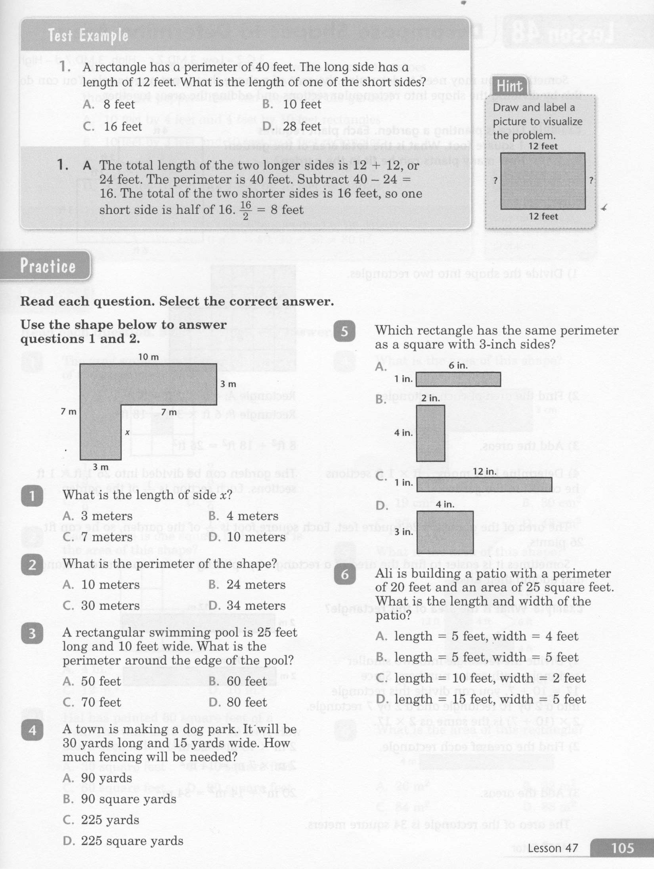
Math-E - Lesson 47 – Perimeter

Slide 4
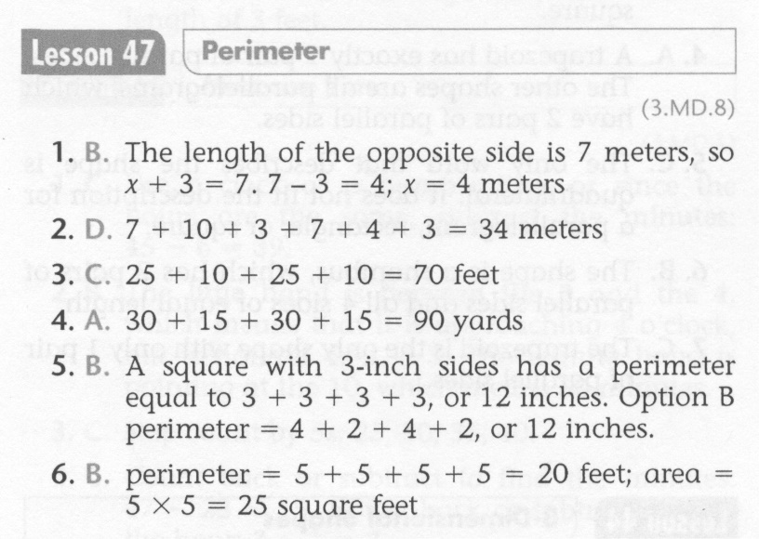
Math-E - Lesson 47 – Perimeter

Slide 5
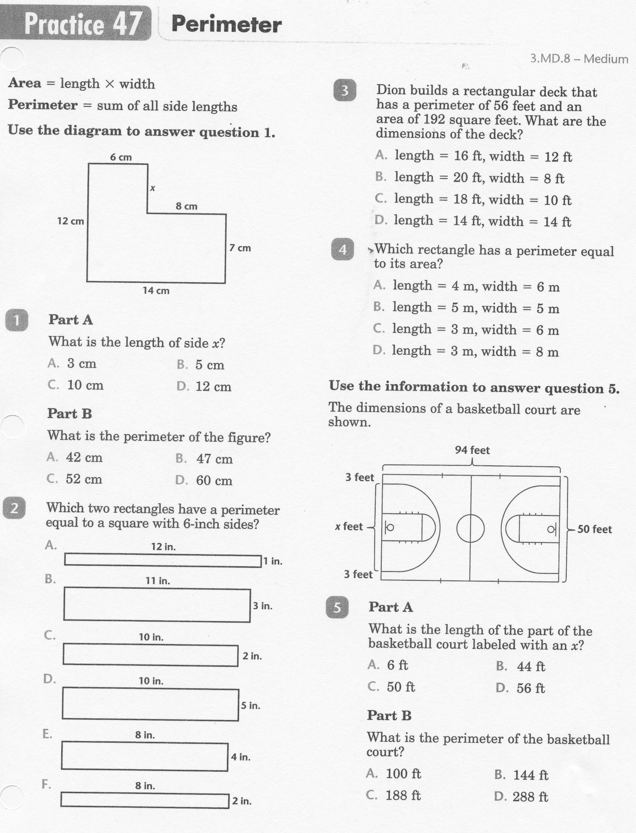
Math-E - Practice 47 – Perimeter

Slide 6
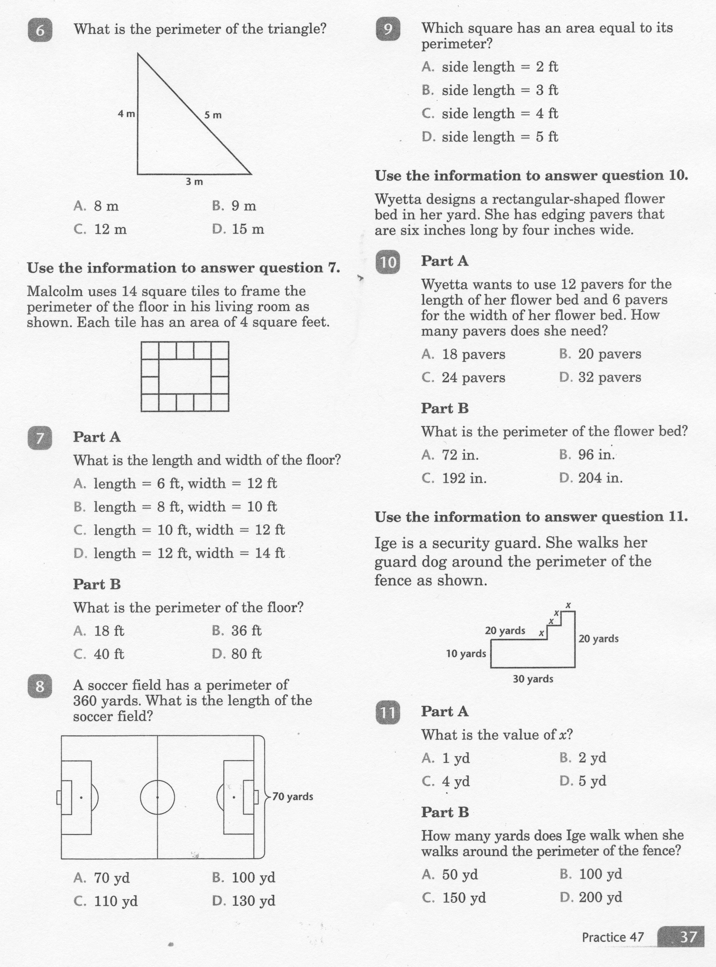
Math-E - Practice 47 – Perimeter

Slide 7
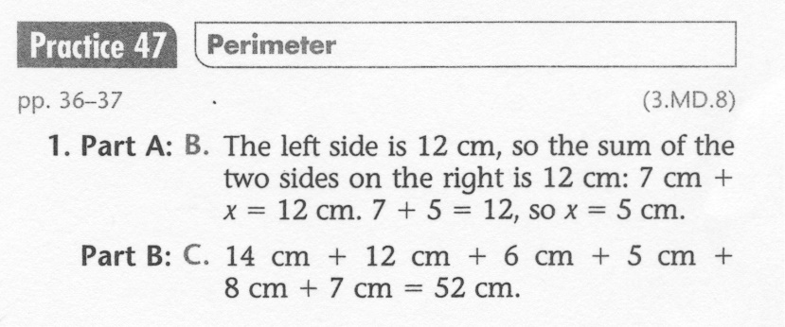
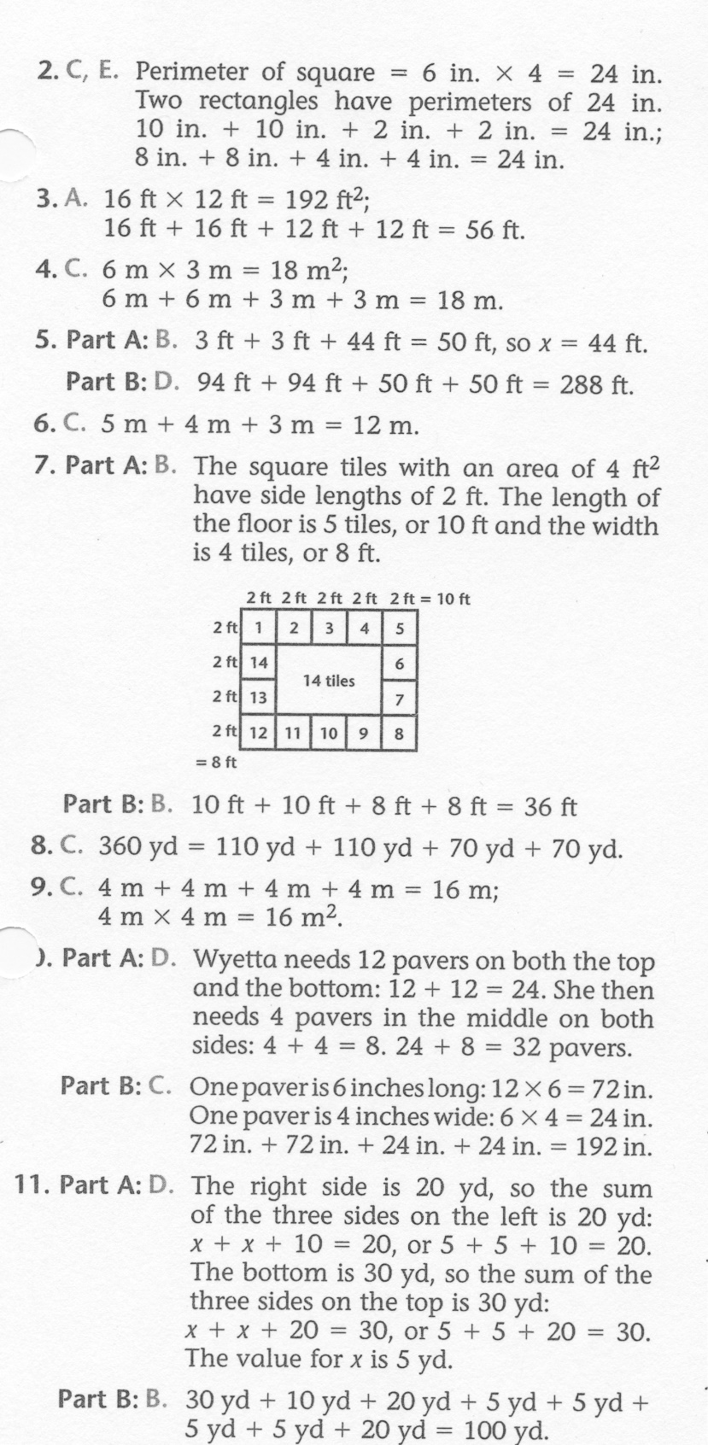
Math-E - Lesson 47 – Perimeter

