Slide 1
TABE Math-E PAXEN Unit-6 Geometry Lesson 42 2-Dimensional Shapes
Revised: November 4, 2023
Nolan Tomboulian
Some graphics may not have copied well during the scan process.

Slide 2
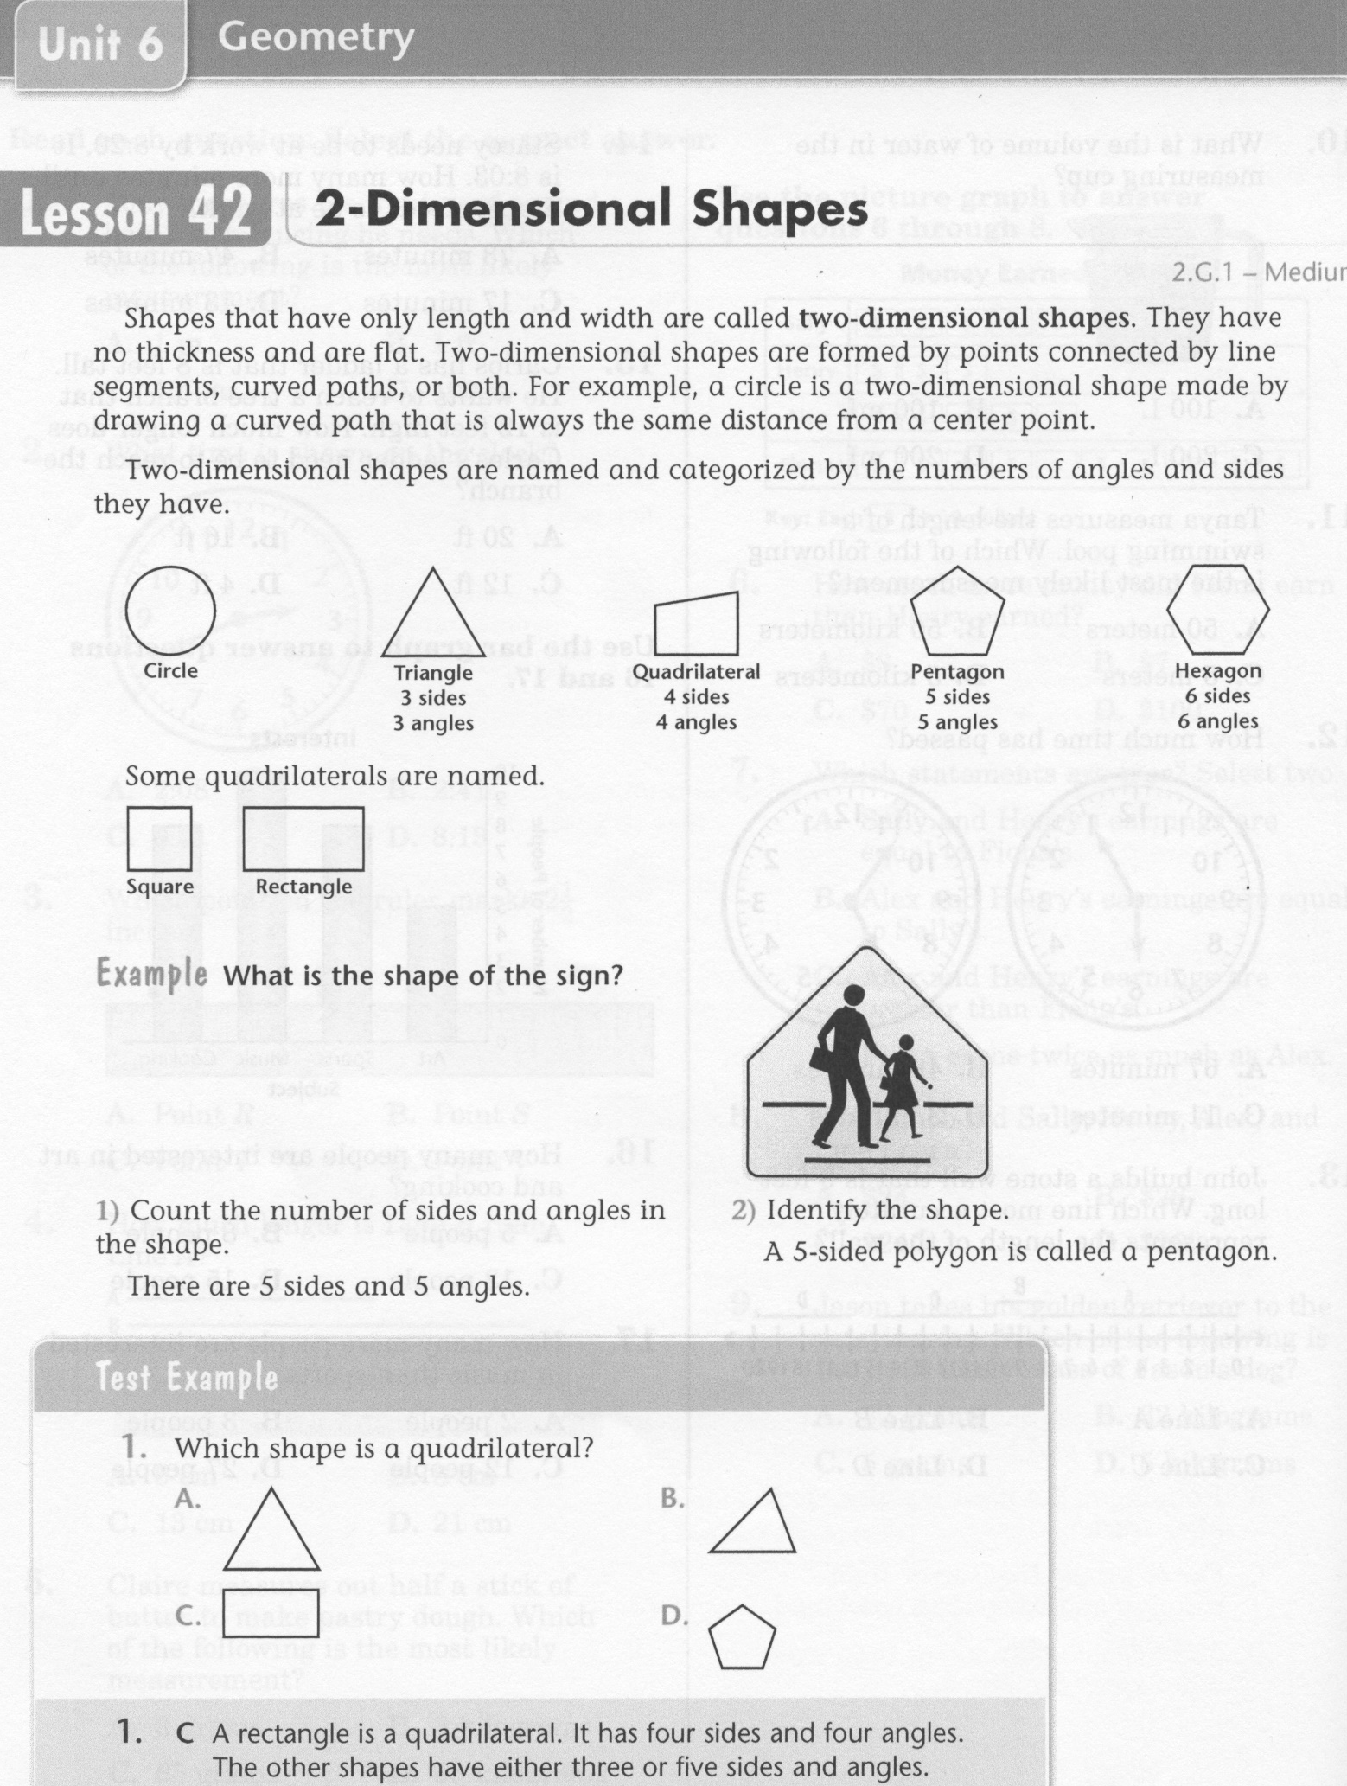
Math-E - Lesson 42 – 2-Dimensional Shapes

Slide 3
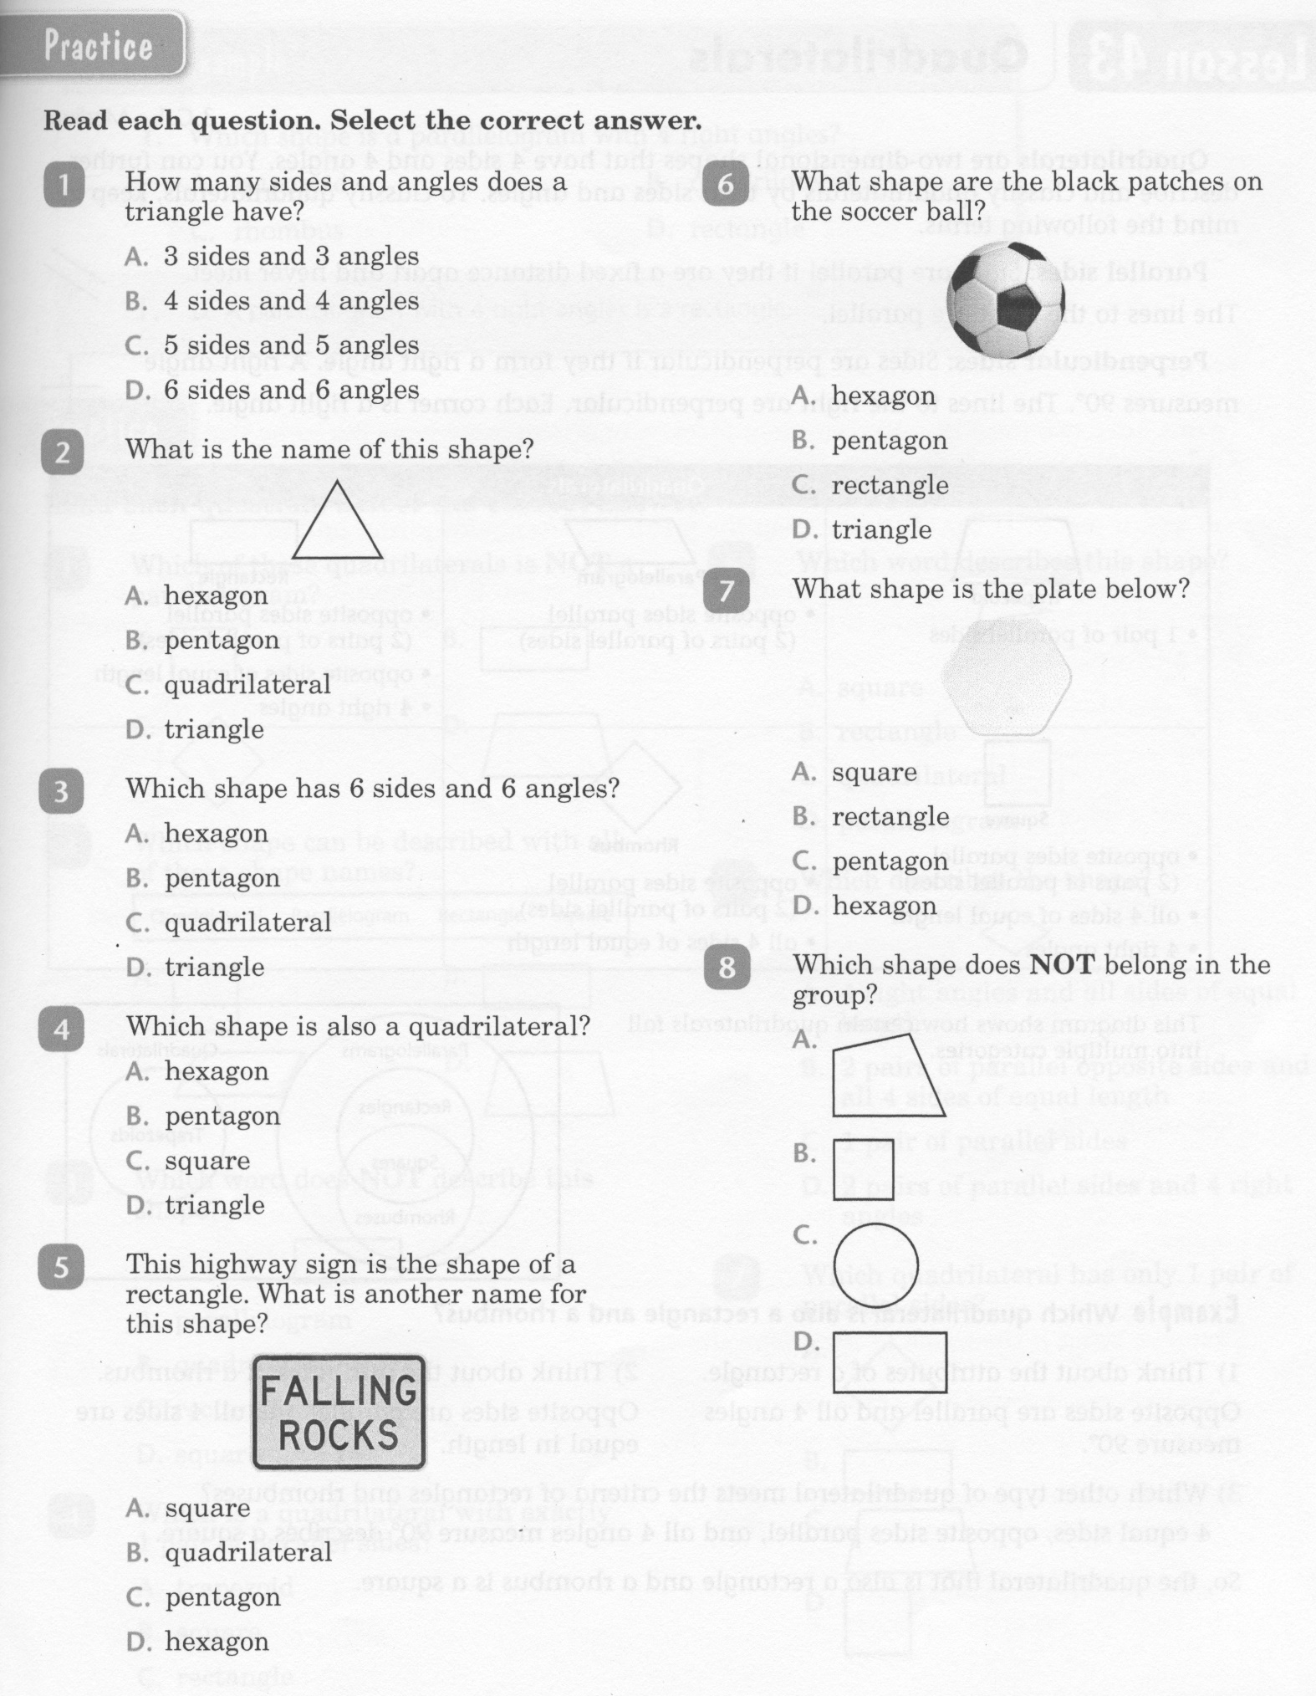
Math-E - Lesson 42 – 2-Dimensional Shapes

Slide 4
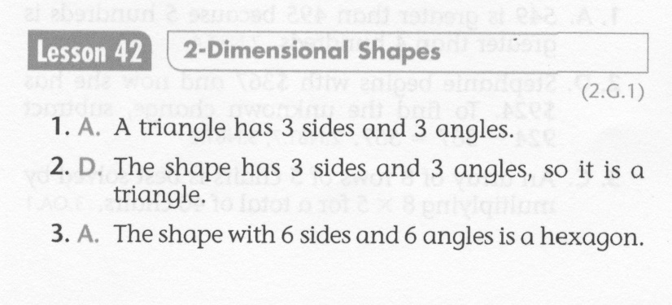
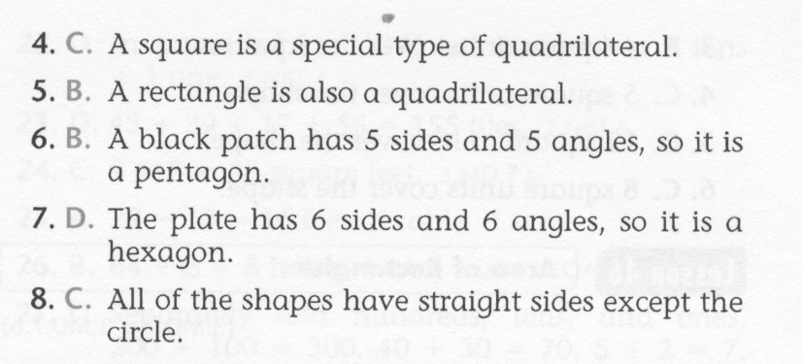
Math-E - Lesson 42 – 2-Dimensional Shapes

Slide 5
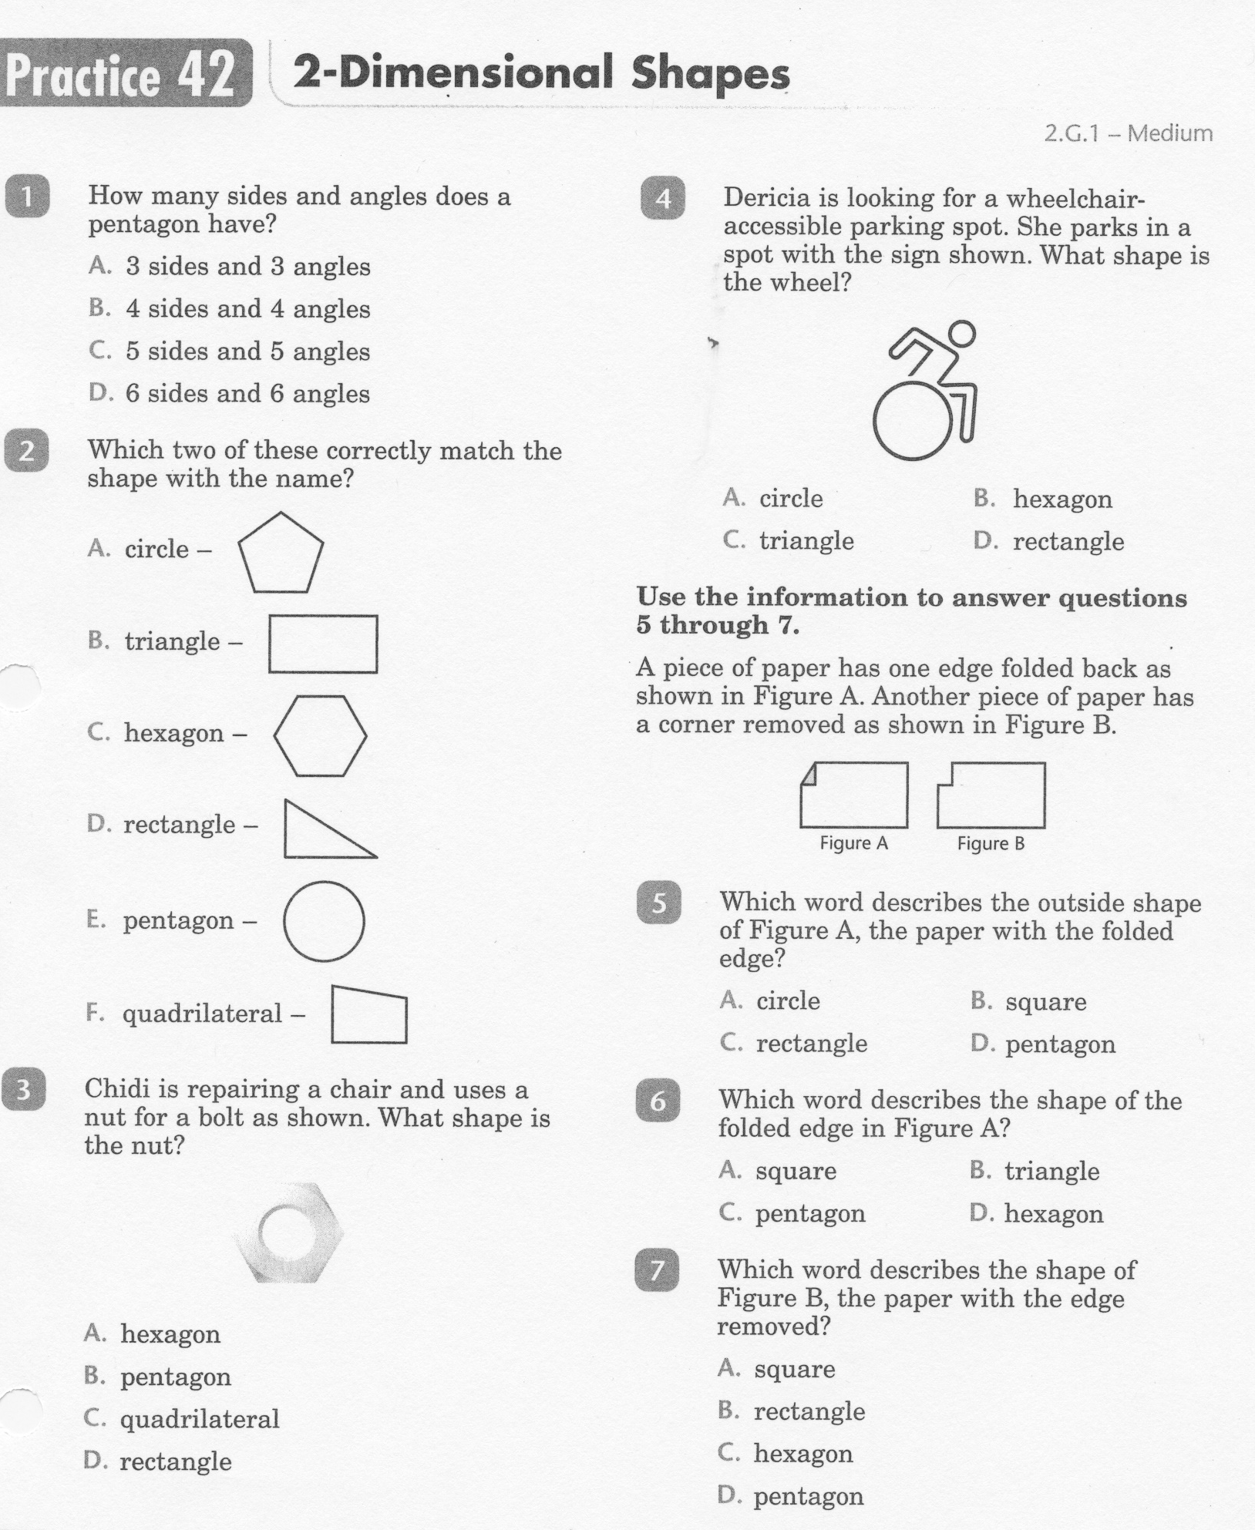
Math-E - Practice 42 – 2-Dimensional Shapes

Slide 6
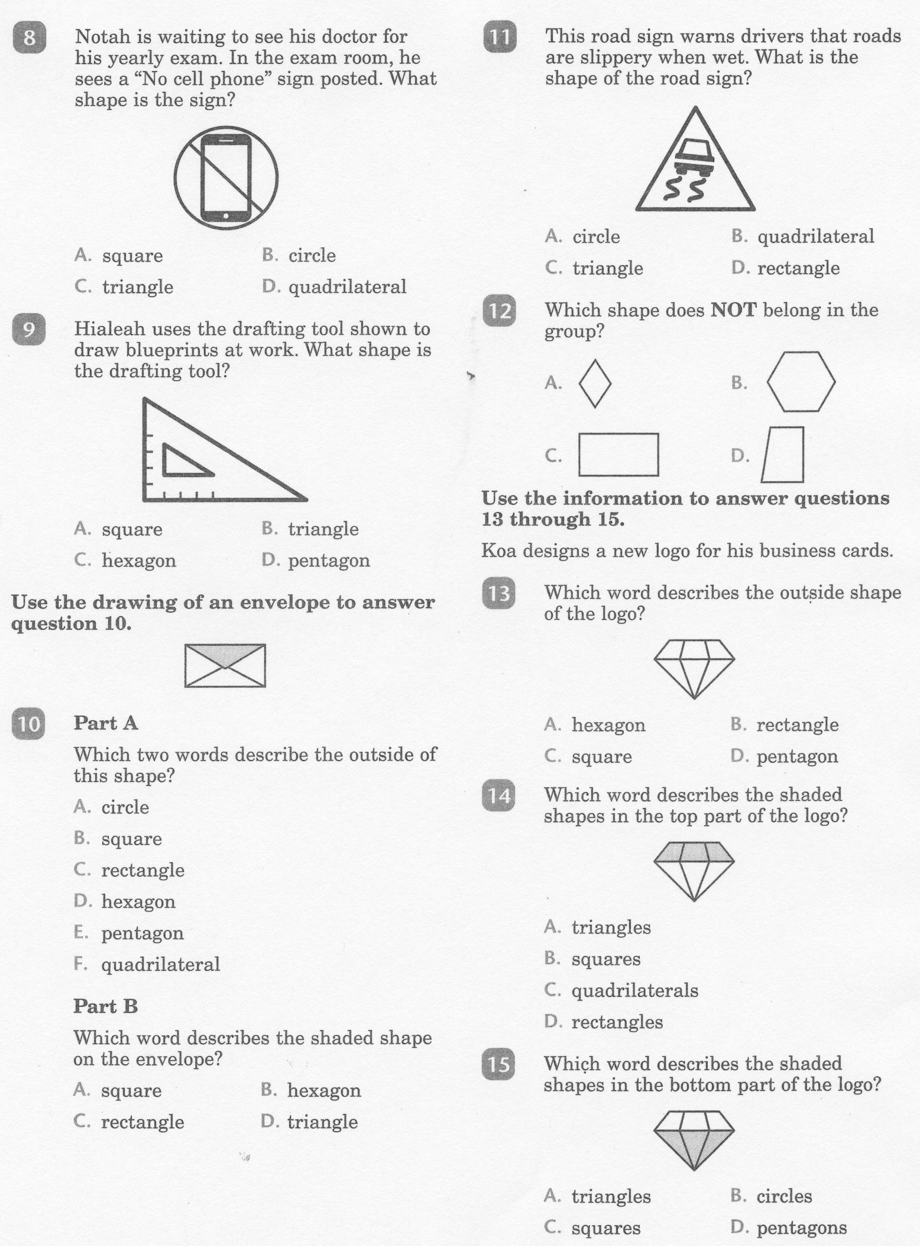
Math-E - Practice 42 – 2-Dimensional Shapes

Slide 7
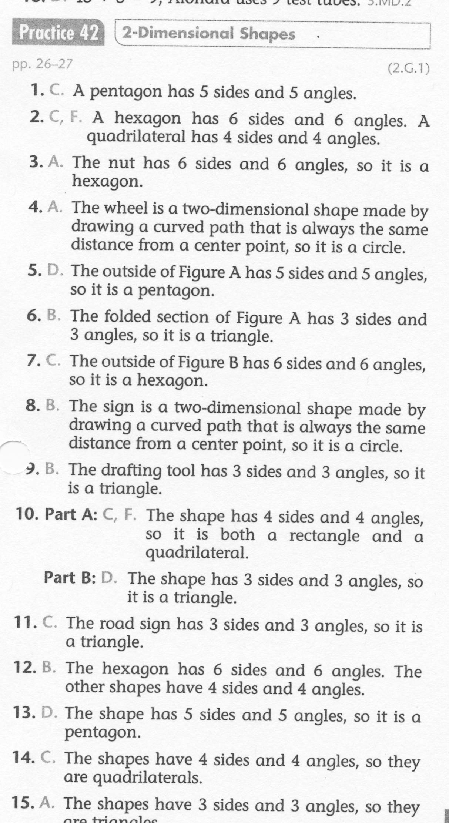
Math-E - Practice 42 – 2-Dimensional Shapes

