Slide 1
TABE Math-E PAXEN Unit-5 Measurement and Data Lesson 33 Standard Units Measure Metric
Revised: October 16, 2023
Nolan Tomboulian
Some graphics may not have copied well during the scan process.

Slide 2
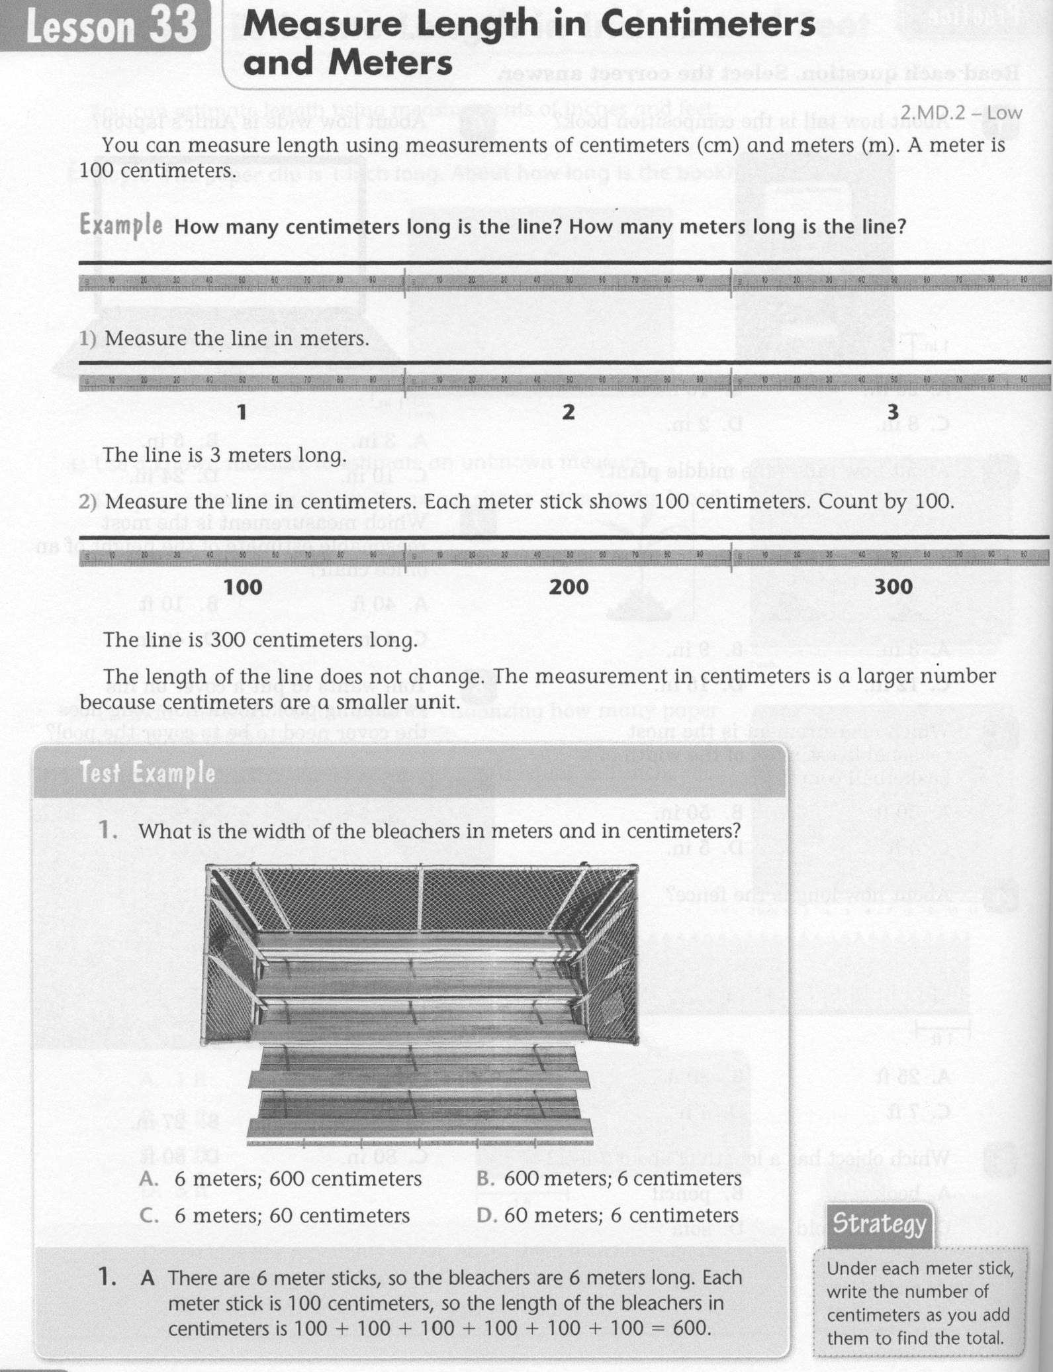
Math-E - Lesson 33 – Metric Measures

Slide 3
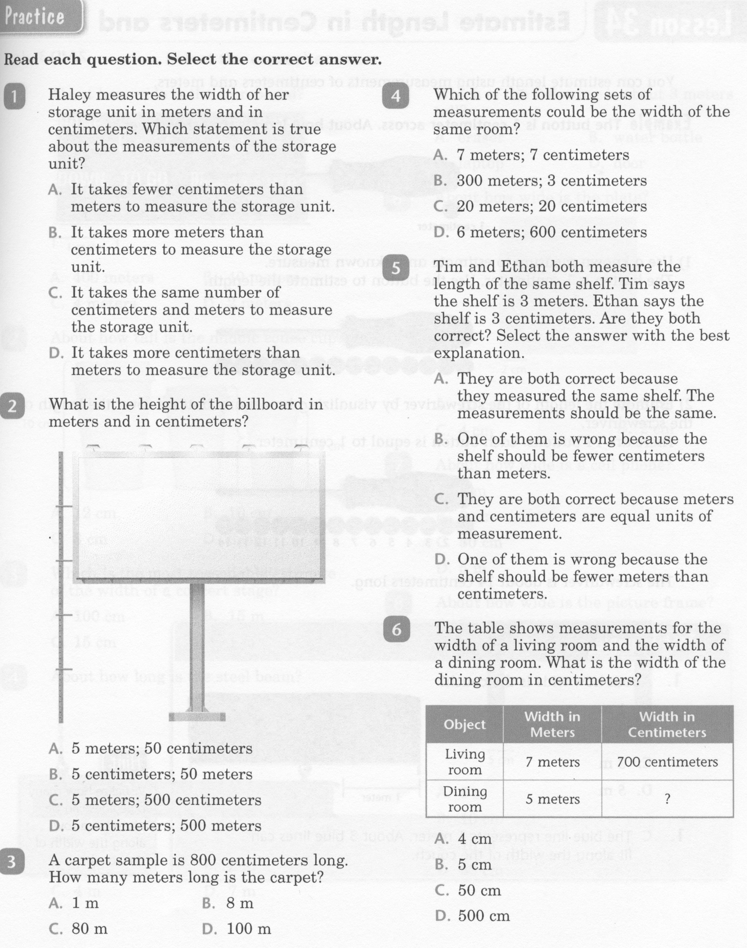
Math-E - Lesson 33 – Metric Measures

Slide 4
Math-E - Lesson 33 – Metric Measures

Slide 5
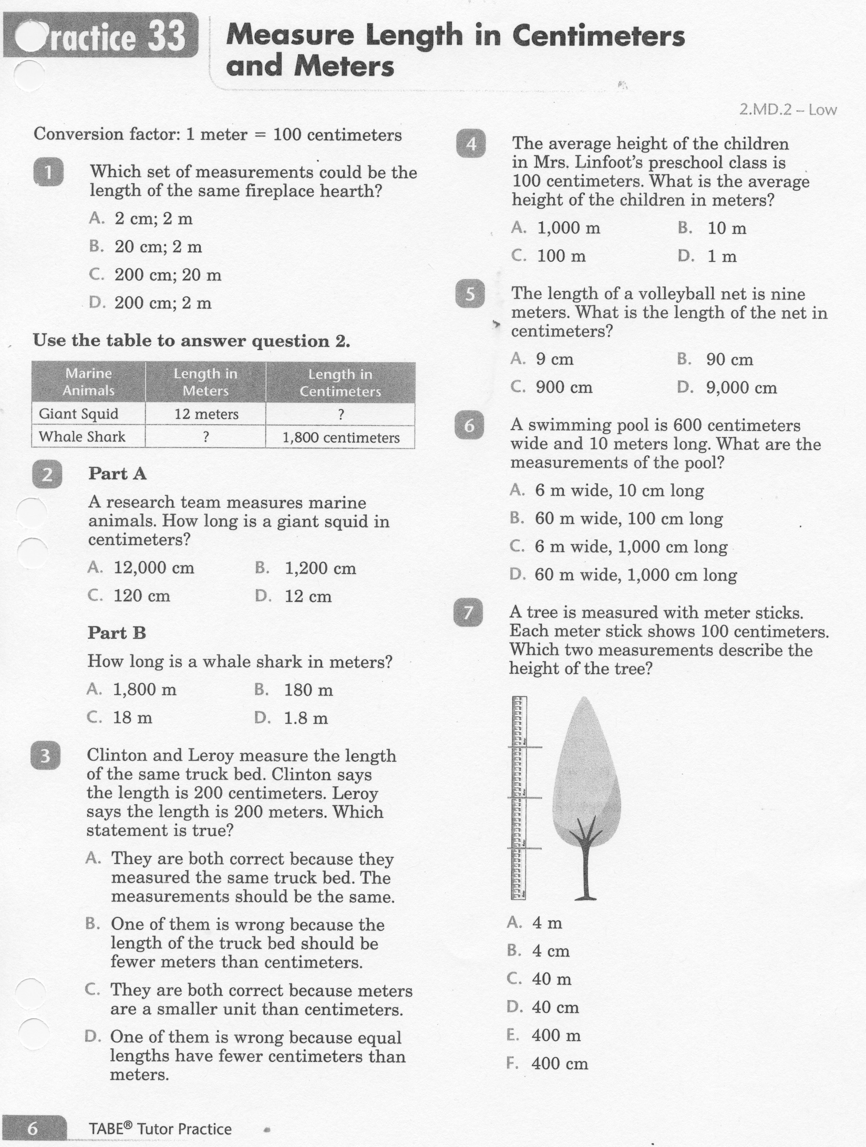
Math-E - Practice 33 – Metric Measures

Slide 6
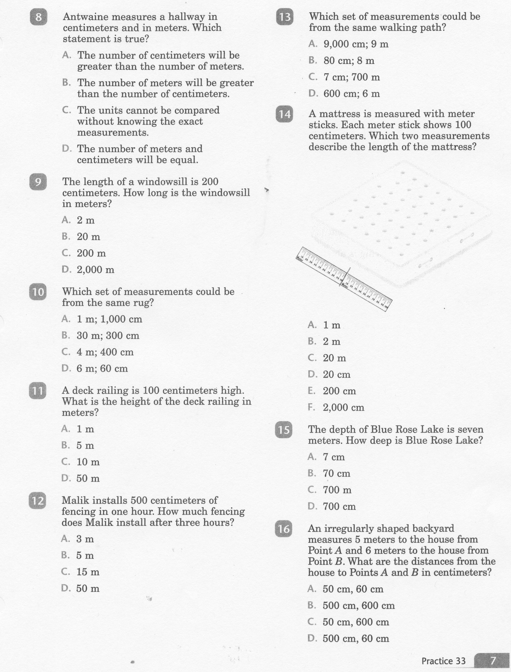
Math-E - Practice 33 – Metric Measures

Slide 7
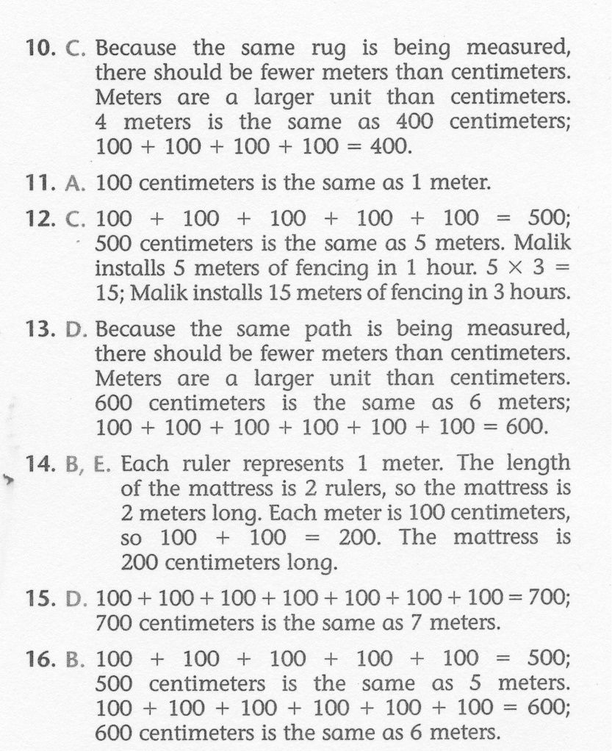
Math-E - Practice 33 – Metric Measures

