Slide 1
TABE Math-E PAXEN Unit-4 Fractions Lesson 24 Fractions of a Whole
Revised: October 16, 2023
Nolan Tomboulian
Some graphics may not have copied well during the scan process.

Slide 2
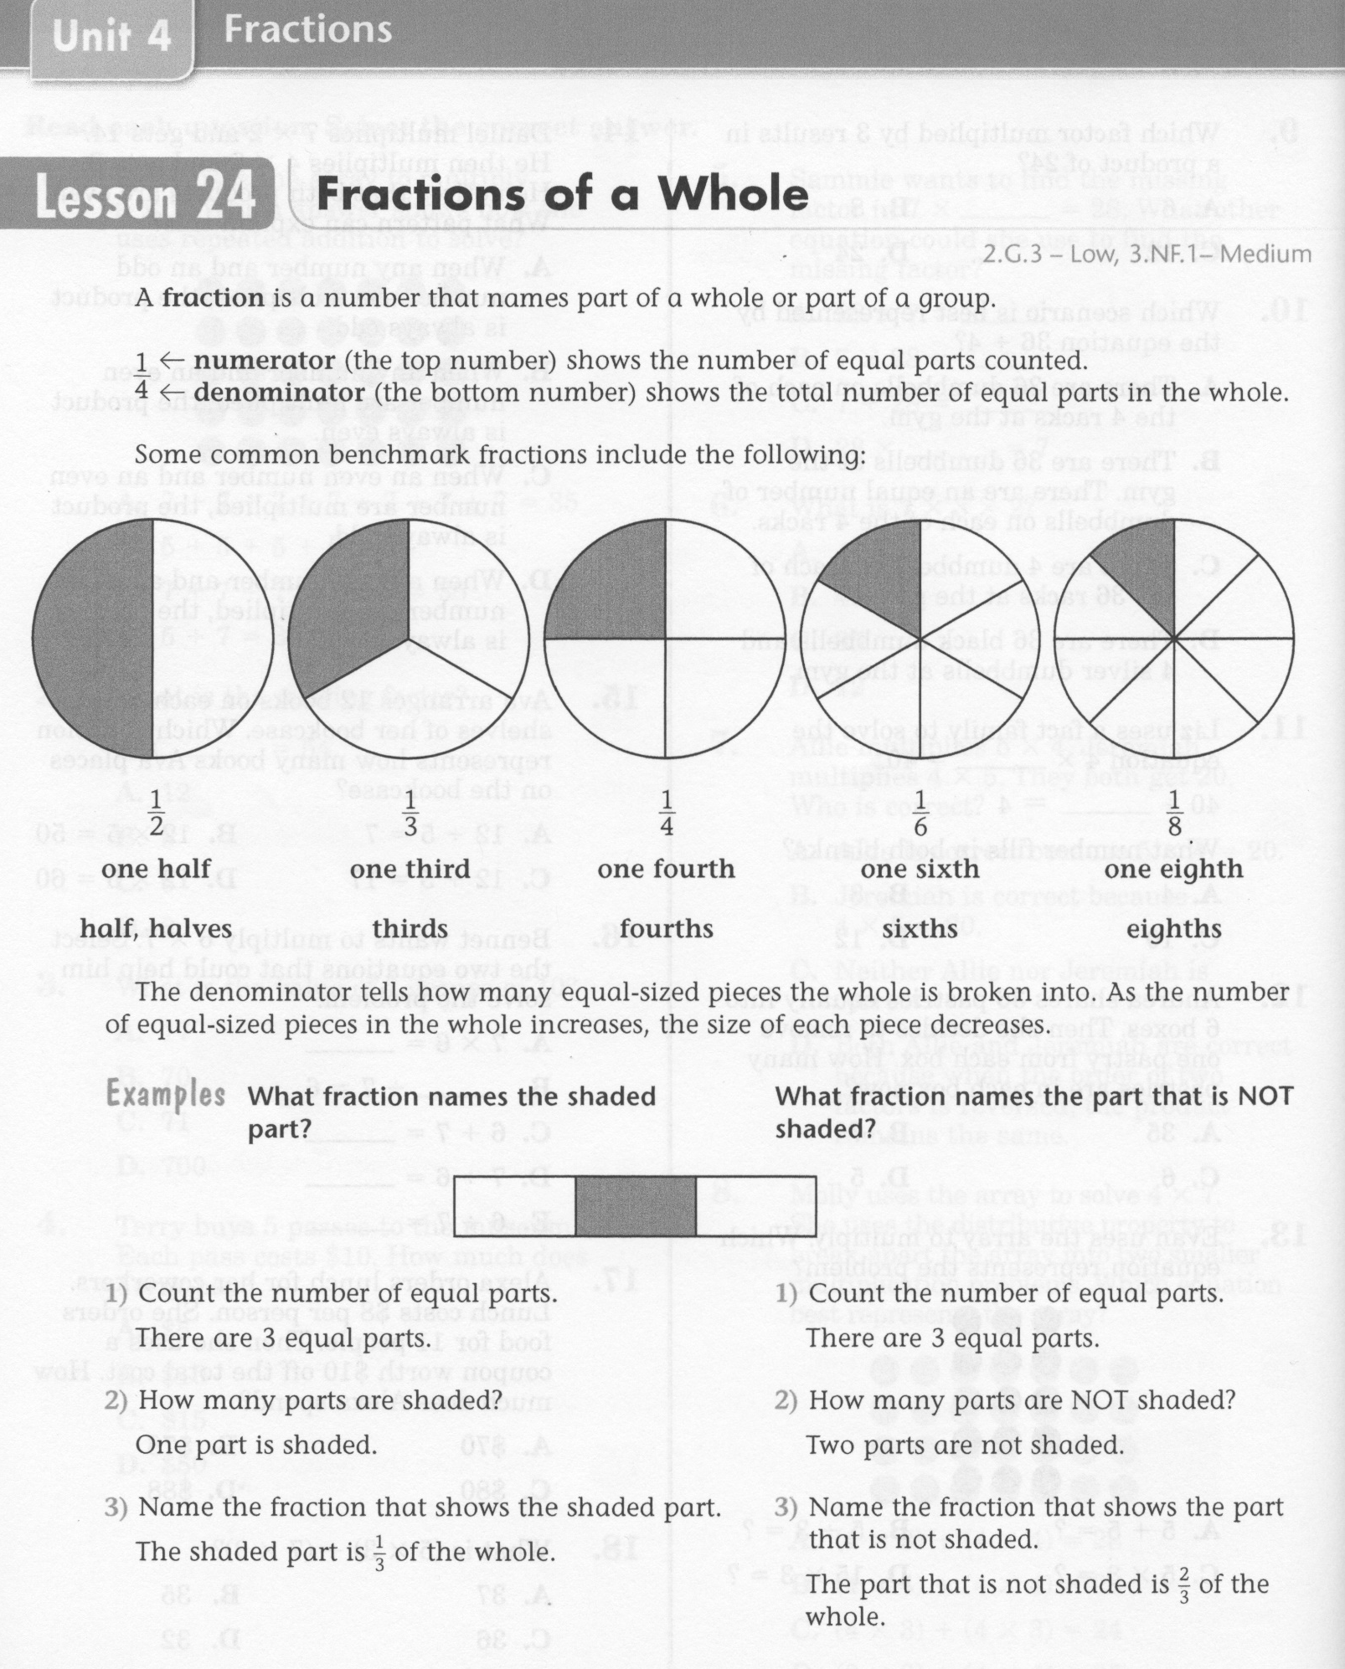
Math-E - Lesson 24 – Fractions of a Whole

Slide 3
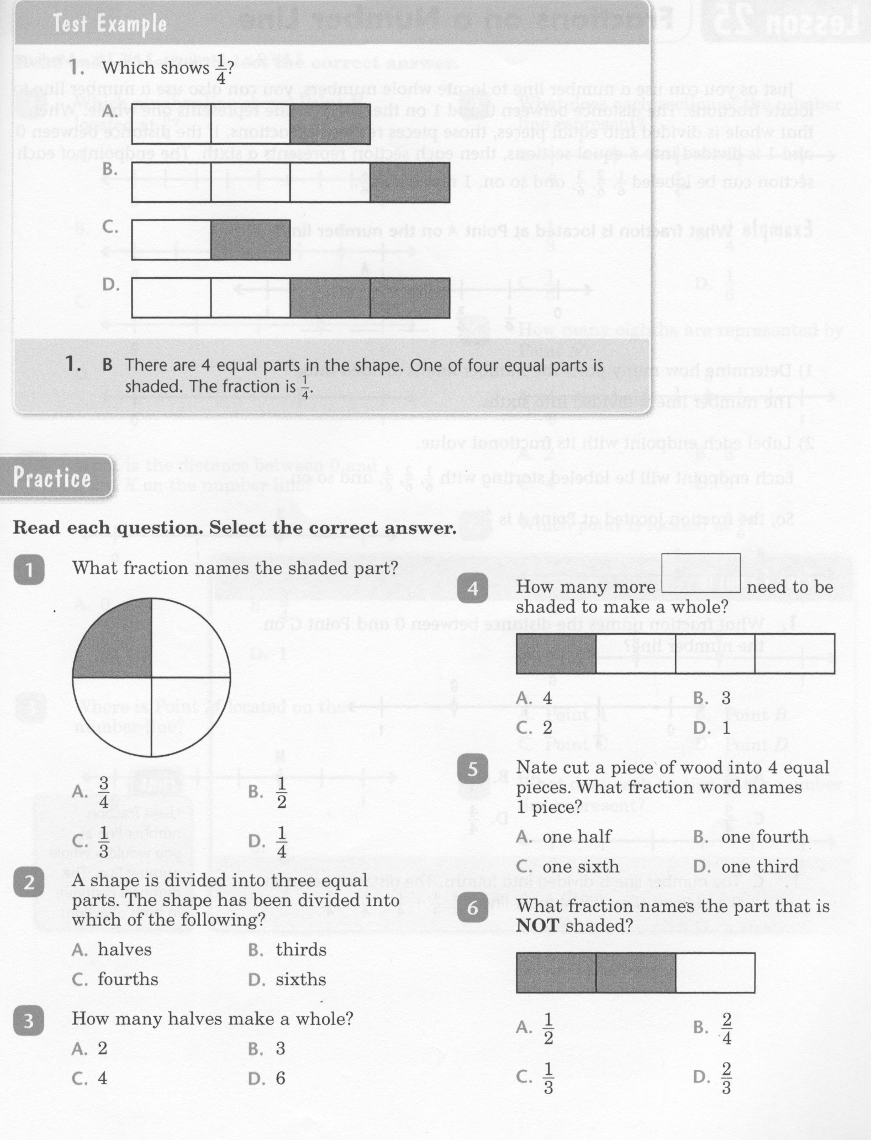
Math-E - Lesson 24 – Fractions of a Whole

Slide 4
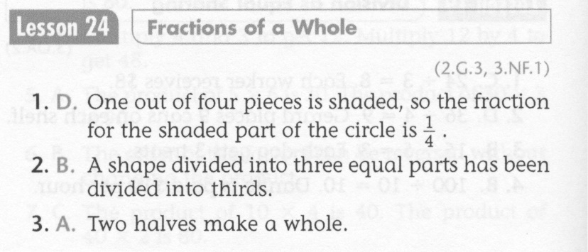
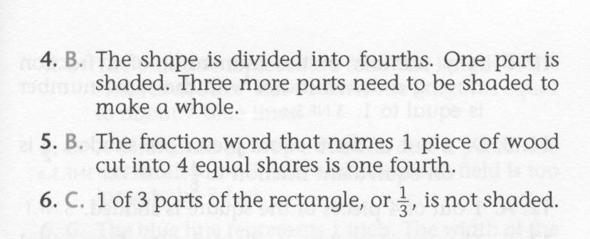
Math-E - Lesson 24 – Fractions of a Whole

Slide 5
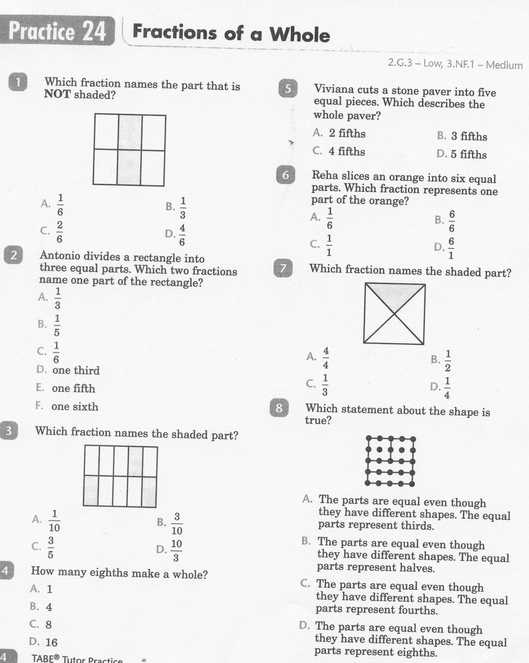
Math-E - Lesson 24 – Fractions of a Whole

Slide 6
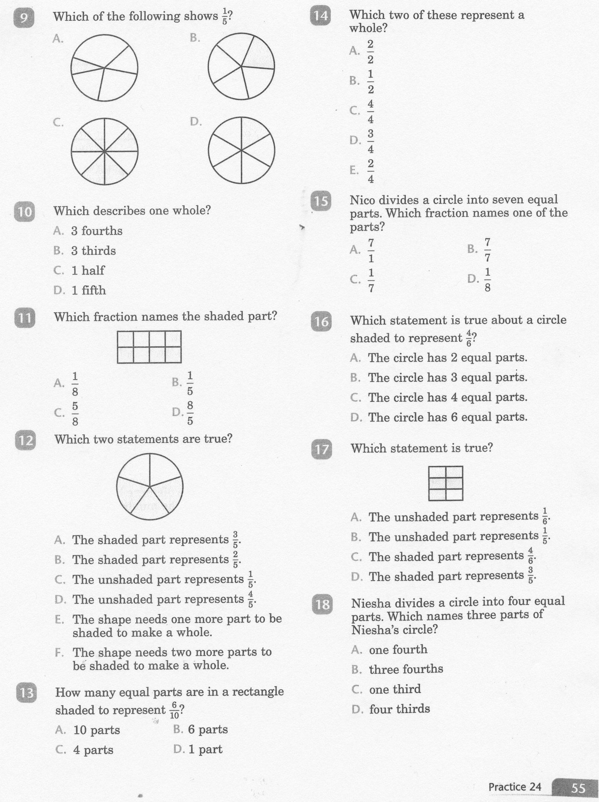
Math-E - Lesson 24 – Fractions of a Whole

Slide 7
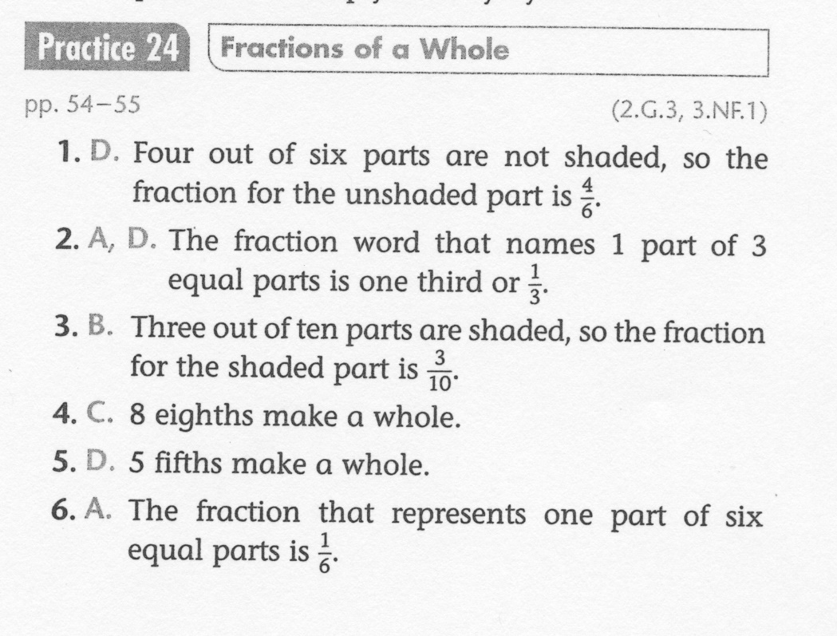
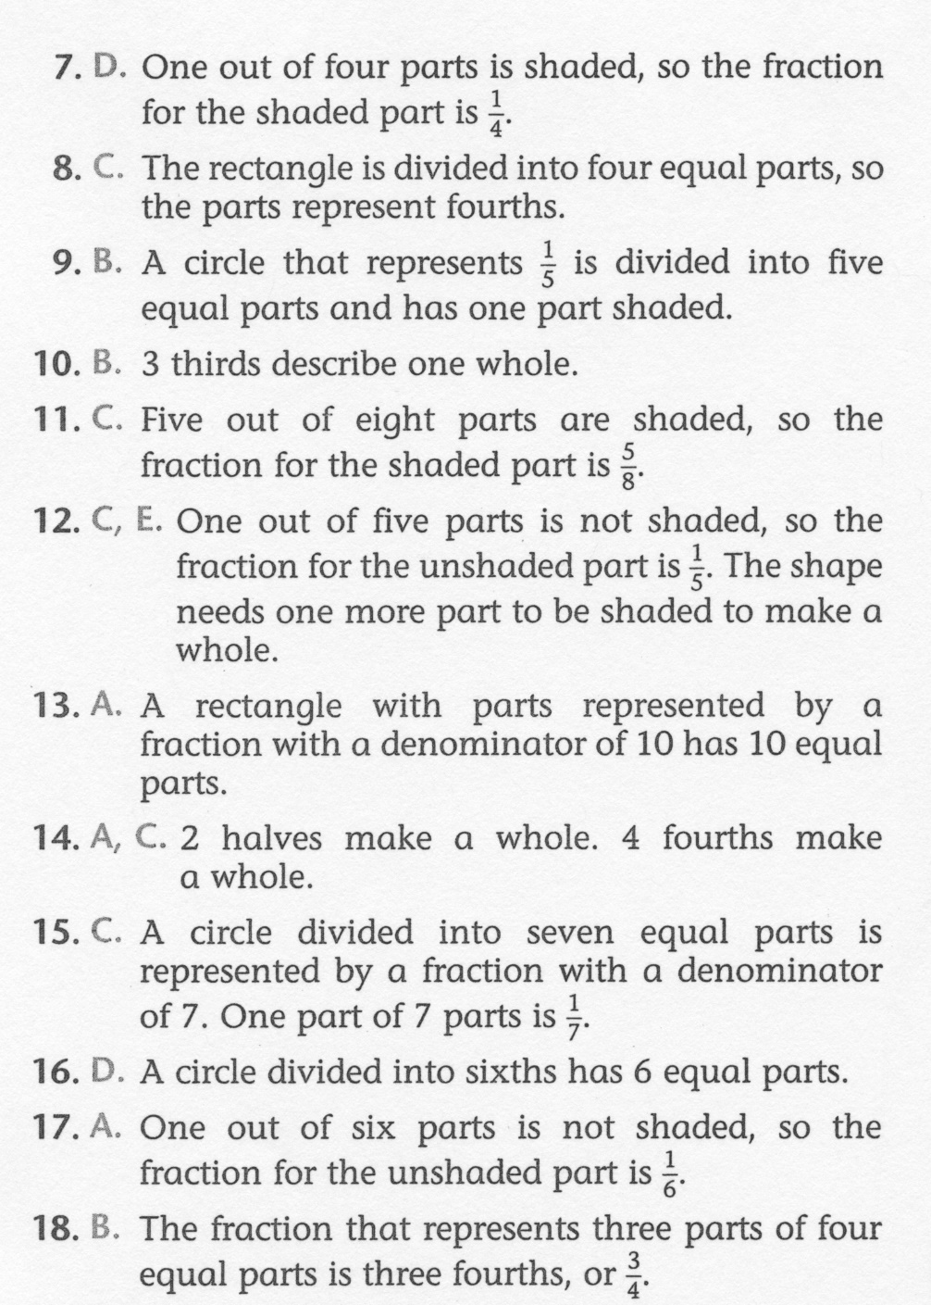
Math-E - Lesson 24 – Fractions of a Whole

