Slide 1
TABE Math-E PRAXEN Unit-2 Add and Subtract Whole Numbers Lesson-10 Subtraction Models
Revised: October 16, 2023
Nolan Tomboulian
Some graphics may not have copied well during the scan process.

Slide 2
Math-E - Lesson-10 – Subtraction Models

Slide 3
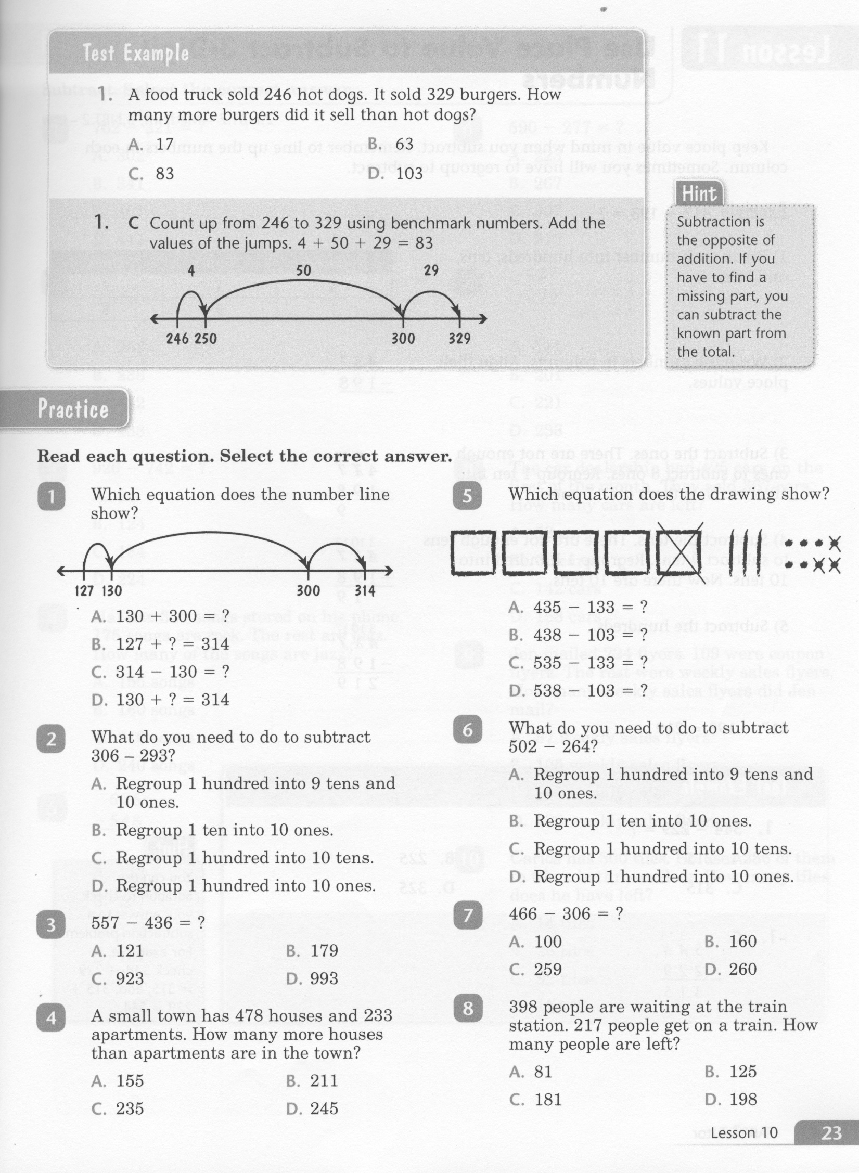
Math-E - Lesson-10 – Subtraction Models

Slide 4
Math-E - Lesson-10 – Subtraction Models

Slide 5
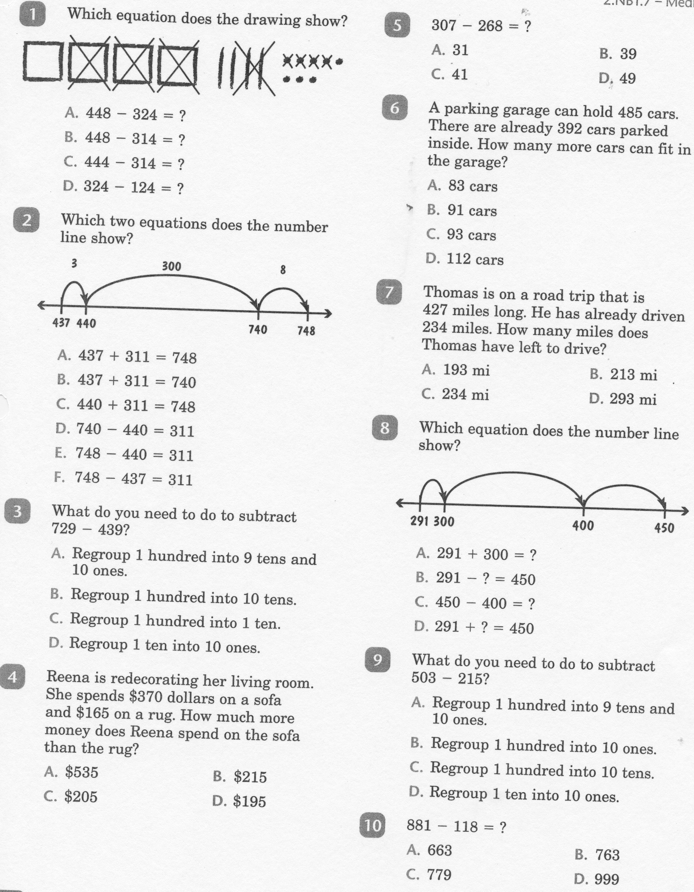
Math-E - Practice-10 – Subtraction Models

Slide 6
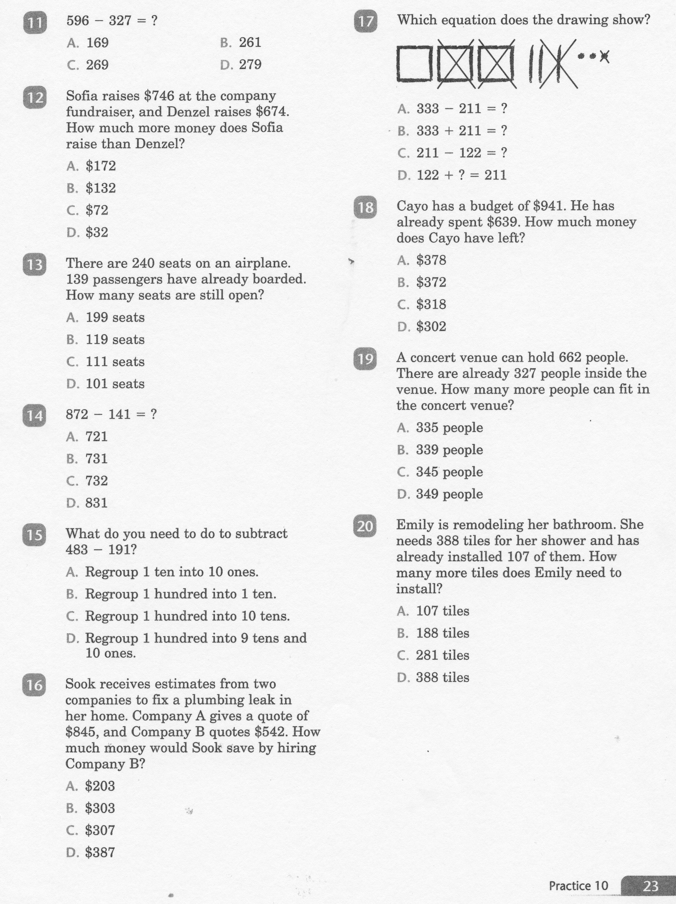
Math-E - Practice-10 – Subtraction Models

Slide 7
Math-E - Practice-10 – Subtraction Models

