Slide 1
TABE Math – D Pre-Test KEY
Revised: March 6, 2024

Slide 2
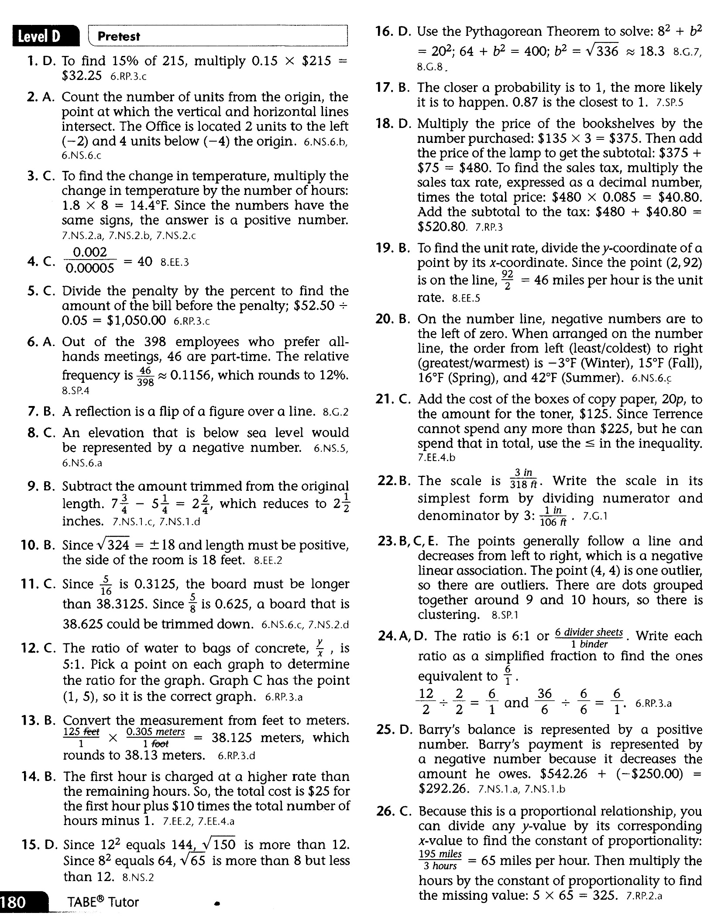
TABE-D : PreTest Review

Slide 3
