Slide 1
TABE ELA-E PAXEN Unit-5 Text Types and Purposes Lesson-36 Transitions
Some graphics may not have copied well during the Scan Process

Slide 2
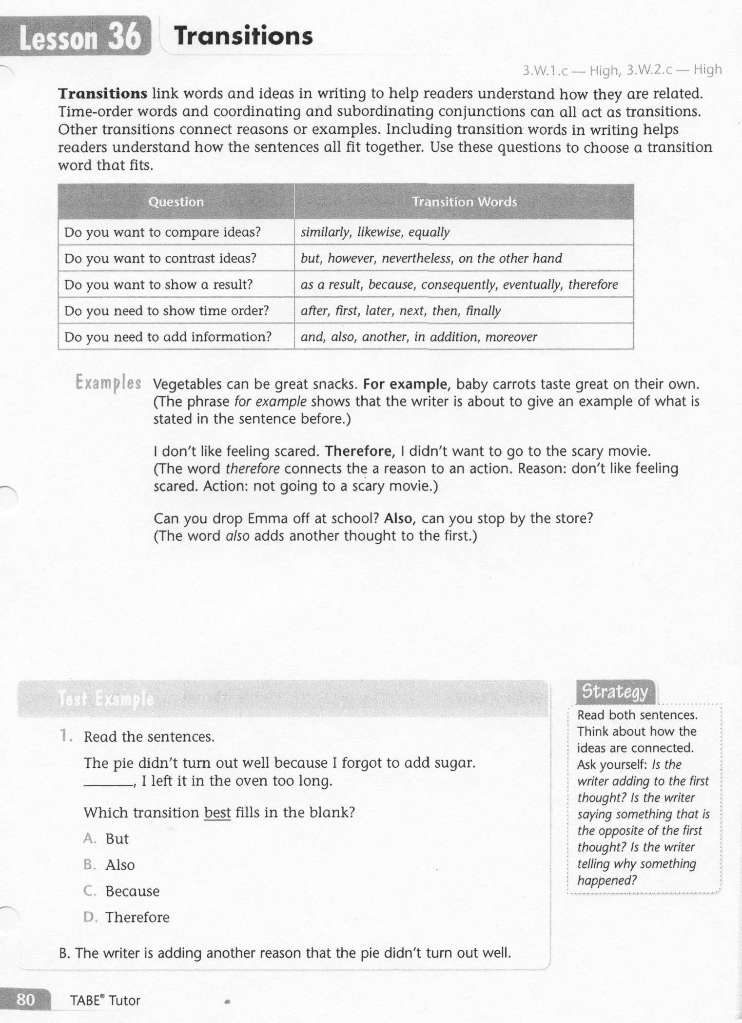
ELA-E-36 Transitions

Slide 3
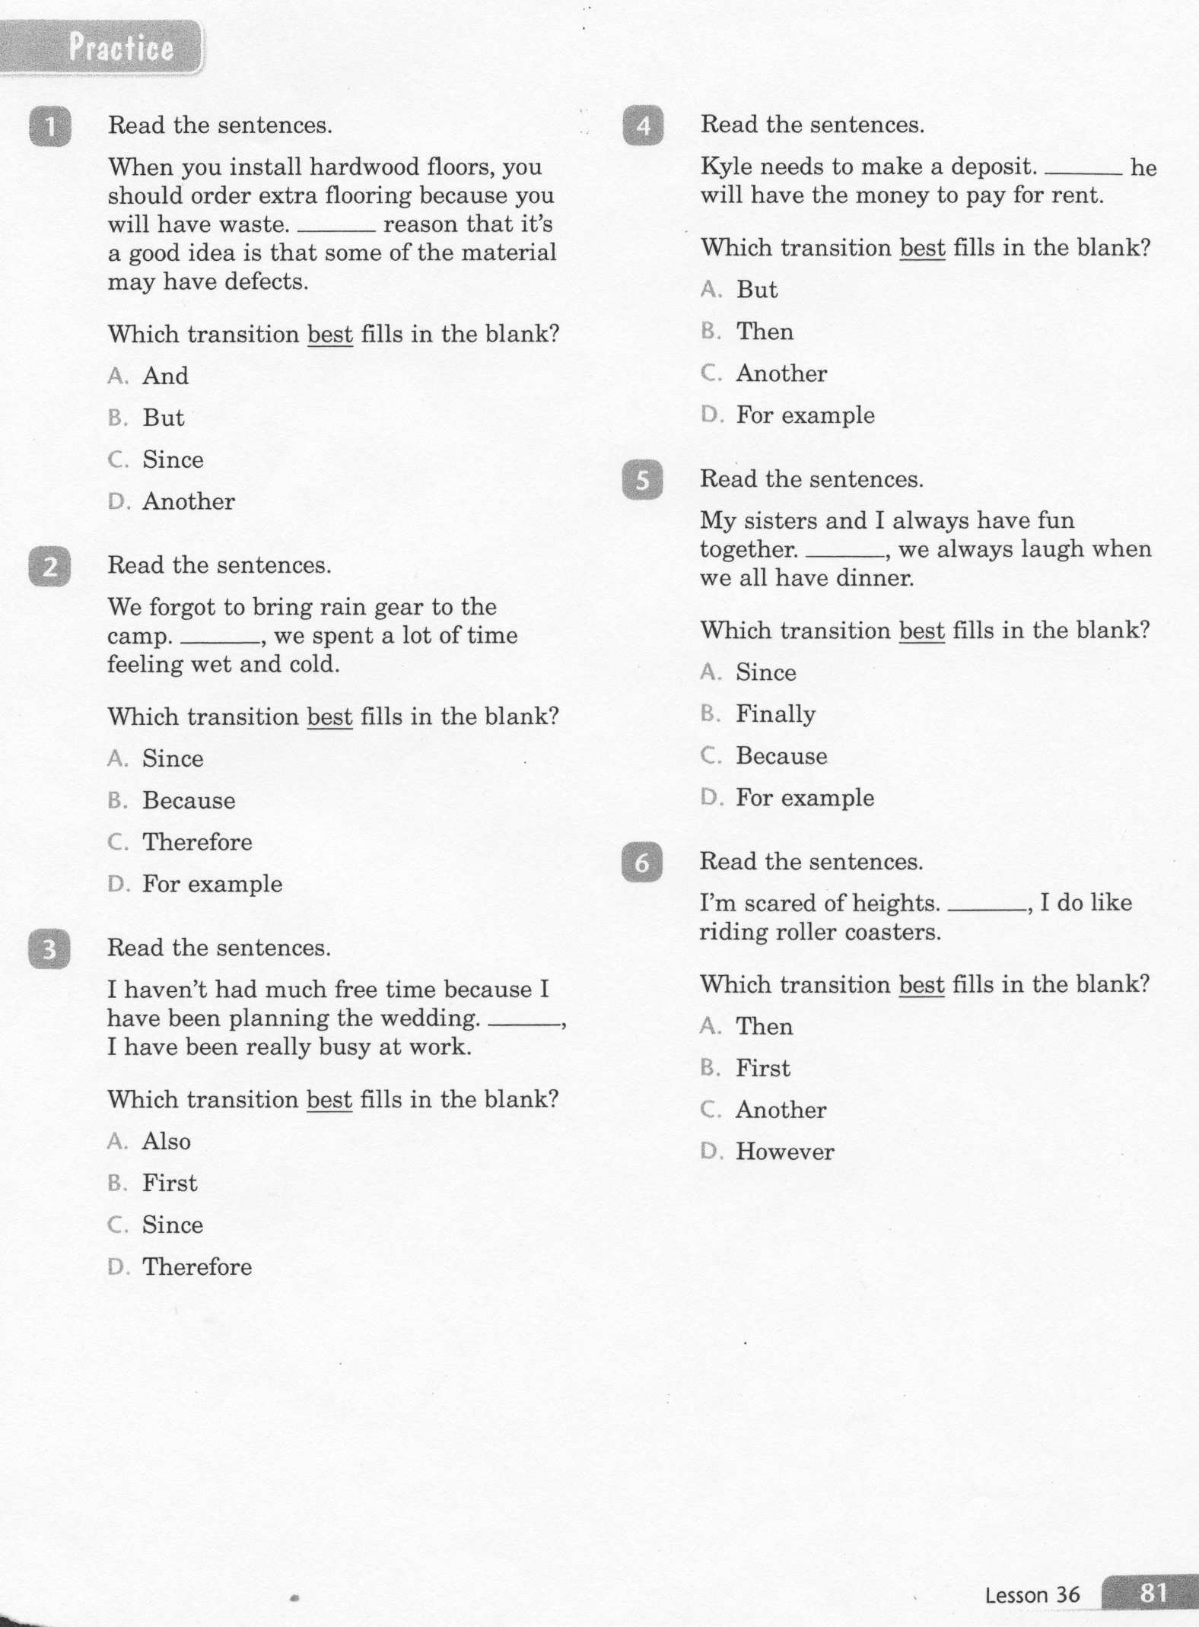
ELA-E-36 Transitions

Slide 4
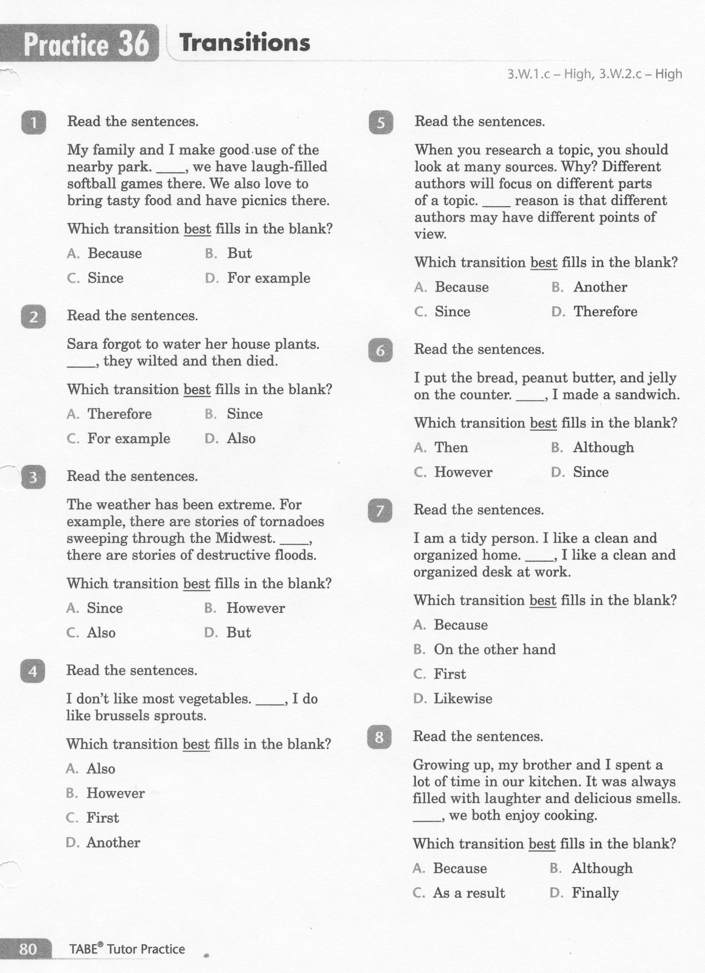
ELA-E-36 Transitions

Slide 5
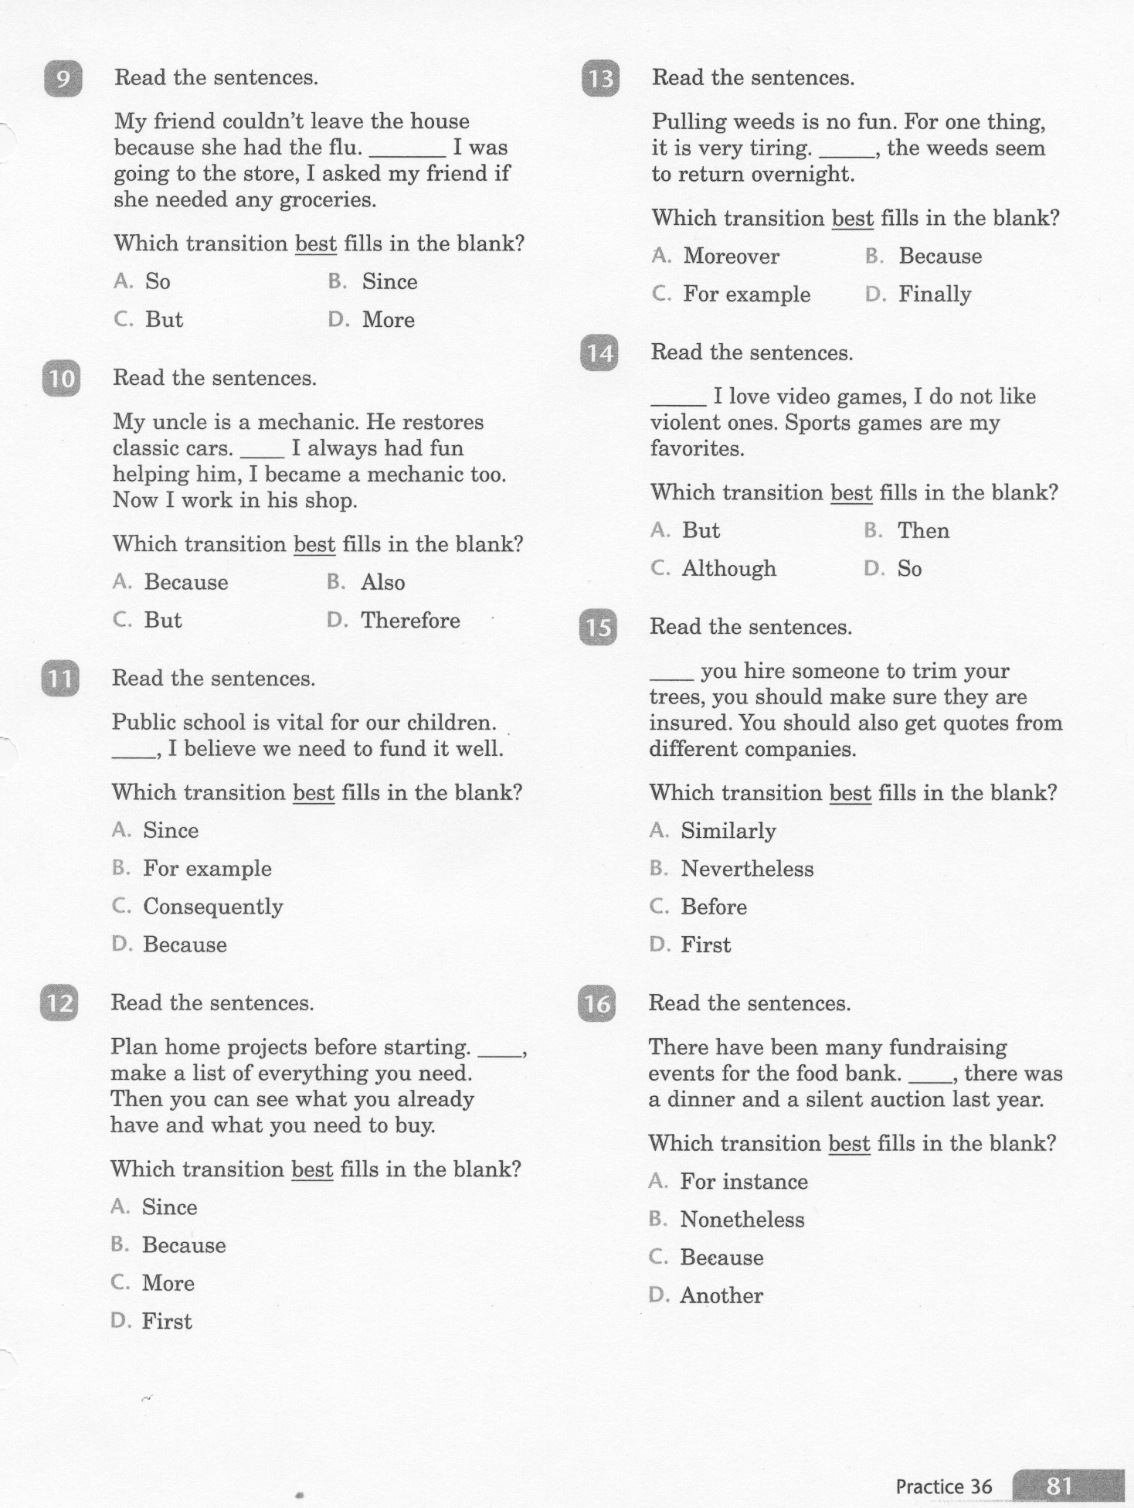
ELA-E-36 Transitions

Slide 6
ELA-E-36 Transitions

Slide 7
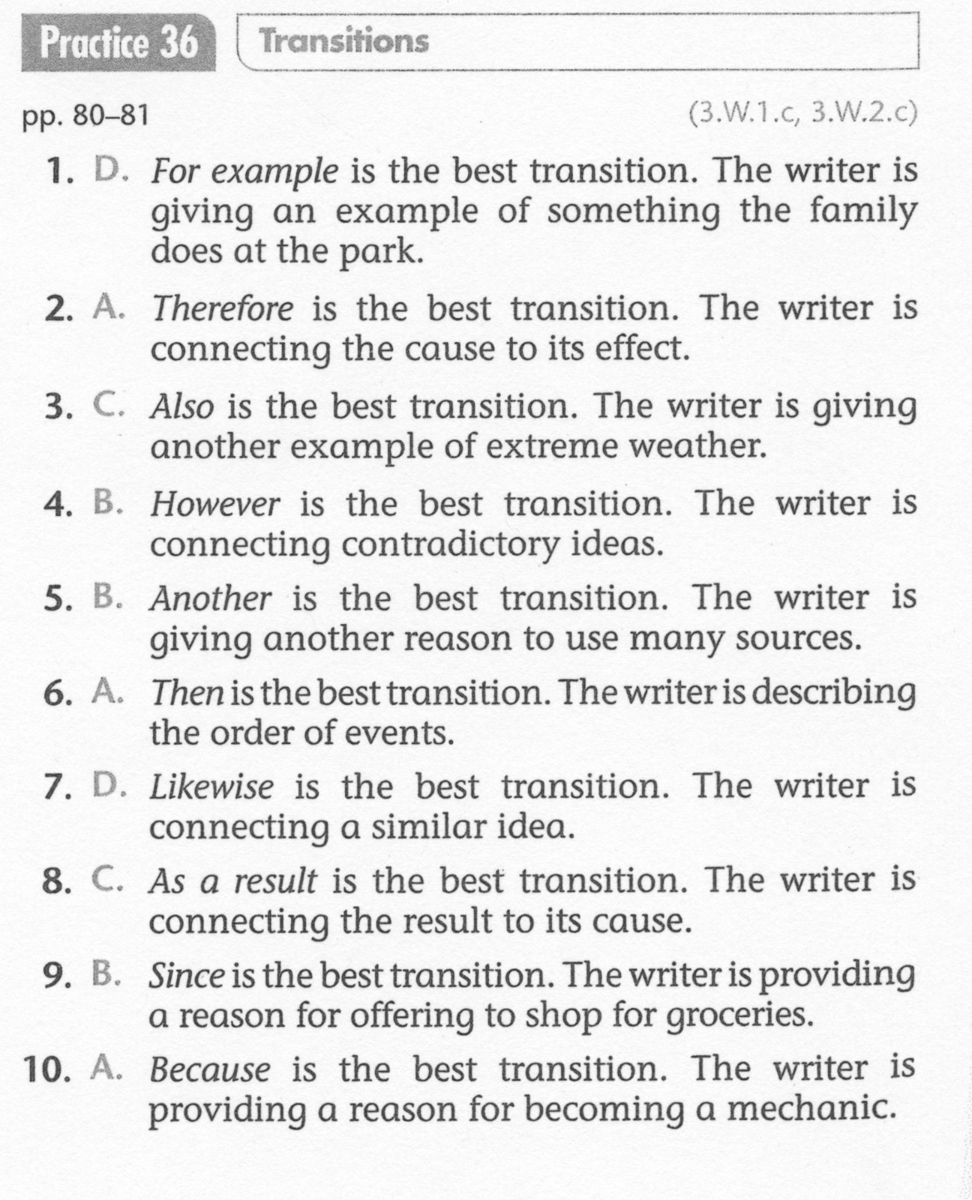
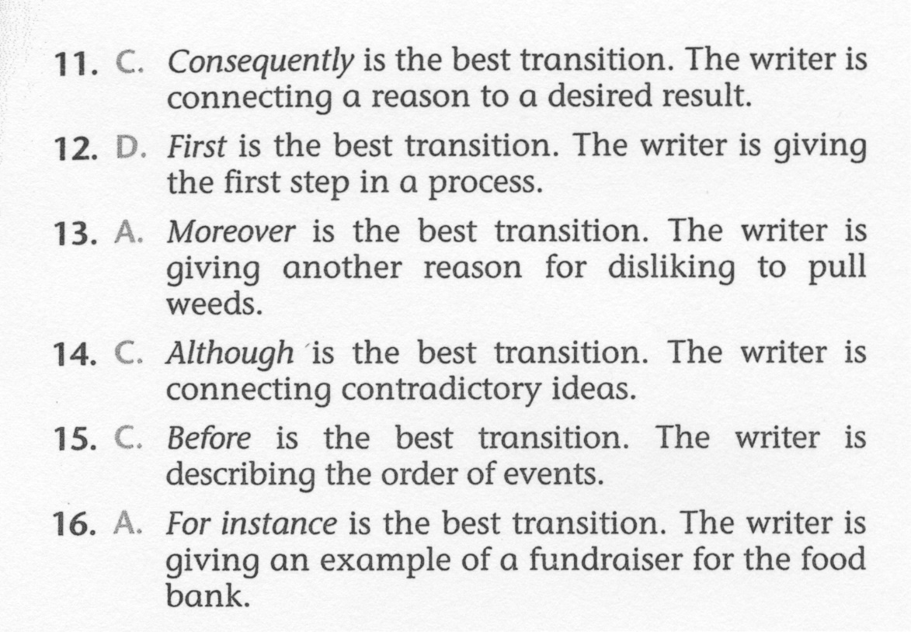
ELA-E-36 Transitions

