Slide 1
TABE ELA-E PAXEN Unit-5 Text Types and Purposes Lesson-31 Text Purposes: Opinion and Informative
Some graphics may not have copied well during the Scan Process

Slide 2
ELA-E-31 Text Types: Opinions

Slide 3
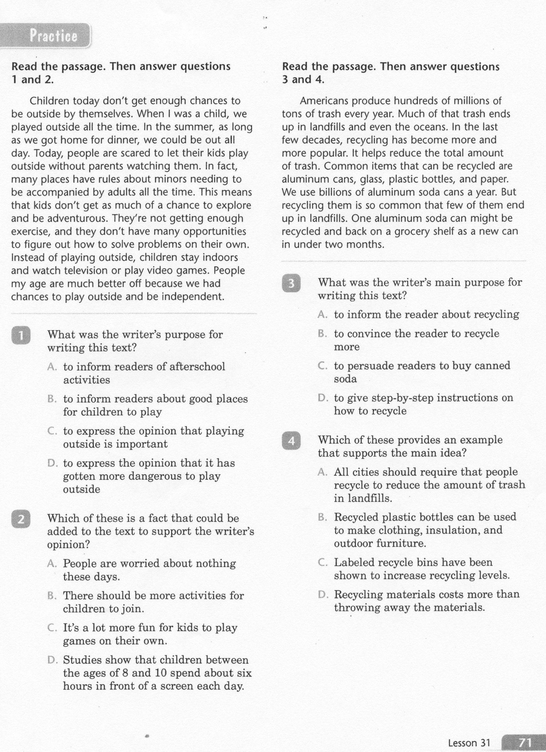
ELA-E-31 Text Types: Opinions

Slide 4
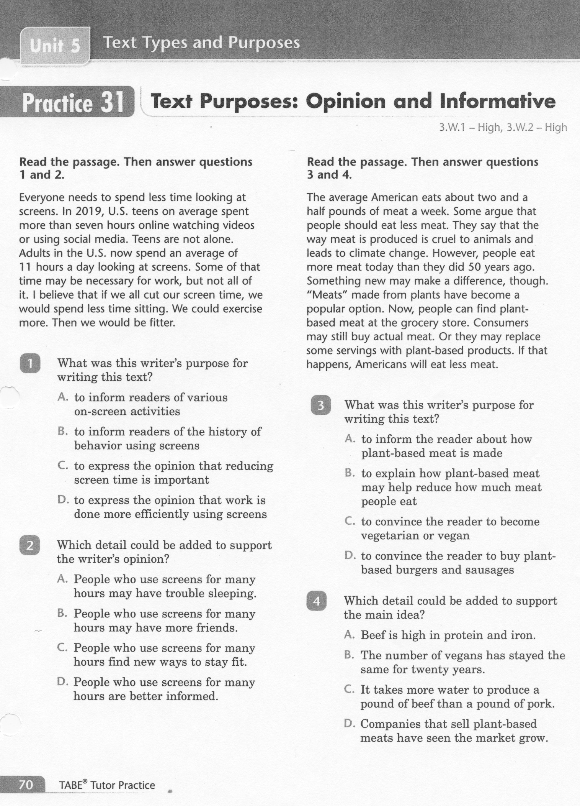
ELA-E-31 Text Types: Opinions

Slide 5
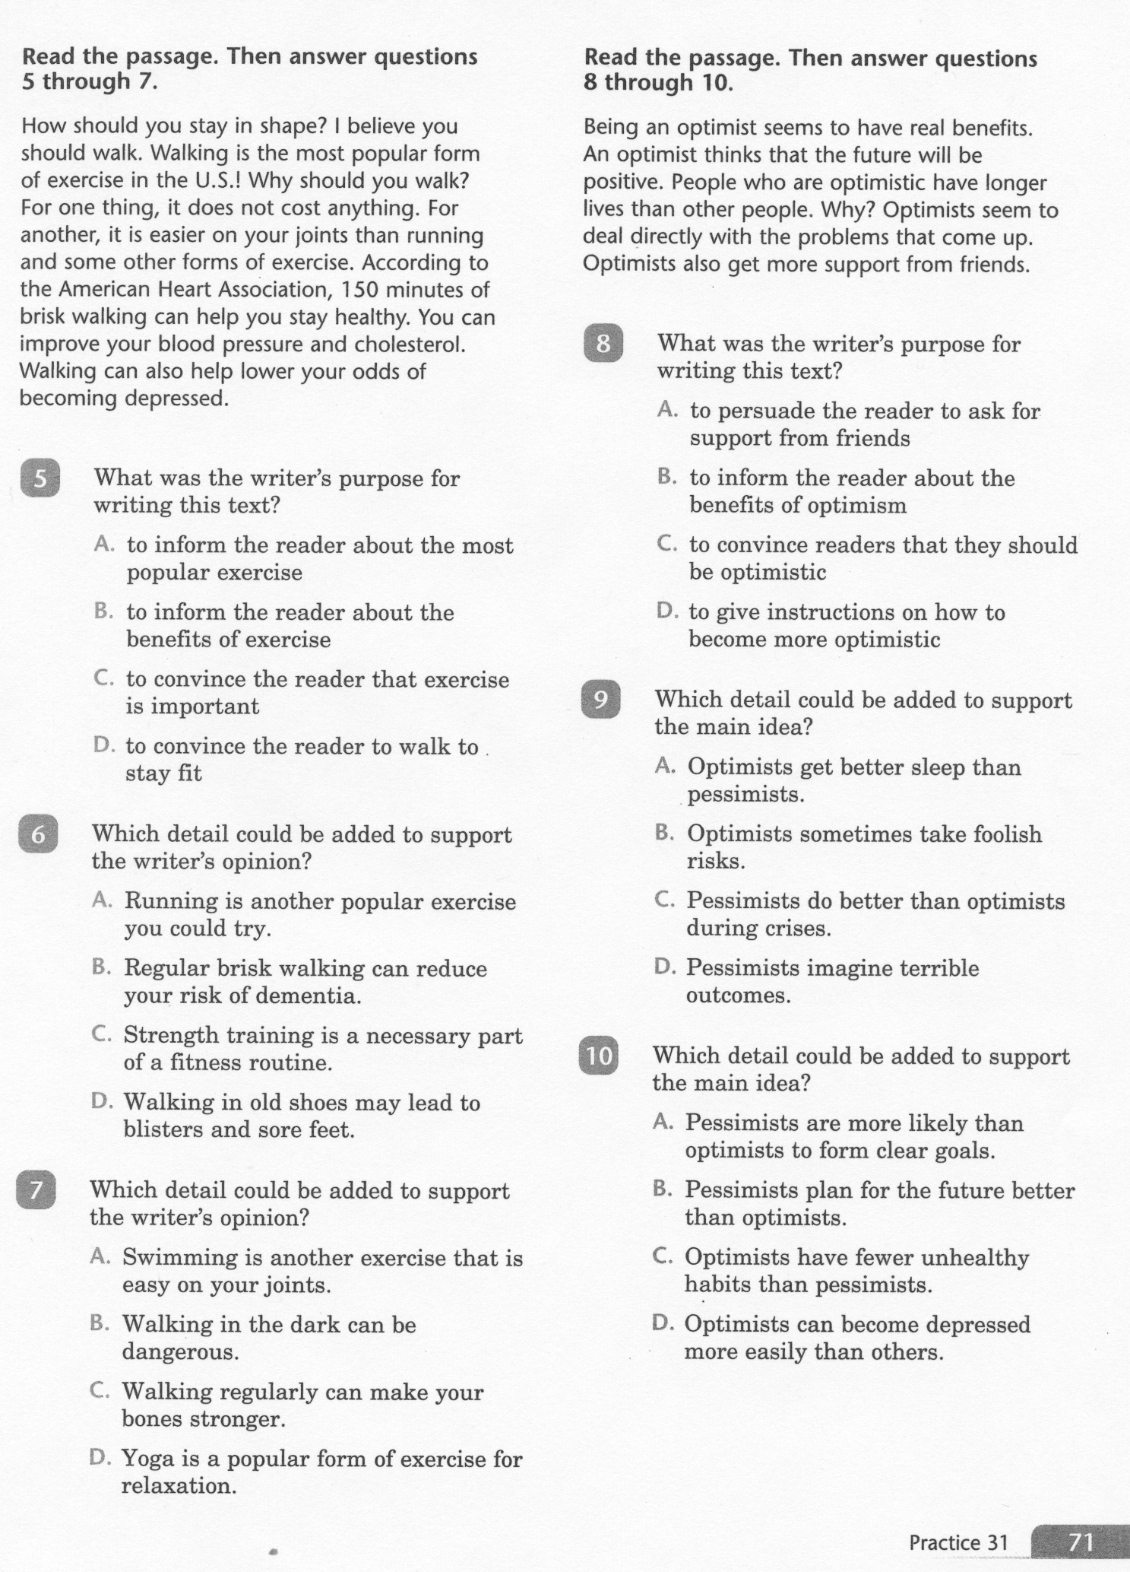
ELA-E-31 Text Types: Opinions

Slide 6
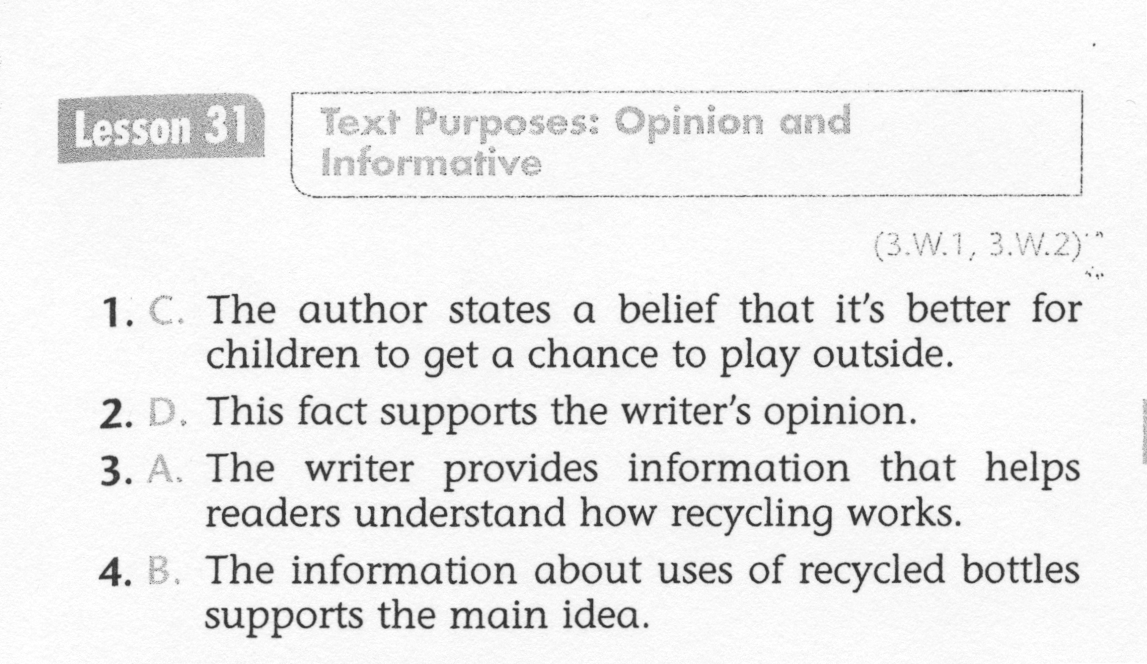
ELA-E-31 Text Types: Opinions

Slide 7
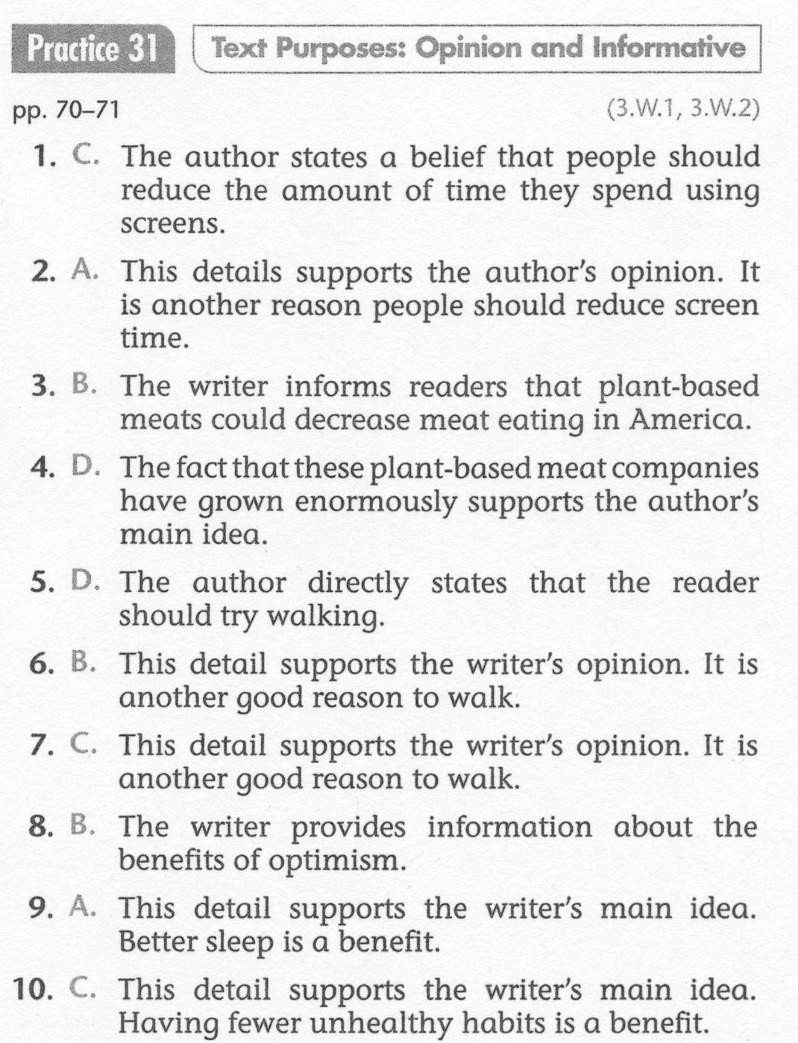
ELA-E-31 Text Types: Opinions

