Slide 1
TABE ELA-E PAXEN Unit-2 Punctuation, Capitalization, and Spelling Lesson-13 Capitalization
Some graphics may not have copied well during the Scan Process

Slide 2
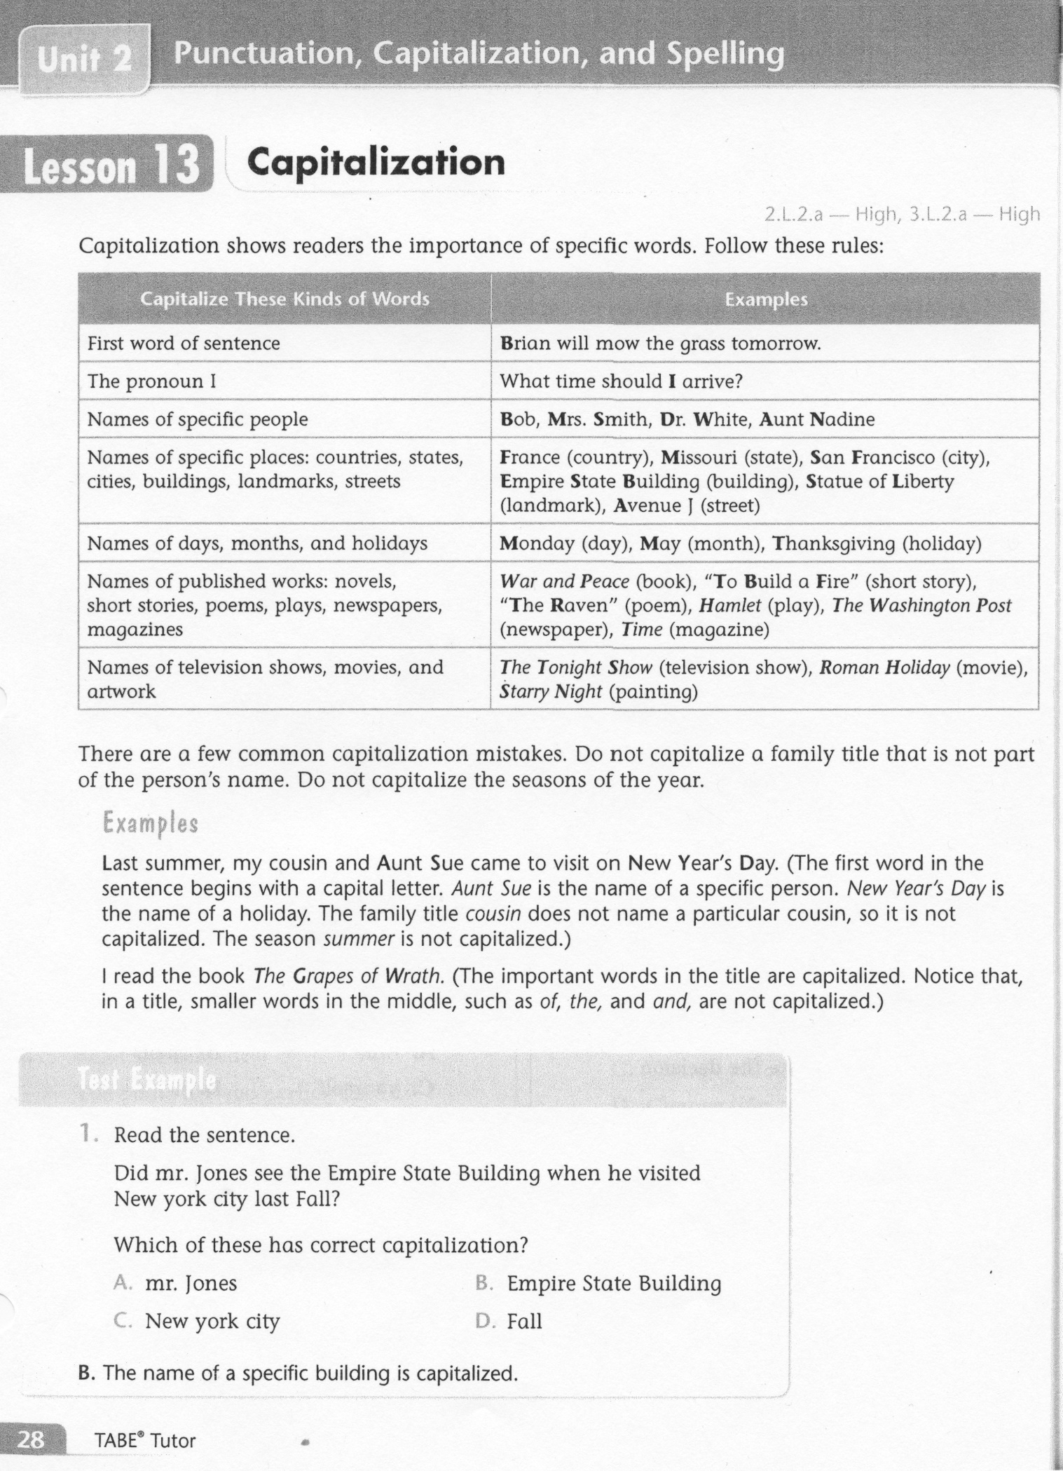
ELA-E-13 Capitalization

Slide 3
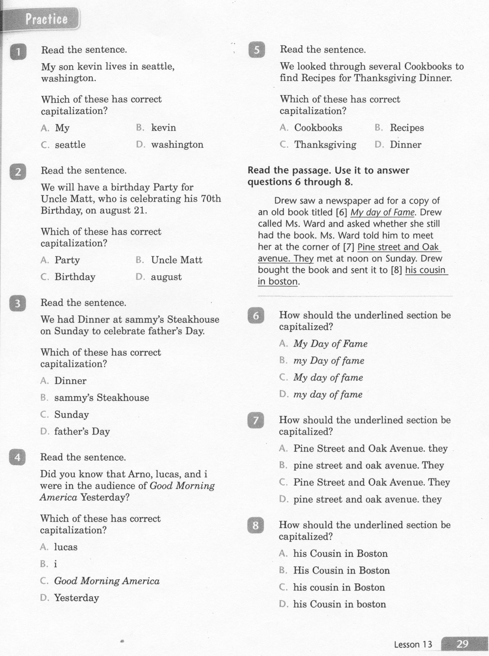
ELA-E-13 Capitalization

Slide 4
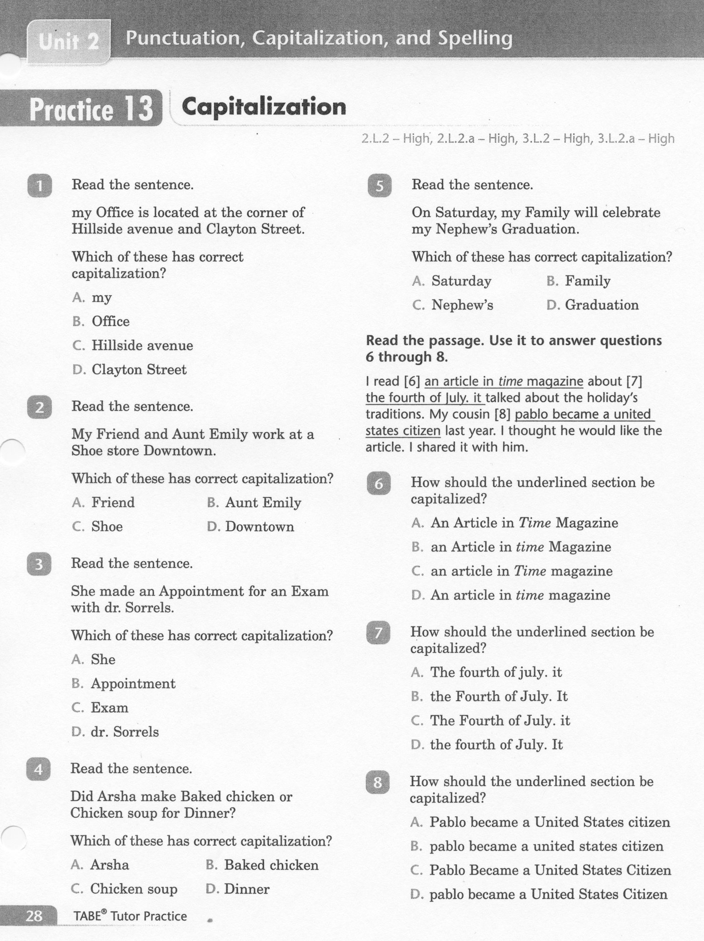
ELA-E-13 Capitalization

Slide 5
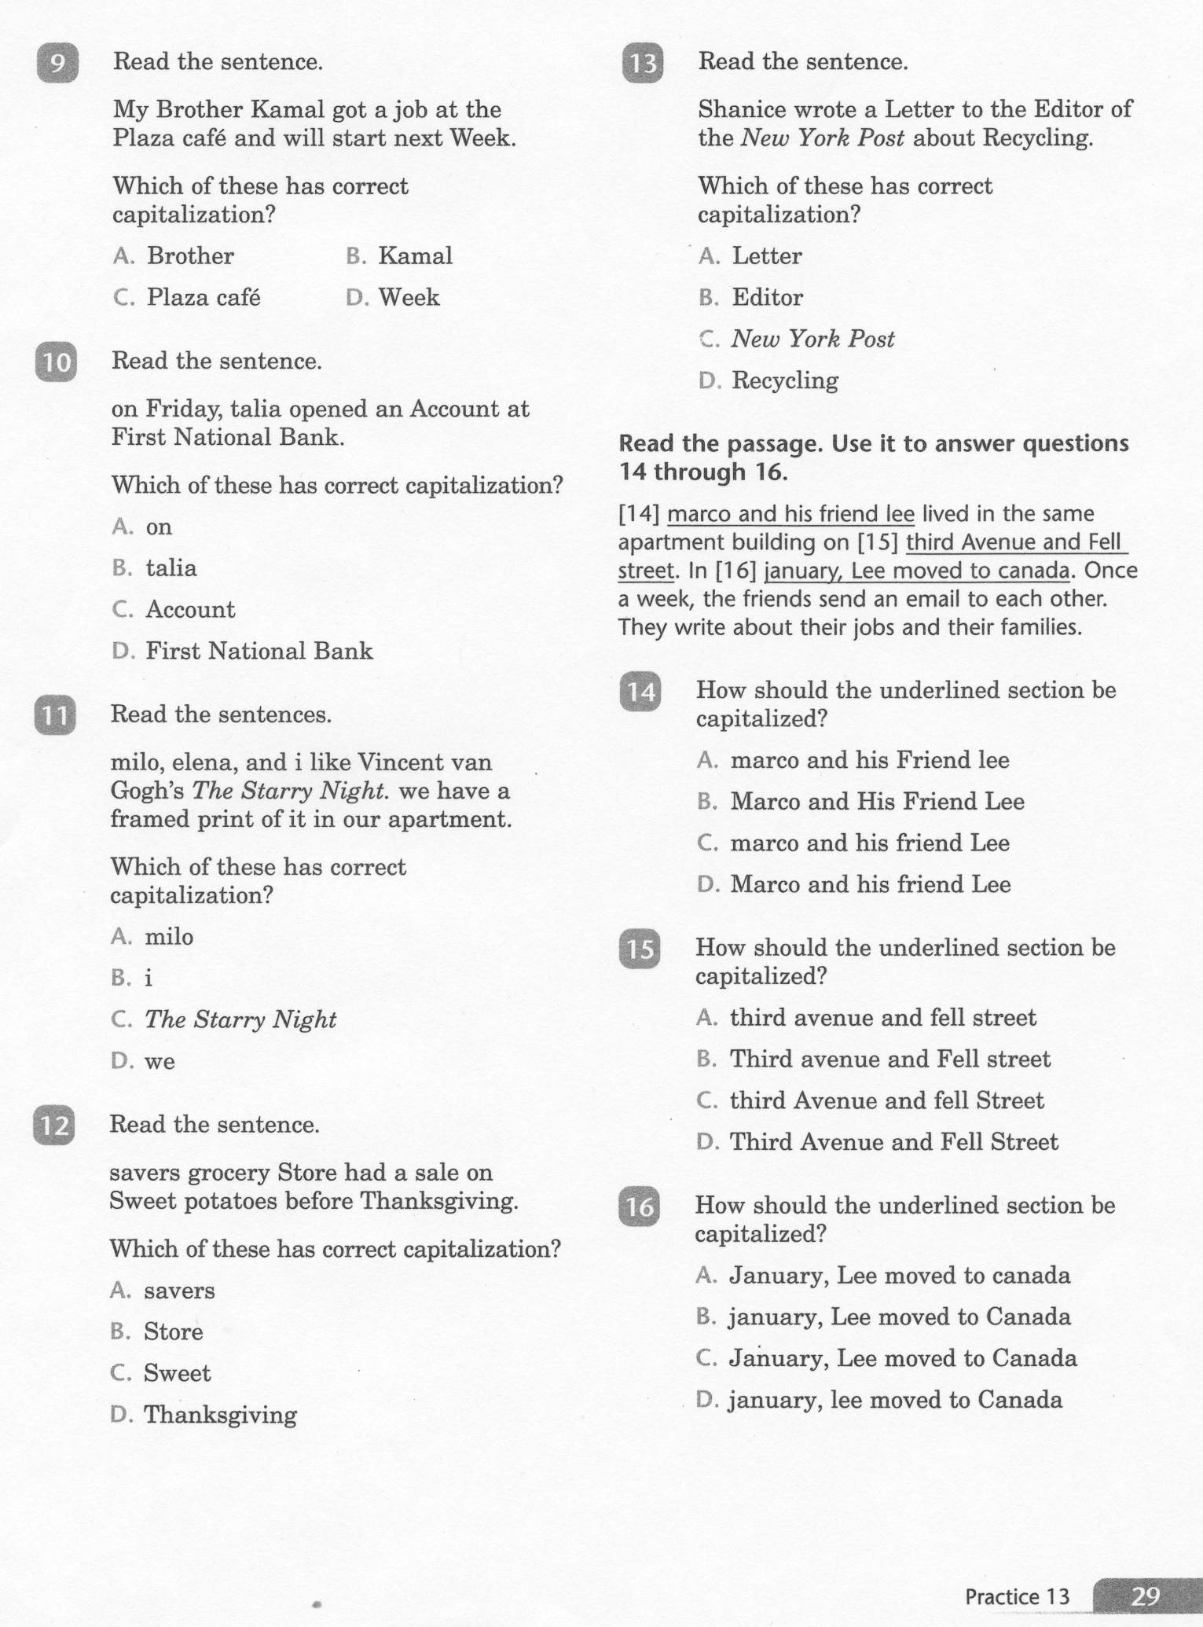
ELA-E-13 Capitalization

Slide 6
ELA-E-13 Capitalization

Slide 7
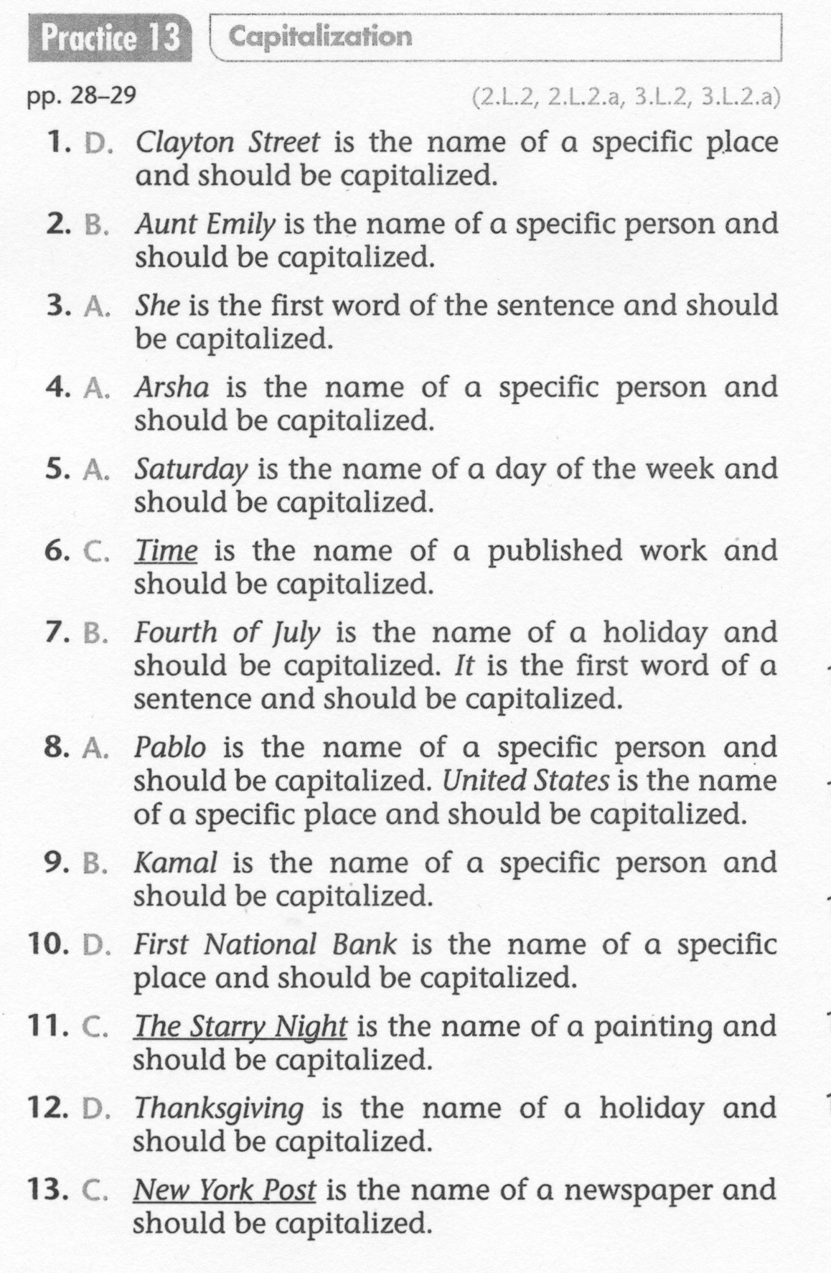
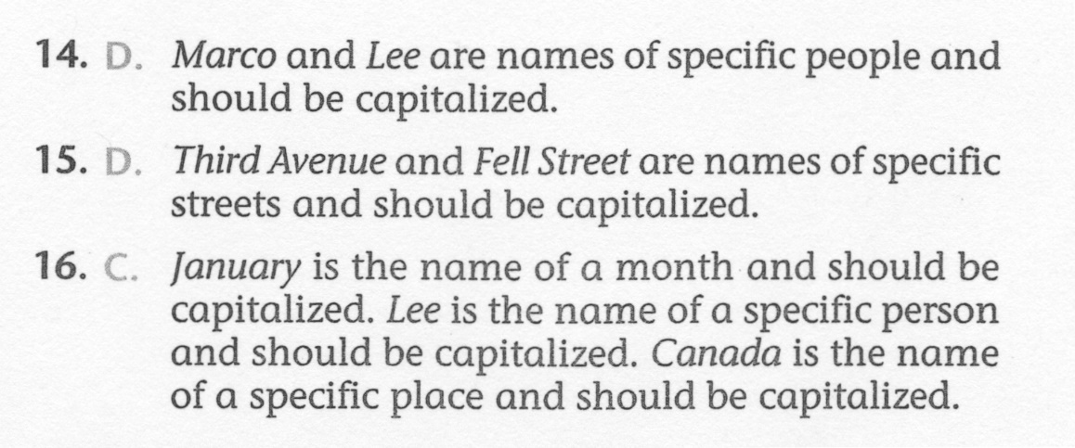
ELA-E-13 Capitalization

