Slide 1
TABE ELA-E PAXEN Unit-1 Usage Lesson-11 Subject and Verb Agreement
Some graphics may not have copied well during the Scan Process

Slide 2
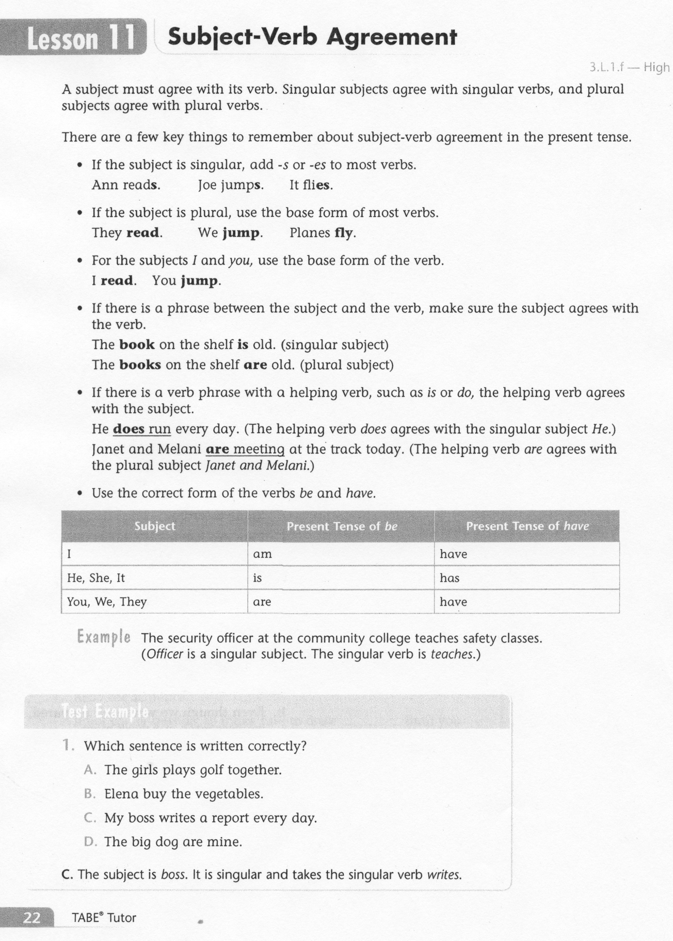
ELA-E-11 Subject and Verb Agreement

Slide 3
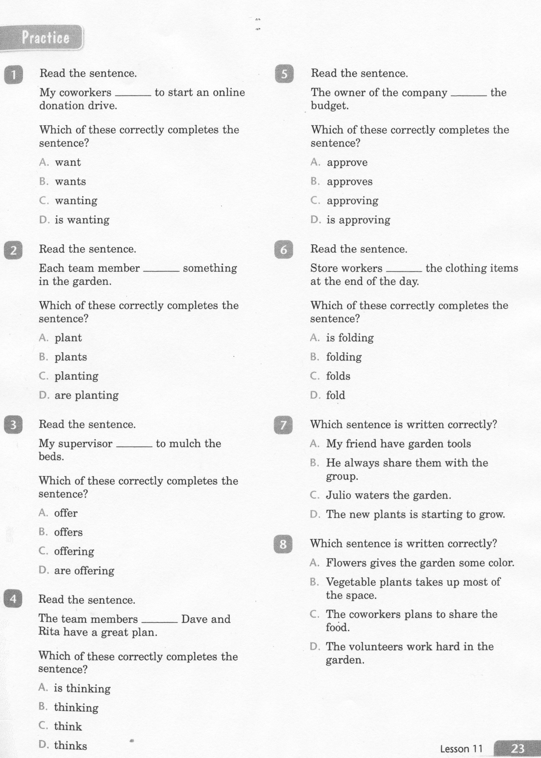
ELA-E-11 Subject and Verb Agreement

Slide 4
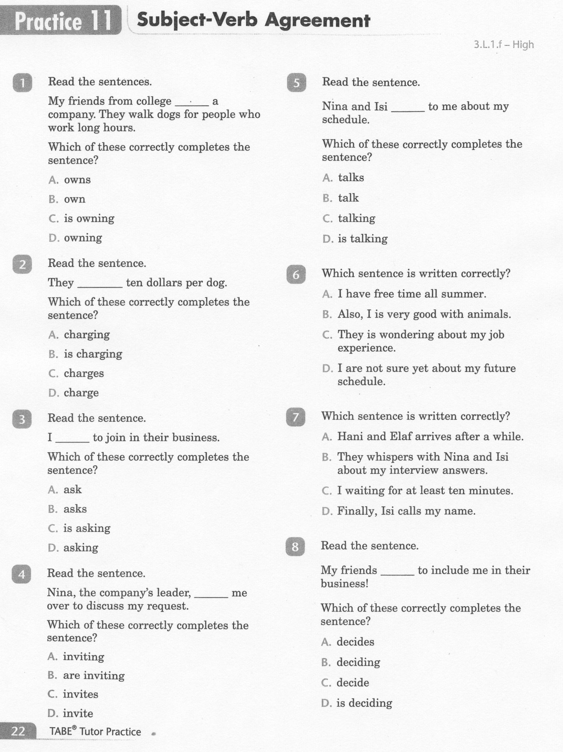
ELA-E-11 Subject and Verb Agreement

Slide 5
ELA-E-11 Subject and Verb Agreement

Slide 6
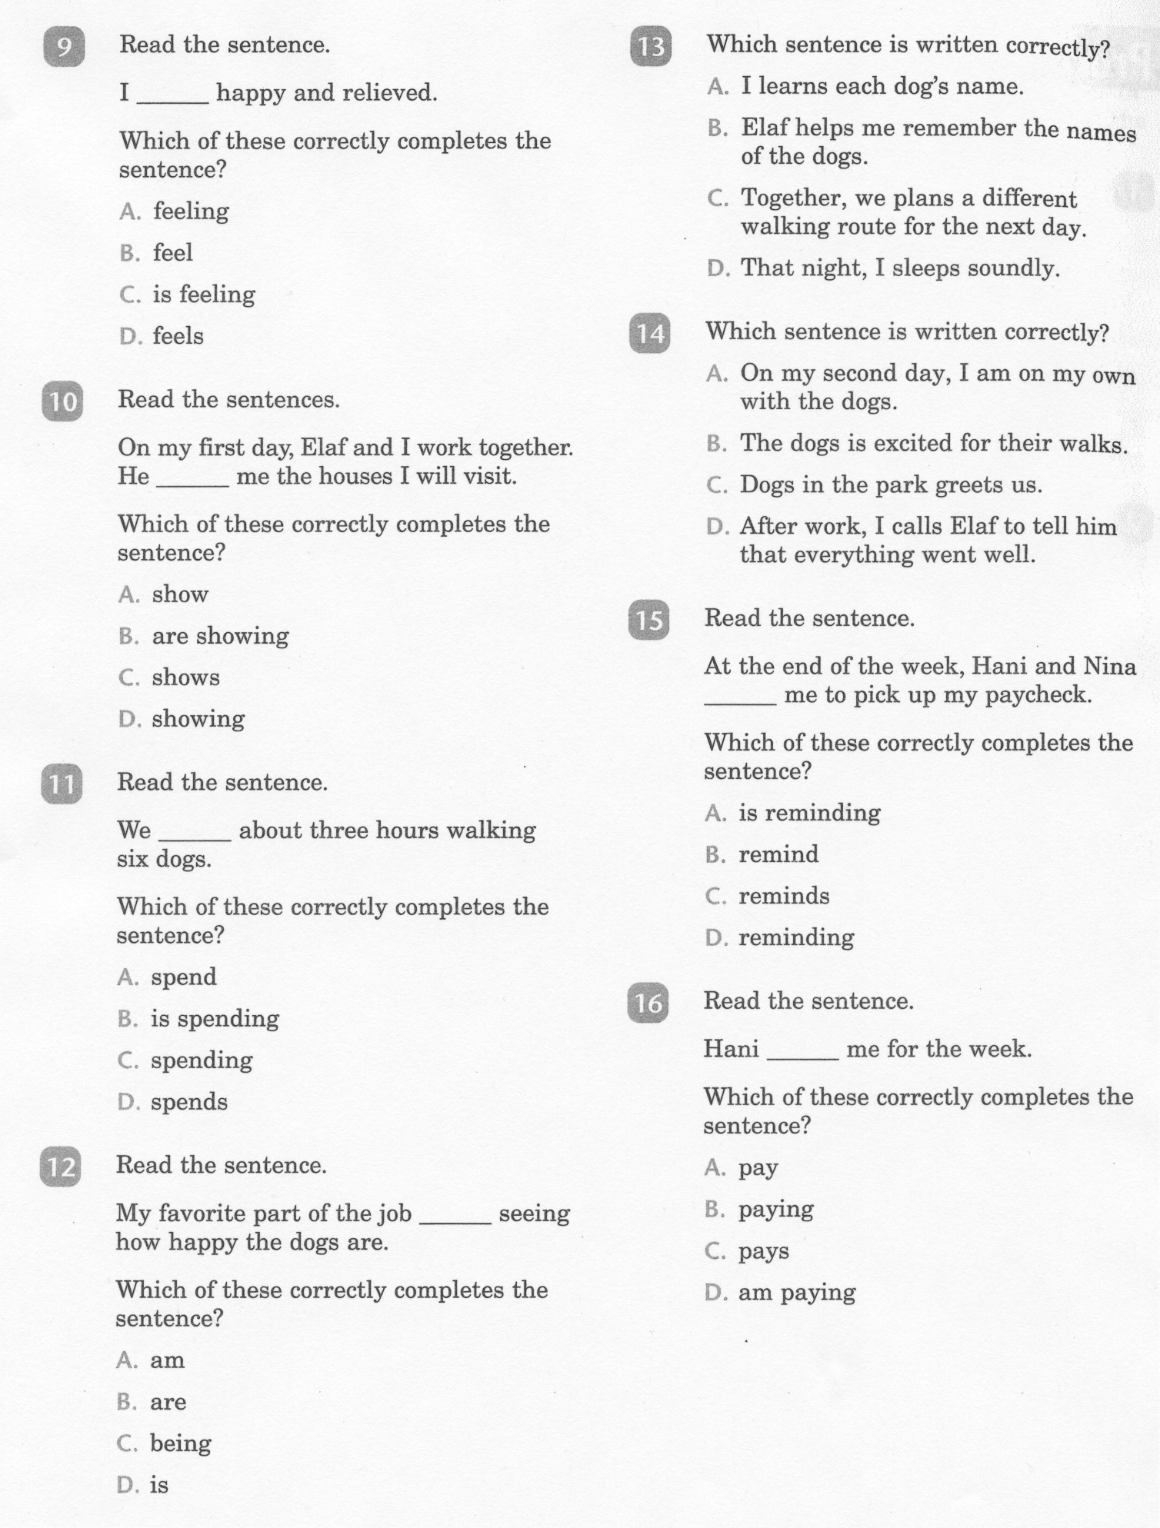
ELA-E-11 Subject and Verb Agreement

Slide 7
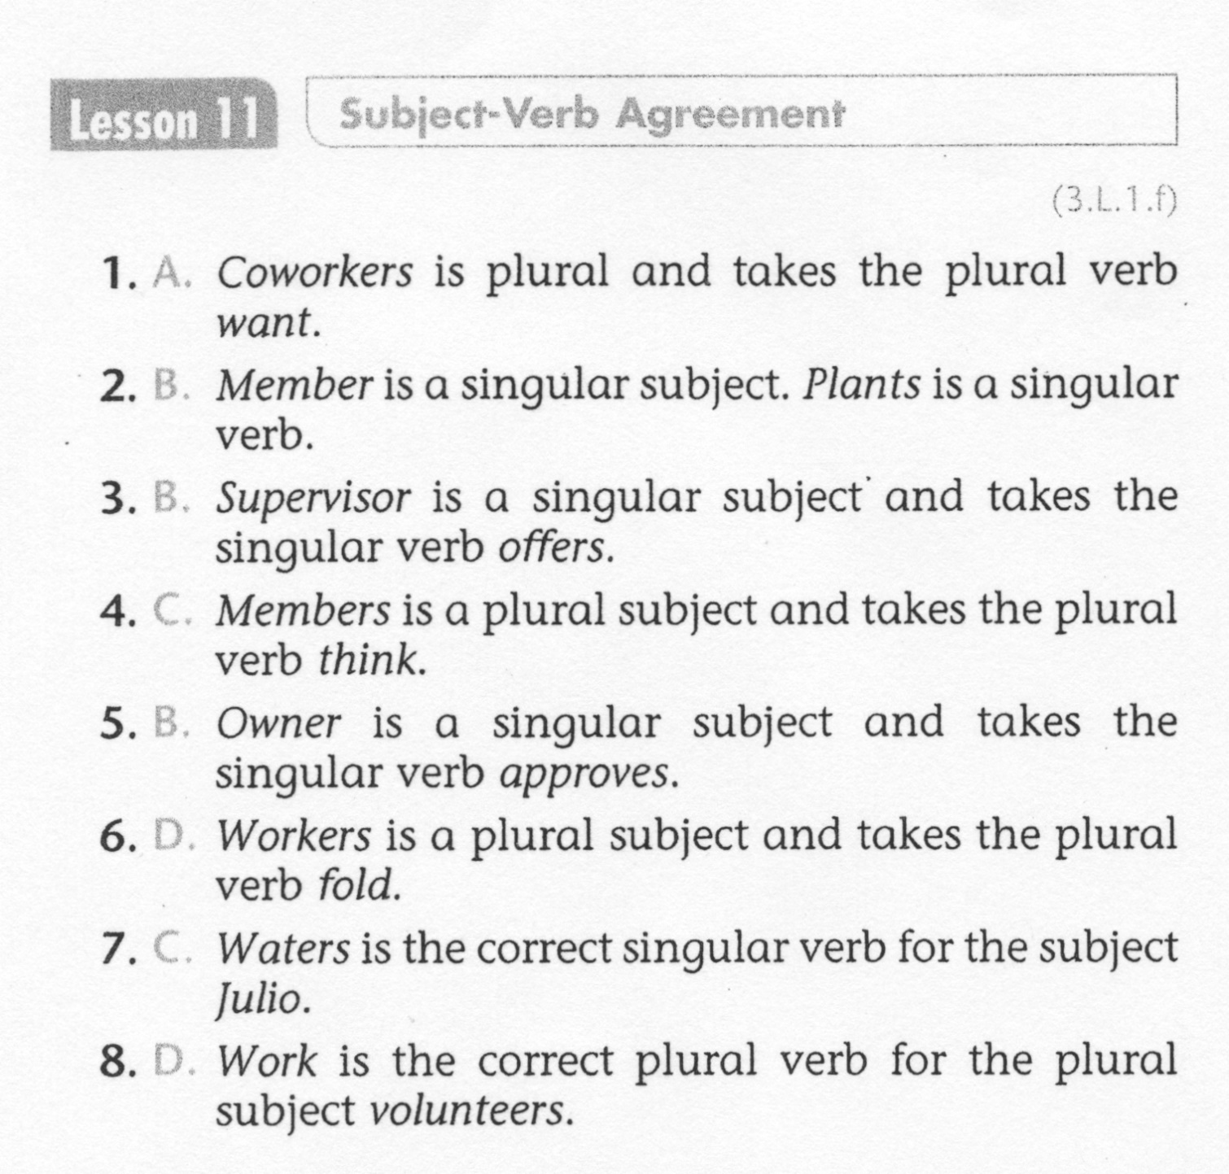
ELA-E-11 Subject and Verb Agreement

Slide 8
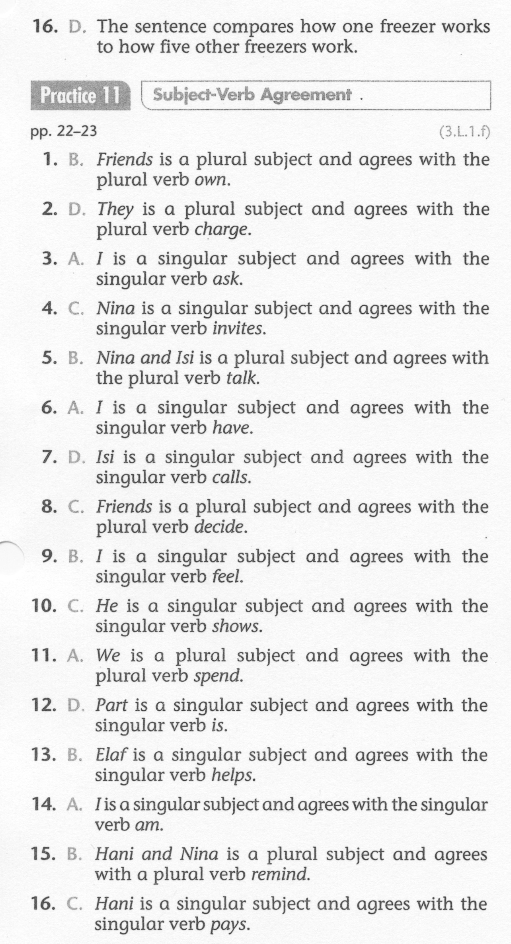
ELA-E-11 Subject and Verb Agreement

