Slide 1
TABE ELA-E PAXEN Unit-1 Usage Lesson-08 Verbs: Irregular Tenses
Some graphics may not have copied well during the Scan Process

Slide 2
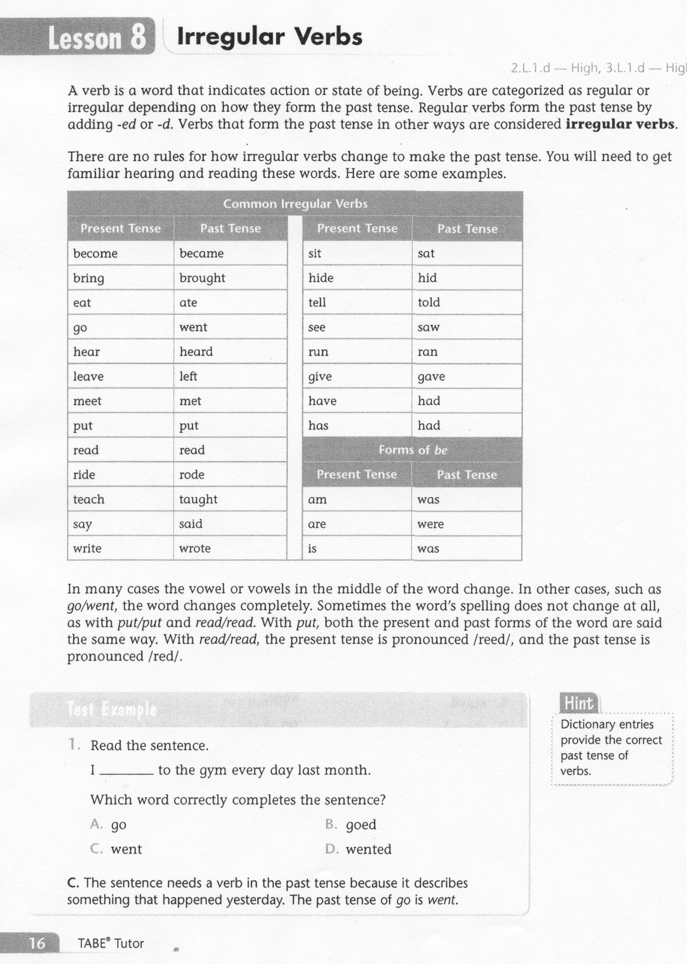
ELA-E-08 Verbs: Iregular Tenses

Slide 3
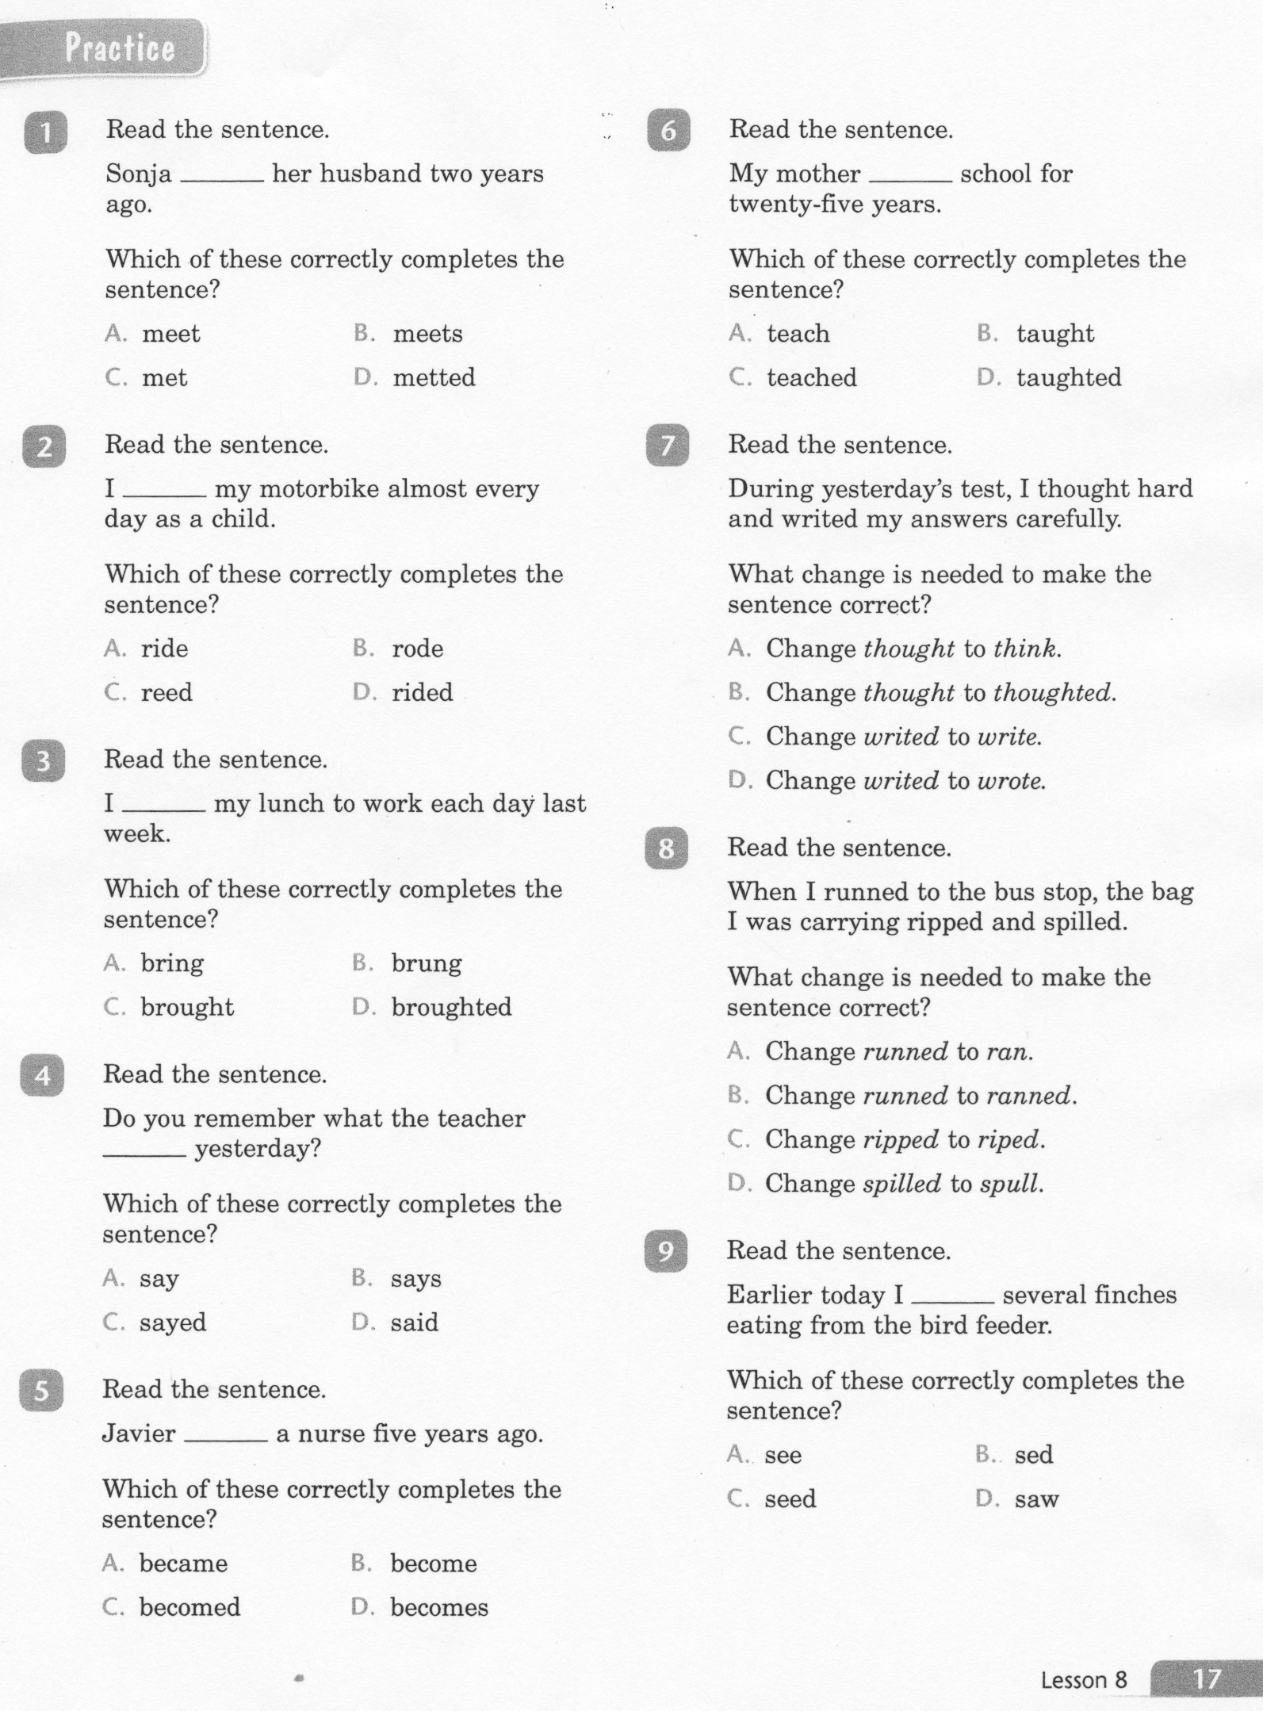
ELA-E-08 Verbs: Irregular Tenses

Slide 4
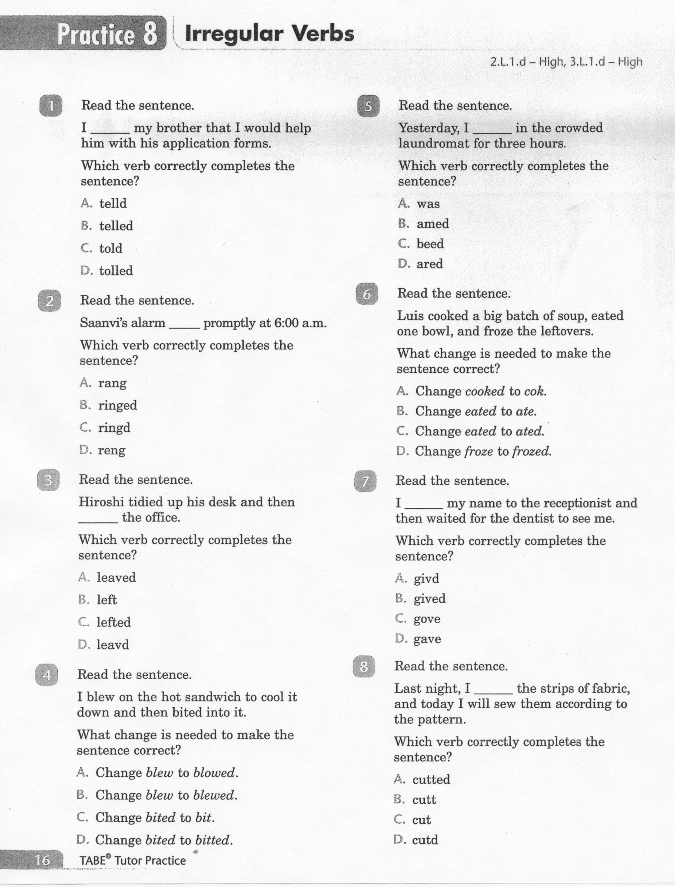
ELA-E-08 Verbs: Irregular Tenses

Slide 5
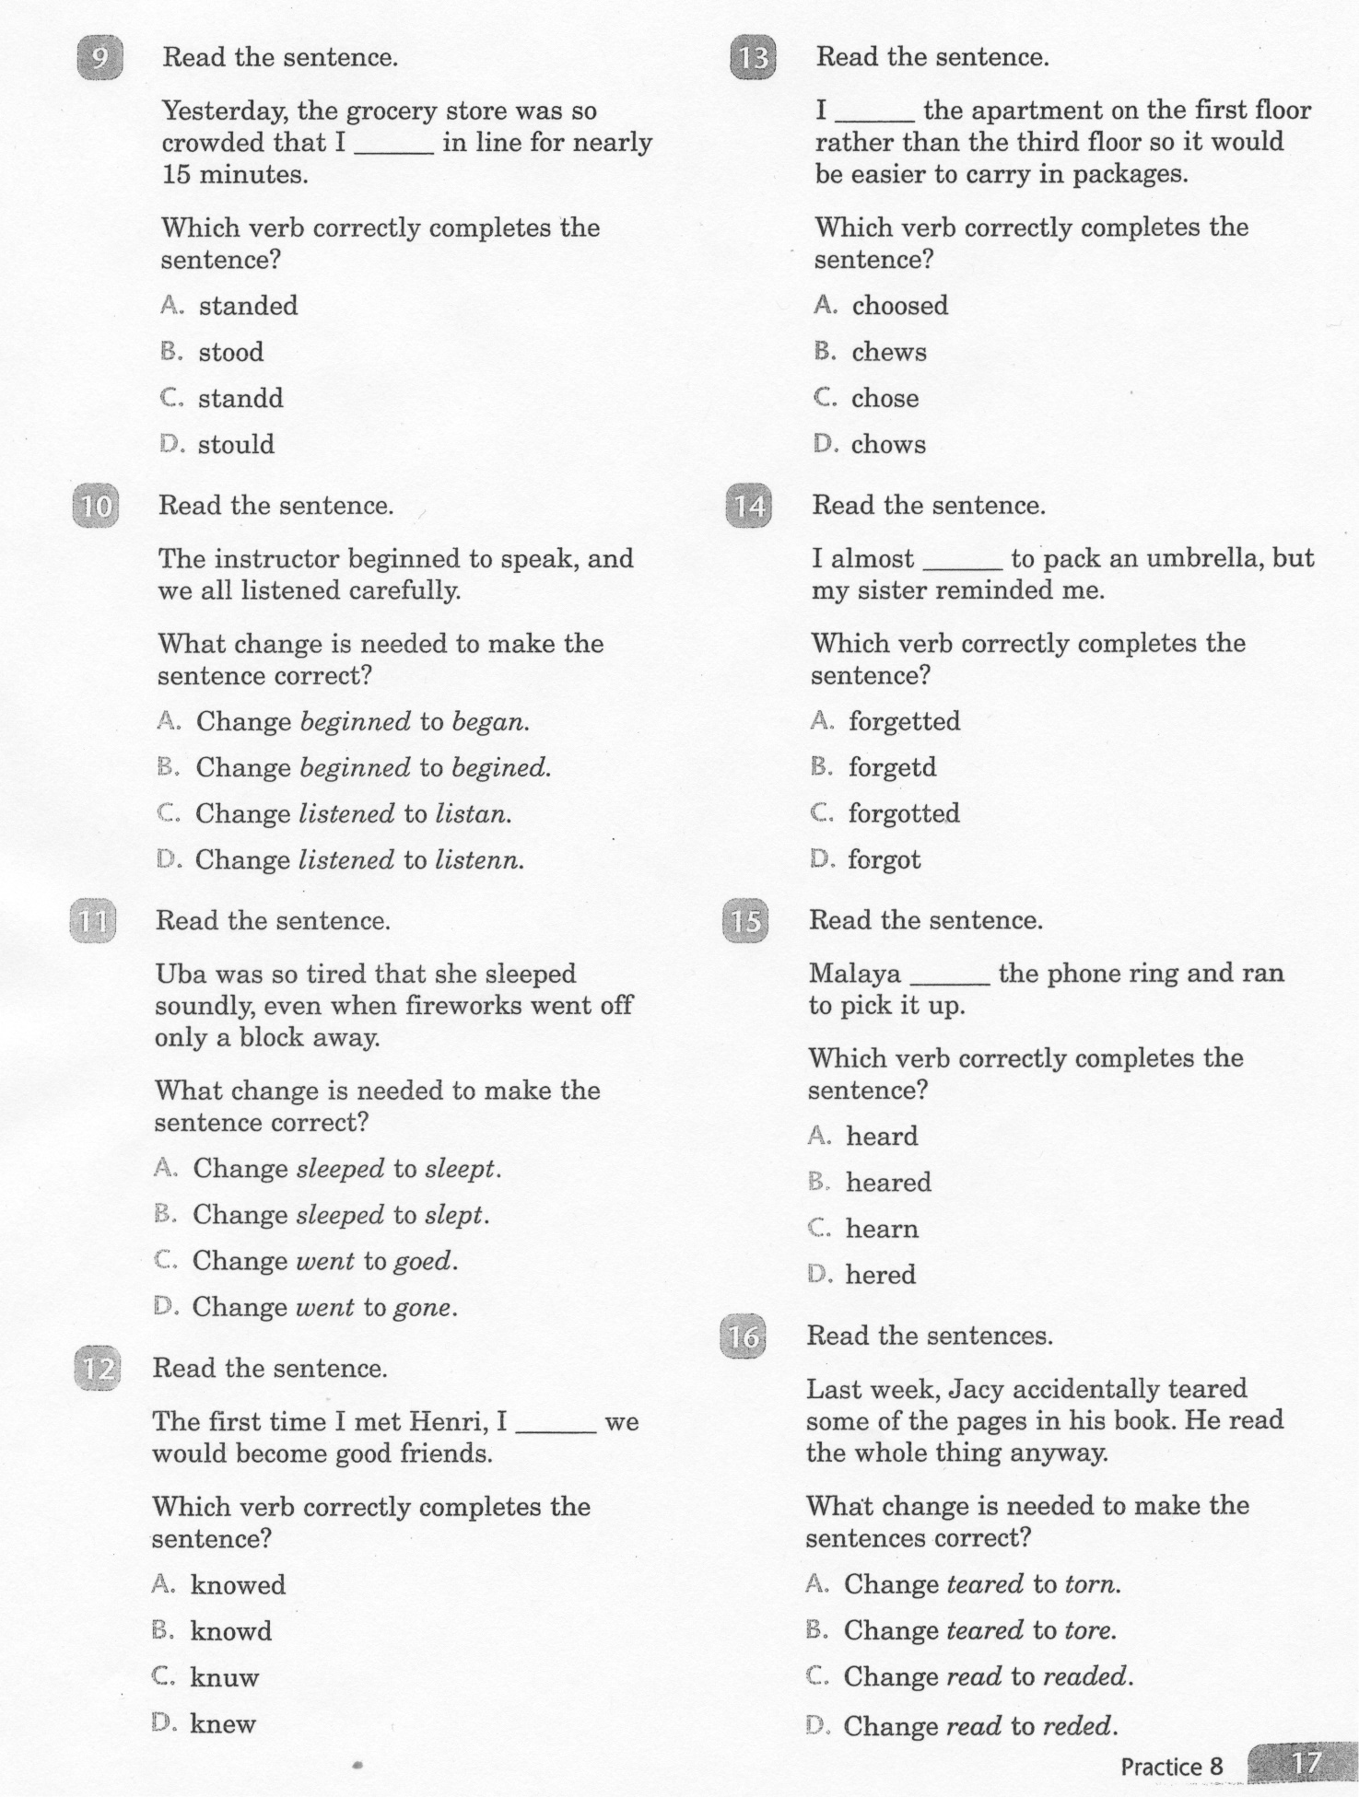
ELA-E-08 Verbs: Irregular Tenses

Slide 6
ELA-E-08 Verbs: Irregular Tenses

Slide 7
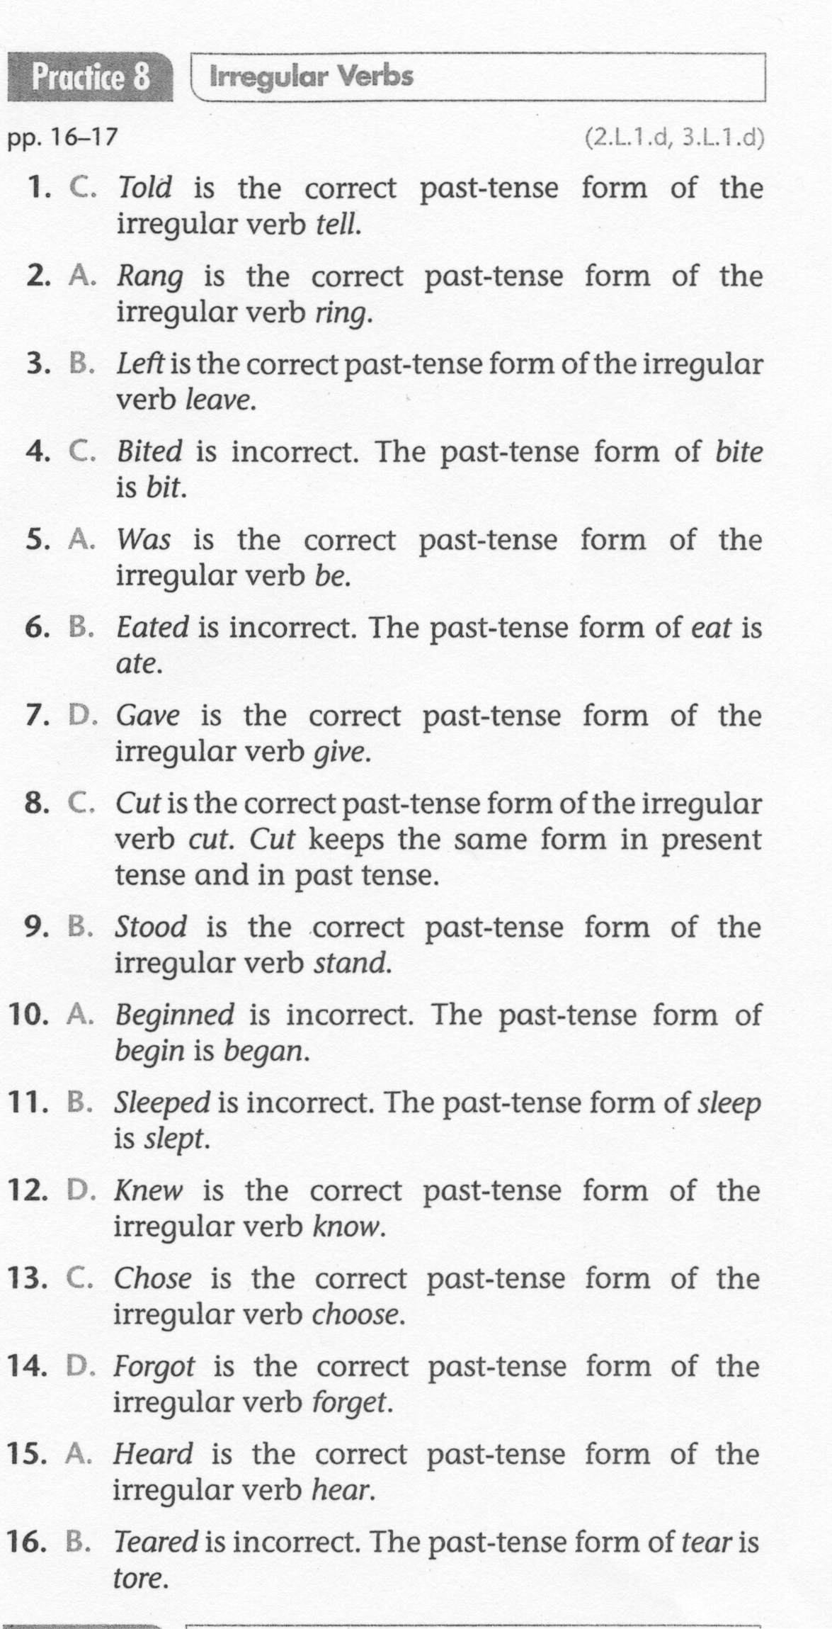
ELA-E-08 Verbs: Irregular Tenses

