Slide 1
TABE ELA-E PAXEN Unit-1 Usage Lesson-02 Verbs and Adverbs
Some graphics may not have copied well during the Scan Process

Slide 2
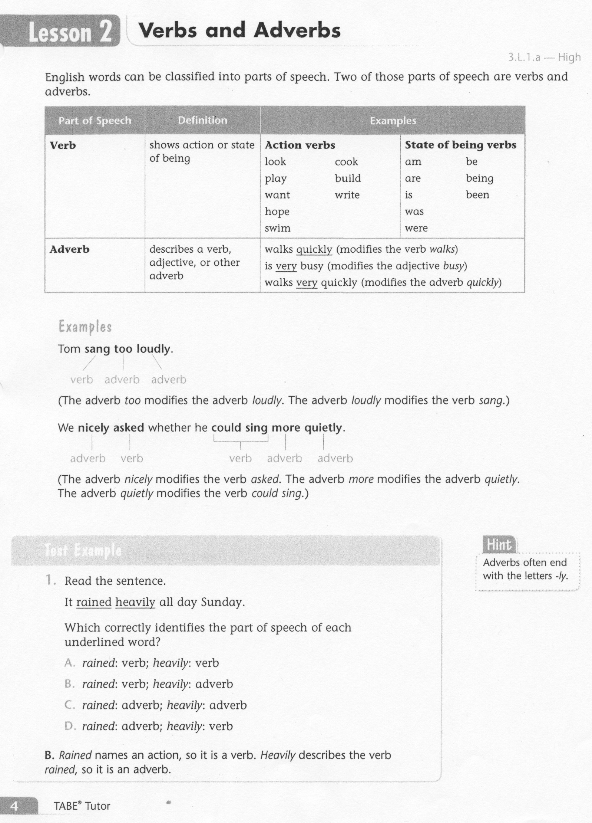
ELA-E-02_Verbs and Adverbs

Slide 3
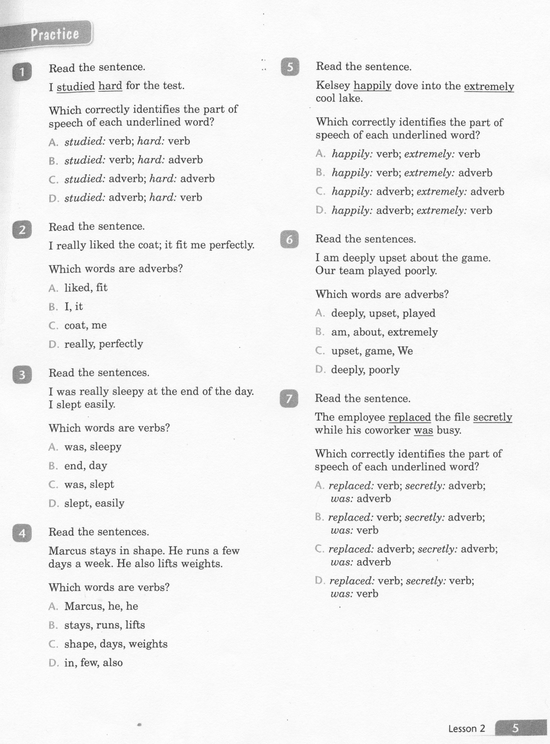
ELA-E-02_Verbs and Adverbs

Slide 4
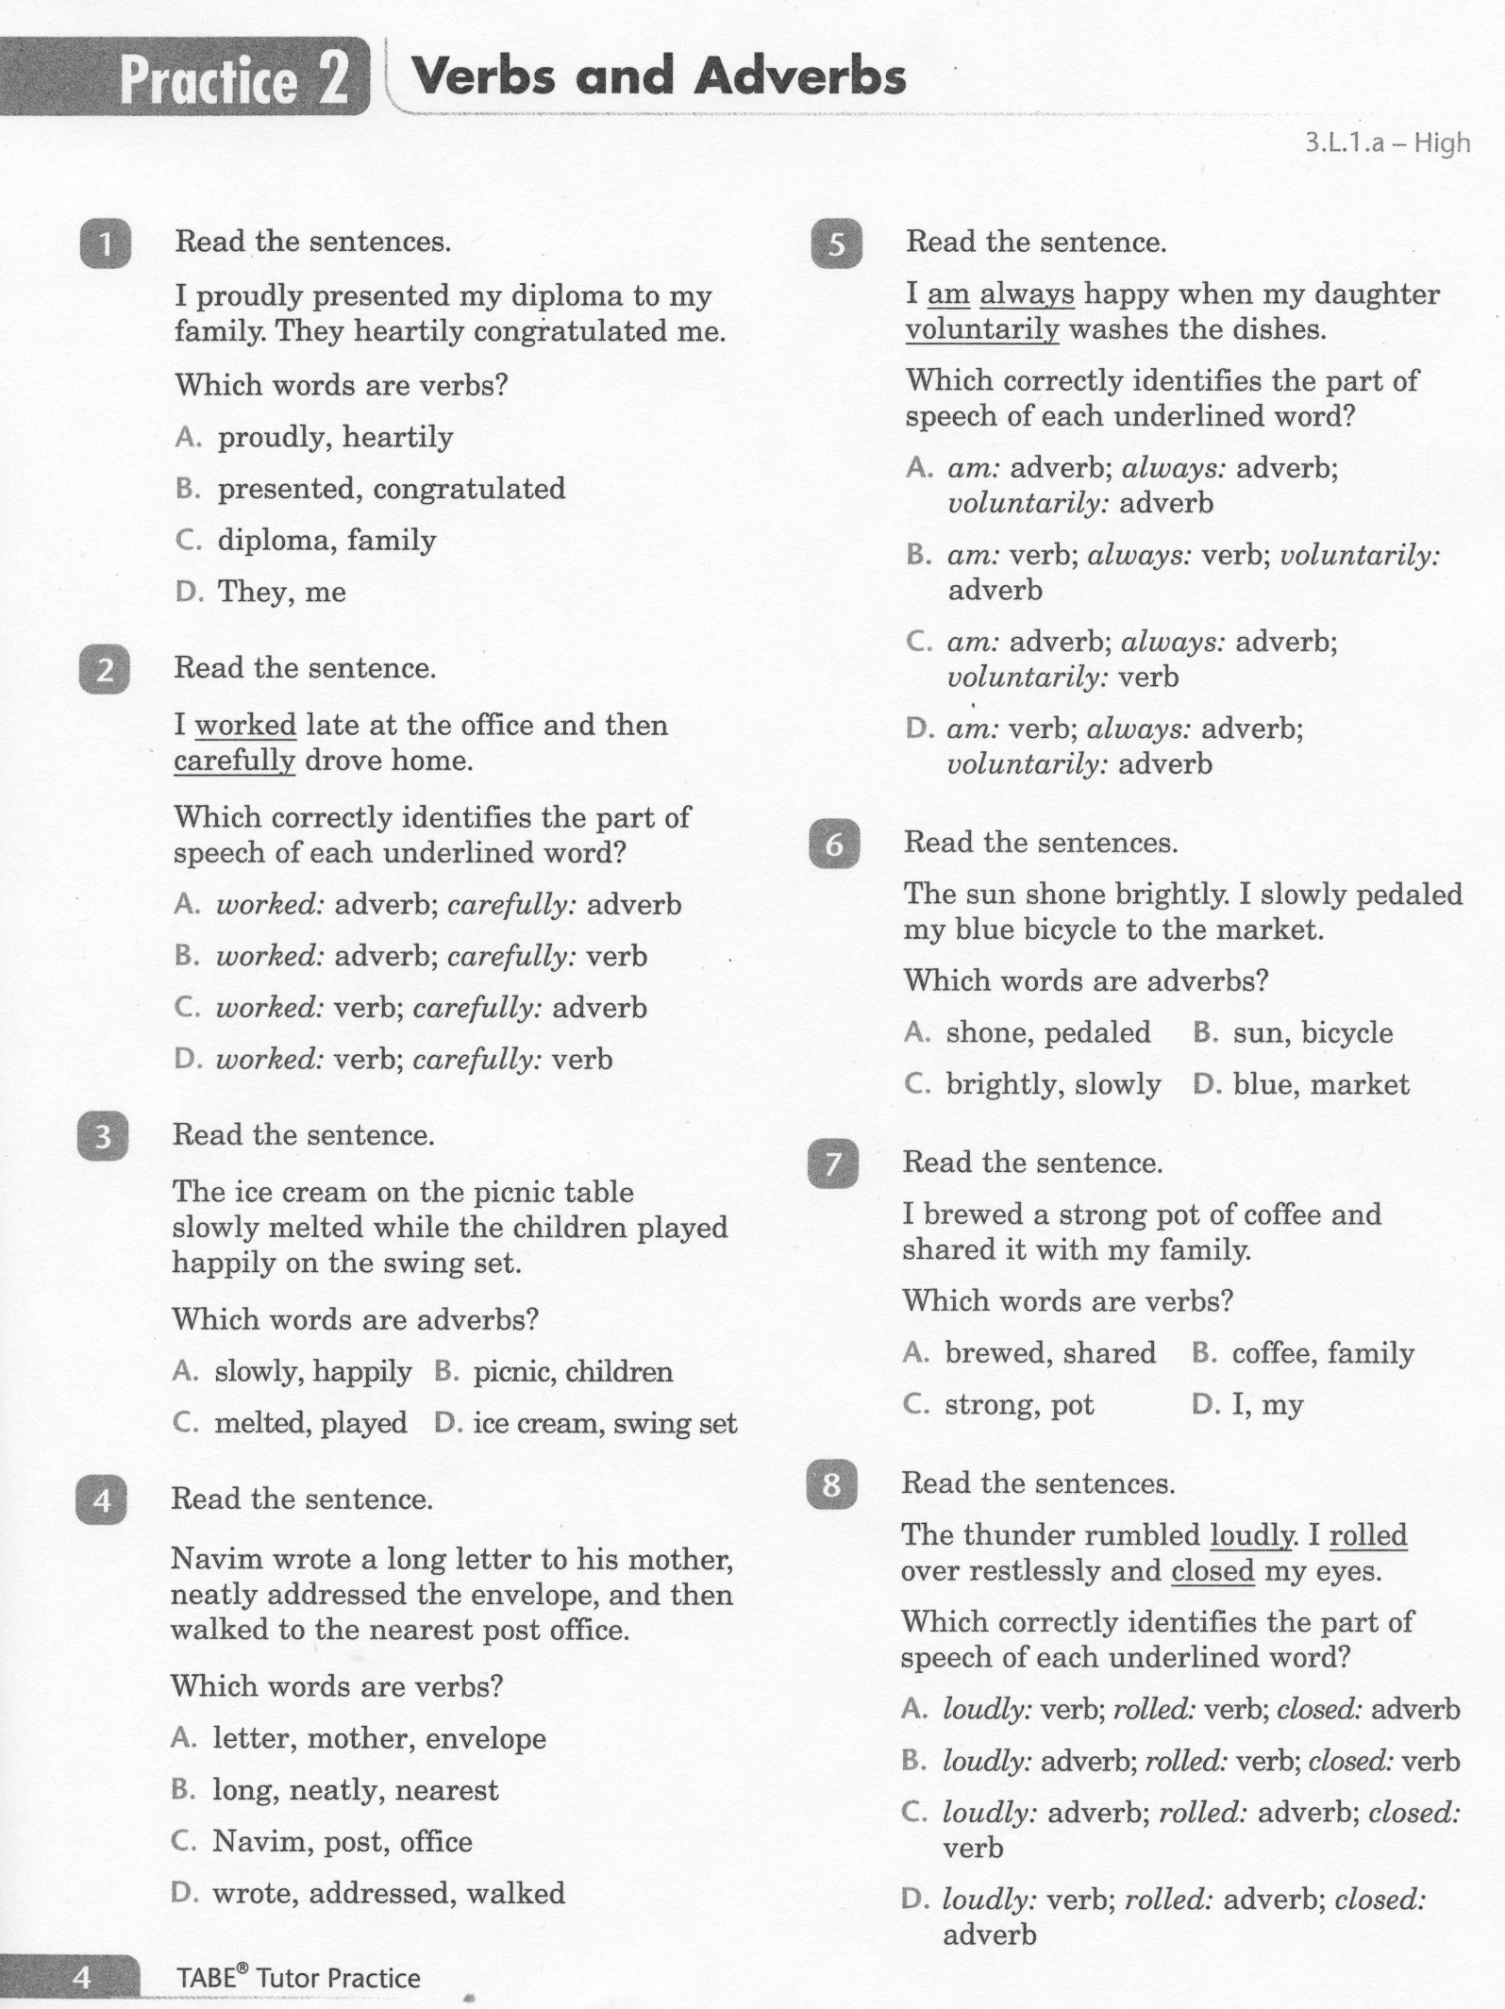
ELA-E-02_Verbs and Adverbs

Slide 5
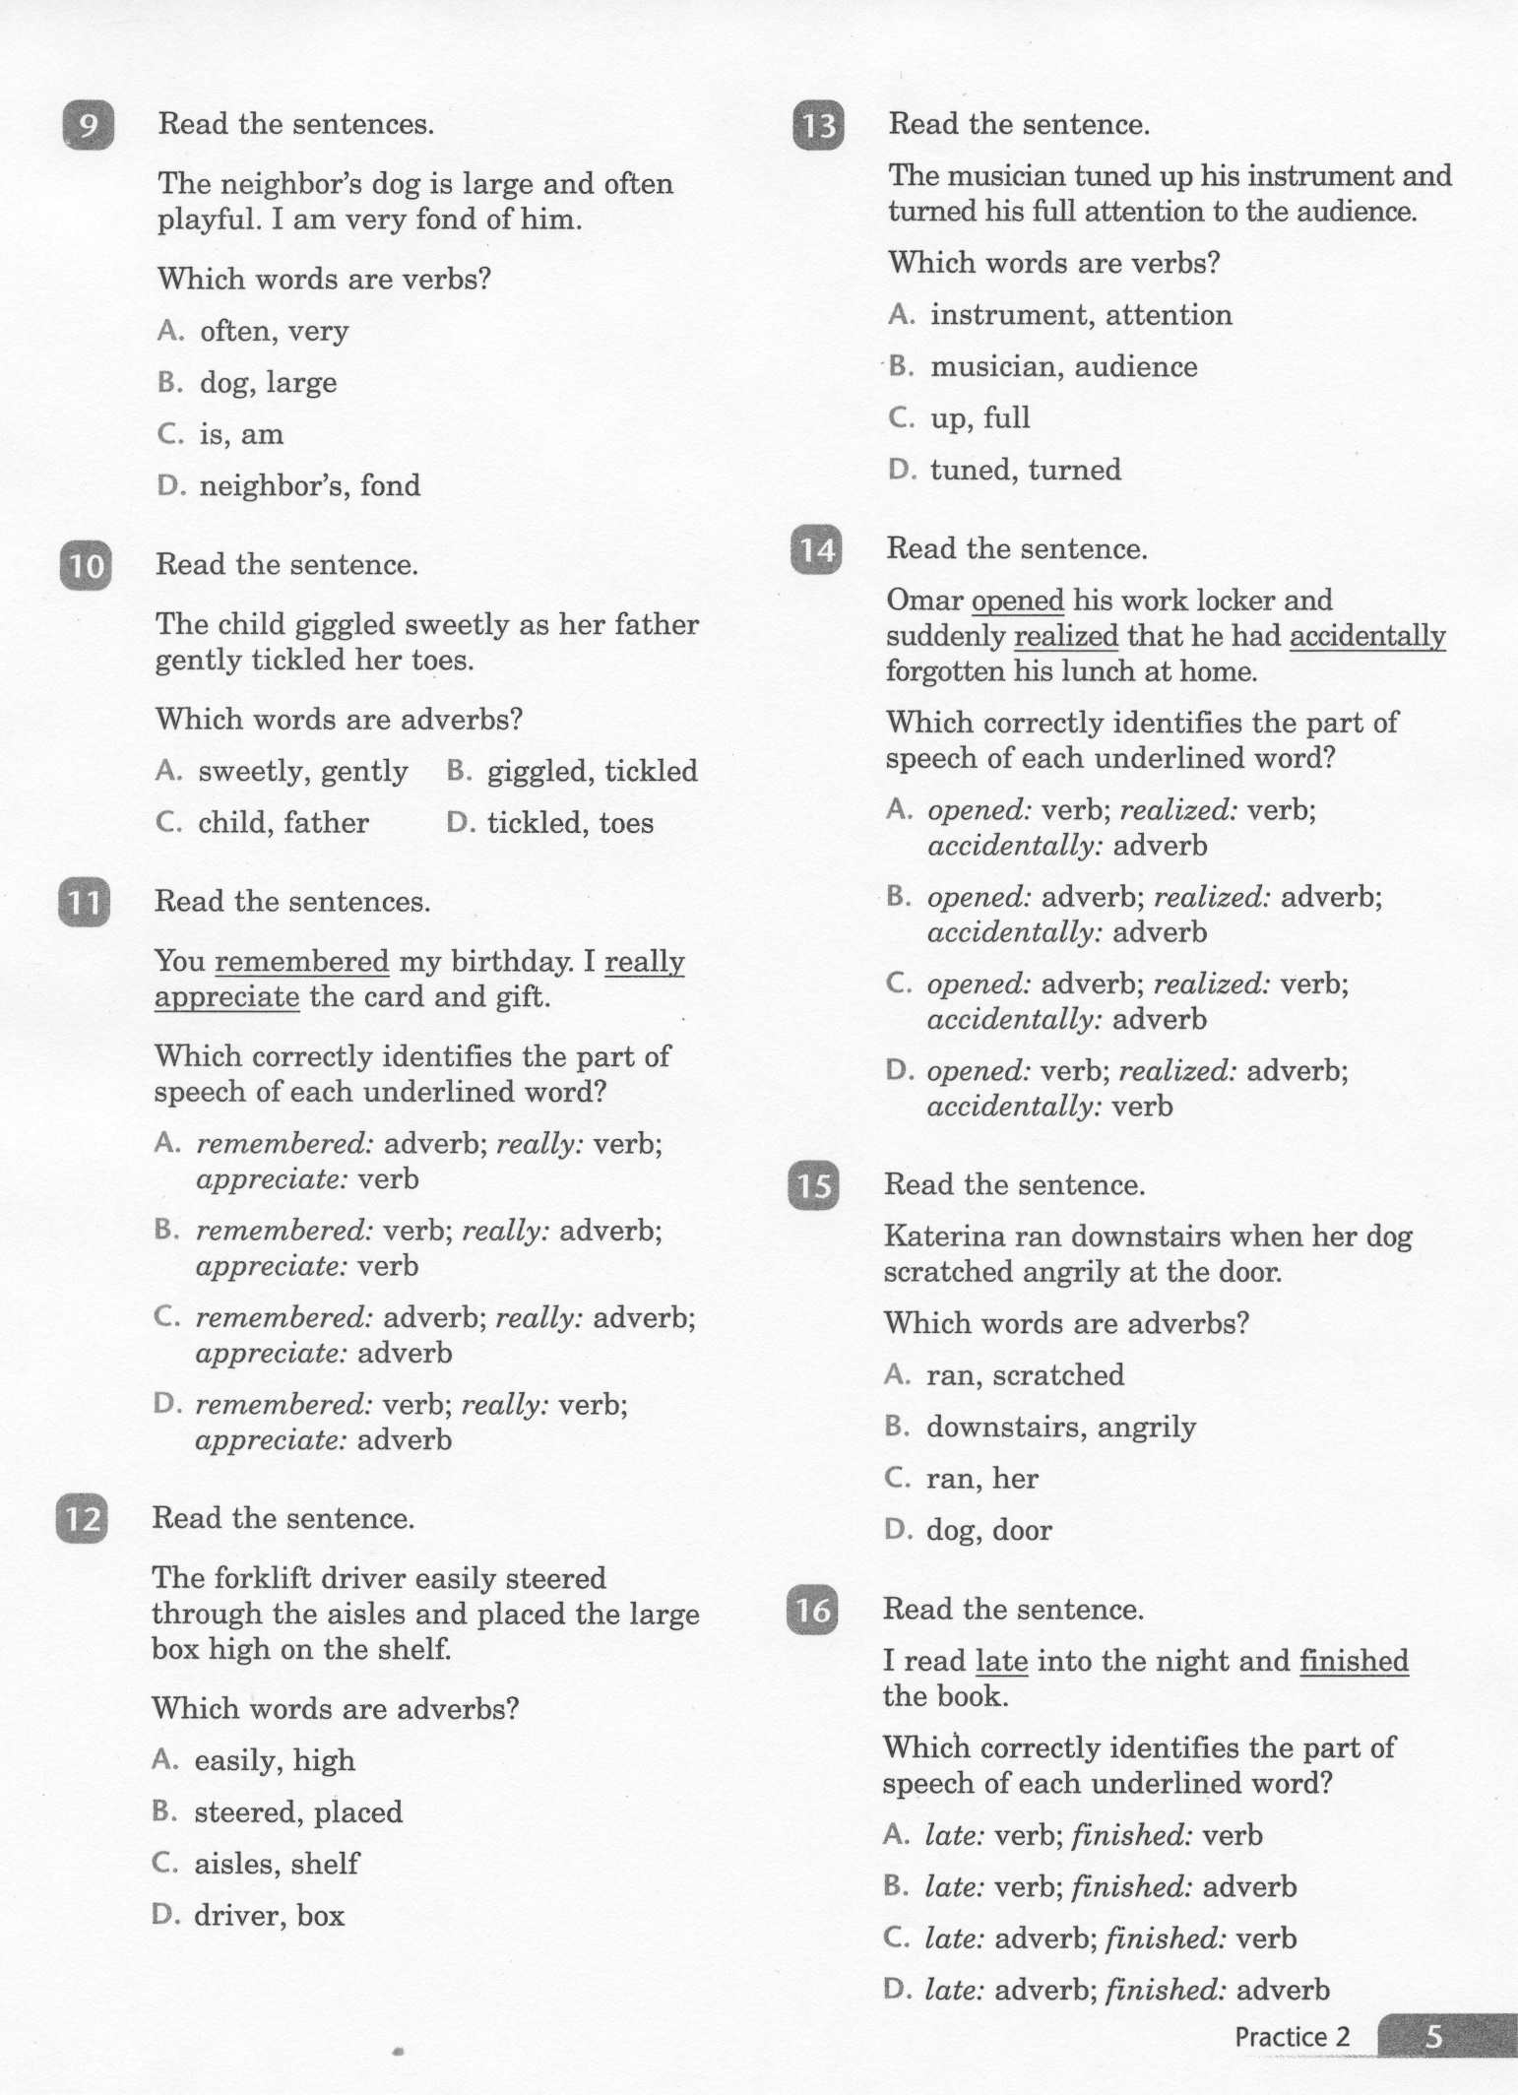
ELA-E-02_Verbs and Adverbs

Slide 6
ELA-E-02_Verbs and Adverbs

Slide 7
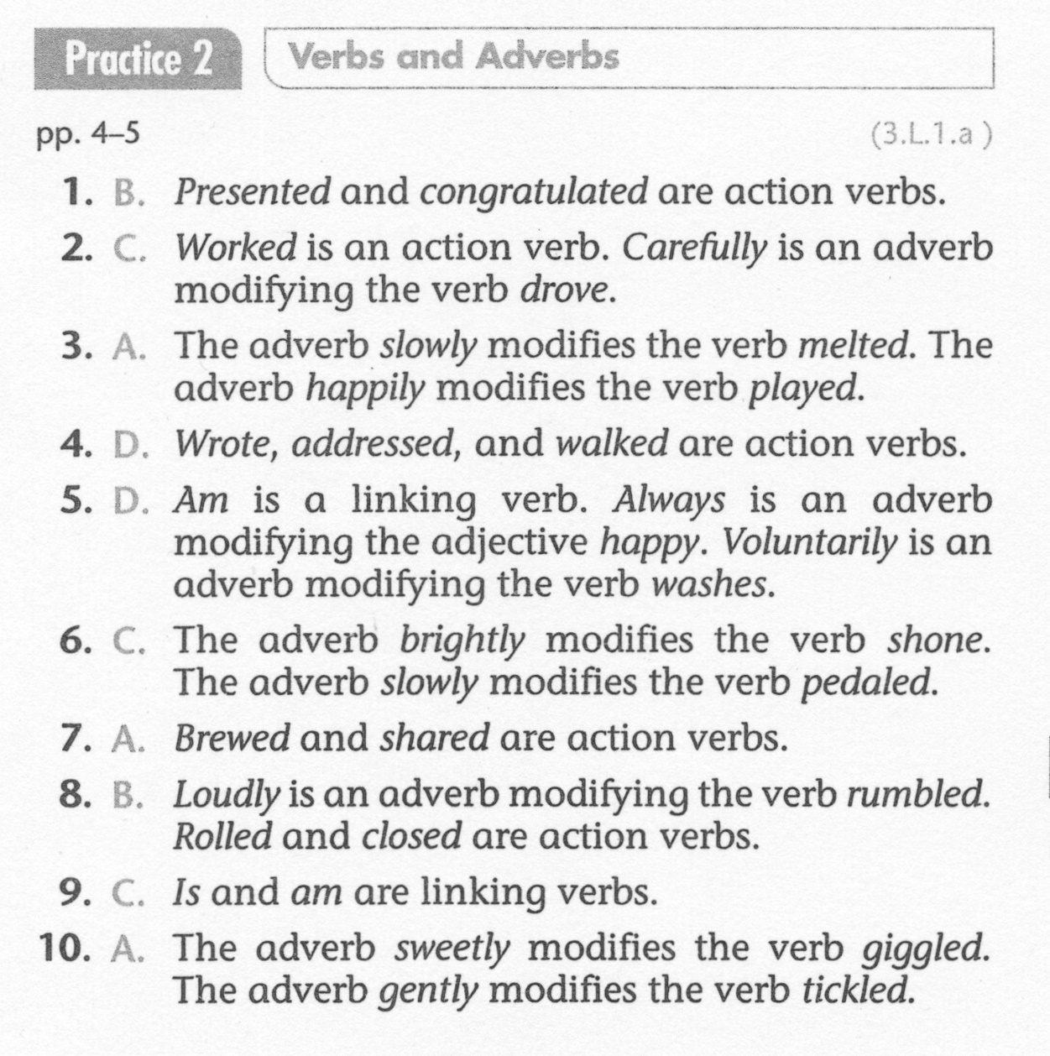
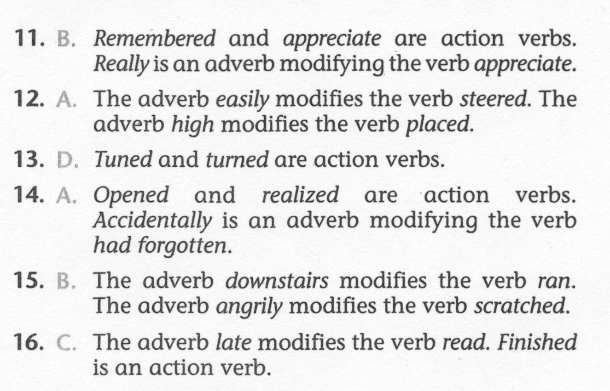
ELA-E-02_Verbs and Adverbs

